Slide 1
Seed Treatment and Environment Committee
CSS
December 5, 2017

Slide 2
Product and Regulatory Landscape
BioPesticides
BioStimulants
BioFertilizers
Pesticides and Plant Growth Regulators (PGRs)
Materials that improve vigor, yield, stress tolerance, etc.
Living microorganisms that increase nutrient availability
FIFRA
EPA
State Fertilizer Laws
American Association of Plant Food Control Officials (AAPFCO)
Product claims and marketing intent are critical
Notes:
Biostimulants are a diverse group of materials that are used to improve crop vigor, quality, and yield, as well as tolerance to abiotic stresses (drought, salinity, heat, etc.). Biostimulants can work in many different ways, including: 1) facilitating nutrient uptake, 2) enhancing the development of soil microorganisms, and 3) stimulating root growth to increase water use efficiency.
Biofertilizers contain living microorganisms that, when applied to the seed, plant or soil, and inhabit the area around the roots or live in the roots. These microorganisms promote plant growth by increasing the supply or availability of nutrients, by stimulating root growth or by aiding other beneficial symbiotic relationships.
Plant Growth Promoting Rhizobacteria (PGPRs) are bacteria that colonize plant roots and form a symbiotic relationship with the plant. PGPRs can enhance plant growth by direct and indirect ways. Direct plant growth promotion can be by a variety of means, including: 1) fixation of atmospheric nitrogen so it can be used by the plant, 2) solubilization of minerals, and 3) the synthesis of phytohormones. Indirect plant enhancement is characterized by the ability of the PGPR to minimize the damaging effects of plant pathogens on plant growth. As new types of products become more widely used, growers should educate themselves and be aware of their advantages and challenges, and how they can be used effectively in various crop production systems

Slide 3
ASTA Priorities
Education and Outreach
Align on terminology and definitions and educate on those throughout the industry and regulatory community.
Provide educational information on types of biologicals, applications, the role of treated seed and where biologicals fit within potential regulatory frameworks.
Seed labeling
Facilitate inter-state movement of coated seed
Consistent and predictable regulation of requirements
Engagement with registrants to update product labels, if needed
Approaches for consumer assurance
Ensure truth in labeling
Determine testing standards, both internal to seed companies and for oversight purposes
Import/Export of Coated Seed
Second Tier – will address once the items above are more mature

Slide 4
ASTA Biologicals Working Group Report
Communication and Education
Various Audiences: Seed companies, hill, regulators
Seed company - Visual flow chart starting with claims that drive category
Worker safety connection
Regulators - Alignment with Federal Seed Act
Hill - Basic communication needs
Labeling
At the state level – goal of consistency/predictability
Customer Assurance
Testing will be a challenge

Slide 5
Coordination with BPIA and Biostimulant Coalition on Federal Regulatory Approaches
EPA
Pending guidance on permissable label claims (ie non-plant regulator claims)
Will not include a definition of “biostimulant” or “nutritional chemical”
Timing unclear
EPA staff said OMB was reviewing could be delayed until end 2018 early 2019

Slide 6
Coordination with BPIA and Biostimulant Coalition on Federal Regulatory Approaches
Farm Bill - Goals
Biostimulant definition
“A substance or substances and/or micro-organisms whose function when applied to seeds, plants or the rhizosphere is to stimulate natural processes enhanced/benefit nutrient uptake, nutrient efficiency, tolerance to abiotic stress, crop quality and/or yield.
Study on potential regulatory paths for biostimulants – not as pesticides or plant regulators
Inclusion of use of plant biostimulants as a conservation practice
Supporters: BPIA, Biostimulant Coalition, ASTA, The Fertilizer Institute
Farm Bill – Timing

Slide 7
Treated Article Exemption Update
CFS et al. submit petition in May 2017
Seeds coated with systemic insecticides fit the definition of “pesticide”
“EPA exempts the coated seeds from FIFRA’s registration and labeling requirements, improperly relying on the Treated Article Exemption”
“Seeks an ammendment to, or a formal re-interpretation of, the Treated Article Exemption that systemic pesticidal seeds intended to kill insect pests of the plansts are not included under the Treated Article Exemption and are therefore subject to FIFRA requirements.”

Slide 8
Treated Article Exemption-Next Steps
EPA could deny the petition indicating that the Treated Article Exemption is not EPA policy but is self-implementing. Therefore, EPA retains enforcement capability.
(Similar to argument made in Anderson vs. EPA)
EPA could ask for public comment.
(That would allow us to refute false statements but would open up to a lot of comments.)
Groups can sue on petition denial or if EPA doesn’t take “timely” action.

Slide 9
Guide to Seed Treatment Stewardship Update
https://youtu.be/uR6AGiCZXl0

Slide 10
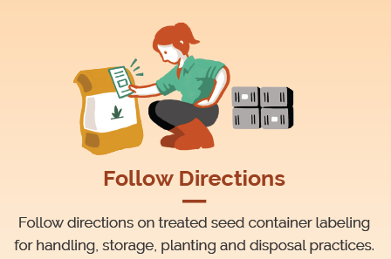
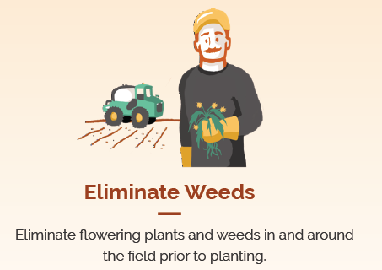
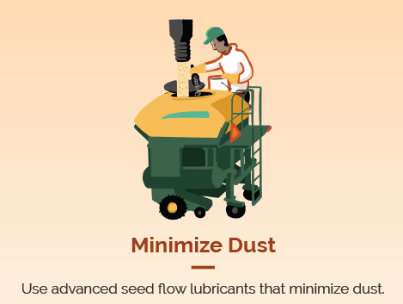
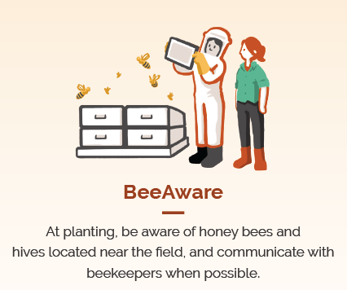
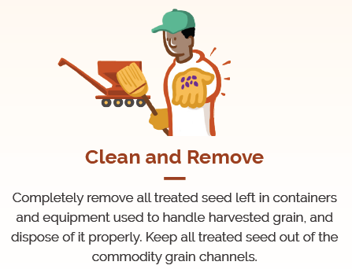
Seed Treatment Stewardship
Follow the Basic 5: Farmer applicator graphics
Order Handouts:
jdemarchi@betterseed.org
Notes:
PSA
Press Release

Slide 11
Guide to Seed Treatment Stewardship
Relaunch:
Repackaging information
Co-Messaging
Graphic Social Push
http://seed-treatment-guide.com/
Notes:
Relaunch gained traction:
http://ncga.com/news-and-resources/news-stories/article/2017/04/five-steps-help-properly-steward-treated-seed
http://www.westernfarmpress.com/seed-treatment/5-steps-treated-seed-stewardship
http://seedworld.com/asta-reminds-treated-seed-stewardship/

Slide 12
Strategic Plan Update
Winter Timeline
ASTA Board interviewing members
Website set up to take feedback
Seed Treatment falls in Domestic Policy Goal #1
Identify key legislation and regulations that either directly or indirectly impacts the seed industry.

Slide 13
Questions & Answers

