Slide 1
Federal Update Jane DeMarchi
Tuesday, December 9, 2015

Slide 2
Current Issues
Legislative
GMO Labeling Preemption
Trans Pacific Partnership
International Treaty
Funding for Ag Research
Regulatory
Food Safety Modernization Act

Slide 3
GMO Labeling – Federal Preemption
June 2016 Vermont labeling law goes into effect
Food companies will begin making compliance decisions in December
GMA announces Smart Label
Current strategy
Get preemption into Omnibus

Slide 4
International Treaty on Plant Genetic Resources for Food and Agriculture
Support is growing
American Soybean Association new supporter
Still waiting…

Slide 5
Trans Pacific Partnership (TPP) Agreement
Countries: 12 including Japan, Vietnam, Australia, Malaysia
Benefits for Seed
Intellectual Property Protection
Biotech
SPS
Congress
Vote after May 18 ITC reports
Notes:
But the majority of the Obama administration's 27 trade advisory committees back the agreement in the congressionally mandated reports they released Friday.
The TPP includes strong intellectual property protections which is a fundamental priority for the seed industry because creation of new plant varieties requires up to 15 years of research and millions of dollars of financial investment.
• The Intellectual Property chapter supports strong intellectual property standards. Language in the agreement requiring universal adoption of the latest Convention (UPOV 1991) of the International Union for the Protection of New Varieties of Plants provides robust protection for developers of new seed varieties.
• The inclusion of criminal treatment for trade secret theft and cross border counterfeit supply chains further address on-going concerns of seed companies.
MODERN AGRICULTURE BIOTECHNOLOGY
• Products derived from agricultural biotechnology are grown in 28 countries and are widely traded. The TPP marks the first time that biotechnology has been included in a trade agreement in such detail-- an important step in harmonizing international approval standards and ensuring market access for new products.
SANITARY AND PHYTOSANITARY (SPS)
• Phytosanitary regulations can be a significant barrier to trade. TPP’s SPS measures will help ensure that our partners use science and risk analysis as a foundation for SPS measures.
• For example, they must:
o Use appropriate import check and restriction policies focused on direct threats to health and safety; and
o Avoid duplicative or unnecessary testing requirements and other phytosanitary measures where food and seed already meet accepted international standards; and use transparent procedures for developing regulations — including providing opportunities for public comment.

Slide 6
Other Legislative Issues
Omnibus
Marshall Ryegrass
Federal funding for research
White House effort to “Raise the Profile of Agriculture and Agriculture Research”

Slide 7
Regulatory Update
Food Safety Modernization Act
Preventive Controls for Animal Food
Creates new regulations requiring food safety plans and their implementation
Creates new regulations requiring cGMPs
Regulations codified in 21 CFR Part 507

Slide 8
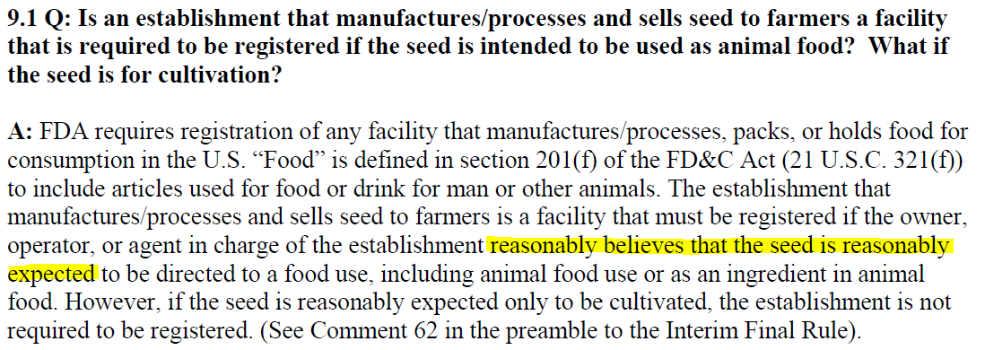
FDA Guidance
FDA Guidance for Industry: Questions and Answers Regarding Registration of Food Facilities (Sixth Edition; November 2014)
FDA has not yet updated the facility registration guidance to reflect FSMA

Slide 9
Overview of GMP Requirements (when applicable)
GMPs address:
Personnel.
Plant and grounds.
Sanitation.
Water supply and plumbing.
Equipment and utensils.
Plant operations.
Holding and distribution.

Slide 10
Overview of Preventive Controls Requirements (when applicable)
Conduct hazard analysis
Identify and implement preventive controls (including supplier verification, as required)
Apply the management components, as appropriate and necessary based on the nature of the preventive control and its role
Monitoring
Verification
Validation
Corrective Actions
Document everything

Slide 11
Conclusion
The analytical framework for seed operations is complicated!
For now, ASTA is focusing on whether operations involving seed that will be diverted to animal feed fall within the “farm” definition or the storage of raw agricultural commodities.
Additional guidance from FDA will provide further clarity
Stay tuned!

Slide 12
Compliance Dates
Size of Business | cGMP Compliance | Prevent. Control
<$2,500,000 feed sales | September 2018 | September 2019
10-499 FTE | September 2017 | September 2018
500+ FTE | September 2016 | September 2017

