Slide 1
U.S. Coalition for UN Food Systems Summit Engagement
March 23, 2020

Slide 2
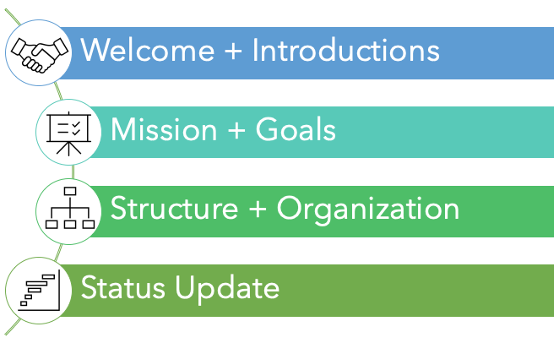
Coalition Call Agenda
Notes:
Welcome and Introductions
Mission and Goals
Structure and Organization
Food Directions et al
Government Advocacy - Shawna Morris-NMPF/Messina Group
Communication Coodination - Melissa San Miguel – Red Flag
Full Coalition
Meeting Frequency – every three weeks
Communications/Updates – weekly plus “as needed”
Steering Committee – members
Meeting Frequency – weekly
Includes WG leaders
Working Groups – WG leaders
Goals
Message development – broad and by action track
Independent Dialogue
Meeting Frequency – minimum biweekly
Status Update
Summit Update
Industry engagement to-date
USDA status

Slide 3
Introductions
Steering Committee
Food Directions Team

Slide 5
Influence Pathways: Action Tracks
Action Track #1 Chair | Lawrence Haddad, Global Alliance for Improved Nutrition
Action Track #2 Chair | Gunhild Stordahlen, EAT Foundation
Action Track #3 Chair | Joao Campari, WWF International

Slide 6
Pathways for Engagement
Member State-sponsored Dialogues
Individual Dialogues
Food Systems Champions
Food Systems Heroes
Global Summit Dialogues
Action Track submissions (Game Changers)
Advisory Committee
Scientific Committee

Slide 7
Coalition Objective
Develop a U.S. agricultural industry-wide coalition to coordinate engagement in the UN Food Systems Summit 2021

Slide 8
Mission
Ensure the U.S. food and agriculture sector’s support for innovation, access to diverse production systems and processing technologies, and evidence-based nutrition recommendations that recognize global dietary diversity are prominently featured in UN FSS recommendations.

Slide 9
Goals
Develop one central message for U.S. food and agriculture.
Coordinate and support the outreach efforts undertaken by individual organizations domestically and with international counterparts to strategically focus on specific aligned countries’ governments.
Coordinate engagement in member-state sponsored and independent dialogues and explore holding appropriate individual dialogues.
Open and maintain a line of communication with U.S. government representatives and members of the various UN FSS committees, Action Tracks and Champions Network.

Slide 10
Structure
Animal & Animal Products
Animal Ag Alliance
Coalition Manager
Food Directions LLC
Producers
Solutions for the Land
Food Service
Steering Committee
Communications
Kellie Bray
Finished Food & Products
Grains, Feeds, Seeds
GA Outreach
Shawna Morris, NMPF
Fruits, Vegetables & Specialty Crops

Slide 11
Coalition Next Steps

Slide 12
Timeline
3.19 | Steering Committee Kick Off
9.1 | UN FSS & Report
Increase Coalition Members
March
April
May
June
July
August
September
Message Playbook for Outreach Finalized
7.19-21 | UN FSS Pre-Meeting
Rome
3.23 | Coalition Kick Off

Slide 13
Status Update | Upcoming Key Dates
July-Pre Summit details announced
USDA hosts webinar on action
Action Tracks continue their work
Dates
Coalition Kick Off | March 23, 2021
Animal Ag Independant Dialogue | April 8, 2021, 1:00 - 4:00 PM EST
Solutions for the Land Dialogue
US National Dialogues | April, May

Slide 14
Strategy Snapshot
Develop message playbook
Prioritize and coordinate outreach efforts
Seek alignment/coordinate with USG
Seek alignment/coordinate outreach to like-minded countries
Seek alignment/coordinate outreach to international counterparts
Coordinate UN FSS Coalition Related Dialogues
Monitor, prepare, and engage in July & September UN FSS Summit meetings
Notes:
Beth presents

Slide 15
Phased Approach: Building to the Pre-Summit in July
Phase 1 March-April
Information Gathering Messaging Identifying Key Touch Points Starting Outreach Monitoring/Engagement with Working Groups
Phase 2: Mid-April to May
Continue outreach Share messages
Phase 3: Mid May-June
Prepare for the pre-summit, including follow up calls to key stakeholders and engagement with WG activities
Phase 4: July Pre Summit
Attend the Pre-Summit meeting, report back, and adjust communication strategy and engagement accordingly

Slide 16
Goal One: Messaging
Develop a message playbook encompassing common coalition understanding of Summit opportunities/challenges, key asks, and compelling proof points to support coalition views
Needs:
Game changers submitted
Proof points related to action tracks

Slide 17
Goal Two: International Outreach
Initiate calls - US industry groups to counterparts in select countries
Share intel on FSS activities, messaging (later), build trust
Drive counterparts toward joint messaging/outreach to their governments & collectively, to UN leadership
Deadline May & June (in advance of July pre-summit in Rome)
Select/agree on 10+ key & geographically diverse countries/regions
Proposed: Canada, EU, Argentina, Brazil, Australia, New Zealand, Western Hemisphere (IICA), Philippines, UK -- Africa, Israel, Saudi Arabia/GCC, Hungary/Poland, Slovakia, Indonesia
Needs:
By key country, a roster of key organizations & their lead person.
Industry commitment to calls ASAP.
Based on feedback, find shortcuts that ensure maximum # of foreign countries

Slide 18
Goal Three: Engagement in Summit Process
As part of monitoring/outreach, will engage with the Private Sector Mechanism to ensure timely updates
Coordinating response to scientific papers
Engaging on Action Tracks

Slide 19
Goal Four: Biden Admin & Congressional Outreach
Prioritize and coordinate outreach efforts
Identify key Biden Administration contacts
White House officials and political appointees at USDA, State, USAID, and possibly others.
Needs:
Assessment of past coalition and steering committee White House and Biden Administration outreach (if any), and relationships with staff in these positions
Need to have government/industry alignment on messaging & tactics
Note: Plans for Congressional outreach will be coordinated with the GA working group and presented to the Steering Committee

Slide 20
Goal Four: Administration Outreach
Prioritize and coordinate outreach efforts
USG: As Coalition coordinates messaging, initial & immediate outreach to:
First Tier
USDA FAS and Office of the Chief Economist
State Department - Office of Economic & Development Affairs; Ag Office
USAID
Target: Interagency Working Group on UN FSS
Second Tier
HHS Office of Global Affairs
Commerce
USTR
Needs:
Assessment of past coalition and steering committee USG outreach, and relationships with staff in these positions
Activity (past, present, future) with foreign countries

Slide 21
March Overview & Goals
Goals
Finalize broad communication themes for the Message Library
Secure initial outreach meeting to key political staff of Biden Administration
Secure outreach meetings to USDA FAS/Office Chief Economist, State Department, USAID
Identify and secure outreach meetings to like-minded counterpart organizations in foreign countries who share the U.S. views

Slide 22
Coalition Schedule
Standing Steering Committee Calls/Updates: Weekly
Working Group Calls: Weekly (Determined by Chair)
Standing Full Coalition Calls: Every three weeks and ad hoc as needed
Weekly Updates Emailed to Whole Coalition

Slide 23
Communication Tools
Google Drive: Coalition UN FSS Google Drive (Read only)
Zoom will be used for Steering Committee and Coalition Meetings being run by Food Directions

Slide 24
Join the Coalition!
https://corn.org/food-systems-summit-coalition/

