Slide 1
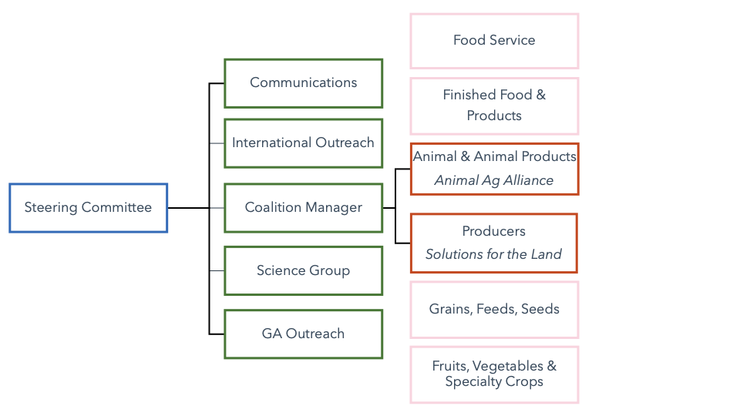
Committee and Working Group Structure Changes

