Slide 1
U.S. Coalition for UN Food Systems Summit Engagement
April 13

Slide 2
Agenda
Welcome
Coalition Member Engagement and Outreach
FSS Recent Happenings
Coalition Actions and Updates
Structure and Organization
Next Call

Slide 3
Coalition Member Engagement
Agricultural Retailers Association
American Feed Industry Association
American Frozen Food Institute
American Seed Trade Association
Animal Agriculture Alliance
Animal Health Institute
Association of Equipment Manufacturers
Biotechnology Innovation Organization
Corn Refiners Association
Corteva Agriscience
CropLife America
International Dairy Foods Association
KCoe Isom, LLP
Merck Animal Health
National Association of State Departments of Agriculture
National Confectioners Association
National Corn Growers Association
National Council of Farmer Cooperatives
National Milk Producers Federation
North American Meat Institute
Pet Food Institute
Solutions for the Land
Syngenta
The Fertilizer Institute
U.S. Dairy Export Council
U.S. Grains Council
U.S. Soybean Export Council

Slide 4
Coalition Objective
Develop a U.S. food & agricultural industry-wide coalition to coordinate engagement in the UN Food Systems Summit 2021

Slide 5
Mission
Ensure the U.S. food and agriculture sector’s support for innovation, access to diverse production systems and processing technologies, and evidence-based nutrition recommendations that recognize global dietary diversity are prominently featured in UN FSS recommendations.

Slide 6
Goals
Develop one central message for U.S. food and agriculture.
Coordinate and support the outreach efforts undertaken by individual organizations domestically and with international counterparts to strategically focus on specific aligned countries’ governments.
Coordinate engagement in member-state sponsored and independent dialogues and explore holding appropriate individual dialogues.
Open and maintain a line of communication with U.S. government representatives and members of the various UN FSS committees, Action Tracks and Champions Network.

Slide 7
FSS Recent Happenings

Slide 8
FSS Updates from April
Action Tracks
Action Tracks Publish Summary Paper of Game-Changers in Wave 1 & Action Track Synthesis Reports
FSS Related News
Articles from Agnes Kalibata in the Hill, the Guardian
UN Ambassador letter on WTO
USG
USDA FAQs expected
May US National Dialogue
Coalition Activity
Solutions from the Land Dialogue and AAA Dialogue

Slide 9
Coalition Progress & Next Steps

Slide 10
Status Update | Timeline
9.1 | UN FSS & Report
4.1 - 7.19 | Outreach to Domestic and International Stakeholders
March
April
May
June
July
August
September
4.15 | Message Playbook for Outreach Finalized
7.19-21 | UN FSS Pre-Meeting
Rome

Slide 11
Phased Approach: Building to the Pre-Summit in July
Phase 1 March-April
Information Gathering Messaging Identifying Key Touch Points Starting Outreach Monitoring/Engagement with Working Groups
Phase 2: Mid-April to May
Continue outreach Share messages
Phase 3: Mid May-June
Prepare for the pre-summit, including follow up calls to key stakeholders and engagement with WG activities
Phase 4: July Pre Summit
Attend the Pre-Summit meeting, report back, and adjust communication strategy and engagement accordingly

Slide 12
April Goals
Goals
Finalize broad communication themes for the Message Library
Secure initial outreach meeting to key political staff of Biden Administration
Signatures for letter to Secretaries of USDA/State
Secure outreach meetings to staff at USDA FAS/Office Chief Economist, State Department, USAID
Identify and secure outreach meetings to like-minded counterpart organizations in foreign countries who share the U.S. views

Slide 13
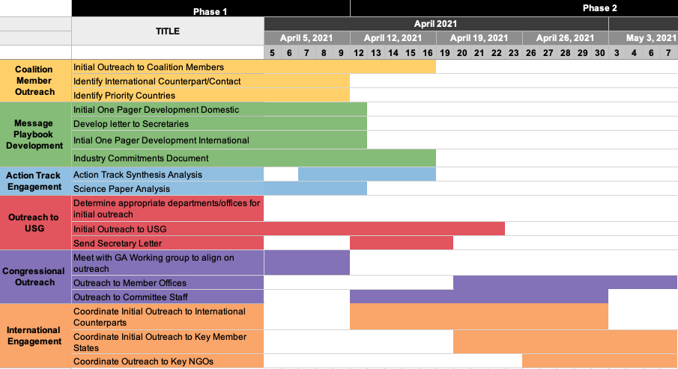

Slide 14
Goal One: Messaging & Communications
Goal: Develop a message playbook encompassing common coalition understanding of Summit opportunities/challenges, key asks, and compelling proof points to support coalition views
Update: GA/Communications hosted a WG this week. Groups reviewed, provided feedback & discussed initial documents
Communication Documents:
Meeting request letter to USDA and State
Summit Overview and Key Principles for US & International Stakeholders
In Progress:
Coalition Contributions/Commitment Fact Sheet
Draft Summit Overview and Key Principles for Non-US Stakeholders
Next Steps:
Collect signatures for Secretary letter from whole coalition (submitting week of April 19)
Collect game-changers from full Coalition for Contributions/Commitments

Slide 15
Goal Two: International Outreach
Goal: Initiate calls with US industry groups to counterparts in select countries; Select/agree on 10+ key & geographically diverse countries/regions
Update:
Conducted fact-finding calls to Coalition Members
Began set up of Summit introductory briefings with coalition member counterparts
Current priority country list: Canada, EU, Argentina, Brazil, Australia, New Zealand, Western Hemisphere (IICA), Philippines, UK -- Israel, Saudi Arabia/GCC, Hungary/Poland, Slovakia, Indonesia, African Regions
Call with Robynne Anderson at PSM
Next Steps:
Continue fact-finding calls, help with coalition member to counterpart calls
With briefing documents completed, begin setting up briefing calls with counterparts as requested by coalition members
Consider outreach to very select NGO's who are deeply involved in the FSS effort, and who could be influenced on select Action Tracks.

Slide 16
Goal Three: Engagement in Summit Process with Science Group
Goal: Equip Coalition members with tools to submit feedback into the FSS mechanism and USG
Update:
New Action Track Summary Paper
Coalition team is reviewing and will circulate an overview of the action track synthesis reports
Initial assessment of two science papers sent to coalition
Next Steps: Review papers and provide Coalition members feedback to FSS. The effort will be coordinated between the Coalition Comms and Science groups
Needs: Chair of Science Group

Slide 17
Independent Dialogue Updates
April 6, 2021: Solutions from the Land- Ernie Shea
April 8, 2021: Animal Agriculture Alliance- Hannah Thompson-Weeman

Slide 18
Goal Four: Biden Administration Outreach: Political
Goal: Secure meetings with key political staff and Biden Administration staff
Update: Finalized list of targets for outreach with Government Affairs team
Next Steps: Coordinating meeting request for Secretaries of State & Agriculture
Other targets include: White House Domestic Policy Council, UN Ambassador

Slide 19
Goal Four: Biden Administration Outreach: Career
Goal: Secure meetings with key career staff in Biden Administration
Update: Finalizing list of targets for outreach with Government Affairs team
Next Steps: Scheduling calls and initial briefing calls with key career staff.
USDA
Elise Golan, Director for Sustainable Development ,USDA & Lead of US Engagement in UN Food System Summit
Hope-Bigda Peyton, International Trade Specialist USDA Foreign Agricultural Service
Cathy McKinnell, Division Director, USDA Foreign Agricultural Service
Andrian McAdams, International Trade Specialist, USDA Office of Trade and Foreign Agricultural Affairs
State
Rose Marks, Senior Food Security Advisor, Bureau of International Organization Affairs (IO)
Nerissa Cook, Deputy Assistant Secretary, Bureau of International Organization Affairs (IO)
Jennifer Harhigh, Chargé d’Affaires ad interim, USUN Rome
USAID
David Hegwood, Senior Food Security Advisor, USAID

Slide 20
Goal Four: Congressional Outreach
Goal: Begin briefing key Committees and outreach Members
Update: Finalizing list of targets for outreach with Government Affairs team
Initial targets for briefings include:
House and Senate Agriculture Committee
House & Senate Foreign Affairs Committee
Next Steps: With communications documents finalized, begin briefings

Slide 21
Coalition Structure & Communication Tools

Slide 22
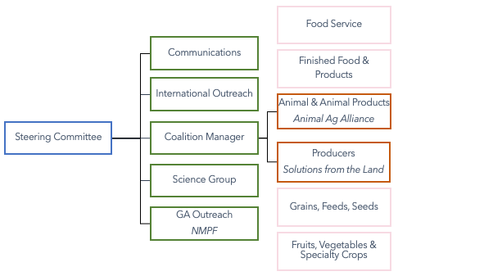
Committee and Working Group Structure

Slide 23
Coalition Schedule
Standing Steering Committee Calls/Updates: Weekly
Working Group Calls: Weekly (Determined by Chair)
Standing Full Coalition Calls: Every three weeks and ad hoc as needed
Weekly Updates: Emailed to Whole Coalition

Slide 24
Communication Tools
Google Drive/Doc Website: We currently have a Coalition UN FSS Google Drive (Read only) used as a storage for finalized documents and notes. We are working to transfer document to a password protected website for easier use. All working documents will be circulated as attachments
Zoom will be used for Steering Committee and Coalition Meetings being run by Food Directions

Slide 25
Upcoming Dates

Slide 26
Upcoming Key Dates
Next Full Coalition Call | May 4th at 1pm
US National Dialogues | April, May

Slide 27
Other Business

