Slide 1
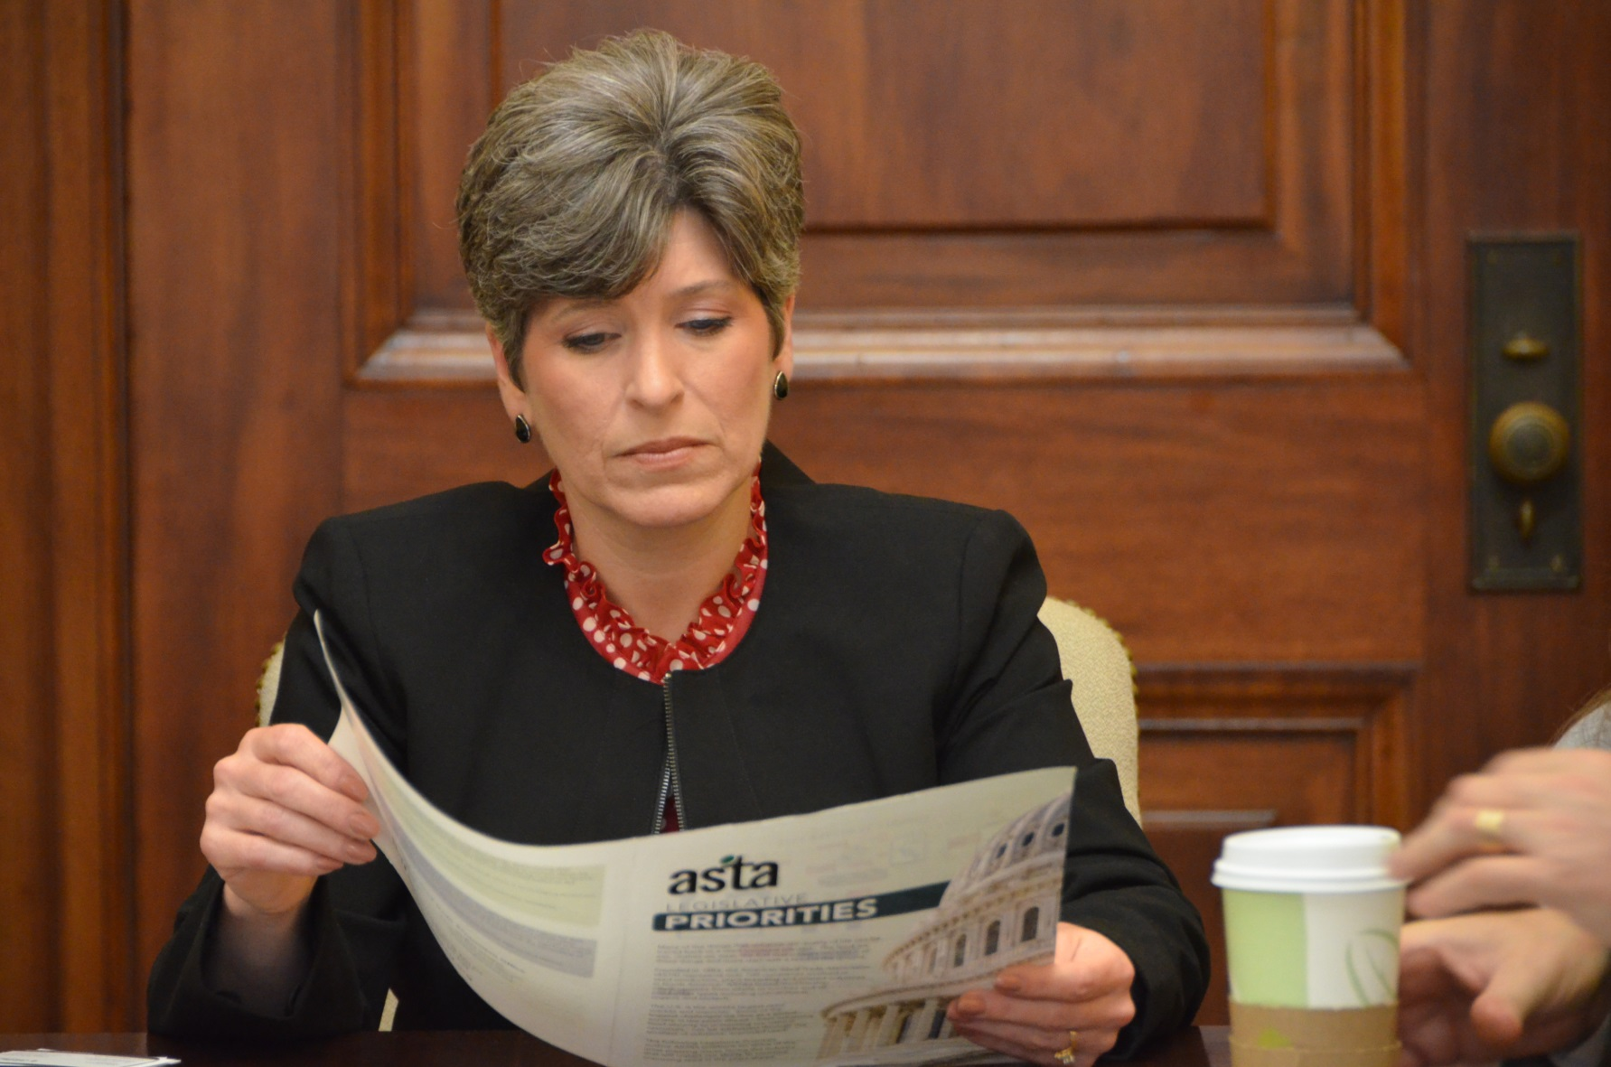
Storm the Hill 2016
Iowa Senator Joni Ernst

Slide 2
Important Information
WHEN: March 14 and 15, 2016
WHERE: Washington D.C. – Hyatt Place National Mall
WHY: To make your voice heard on Capitol Hill!

Slide 3
Schedule of Events
Monday, March 14
9:00 a.m. to 2:00 p.m. -- Environment and Conservation Seed Committee meeting
3:00 p.m. -- Fly-in briefing (All attendees)
Tuesday, March 15
8:00 a.m. -- Constituent breakfasts
9:00 a.m. to Noon -- Hill visits
1:00 p.m. to 4:00 p.m.-- Hill visits
5:30 p.m.-- Depart D.C.

Slide 4
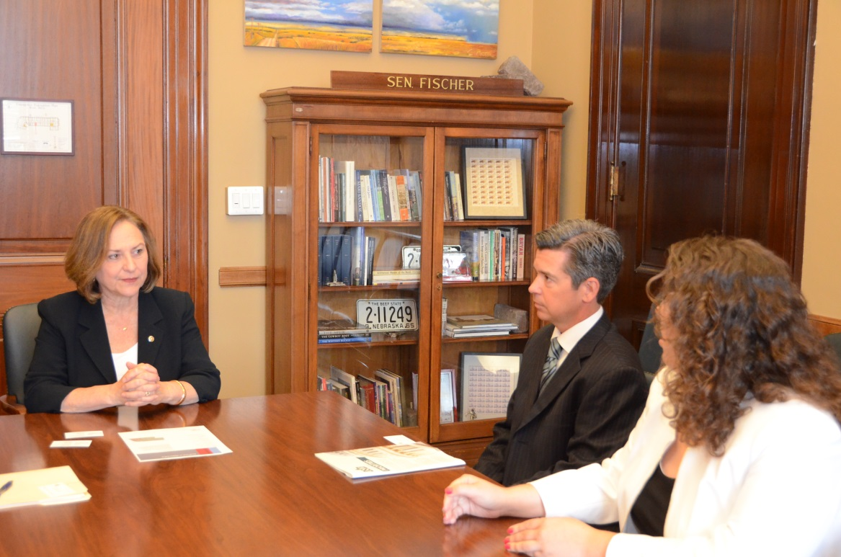
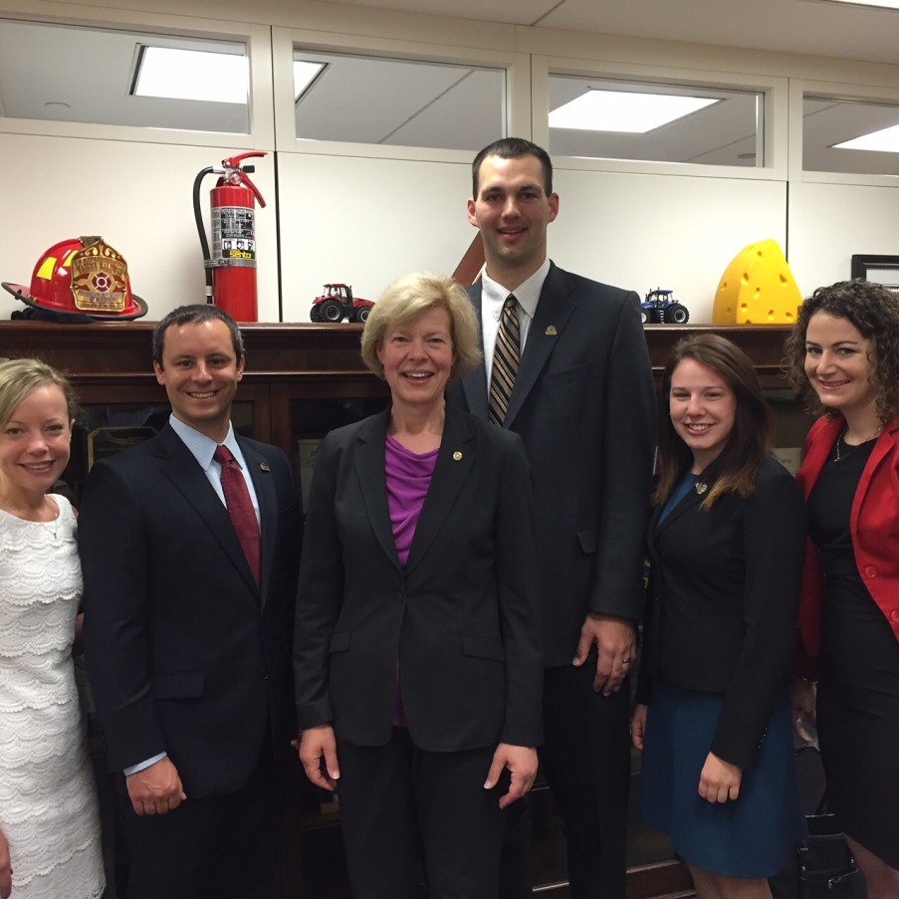
Scenes from 2015

Slide 5
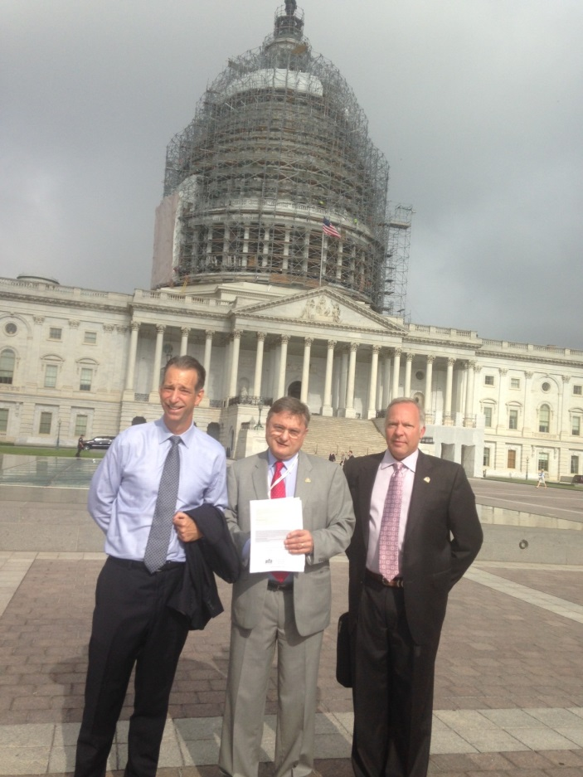
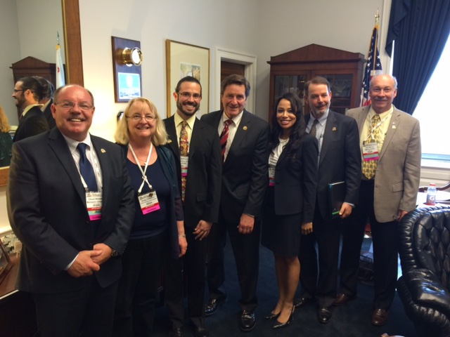
Scenes from 2015

Slide 6
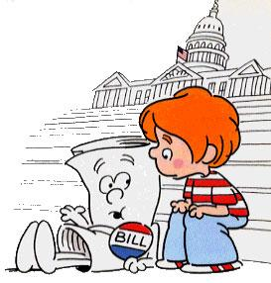
See you in D.C.!

