Slide 1
ASTA Seed Treatment and Environment Committee
Chicago, Illinois ASTA CSS Expo
Dave Carey, Executive Director

Slide 2
Status of Seed Treatments in Canada

Slide 3
Key Issues and Updates
PMRA Re-Evaluations
Ontario Neonicotinoid Regulations
Quebec Proposed Regulations

Slide 4
PMRA Re-Evaluations
3 primary work streams:
“Original 401”
  Pre-1995 chemistries
  Examples include Bravo (chlorothalonil); Lorsban (chlorpyrifos)
Cyclical re-evaluations
  Post-1995 chemistries
  Examples include Matador (λ-cyhalothrin); Admire (Imidacloprid); Poncho (clothianidin)
Special reviews:
  OECD bans and/or new data
  Examples include Poncho (clothianidin)
Notes:
since the early 2000’s there have been three main re-evaluation work streams within the PMRA. The first of these dealt with those older chemistries and we usually refer to it as the “original 401”. This work stream included products like Bravo and Lorsban.
Then came the cyclical re-evaluations for all products registered after 1995. This would include things like Matador, Poncho, and Admire.
The re-eval group also conduct special reviews of products on a case-by-case basis. Even products that are already in re-evaluation or that have just completed re-evaluation. So, for example, products like poncho, which are currently undergoing their 15-year re-evaluation, are also going through a special review based on the proposed decision for Imidacloprid (admire) that was published around this time last year.

Slide 5
PMRA Re-Evaluations
“Original 401”:
  35 still to be finished
Cyclical:
  Currently 74
  369 to be initiated between 2018 and 2028
Special reviews:
  Currently 23
  Unpredictable
PMRA was strongly criticized by CESD in 2015 for not making adequate progress…

Slide 6
PMRA Re-Evaluation Issues
Few opportunities to engage key stakeholders
  Registrants
  Growers
  Provincial specialists
  Academics
No opportunity to refine risk assessment before PRVD published
  Additional data
  Refine assumptions
  Check for errors
Minimal alignment with global regulatory partners

Slide 7
Recent Proposed Decisions
Active ingredient | Mancozeb Group M | Metiram Group M | Ferbam Group M | Ziram Group M | Thiram Group M | Chlorothalonil Group M | Iprodione Group 2 | Captan Group M | Cypermethrin Group 3 | Imidacloprid Group 4 | Λ-cyhalothrin Group 3
Trade Name | Dithane | Polyram | Ferbam | Ziram | Thiram | Bravo | Rovral | Captan | Ripcord | Admire | Matador
Status | March 2018 | March 2018 | June 2018 | June 2018 | June 2018 | March 2018 | March 2018 | March 2018 | Sept 2018 | Dec 2018 | March 2019
Proposed decision | Cancel all uses | Cancel all uses | Cancel all uses | Cancel all uses | Cancel all uses | Cancel certain uses; limit rest | Cancel all uses | Cancel certain uses; limit rest | Fewer applications | Cancel all ag uses | Cancel most uses

Slide 8
Recent Proposed Decisions
Active ingredient | Mancozeb Group M | Metiram Group M | Ferbam Group M | Ziram Group M | Thiram Group M | Chlorothalonil Group M | Iprodione Group 2 | Captan Group M | Cypermethrin Group 3 | Imidacloprid Group 4 | Λ-cyhalothrin Group 3
Trade Name | Dithane | Polyram | Ferbam | Ziram | Thiram | Bravo | Rovral | Captan | Ripcord | Admire | Matador
Status | March 2018 | March 2018 | June 2018 | June 2018 | June 2018 | March 2018 | March 2018 | March 2018 | Sept 2018 | Dec 2018 | March 2019
Proposed decision | Cancel all uses | Cancel all uses | Cancel all uses | Cancel all uses | Cancel all uses | Cancel certain uses; limit rest | Cancel all uses | Cancel certain uses; limit rest | Fewer applications | Cancel all ag uses | Cancel most uses

Slide 9
Overview of PMRA Re-Evaluation of Neonics
Active Ingredient | Pollinator Re-evaluation Targeted Re-evaluation initiated by PMRA (Environment only) | Cyclical Re-evaluation PCPA s.16(2) (Human Health & Environment) | Special Review PCPA s.17(1) (Environment only)
Imidacloprid | Preliminary risk assessment: REV2016-05 PRVD – Early 2018 | PRVD2016-20 excluded pollinators RVD (excluding pollinators) – December 2018 | –
Clothianidin | PRVD – December 2017 | PRVD (excluding pollinators) – May 2019 | PRVD on aquatic invertebrates – May 2018
Thiamethoxam | PRVD – December 2017 | PRVD (excluding pollinators) – May 2019 | PRVD on aquatic invertebrates – May 2018
Notes:
I took this directly from a PMRA slide last weel

Slide 10
AAFC Multi-Stakeholder Forum
November, 2016: PMRA held a call with stakeholders to announce their proposed decision to cancel the registration of imidacloprid
December, 2016: AAFC held the 1st in person meeting of the ‘Mutli-Stakeholder Forum on Neonicotinoids’ in Ottawa
  “The objective is to provide a forum for stakeholders to meet and exchange evidence-based knowledge and information related to neonicotinoids.”
It became clear that there were data gaps and missing information. Industry and government struck three working groups to complete projects to feed back into PMRA’s final decision

Slide 11
AAFC Multi-Stakeholder Forum
Environmental Monitoring Working Group
Alternatives Working Group*
Mitigation Working Group*
Work Plans were presented at the February 2017 Forum meeting
Deliverables and timelines were discussed
*CSTA is a working group member
Notes:
So November 2016, Proposed Decision on Imidacloprid comes out….

Slide 12
Mitigation Working Group
The Mitigation Working Group focused on 3 core deliverable projects
Vegetative Strips/Buffer Zones
Seed Treatments
Greenhouses
Whitepapers on each of these projects were to be submitted to PMRA by end of October 2017

Slide 13
Seed Treatment Paper
CSTA was tasked/voluntold to oversee the development of a seed treatment paper that characterizes why farmers use seed treatments
CSTA contracted Dr. Paul Mitchell and Dr. Shawn Conley of AgInfomatics to prepare the report: “Benefits of Seed Applied Technologies to Canadian Farmers”
It is a scientific document written for a lay audience that explores some of the major reasons why Canadian farmers use neonicotinoids and some projections of how they would respond if neonicotinoids were not available
Notes:
Please do give it a read, it is an excellent document and could be a useful tool for communicating with the non-agriculture community,.

Slide 14
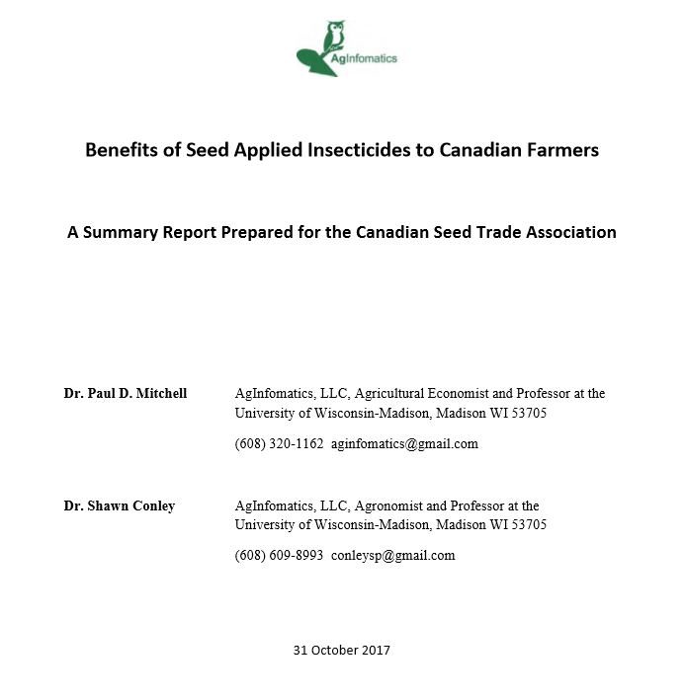
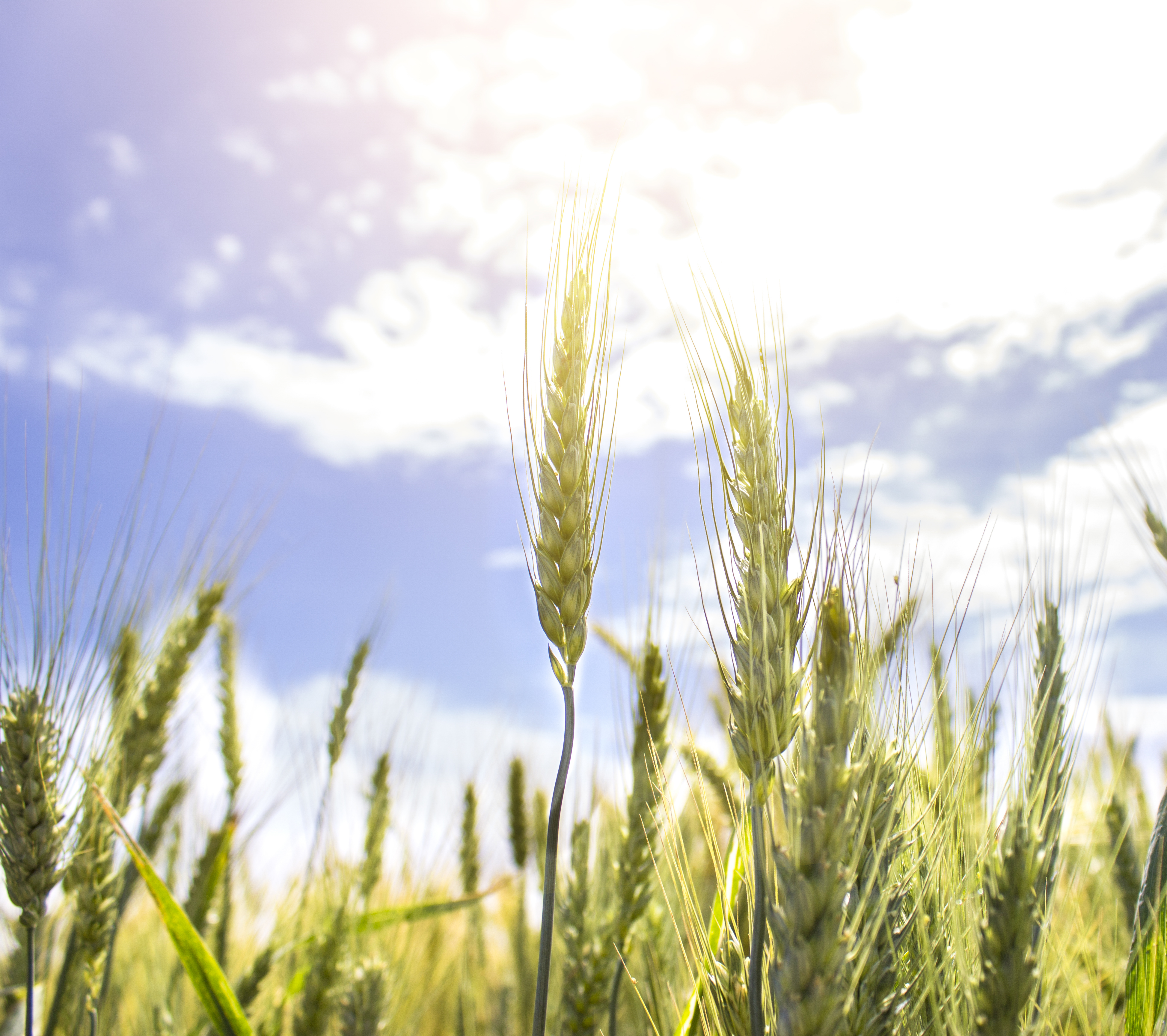
Seed Treatment Paper
The paper was submitted to PMRA by the Chair of the Mitigation Working Group (Deb Conlon, Grain Farmers of Ontario) at the end of October
Available online at: http://cdnseed.org/news-meetings/news/ and was distributed via Trade Winds
Notes:
I would like to say a special thank you to Syngenta and Paul Hoekstra for their support of this project.

Slide 15
Ontario Neonicotinoid Regulations

Slide 16
Ontario Neonic Regulations
Neonic treated corn and soybean seed considered a Class 12 Pesticide
Ontario Aspirational Goal of 80% reduction in treated corn and soybean acres by 2017
Reduce Overwintering losses to 15% by 2020
Update as of July 2017:
  Actual 24% Reduction in 2016
  2017 Vendor Reports submitted by October 2017
  “Can have 100% compliance and not reach aspirational goal
  Overwintering loss goal reached in 2016

Slide 17
Ontario Neonic Regulations
Ontario August 31, 2017 and beyond:
    By county 3rd Party Professional Pest Advisor Assessment
    Required every 3 years
    Self assessment in alternative years
    Fungicide only – no paperwork
    Fungicide and alternative insecticide – no paperwork
Third Party Professional Pest Assessor:
      Can be a CCA or Professional Agrologist
      As long as not deriving majority of income from the sale of a neonicotinoid pesticide

Slide 18
Professional Pest Advisor – Implementation by County
18
Notes:
18

Slide 19
Quebec Proposed Regulations

Slide 20
Quebec
Pesticides Management Code:
  Application of atrazine, chlorpyrifos, thiamethoxam, imidacloprid, and clothianidin for agricultural uses only permitted with the prior approval of a certified agronomist; specifically the planting of neonicotinoid-treated corn, oat, wheat, canola, barley or soybean seeds
  Establishes a new class of pesticide (3A) to capture every pesticide that coats a seed of oats, wheat, canola, grain corn, forage corn, sweet corn, barley or soybean that contains one or more of clothianidin, imidacloprid or thiamethoxam

Slide 21
Quebec
Prohibits the sale of neonics to consumers and commercial users for applications on grass
Require detailed reporting from farmers and retailers on the use and sales of the restricted products
Date | Pesticides
Date of coming into force of this regulation | Class 1 to Class 3 pesticides containing atrazine
1 September 2018 | Class 3A pesticides
1 April 2019 | Class 1 to Class 3 pesticides containing chlorpyrifos, clothianidin, Imidacloprid or thiamethoxam.
Notes:
Class 1
Class 1 includes all pesticides composed of a mixture which includes one or more of the following active ingredients: aldrin, aldicarb, chlordane, dieldrin, endrin, heptachlor as well as all pesticides whose registration is not required under the Pest Control Products Act (used for experimental purposes).
Class 2
Class 2 covers all pesticides considered to be for restricted use by the federal Pest Control Products Act, except those designated as Class 1 and certain Bacillus thuringiensis kurstaki (Btk) formulations. The main part of the label on a Class 2 pesticide container bears an indication to the effect that the product is for restricted use.
Class 3
Most pesticides considered to be for commercial, agricultural or industrial use by the Pest Control Products Act are grouped in Class 3. This class also includes pesticides composed of Btk intended for restricted use in a forest or on a wooded lot, as well as mixtures composed of fertilizers and pesticides of Class 3 prepared by individual users.

Slide 22
Quebec Key Takeaways
Failure to acknowledge and accept the expertise of Health Canada’s Pest Management Regulatory Agency (PMRA) in registering products for sale or use in Canada that are safe for human health and the environment;
Failure to acknowledge the significant contribution that certain pesticides have made to sustainable agricultural production or their important role in Integrated Pest Management (IPM);

Slide 23
Quebec
CSTA consulted with key partners:
  CropLife Canada
  AMSQ (Quebec Seed Trade Association)
  Registrants
  Quebec Grain Growers
CSTA and AMSQ developed a joint submission that focused on the science, difficulty of implementation, etc
Working with a coalition, led by CropLife Canada to address issues at both the federal an provincial levels

