Slide 1

Title: ASTA Core Messaging Deck
Stakeholder Preamble Presentation
  Explains why we need a public presentation and what we want allied partners to do with it
  Audiences: Members and potential spokespeople
Public Education Presentation
  Explains the benefits of seed improvement, outlines how seed improvement occurs and demonstrates what seed breeders do
  Audiences: ALL – members, industry groups and general public
Policy/Advocacy Presentation
  Gives an overview of the topic with supporting detail and articulates the industry POV on key issues including: breeding regulation/policy imperatives, IP, biotech, seed treatments, and the global movement of seed
  Audiences: Members and potential supporters of policy agenda

Slide 2
Usage Instructions and Best Practices
Using the Modules
The “stakeholder preamble” should be used to train presenters and to build consensus for the key messages with allied groups (members, grower groups, etc.)
Modules can be added to address topics of interest based on audiences
For presentations to the general public, start with slide 12
Customizing the Public Awareness Module
Slides 15, 17, and 19 are alternative slides on the key benefit statements
  This allows presenters to use images that are most relevant them and their business (e.g. a presenter from a grass company might prefer slides 15, 18,19)
  For the key benefit slides (15-20) spokespeople can choose to highlight one or more examples from the speaker notes but all notes do not need to be covered
Slides 31 and 32 are alternate images for the last slide (the “call to action” slide). The slide has Bethany’s contact info. listed, but you can switch it out for your own if you’d prefer.
Throughout the deck, speaker notes have additional context as background information for presenters
The full public presentation (slides 12-29) can be delivered in 20-25 minutes
For a 10 minute presentation, presenters can hide slides 13, 25, 26, and 27 and streamline the notes in the key benefit section

Slide 3
Usage Instructions and Best Practices
Preparing for a Presentation: Questions to Think About
What’s the mission of the group/organization?
What’s in it for them?
What’s the bottom line message you want them to take away from the presentation?
Which topics should be the focus (i.e. environment, economy, health & wellness, innovation, GMOs, IP, etc)?
Which modules will you use?
Which slides/images will you show/hide?
What types of questions do you anticipate?
What’s your “ask”/call to action?
  Help share the message?
  Opportunities for collaboration?

Slide 4

  Module: Stakeholder Preamble Presentation
  -Explains why we need a public presentation and what we want allied partners to do with it
  -Audiences: Members and potential spokespeople

Slide 5
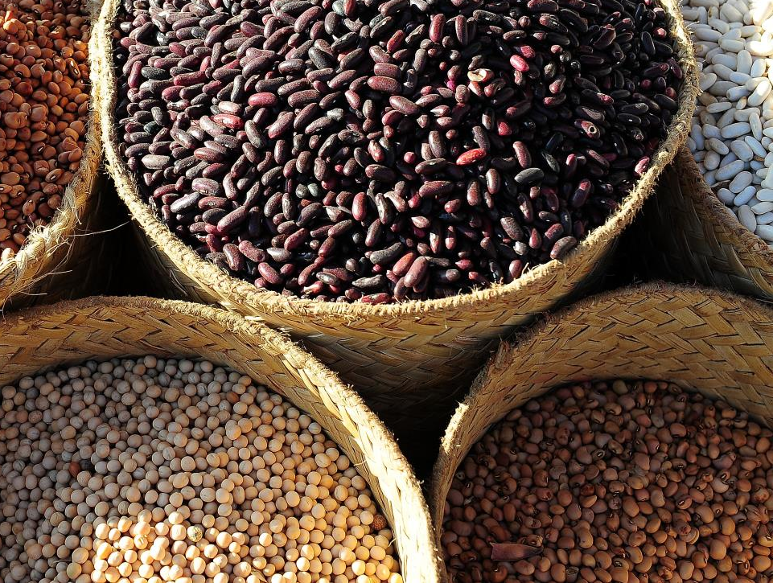

Notes:
Imagine our world without seed. You can’t. Because seed is the foundation of life. The food we eat, the clothes we wear, the fuel in our cars—all these and more can be traced to a seed someone planted.
Think about all of the many interactions with seed you have already had today. Perhaps it was the sheets that you woke up in, the clothes you put on, the oatmeal and coffee you had for breakfast or the grass that you walked across to get to your car. In fact, everything on earth that’s not covered by water or ice comes from seed and 100% of the global population is impacted by seed.
The global vital importance of seed and the need to constantly improve it is at the core of an important communications initiative being launched by the American Seed Trade Association and its more than 700 members, including [insert your company or organization name] that I am here to speak with you about today. ASTA’s slogan is First-The Seed® and now, more than ever, does everything start with seed.

Slide 6
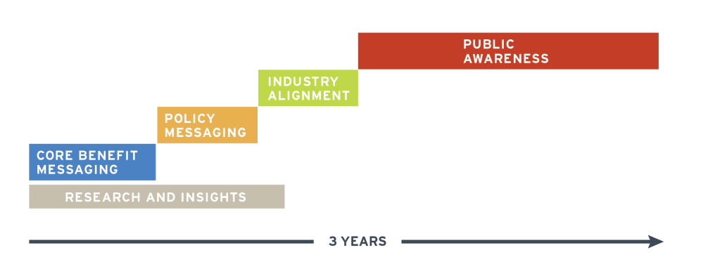
The Better Seed, Better Life program is about aligning the industry to tell the story of seed and its impact on our quality of life.
Notes:
We began this program by gathering insights from ASTA’s membership and performed market research with key constituents.
Then we used those insights to establish core messaging about the benefits of seed improvement and the evolution of plant breeding.
Next we refined the key policy and advocacy messaging around issues that matter most to member companies, grower groups and consumers.
Now we are reaching out across the industry to build alignment and develop spokespeople for both the core messaging and the policy objectives.
The last phase of this program will focus on reaching outside of the industry to informed consumers and other public audiences.

Slide 7
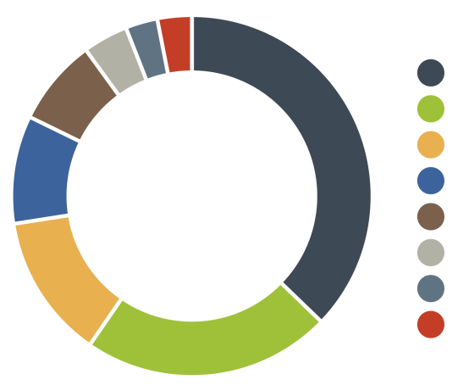
Consumers don’t put seed in the same category as other innovations that enhance our quality of life.
38% ACCESS TO CLEAN WATER
23% RENEWABLE ENERGY
13% REFUSED/DON’T KNOW
10% FOOD ASSISTANCE PROGRAMS
8% ACCESS TO MEDICINES
4% LAND FERTILIZATION
3% OTHER
3% SEEDS
n=602 total (n= 200 Millennials, n=200 moms, n=202 “food focused” people);
MoE=±3.7% total MoE=+ 6.2% per 200 subgroup; fielded November 12–18, 2014
Notes:
As I mentioned, ASTA grounded the program in market research to validate their early assumptions. According to that research key audiences, like moms, millenials and foodies, recognize the role of technology in modern agriculture, but they do not put seed in the same category as other innovations that enhance our quality of life.
ADDITIONAL CONTEXT:
n=602; collected nationwide from November 12–18, 2014; Moms and Food-focused people were contacted by phone via a live telephone operator interview. Millennials were contacted through an online survey.
Millennials are aged 18-34 years old, even gender split, more than 70% lived in cities and suburbs, 29% graduated from college, more than 75% made less than $75K annually (n=200)
Moms had at least one child under 18 living at home, more than 80% attended college, half made less than $50K annually, the majority lived in small towns and suburbs (n=200)
Food-focused people had a higher than average interest in cooking from scratch and gourmet food (n= 202)

Slide 8
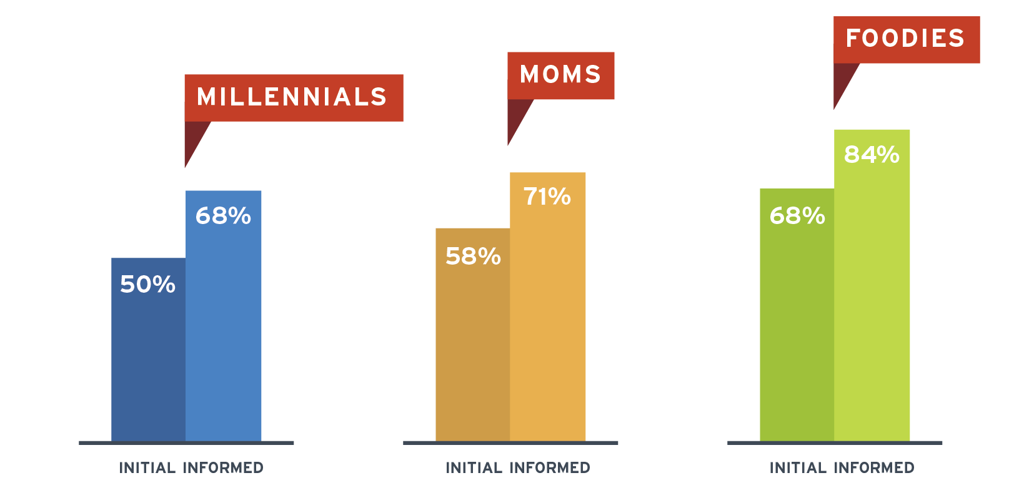
However, when people understand the specific benefits of seed improvement, their opinions improve.
Total Positive Impressions from Millennial (n=200)
Total Positive Impressions from Moms (n=200)
Total Positive Impressions from Foodies (n=202)
Notes:
And yet, when these key audiences were exposed to messages about the specific economic, environmental or health benefits of seed, they rated their impressions of seed improvements much higher. ASTA is using this information as an opportunity to collaborate within agriculture to increase awareness of the seed industry’s innovations and to address misperceptions about seed improvement and breeding methods. Further, when we tested several ways to describe the work of our industry from plant breeding to seed science, seed improvement was the term that tested best with consumers, which is why we use that term in all public communications.
ADDITIONAL CONTEXT:
Survey responders were first asked for their overall impression of the terms: “seed improvement”, “seed science” and “plant breeding”. Then they heard a series of benefit statements using one of the terms.
Benefit messages were collected through workshop session with ASTA members. They include the environmental, economic and health & wellness benefits shown on subsequent slides.
After the responders heard the benefits statements they were asked to rate their overall impression of the terms which showed the shift in perspective after exposure to specific benefits.

Slide 9
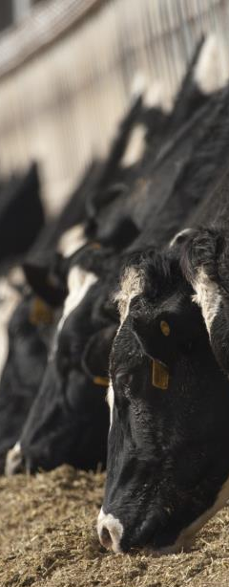

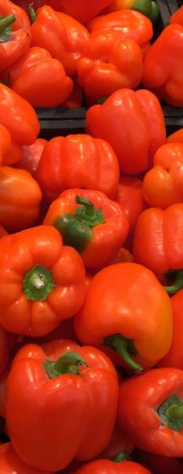





FOOD
FEED
FUEL
FIBER
Many things that enhance our quality of life can be traced back to a seed someone planted.
Notes:
As the cornerstone of our messaging, we want to bring awareness to the idea that many of the things that enhance our quality of life can be traced back to a seed someone planted. The food we eat, clothes we wear, the fuel that powers our cars—all these things and more start with a seed in the ground.
More importantly, some of the biggest challenges we face as a global society in the years ahead - from achieving food security to protecting our natural resources - can be addressed through the smallest of solutions: improved seed.

Slide 10
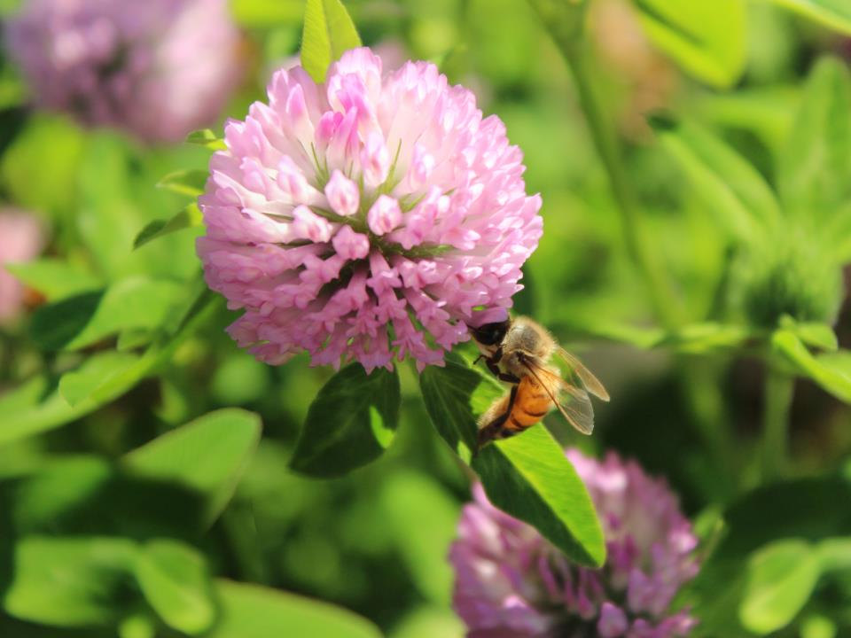
JOIN US IN HELPING TELL THE
STORY OF SEED IMPROVEMENT
Share assets and information
Advocate for the industry
Present a united and consistent voice
Notes:
We are asking you to join us in helping to tell the story of seed improvement. In the slides that follow, I will share the core messaging we’ve developed as part of the Better Seed, Better Life program. We also have modules on specific policy and advocacy topics that can be added to tailor presentations for any specific opportunity or audience. Whether you have the opportunity to speak to a group of fellow ASTA members, a local grower group about the industry POV on seed IP, or the general public about modern plant breeding, this deck will help you tell the compelling story of seed.
So, with that said, please also know that we welcome the opportunity to collaborate. If you have seed-related stories you’d like us to tell, please let us know. If you are hosting forums and would like us to participate, invite us! Bottom line, we hope you join your voice with ours in ensuring that we are presenting a unified, compelling story to the American public.

Slide 11
  Module: Stakeholder Preamble Presentation
  -Explains the benefits of seed improvement, outlines how seed improvement occurs and demonstrates what seed breeders do
  -Audiences: ALL –members, industry groups and general public

Slide 12
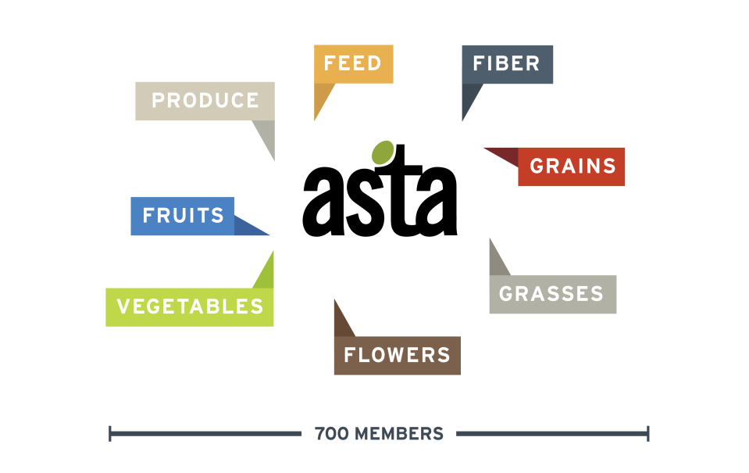
ASTA represents companies who breed, process and package seed of every type.
Notes:
Founded in 1883, the American Seed Trade Association (ASTA) represents over 700 companies involved in seed production, plant breeding and related industries in North America. ASTA’s broad membership offers varieties from alfalfa to zucchini and all production types including conventional, organic and biotech.

Slide 13
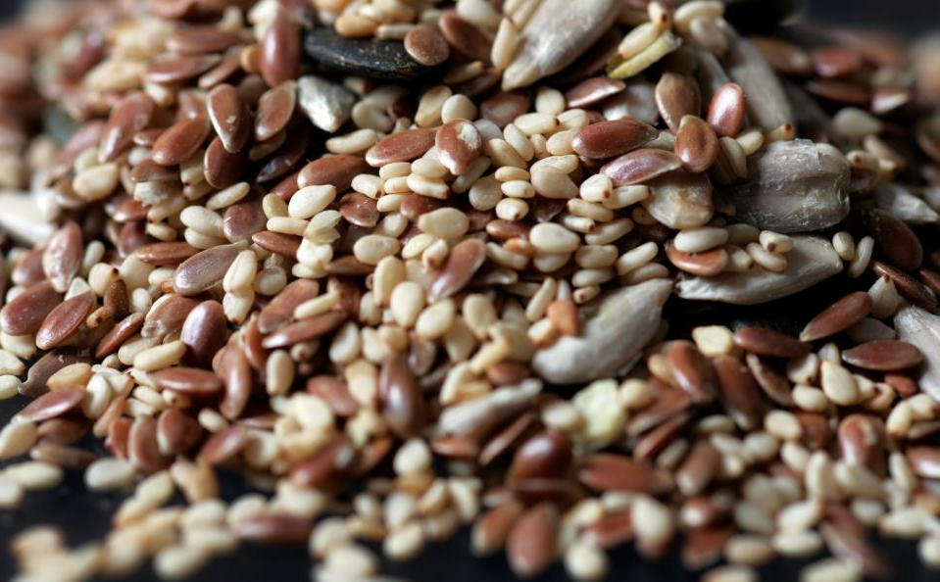
Seed improvement is about selecting new seed varieties through plant breeding tools and techniques.
Notes:
ASTA and their members are focused on seed improvement which refers to the many ways plant breeders create new seeds to address unmet needs of consumers, farmers and growers. Plant breeding includes both new techniques and those that date back thousands of years.

Slide 14

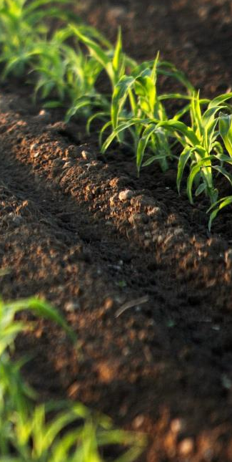
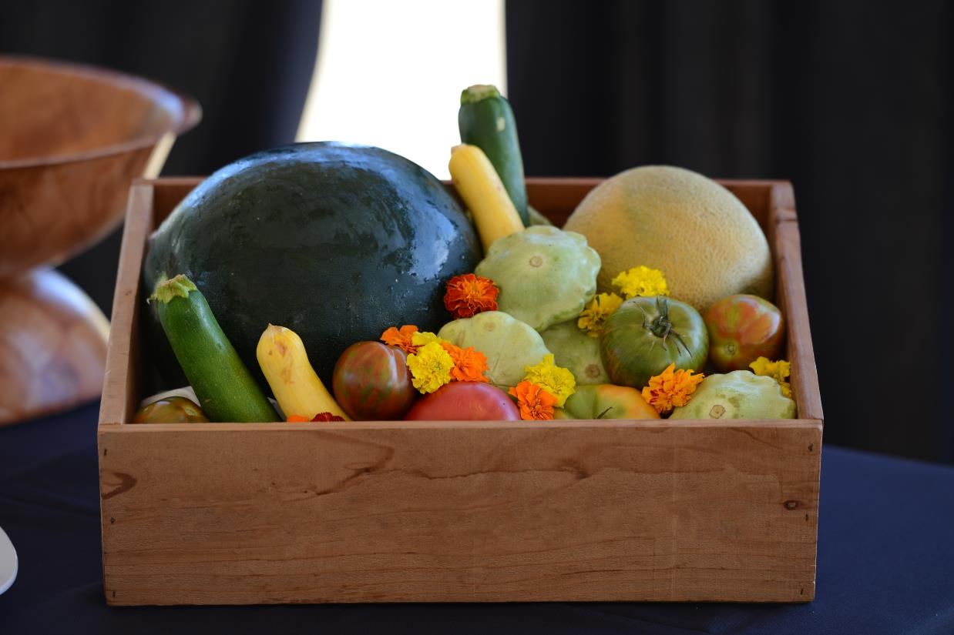



Seed improvement delivers economic, environmental and health benefits.
ECONOMIC
ENVIRONMENTAL
HEALTH & WELLNESS
Notes:
Seed improvement is important because many factors that shape our quality life can be traced back to a seed planted in the ground. The benefits of improved seed to our global society can be categorized into three macro categories: economic viability, protection and enhancement of our natural environment and the health and well-being of people and animals. I’ll share some specific examples…

Slide 15


ECONOMIC BENEFITS
Wide variety
Less waste
Consistent quality
Family farmers can sustain their way of life
Notes:
From an economic perspective, the seed industry is a powerful engine. According to The Context Network, it generates more than $15.5B annually in the United States across a diverse range of industry segments including agriculture, horticulture, home gardening and turf. It’s also responsible for providing seed annually for the more than 400 million acres of planted agriculture production in the US.
In addition to direct contributions to the economy, seed delivers many other types of economic benefits. To name just a few, seed improvements:
Result in less food waste because new varieties yield produce that stays fresh longer and has more consistent quality like more uniform peppers, and lettuce that has longer shelf life. Breeders have also developed serving-sized varieties like melons and avocados.
Allow farmers to grow a wide variety of foods so consumers can make choices that are right for their family’s needs and budget. For example there are more than 10,000 known varieties of tomato.
Help farmers to grow food more efficiently, enabling families in the U.S. to spend less money on food than families in other countries.
Improve fiber crops, resulting in fabrics that are stronger and softer.
Result in innovations such as mildew-resistant spinach and drought-tolerant corn; which enable farmers to stay competitive in an ever-changing global marketplace.
**Consider adding point that ties this to a current event (i.e. increase in African farmers)

Slide 16
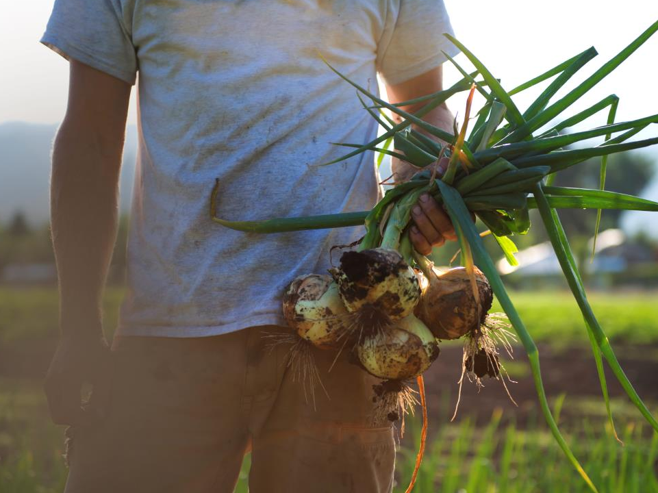
Alternative image
ECONOMIC BENEFITS
Wide variety for farmers and consumers
Less waste
Consistent quality
Family farmers can sustain their way of life
Notes:
From an economic perspective, the seed industry is a powerful engine. It generates more than $12B annually across a diverse range of industry segments including agriculture, horticulture, home gardening and turf. It’s also responsible for providing seed for the more than 400 million acres of planted agriculture production annually in the U.S.
In addition to direct contributions to the economy, seed delivers many other types of economic benefits. To name just a few, seed improvements:
Result in less food waste because new varieties yield produce that stays fresh longer and has more consistent quality like more uniform peppers, and lettuce that has longer shelf life. Breeders have also developed serving-sized varieties like melons and avocados.
Allow farmers to grow a wide variety of foods so consumers can make choices that are right for their family’s needs and budget. For example there are more than 10,000 known varieties of tomato.
Help farmers to grow food more efficiently, enabling families in the U.S. to spend less money on food than families in other countries.
Improve fiber crops, resulting in fabrics that are stronger and softer.
Result in innovations such as mildew-resistant spinach and drought-tolerant corn; which enable farmers to stay competitive in an ever-changing global marketplace.
**Consider adding point that ties this to a current event (i.e. increase in African farmers)

Slide 17
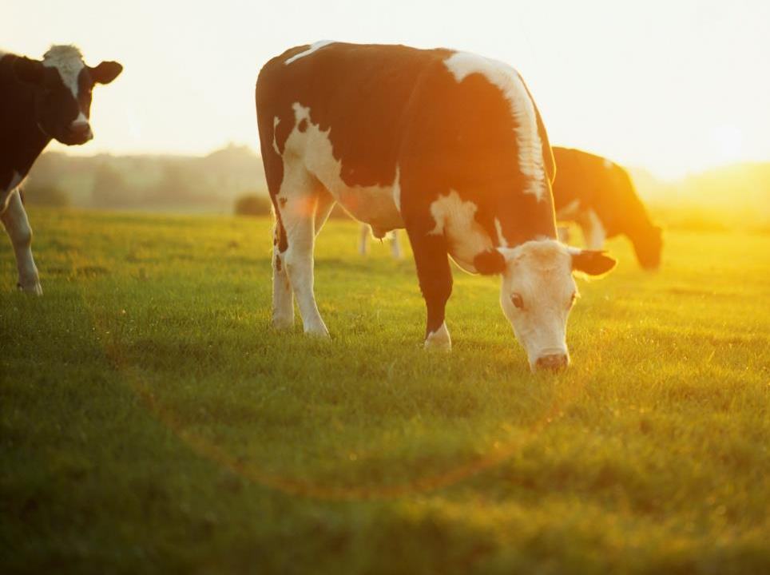

Alternative image
ENVIRONMENTAL BENEFITS
More food from the same land
Land restoration and reduced erosion
Reduced pesticide use
Efficient water use
Sustainable habitats
Notes:
Seed improvements also protect and enhance our natural environment. A few examples include:
Producing more food from the same land like grasses and grains used for feeding cattle. This will become increasingly important as the world’s population swells to an estimated 9 billion people by 2050.
Certain seed improvements also allow for reduced pesticide use which by some estimates has reduced the environmental footprint associated with pesticide use by 19%
“Biotechnology has reduced pesticide spraying by 550 million kg and has reduced the environmental footprint associated with pesticide use by 19%.” GM Crops: Global Socio-Economic and Environmental Impacts 1996-2013” Graham Brookes and Peter Barfoot, PG Economics
Plants that are ideal for restoring land damaged by mining, forest fires or other environmental disasters.
Enhanced environmental benefits, such as plants that reduce soil erosion and use water more efficiently.
Establishment of more sustainable habitats for wildlife and pollinators and more nutritious and efficient feed for livestock.
Plants that improve our air quality
**Consider adding point that ties this to a current event (i.e. seeds to restore forestation after wildfire)

Slide 18
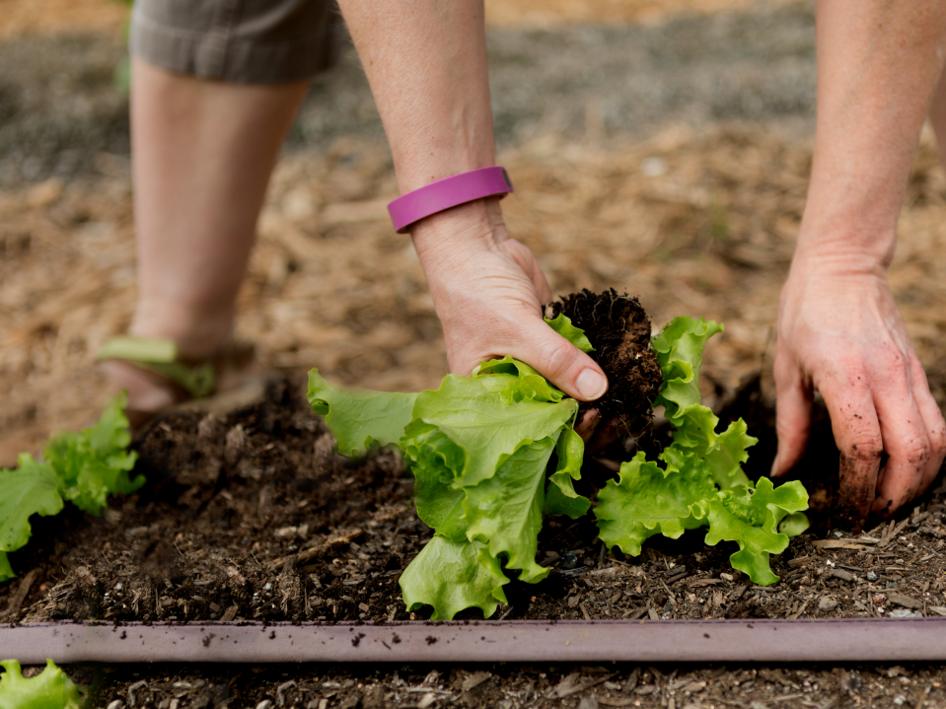
ENVIRONMENTAL BENEFITS
More food from the same land
Land restoration and reduced erosion
Reduced pesticide use
Efficient water use
Sustainable habitats
Notes:
Seed improvements also protect and enhance our natural environment. A few examples include:
Producing more food from the same land like grasses and grains used for feeding cattle. This will become increasingly important as the world’s population swells to an estimated 9 billion people by 2050.
Certain seed improvements also allow for reduced pesticide use which by some estimates has reduced the environmental footprint associated with pesticide use by 19%
“Biotechnology has reduced pesticide spraying by 550 million kg and has reduced the environmental footprint associated with pesticide use by 19%.” GM Crops: Global Socio-Economic and Environmental Impacts 1996-2013” Graham Brookes and Peter Barfoot, PG Economics
Plants that are ideal for restoring land damaged by mining, forest fires or other environmental disasters.
Enhanced environmental benefits, such as plants that reduce soil erosion and use water more efficiently.
Establishment of more sustainable habitats for wildlife and pollinators and more nutritious and efficient feed for livestock.
Plants that improve our air quality
**Consider adding point that ties this to a current event (i.e. seeds to restore forestation after wildfire)

Slide 19
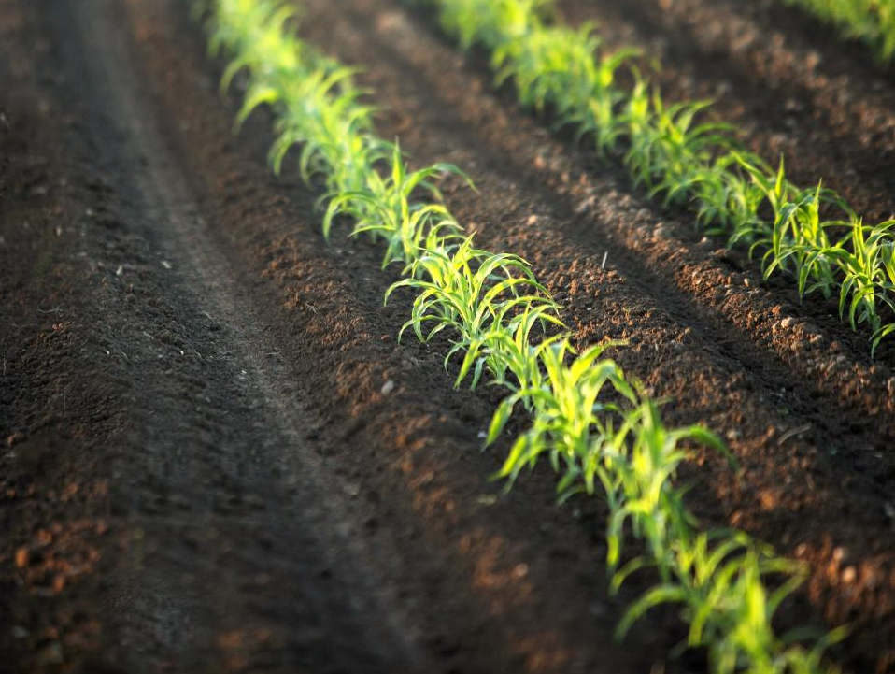
Alternative image
ENVIRONMENTAL BENEFITS
More food from the same land
Land restoration
Reduced pesticide use
Reduced erosion and water use
Sustainable habitats
Notes:
Seed improvements also protect and enhance our natural environment. A few examples include:
Producing more food from the same land like grasses and grains used for feeding cattle. This will become increasingly important as the world’s population swells to an estimated 9 billion people by 2050.
Certain seed improvements also allow for reduced pesticide use which by some estimates has reduced the environmental footprint associated with pesticide use by 19%
“Biotechnology has reduced pesticide spraying by 550 million kg and has reduced the environmental footprint associated with pesticide use by 19%.” GM Crops: Global Socio-Economic and Environmental Impacts 1996-2013” Graham Brookes and Peter Barfoot, PG Economics
Plants that are ideal for restoring land damaged by mining, forest fires or other environmental disasters.
Enhanced environmental benefits, such as plants that reduce soil erosion and use water more efficiently.
Establishment of more sustainable habitats for wildlife and pollinators and more nutritious and efficient feed for livestock.
Plants that improve our air quality
**Consider adding point that ties this to a current event (i.e. seeds to restore forestation after wildfire)

Slide 20
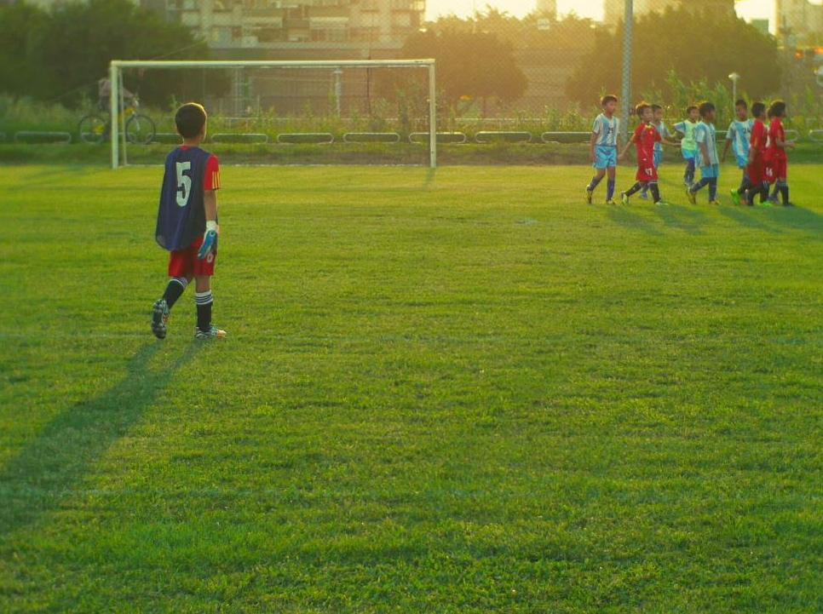

Alternative image
HEALTH & WELLNESS BENEFITS
More nutritious produce
Turf for sports/recreation
Wider variety of food
More successful home gardens
Notes:
Finally, seed improvements contribute to the health and well-being of people around the world. Some of these improvements include:
Produce that is healthier and more nutritious. For example, breeders have developed carrots with increased beta-carotene which improves both the appearance and nutrition profile.
Creating a wider variety of foods, including fruits and vegetables that are more convenient and appealing for consumers, such as personal sized watermelons and grape tomatoes.
Turf that is safer for sports or recreational use. For example, the NFL reports fewer injuries on natural grasses (Turfgrass Producers International)
Allowing home gardeners to have more successful backyard plots with heartier ornamental grasses and annuals.
Creating new, better tasting produce that is more likely to become part of a healthy diet. Like new butterscotch squash which is unusually rich, sweet, starchy flavor (ngb.org)
Cultivating flowers with more vibrant colors and more pleasing fragrances.(ex. new Dahlias and geraniums – ngb.org)
**Consider adding point that ties this to a current event (i.e. Golden Rice)

Slide 21

HEALTH & WELLNESS BENEFITS
More nutritious produce
Turf for sports/recreation
Wider variety of food
More successful home gardens
Notes:
Finally, seed improvements contribute to the health and well-being of people around the world. Some of these improvements include:
Produce that is healthier and more nutritious. For example, breeders have developed carrots with increased beta-carotene which improves both the appearance and nutrition profile.
Creating a wider variety of foods, including fruits and vegetables that are more convenient and appealing for consumers, such as personal sized watermelons and grape tomatoes.
Turf that is safer for sports or recreational use. For example, the NFL reports fewer injuries on natural grasses (Turfgrass Producers International)
Allowing home gardeners to have more successful backyard plots with heartier ornamental grasses and annuals.
Creating new, better tasting produce that is more likely to become part of a healthy diet. Like new butterscotch squash which is unusually rich, sweet, starchy flavor (ngb.org)
Cultivating flowers with more vibrant colors and more pleasing fragrances.(ex. new Dahlias and geraniums – ngb.org)
**Consider adding point that ties this to a current event (i.e. Golden Rice)

Slide 22
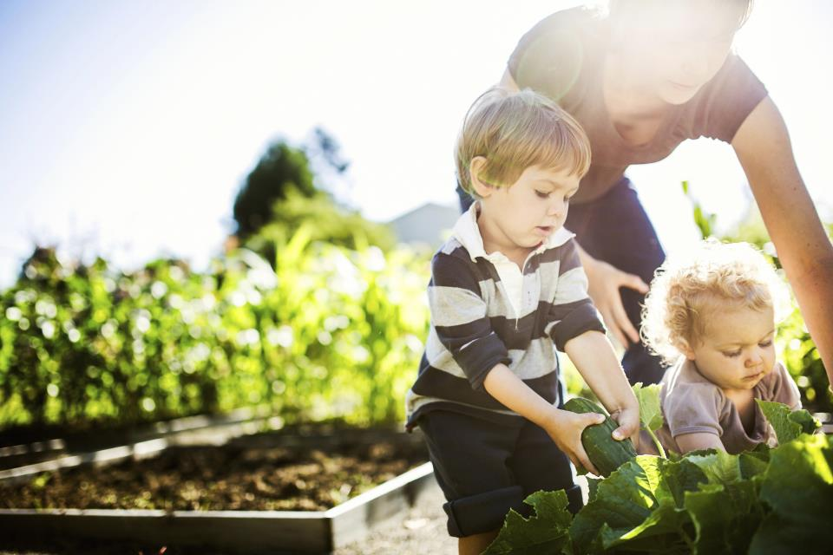
Even with these notable contributions, there is little public awareness of seed as a solution to many of the challenges facing society.
Notes:
Even with these notable contributions, there is little public awareness of seed as a solution to many of the challenges facing society.
ASTA and the seed industry have the opportunity and responsibility to communicate the many benefits of seed’s contributions to society, address misperceptions about the evolution of plant breeding, and ensure a positive policy environment that encourages and protects further innovation.

Slide 23
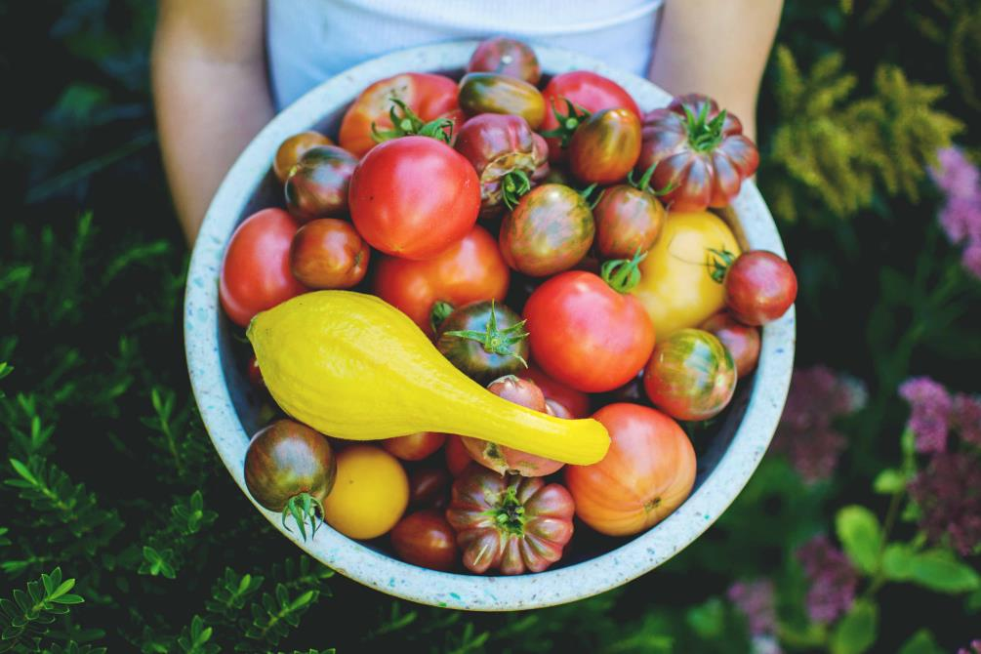
Plant breeders have been improving varieties for centuries.
Notes:
Not only do people lack awareness of seed benefits, but they also don’t know how seed improvement happens or anything about the people behind it. The seeds planted today by farmers, gardeners, turf managers and others are the result of centuries of evolving plant breeding techniques.
Historically, seed improvements came from selective breeding by saving seeds from observed spontaneous changes
More recently, plant breeders began to use tools to induce changes which resulted in beloved varieties like sweet corn used at summer BBQs and more than 10,000 varieties of tomato
Genetic diversity has always been the foundation of plant breeding.

Slide 24
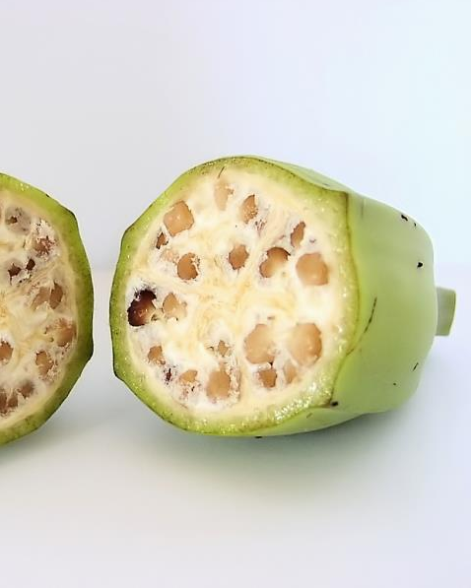

Plant breeders improved the modern banana into the beautiful, healthy and tasty fruit consumers have come to know and love.
Notes:
Plant breeding at its core has always been about selecting an improved variety. Over time the banana was selected and improved by plant breeders into the beautiful, healthy and tasty fruit consumers have come to know and love. It is just one of many examples of crops, fruits and vegetables that have been improved by centuries of plant breeding techniques.

Slide 25
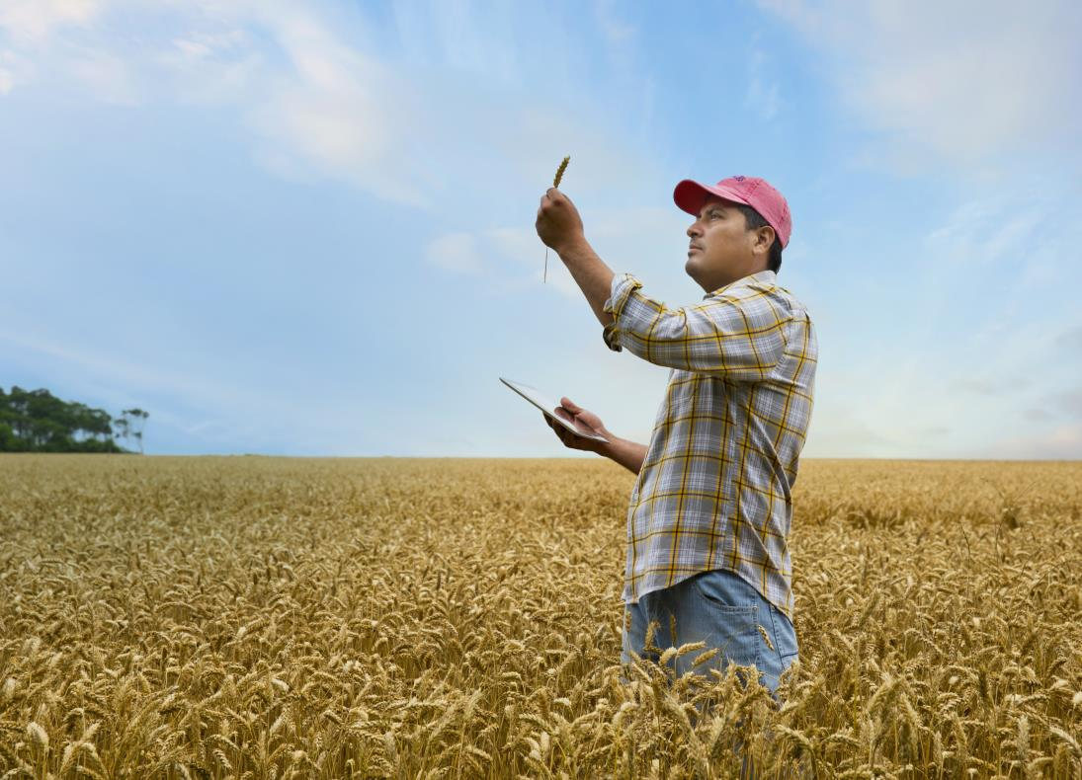

Seed improvements are driven by consumer demand, grower or gardener needs and evolving innovations.
Notes:
Let’s explore that plant breeding journey a bit more. It begins with a problem to be solved or an identified farmer/consumer need, such as better taste, smaller size or the ability to withstand drought, disease or insects.
Opportunity to engage the audience: What would your wish list include? Bite-size avocados? Snap peas without spines? Beets that don’t stain your hands? Extreme drought resistant maize?

Slide 26
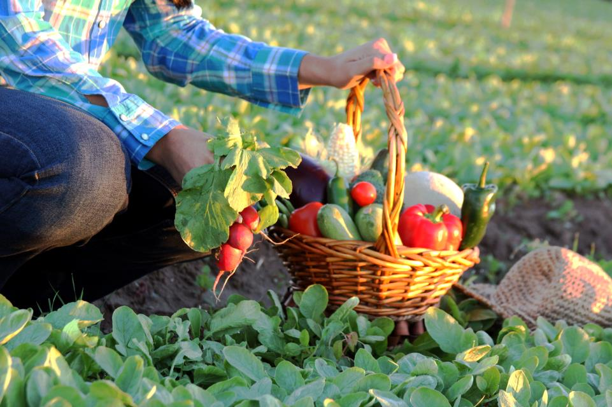

Breeders and researchers continue to improve plant breeding processes to create more desirable seed varieties.
Notes:
Plant breeding still involves three core tenets: planting seeds, observing a characteristics of the resulting plants—like sight, touch, and taste —and selecting for the most desirable characteristics to breed the next generation of plants, drawing on the existing genetic variability within plants and related species.
Just as people begin a car trip by entering their destination into a GPS to avoid wrong turns that cost time and money, plant breeders today use advanced tools, information and improved methods with the goal to reach the same endpoint more accurately and efficiently.

Slide 27
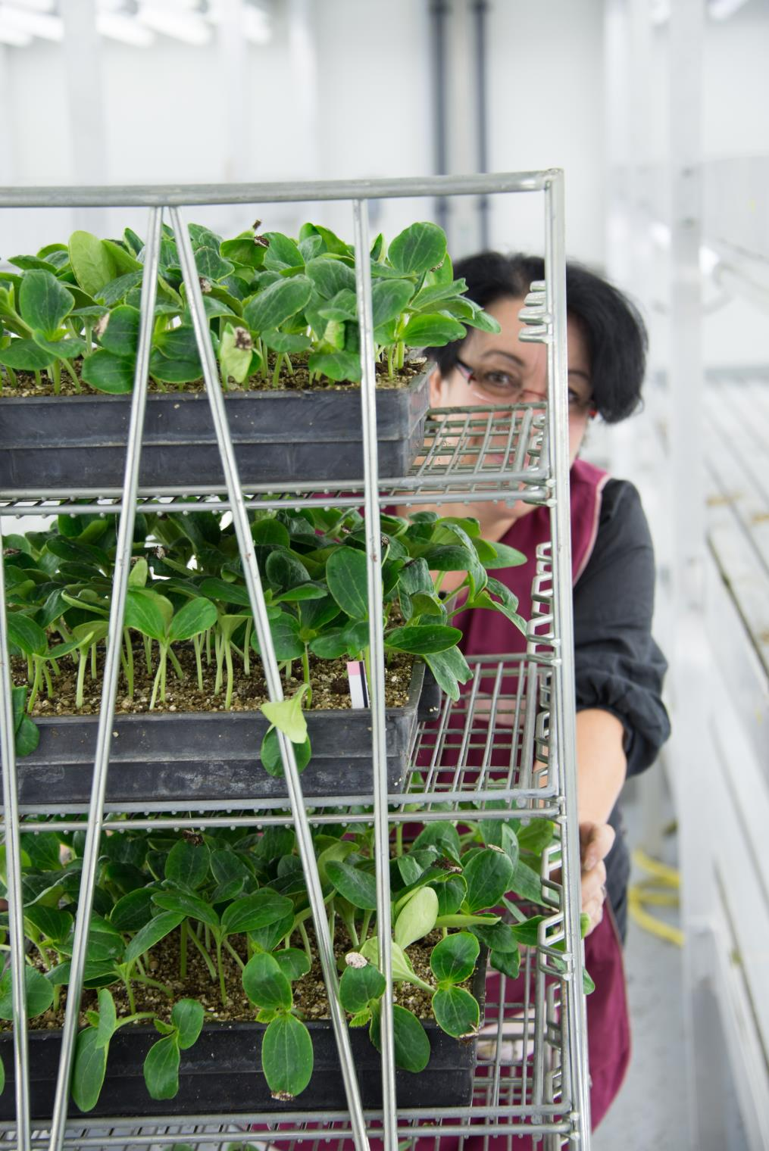

Plant breeders today have access to an incredible array of genetic information from both commercial and wild plant varieties.
Notes:
Modern plant breeders have access to an incredible array genetic information about both commercial and wild plant varieties. They use their advanced understanding to select improved varieties with more speed and precision than ever before by working with genes to enhance or minimize certain traits.

Slide 28
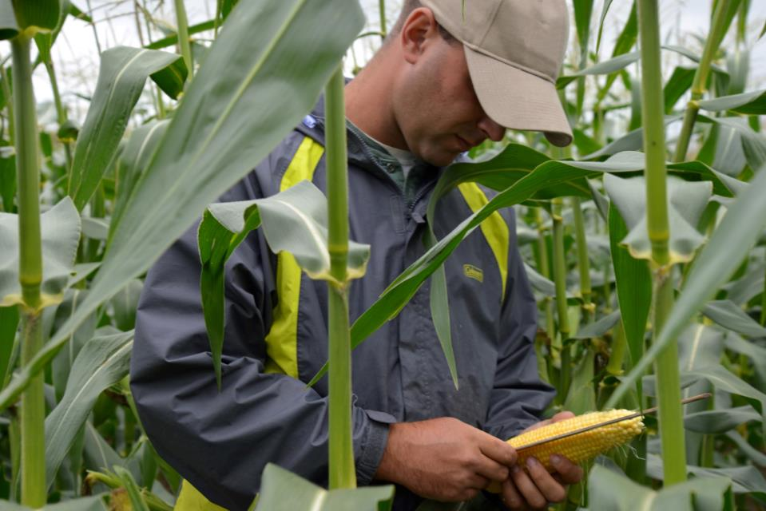

Plant breeders use precise methods to enhance or minimize specific plant qualities.
Notes:
With the evolution of science and increased understanding of plant biology and genetics, breeding methods have become much more precise. Based on knowledge of how plant genes function and sophisticated methods that harness natural plant characteristics, breeders can identify a variety combinations with desirable characteristics and then work with specific genes in the plant to enhance or minimize certain qualities.

Slide 29
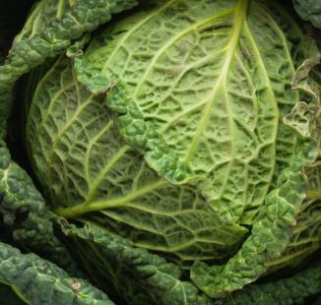
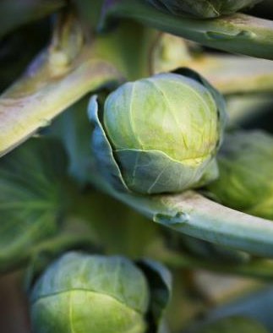
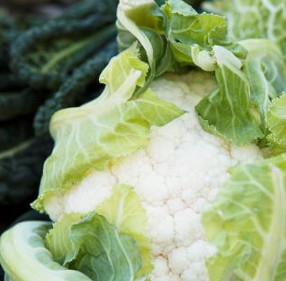

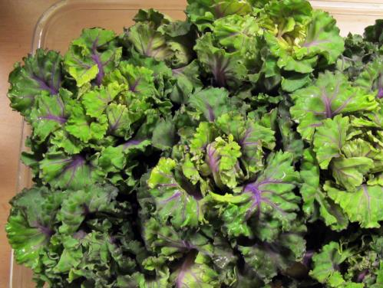
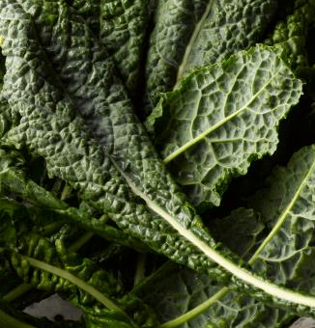
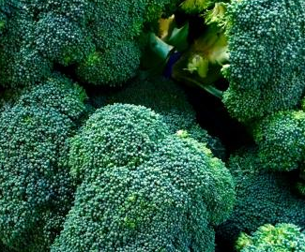
Plant breeding has resulted in new varieties of fruits and vegetables.
CABBAGE
BRUSSEL SPROUTS
CAULIFLOWER
KALE
BROCCOLI
KALETTES
Notes:
For example, by aligning desirable characteristics, plant breeders have been able to work within the wild mustard family to select staples such as broccolini, kale and improved varieties of cauliflower. More recently, plant breeders introduced “kalettes”: a cross between kale and Brussels sprouts.

Slide 30
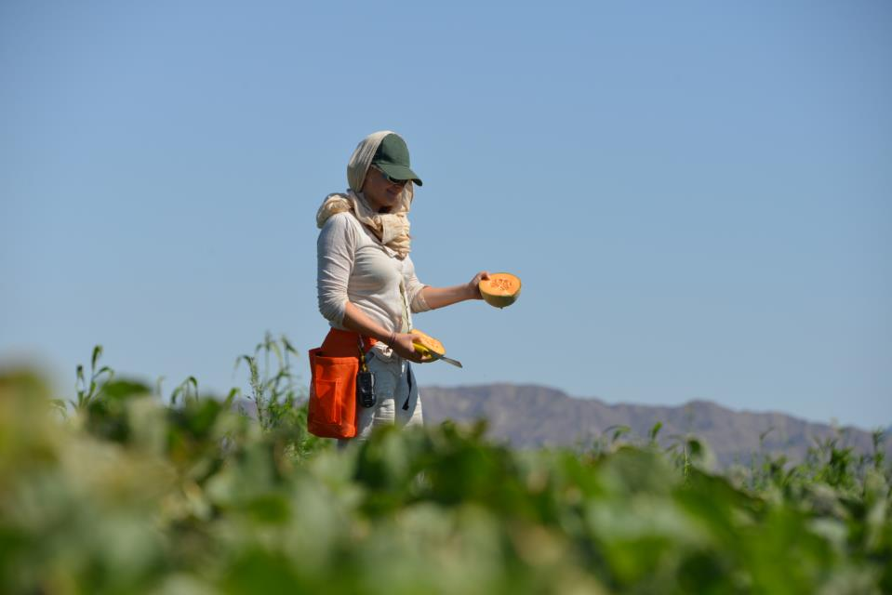

The global seed industry ensures farmers have the seeds they need to feed the world.
Consistent harvests
Affordable food
Wide variety
Sustainable development
Notes:
Seed industry innovations will help us feed an expected global population of 9 billion people by 2050. Through seed improvement, farmers can count on consistent and reliable harvests of food that stays fresher longer which can be efficiently distributed to the people who need it most.
Seed improvements will also increase the variety of crops and vegetables available to farmers around the world so that families across the globe can make choices that are right for their needs and budgets.
As an industry, we are proud of the work we do to improve the very basic qualities of life that we all take for granted. Very few industries are able to have a positive global impact on the economy, the environment and the health and wellness of people and animals. On an individual level, the work of the industry puts affordable food on our kitchen tables, increases the beauty and sustainability of our neighborhoods and allows each and everyone of us to live healthier lives. Since the dawn of agriculture thousands of years ago, we have been improving our seed to the benefit of all. As we all knew or now know, seed improvement continues today with increased precision and speed, ensuring that the seed industry will meet the global challenges we face as a society.

Slide 31
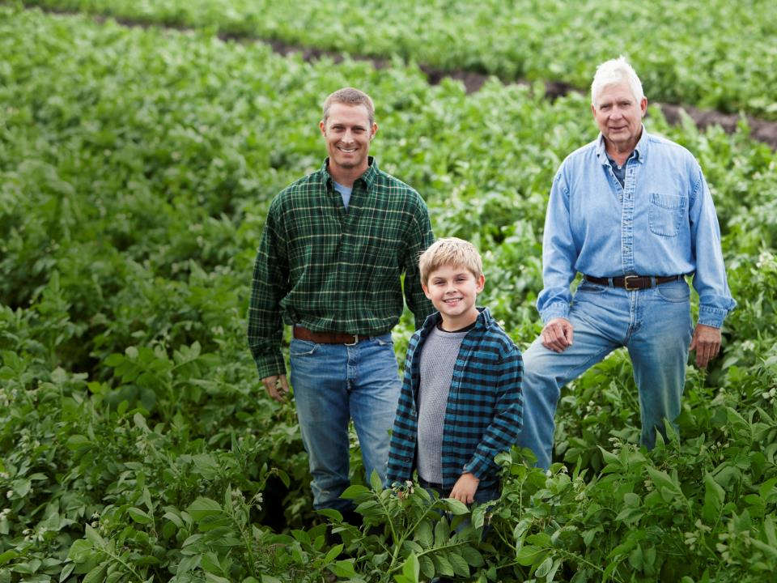
JOIN US
Champion the contributions of seed
Address misperceptions
Create a favorable environment for continued innovation around seed improvement
CONTACT
Bethany Shively
bshively@amseed.org
Notes:
The time is right to seize the opportunity to champion the contributions of seed, address misperceptions, and create a favorable environment for continued innovation around seed improvement.
Hopefully I’ve given you a sense for what ASTA wants to accomplish with this project. We believe this will benefit all of agriculture and will complement the communications efforts of many allied organizations. For that reason, we welcome the opportunity to collaborate. If you have seed-related stories you’d like us to tell, please let us know. If you would like to use our content and materials to fortify your programs, just ask. And, if you are hosting forums that might be appropriate for discussing seed, we would love to participate. Bottom line, everything starts with seed but through seed improvement that idea of “First-The Seed” becomes “Better Seed, Better Life.”

Slide 32
JOIN US
Champion the contributions of seed
Address misperceptions
Create a favorable environment for continued innovation around seed improvement
JOIN US
Champion the contributions of seed
Address misperceptions
Create a favorable environment for continued innovation around seed improvement
CONTACT
Bethany Shively
bshively@amseed.org
Notes:
The time is right to seize the opportunity to champion the contributions of seed, address misperceptions, and create a favorable environment for continued innovation around seed improvement.
Hopefully I’ve given you a sense for what ASTA wants to accomplish with this project. We believe this will benefit all of agriculture and will complement the communications efforts of many allied organizations. For that reason, we welcome the opportunity to collaborate. If you have seed-related stories you’d like us to tell, please let us know. If you would like to use our content and materials to fortify your programs, just ask. And, if you are hosting forums that might be appropriate for discussing seed, we would love to participate. Bottom line, everything starts with seed but through seed improvement that idea of “First-The Seed” becomes “Better Seed, Better Life.”

Slide 33
  Policy/Advocacy Presentation
  -Gives an overview of the topic with supporting detail and articulates the industry POV on key issues including: breeding regulation/policy imperatives, IP, biotech, seed treatments, and global movement of seed
  -Audiences: Members and potential supporters of policy agenda

