Slide 1

January 2018

Slide 2











Who We Are
Provide strategy and marketing in the fresh produce supply chain – from seed to retail.
  Business Strategy Marketing Services Business Development

Slide 3

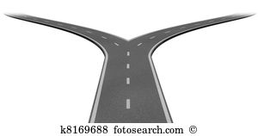


Category Data Strategy
Reduce ineffective process
Increase flavor, consumption, seed volume
Retail data allows users
categorizes items
to better analyze
current shopper
demands, to
forecast future
needs, enabling a
more effective
long-term strategy.
Jointly identify category growth opportunities
Marketer / Grower: Develop stronger relationships

Slide 4
Benefits
Program Consistency Via More Predictable Supply
Item Differentiation / Trend Spotting
Collaboration - Strategic Partners

Slide 5



Trend Sources
IRI and AC Nielsen: Capture POS (point-of-sale) data from retailers. Representative of 75 – 85% of total retail market. Granular data at an market, item, and retail level.
Menu Monitor tracks flavor and produce trends across 1000’s of food service sectors, from QSR (quick serve = mainstream to white table cloth = new trends)
Consumer and Category Studies via trade groups

Slide 6
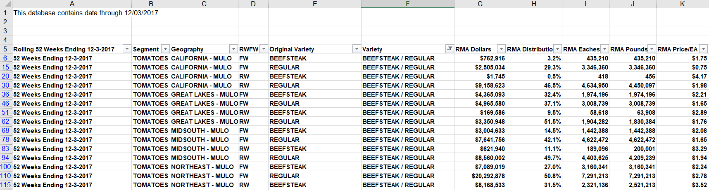
Key Data Metrics
Sales | Distribution | Brand | Geography
Tonnage | Variety | Retail Performance | Fixed (packaged) vs. Random (bulk) Weight
Sample Data:

Slide 7
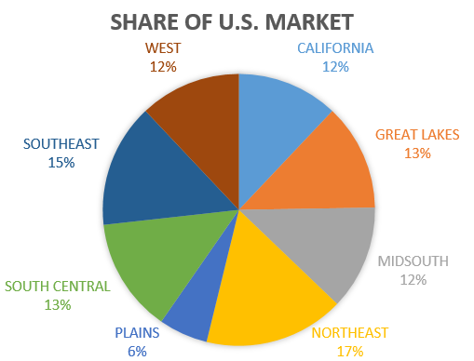
Tomato Category Snapshot
The tomato category comprises 2.5 % of all produce sales at retail. 2015 to 2017 Trends:
The category has seen 5% volume growth from 2015 to 2017
Where is the growth in the category?
Where is growth coming from?

Slide 8
Tomato Category Snapshot
Track Brand Performance at an Item Level

Slide 9
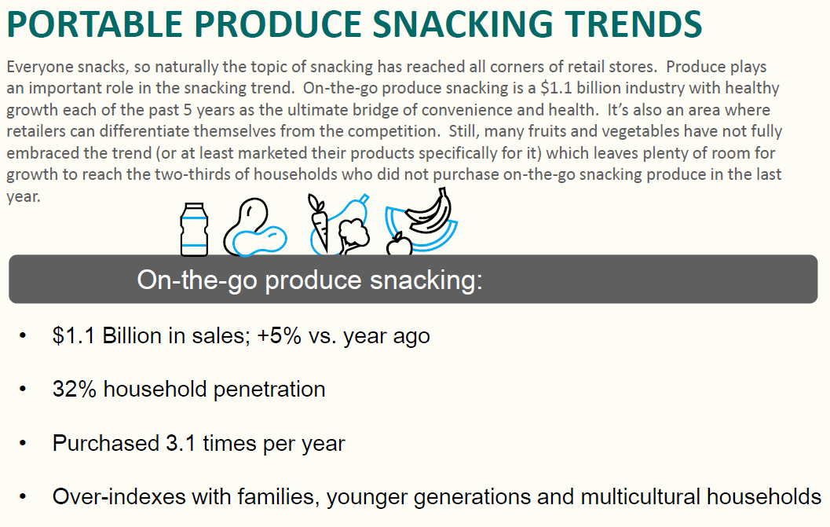
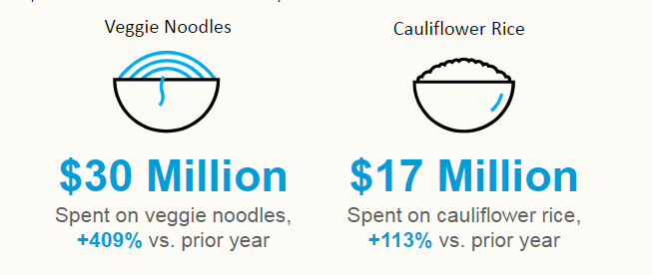
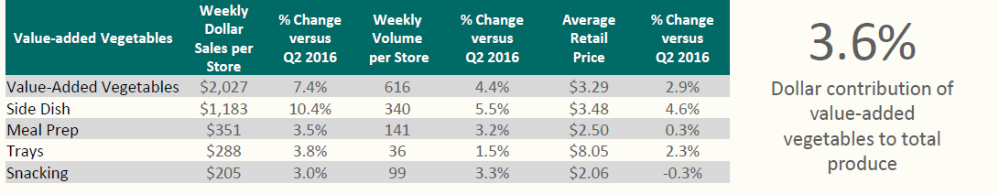
Broad Retail Trends in Produce
On-the-Go / Snacking
New Combinations / Pasta Alternatives
Value Added / Convenience

Slide 10
Recommendations
Annual purchase and analysis of IRI data for key categories and customers
Additional analysis of categories trends via industry sources
Develop insights by category annually

Slide 11
Thank you!
Tom Thompson
Vice President
Tom@goldensunmarketing.com
952-380-7260

