Slide 1
Seed Treatment Regulations in Canada
Dave Carey, Executive Director
December 2018

Slide 2
CSTA Staff
Dave Carey, Executive Director
dcarey@seedinnovation.ca
Claudio Feulner, Regulatory Affairs and Policy Coordinator
cfeulner@seedinnovation.ca
Lauren Martin, Government and Industry Relations Coordinator
lmartin@seedinnovation.ca
Kim Sabourin, Manager, Communications and Member Engagement
ksabourin@seedinnovation.ca
Kristen St. Denis, Executive Administrator and Meeting Planner
kstdenis@seedinnovation.ca
Office: 130 Albert Street, Suite 300, Ottawa, Ontario K1P 5G4
P: 613-829-9527 E: info@seedinnovation.ca
Notes:
Unpack who the staff are

Slide 3
Seed Treatment Regulations in Canada

Slide 4
Overview
Federal Updates:
Neonics
Thiram
PMRA Review
Provincial Updates:
Quebec
Ontario

Slide 5
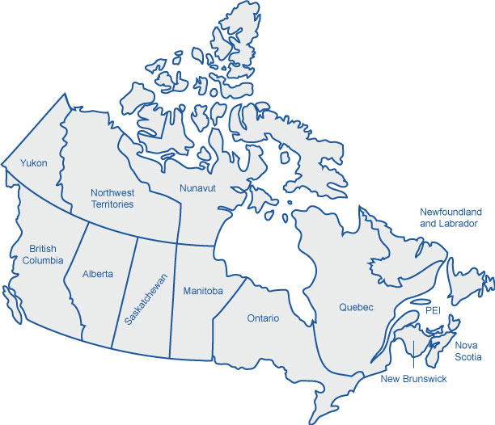
Shared Jurisdiction
Notes:
Canada is a federation. Some decisions are made by the head of the country in Ottawa, while other decisions are the jurisdiction of the provinces. Agriculture and environment is a shared jurisdiction between the federal and provincial governments.
The Federal government, through PMRA, has the jurisdiction to evaluate, approve, register and review pesticides and crop protection products
Once registered a product can be used in across Canada • Provinces have the jurisdiction to further regulate how and when federally registered crop protection products are used
PMRA reports to Health Canada. CFIA has dual reporting to Health and AAFC

Slide 6
Imidacloprid
Full Cyclical Re-evaluation (excluding Pollinators):
Proposed decision published in November 2016 for public comment (PRVD2016-20).
Proposed decision: Phase out all agricultural uses, including seed treatments, and a majority of other outdoor uses for the protection of the environment.
Extensive comments and data were received and are currently under review.
Pollinator Re-evaluation:
Proposed decision published in May 2018 for public comment (PRVD2018-12).
Proposed decision: Phase out many uses of imidacloprid on crops that bees find attractive and to restrict when these products can be applied.
Seed treatment uses were found to be acceptable.
Extensive comments were received and are currently under review.
A final decision that includes pollinators, human health, value and a full environmental assessment is anticipated in December 2018:
Will consider comments received on the two consultations of November 2016 and May 2018.

Slide 7
Clothianidin and Thiamethoxam
Special Reviews on Aquatic Invertebrates:
Proposed decisions published August 15 (PSRD2018-01 and PSRD2018-02).
Proposed decision: Phase out all outdoor agricultural and turf uses of clothianidin and, Phase out all outdoor agricultural and ornamental uses of thiamethoxam.
Consultation ended on November 13th, 2018. Extensive comments and data were received will be reviewed.
Final special review decisions are expected in January 2020.
Pollinator Re-evaluations:
Proposed decisions published December 2017 (PRVD2017-23 and PRVD2017-24).
Proposed decisions: Phase out many of the uses on crops that bees find attractive and to restrict when these products can be applied. Seed treatment uses were found to be acceptable.
Extensive comments were received and are currently under review.
Final decisions are expected in December 2018.
Full Cyclical Re-evaluations (excluding Pollinators and aquatic invertebrates):
Initiated in 2016, currently underway.
Proposed decisions are expected in December 2019.

Slide 8
Thiram
Proposed Re-evaluation Decision (PRVD2016-07):
Proposed decision published February 29th 2016.
Proposal to phase out all thiram uses, based on risks of concerns to human health and the environment.
Comments received from the registrants and other stakeholders, including the seed sector.
Comments have been considered and assessments are being revised, where warranted.
A final re-evaluation decision expected in December 2018.
As per current practice, stakeholders will be informed of the document’s release prior to its publication.

Slide 9
Re-evaluation process

Slide 10
Some recent proposed decisions
Active ingredient | Mancozeb Group M | Metiram Group M | Ferbam Group M | Ziram Group M | Thiram Group M | Chlorothalonil Group M | Iprodione Group 2 | Captan Group M | Cypermethrin Group 3 | Imidacloprid Group 4 | Λ-cyhalothrin Group 3
Trade Name | Dithane | Polyram | Ferbam | Ziram | Thiram | Bravo | Rovral | Captan | Ripcord | Admire | Matador
Status | March 2018 | March 2018 | June 2018 | June 2018 | June 2018 | March 2018 | March 2018 | March 2018 | Sept 2018 | Dec 2018 | March 2019
Proposed decision | Cancel all uses | Cancel all uses | Cancel all uses | Cancel all uses | Cancel all uses | Cancel certain uses; limit rest | Cancel all uses | Cancel certain uses; limit rest | Fewer applications | Cancel all ag uses | Cancel most uses

Slide 11
PMRA Consulting on Process
Notes:
CSTA, CropLife and several partners have actively been advocating for improvements to the re-evaluation process.

Slide 12
PMRA Consulting on Process
Notes:
We will be fully engaged in this process

Slide 13
PMRA Consulting on Process
Notes:
We will be fully engaged in this process

Slide 14
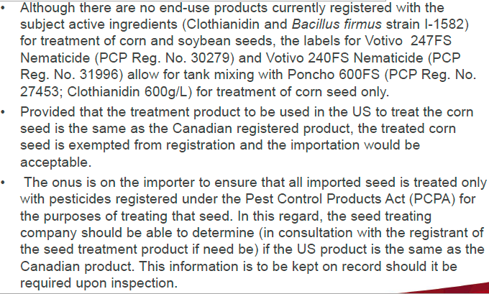
Import of Seed Treated with Poncho/Votivo

Slide 15
PMRA Contact

Slide 16
Provincial
Notes:
Discuss how some provinces are adding extra layers of regulation with respect to seed treatment. Notably, Ontario, Quebec and British Columbia– large provinces, with large markets and large urban populations also regulate seed treatments. These three provinces have large urban centres which may explain the province’s need to interfere with federal decision making.

Slide 17
Ontario
Regulation 63/09
&
Ontario Pesticide Advisory Committee
Notes:
Ontario, for example, has established its own classification systems to regulate the sale, use, transportation, storage and disposal of federally registered pesticides.
There are currently 12 classes of pesticides under the existing Ontario pesticide legislation (Regulation 63/09).
Another element that is unique to Ontario is the Ontario Pesticide Advisory Committee (OPAC), which is responsible for reviewing pesticide applications and making a recommendation on classification to the Minister of Environment. While the Minister of Environment has the final decision on which class a pesticide belongs to, OPAC nevertheless has influence on this matter. Different classes of pesticides come with varying regulatory requirements. Thus, what class a pesticide is an important matter. Moreover, the extra review process created by Ontario means that Ontario growers experience delays in accessing new technologies relative to their counterparts in other provinces who can access it as soon as the federal registration is approved. In some instances, this means they miss an entire growing season.

Slide 18
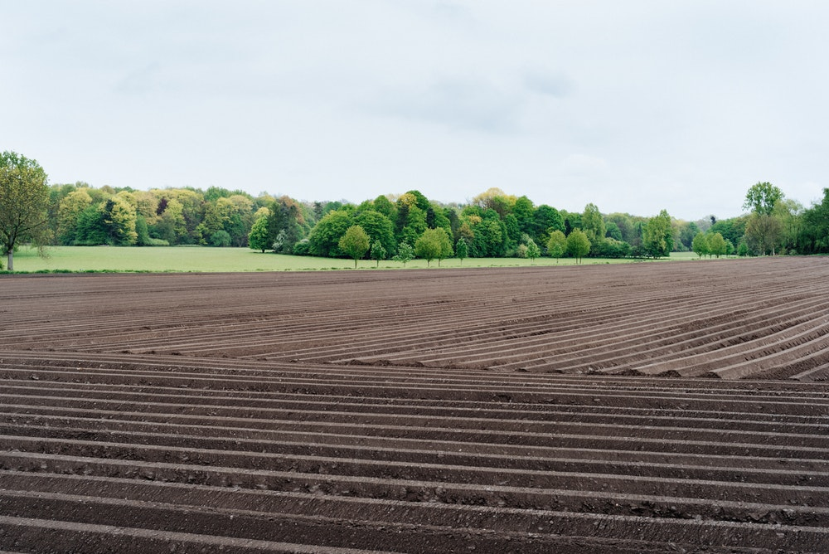
Quebec
Changes to Pesticide Act: Class 3A
&
The importance of agronomists
Notes:
Similar to Ontario, Quebec also has a second layer of approval for pesticides, which include seed treatments.
Recent amendments to the Pesticide Act (La loi sur les pesticides) and its accompanying regulations created a new class of pesticides – Class 3a. Those pesticides which are considered to be Class 3A pesticides must receive a prescription from an agronomist before being applied in the field and must also, as of September 8, 2018, be reported at the point of sale or purchase. At this time therefore seeds of oats, wheat, canola, grain corn, forage corn, sweet corn, barley and soybeans that are coated with neonicotinoids (thiamethoxam, imidacloprid and clothiadinin) must be reported at the point of sale or purchase.
Given the reality of when seeds need to be purchased (i.e. in advance of spring planting).

Slide 19
@SeedInnovation
CSTA
Canadian Seed Trade Association
Canadian Seed Trade Association
cdnseed.org

