Slide 1
ASTA Communications Update
Bethany Shively, Director, Communications

Slide 2
Plant Breeding Innovation
New resources available
On our microsite:
Blog content
Links to new videos, news articles & other partner resources
Social media content
Students
Videos
Blog posts
Visit:
SeedingInnovation.org

Slide 4
Tuskegee gene editing research on sweet potatoes
“Just as gene editing could be used to make sweet potatoes less palatable to pests, it could be used to make potatoes more palatable to people.”

Slide 6
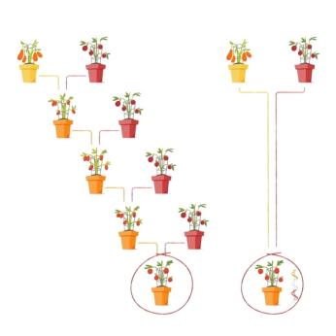
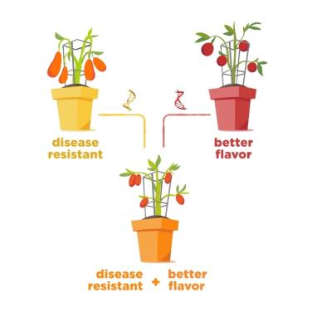
Social Media
@Better_Seed
Plant Breeding Explained in a “Snap”
#JustGrowIt

Slide 7
Ongoing Stakeholder Engagement
International
Coordination with ISF on International PBI Communications Toolkit
Discussion Guide, Presentation, Infographics
ASTA-CLI cornerstone animated video translated into 4 languages in addition to English
Domestic
Message alignment within industry and across the value chain
Notes:
Spanish, Korean, Japanese, Portuguese

Slide 8
Next Steps: Ramp up Proactive Communications
Expansion of existing communications tools
Active engagement with media and the public through a diverse network of spokespeople
Ongoing media listening and rapid response when needed

Slide 9
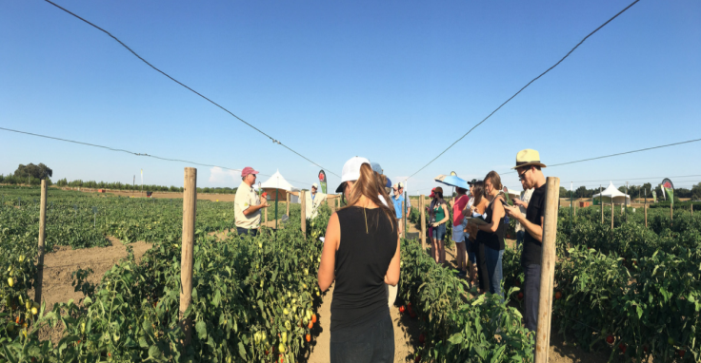
Media Outreach
AgriPulse gene editing series
ASTA Media Tours (cross-cutting seed issues with focus on innovation)
Notes:
Co-hosts: ASTA, NGB, CSA
Stops: HM.Clause, Seminis, UC Davis
Attendees: -Regional mainstream media, food bloggers, garden writers
-Local university students
Speakers: Researchers, marketing reps, plant breeders (plus dinner briefing with reps from ASTA, CSA and Farm Bureau)

Slide 11
ASTA, NAPB, Tri-Societies -- Plant-Science Student Video Contest

Slide 12
Seed Ambassador Leadership Team
Mission: Build an internal network of seed influencers in order to actively engage, promote, and support the seed industry with a unified voice.
Goals:
Increase engagement of ASTA diverse membership
Multiply and amplify the voice and visibility of Better Seed Better Life

Slide 13
PS: Don’t forget to follow us at: @Better_Seed
Questions?

