Slide 1

  Module: GMO Presentation
  -Provides an update on current GMO messaging (consistent with GMOAnswers) and issues
  -Audiences: Members, industry allies and policy decision makers
  - Utility: Used in conjunction with core deck to address questions and explain ASTA’s position on the issues

Slide 2

ASTA supports GMOs and biotechnology as part of a wide array of potential tools at the disposal of plant breeders and farmers to address global challenges.
181M
90%
71
ACRES WORLDWIDE
ARE SMALL OR RESOURCE-LIMITED FARMERS
COUNTRIES GROW, IMPORT AND/OR USE BIOTECH
1.2B
18M
10
LBS OF REDUCED PESTICIDE APPLICATIONS
FARMERS IN 28 COUNTRIES
CROPS

Slide 3
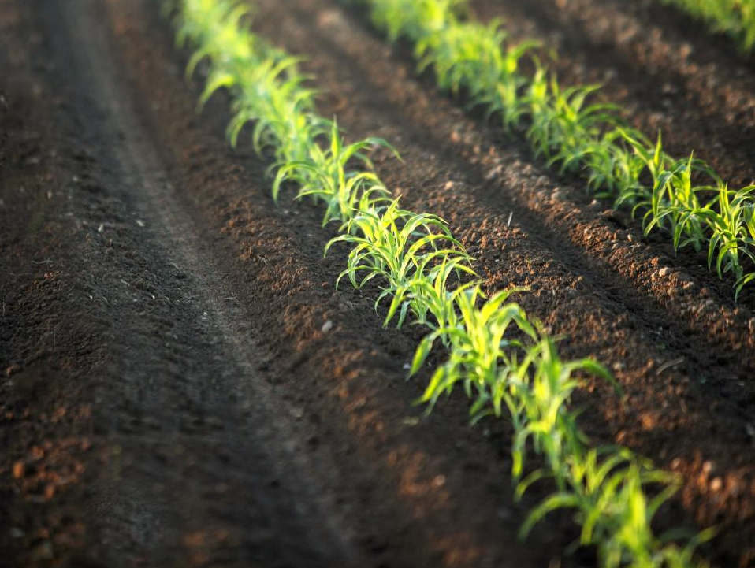
Farmers, consumers, the economy and our environment all positively benefit from GMOs
Producing More, With Less
Improved Farm Incomes
New Opportunities for Farmers in Developing Countries
Affordable Food
Fewer Chemical Applications
A Future of Healthier and More Nutritious Food
Improving Water Quality

Slide 4








ASTA joins many other organizations in confirming that biotech crops are safe for people, animals and the environment.

Slide 5
Specifically, ASTA supports finding a national solution to the current patchwork of state labeling regulations.
Uniform Rules
  ASTA supports the Safe and Accurate Food Labeling Act sponsored by Rep. Mike Pompeo (R-KS) which would establish a uniform, national system governing labeling of biotech foods
National Certification Program
  Allow those that wish to label their products as GMO-Free can do so through a USDA-accredited certification process
Science Based Labeling Standards
  Uphold the FDA’s authority to specify special labeling if it believes it is necessary to protect health and safety
  Develop a Federal definition of ‘natural’
According to recent studies, consumer grocery costs could rise by $500 annually due to patchwork legislation

Slide 6
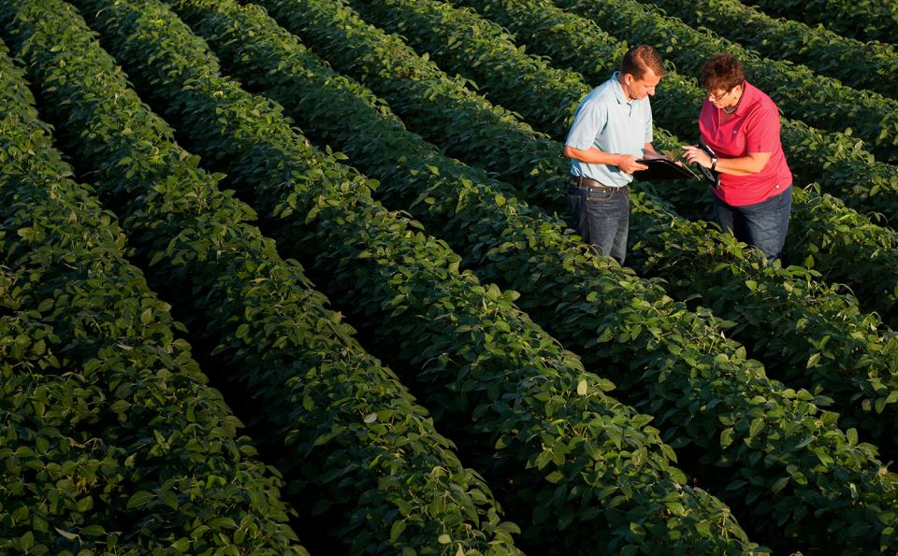
Learn More
www.geneticliteracyproject.org
www.gmoanswers.com
www.biofortified.org

