Slide 1
Guide to Seed Treatment Stewardship
Relaunch:
Repackaging information
Co-Messaging
Graphic Social Push
http://seed-treatment-guide.com/
Notes:
Relaunch gained traction:
http://ncga.com/news-and-resources/news-stories/article/2017/04/five-steps-help-properly-steward-treated-seed
http://www.westernfarmpress.com/seed-treatment/5-steps-treated-seed-stewardship
http://seedworld.com/asta-reminds-treated-seed-stewardship/

Slide 2
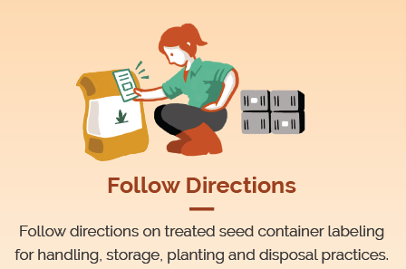
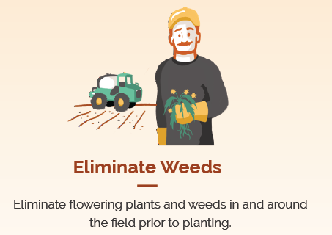
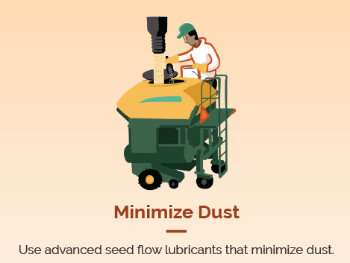
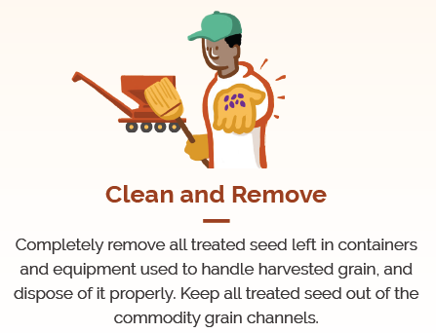
Seed Treatment Stewardship
Follow the Basic 5: Farmer applicator graphics
Social Media Hashtag
#Plant17
Public Service Announcements
Notes:
PSA
Press Release

Slide 3
Planter Demo Day
ASTA, Association of Equipment Manufacturers, National Corn Growers Association
More than three dozen officials from the USDA and EPA’s Office of Pesticide Programs
Hands-on presentations and product demonstrations, including:
seed treatments
planting practices
equipment innovations
Focus on link between innovation and sustainability

Slide 4
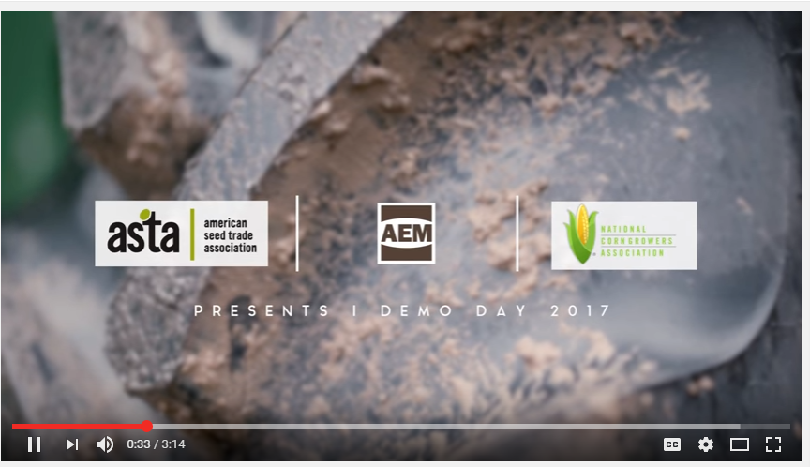
Planter Demo Day –Social Media
YouTube Video

Slide 5
Seed Treatment Communications
Develop proactive communications
Rapid response for studies and news items
Distribute talking points and FAQ’s

