Slide 1
ASTA
Jan. 31, 2017
Mary C. Hartney
Florida Fertilizer &
Agrichemical Association

Slide 2
www.1000friendsofflorida.org/florida2070

Slide 3
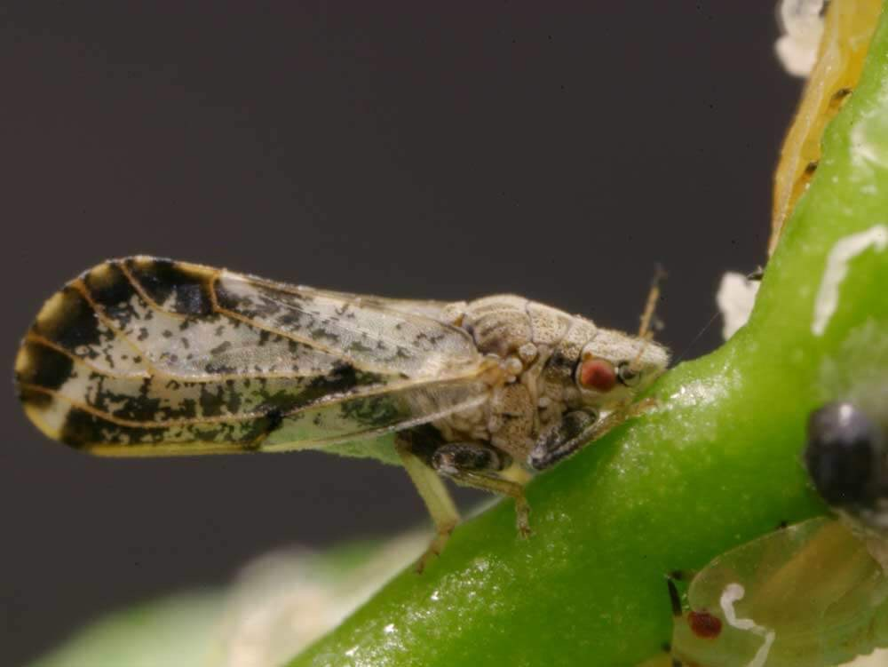
Asian Citrus Psyllid

Slide 4
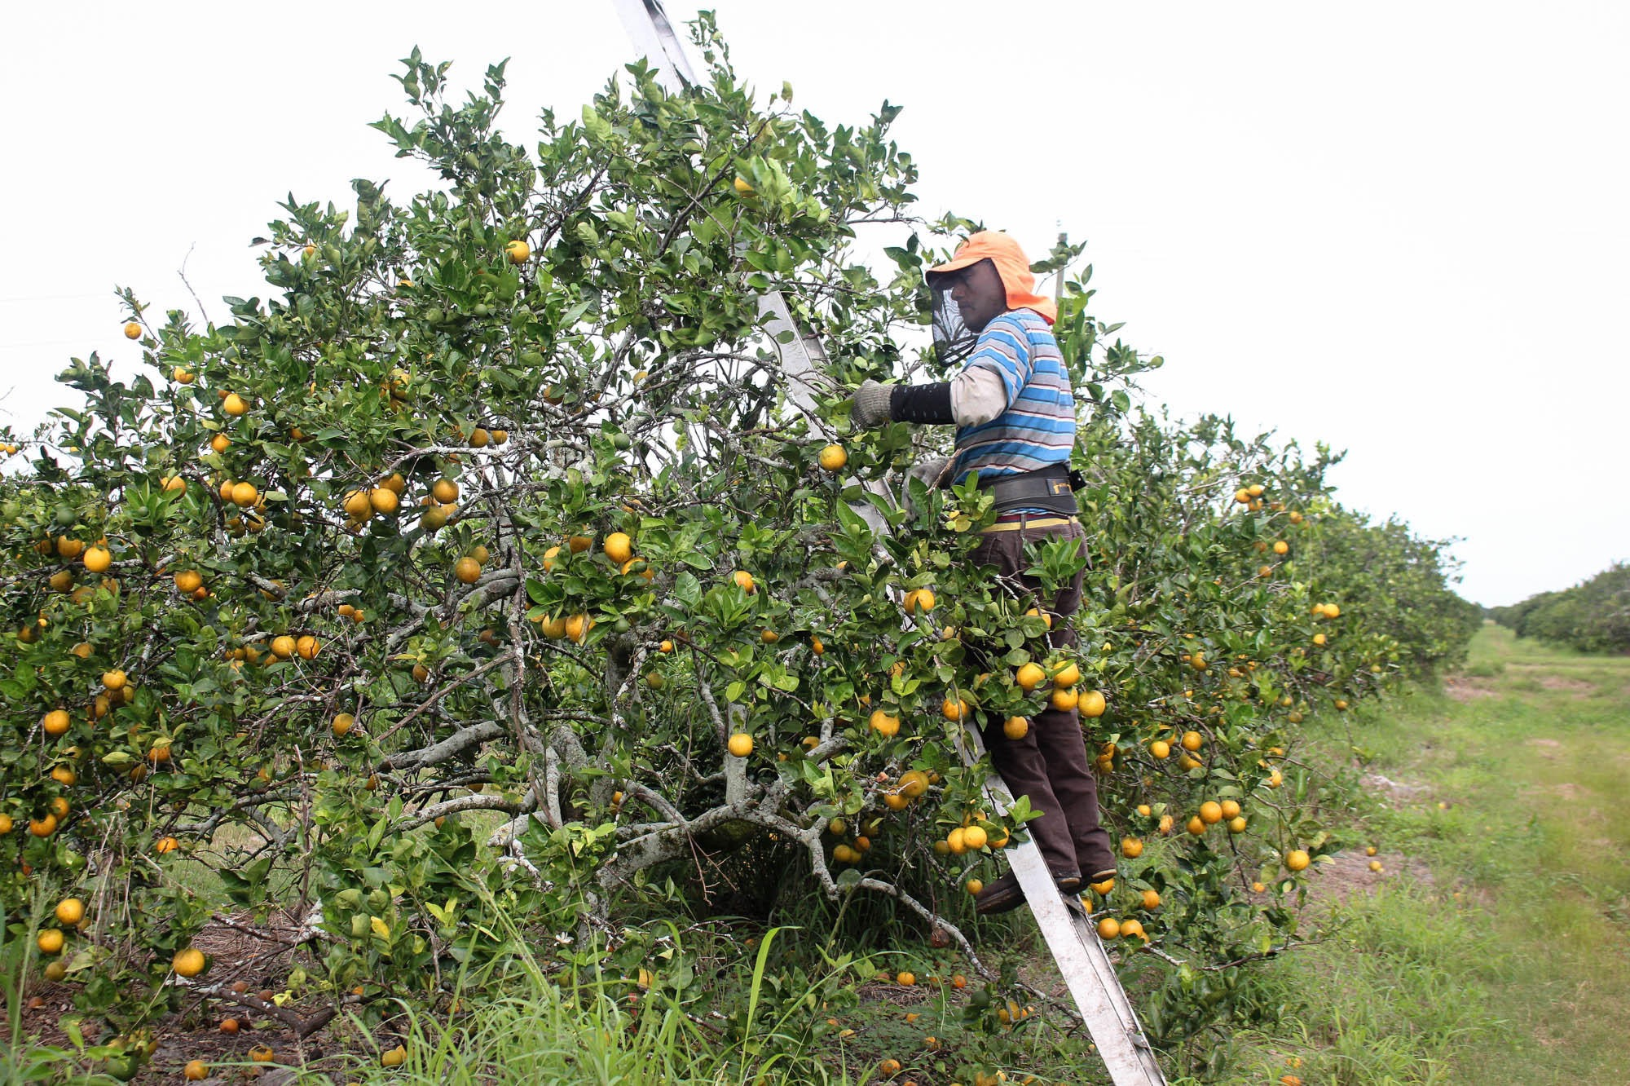
Harvesting oranges near Arcadia, Fla. The sacks that workers carry weigh about 90 pounds when they are full of fruit. DAN CHARLES/NPR

Slide 5
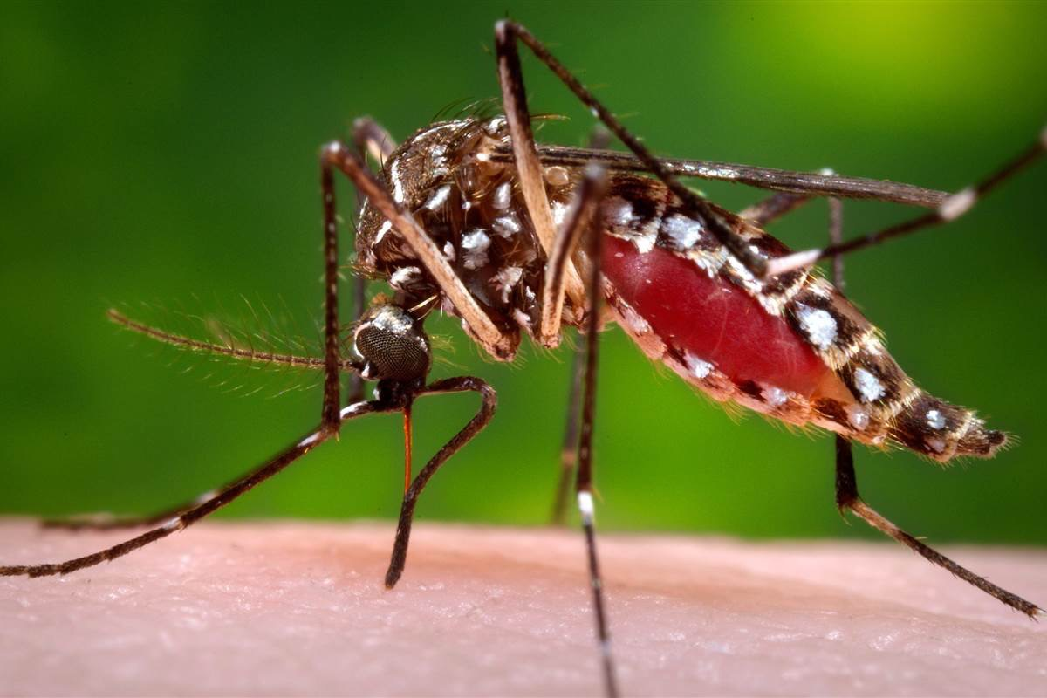
Aedes Aegypti

Slide 6
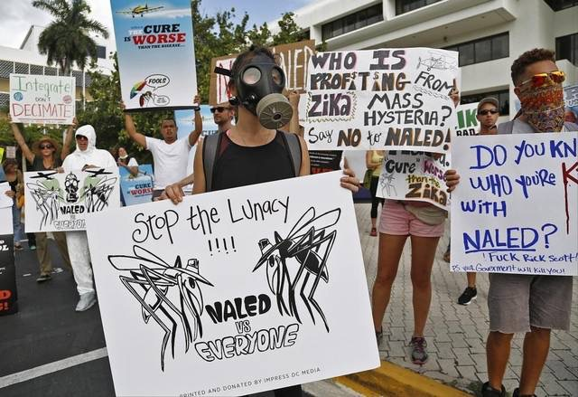
Protestors outside Miami Beach City Hall respond to county decision to start aerial spraying of insecticide to reduce the number of Zika-carrying mosquitoes on the island. CARL JUSTE cjuste@miamiherald.com 9/28/2016

Slide 7
Protestors outside Miami Beach City Hall respond to county decision to start aerial spraying of insecticide to reduce the number of Zika-carrying mosquitoes on the island. CARL JUSTE cjuste@miamiherald.com
Water full of algae laps on the St. Lucie River shore near an Ocean Boulevard bridge Monday in Sewall’s Point. (Richard Grauluch / Palm Beach Post) 6/29/2016

Slide 8
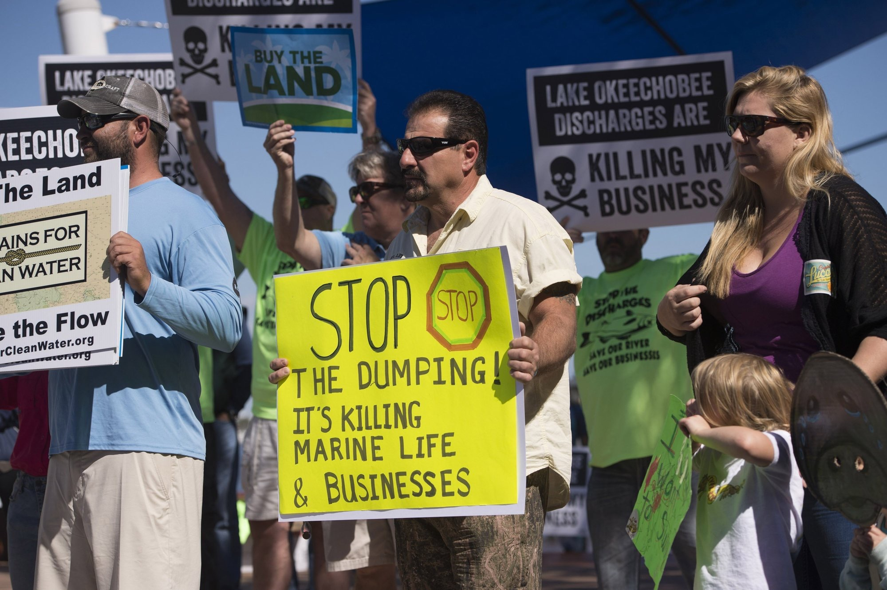
Protestors outside Miami Beach City Hall respond to county decision to start aerial spraying of insecticide to reduce the number of Zika-carrying mosquitoes on the island. CARL JUSTE cjuste@miamiherald.com

Slide 9
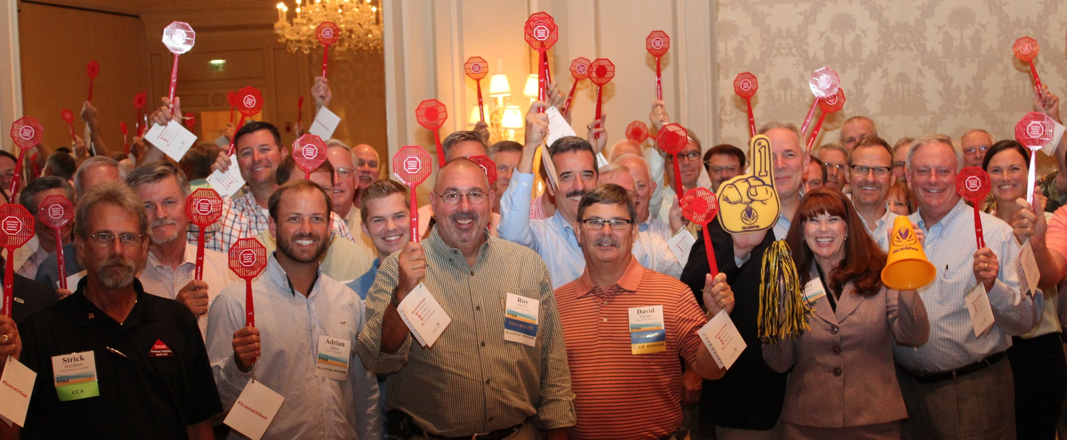
Ag Loud, Ag Proud!

