Slide 1
ASTA Annual Meeting June 2016
Foundation for Food
and Agriculture Research

Slide 2
Overview
Intro to FFAR
Current Programs
Opportunities for Collaboration
Q&A

Slide 3
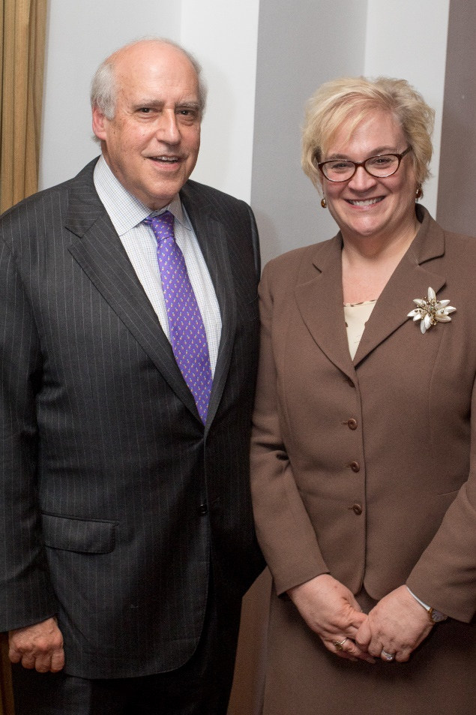
Who We Are
Independent 501 (c) (3) organization
20-Member Board of Directors
Chaired by former Secretary of Agriculture Dan Glickman
Established by the 2014 Farm Bill with $200M to increase food and agriculture research and complement and further the work of the USDA

Slide 4
History of FFAR
Created in the 2014 Farm Bill
$200M investment and obligation to match
Governed by a Board of Directors, advised by expert Councils
Tasked with complementing USDA research

Slide 5
Who We Are - Board
5 Ex oficio Members
Thomas Vilsack Secretary of Agriculture
Dr. France Córdova, Chair, National Science Foundation
Dr. Catherine Woteki, Chief Scientist and Under Secretary for Research, Education and Economics, USDA
Dr. Sonny Ramaswamy, NIFA Director, USDA
Dr. Chavonda Jacobs-Young, AFRI Administrator, USDA

Slide 6
Who We Are - Board
14 Voting Members
Dr. Kathryn J. Boor, Cornell University
Dr. Doug Buhler, Michigan State University
Dr. Nancy Creamer, North Carolina State University
Dr. Deborah Delmer, University of California Davis
Hon. Dan Glickman, Chairman of the Board, Aspen Institute
Dr. Rob Horsch, Bill and Melinda Gates Foundation
Ms. Pamela Johnson, National Corn Growers Association
Dr. Mark Keenum, Mississippi State University
Dr. Michael Ladisch, Purdue University
Dr. Christopher Mallett, Cargill Inc.
Dr. Terry F. McElwain, Washington State University
Dr. Stanley Prusiner, University of California - San Francisco
Dr. Yehia “Mo” Saif, Ohio State University
Dr. Barbara Schaal, Washington State University
Dr. Alton Thompson, University of Maryland, Eastern Shore

Slide 7
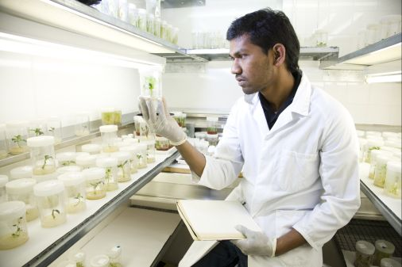
How We Work
Fund cutting-edge research and development through grants and challenges
Build unique public-private partnerships
Work in the pre-competitive space
Convene stakeholders and thought leaders to foster collaboration
Build human capacity to advance innovation
Utilize social, physical, and biological sciences to answer research questions

Slide 8
Partnership
Public-private partnership is a key part of FFAR’s operating model
Precompetitive space
All projects require matching funds from a non-Federal partner; FFAR's ability to leverage and multiply dollars sets the foundation apart
Charged with complementing and furthering USDA-funded efforts

Slide 9
Public-Private Partnership Incentives
Private sector incentives:
Corporate social responsibility
More rapidly develop products where there are common obstacles to advancement
Cost savings
Get direct access to important fundamental research
Access to academic expertise and excellence
Bring in students and trainees
Public Sector incentives:
Address real world problems
Generate research that is transferred quickly to the economy
Get access to resources and data otherwise unattainable
Access to excellent scientists

Slide 10
Pre-competitive Space
Area of research where outcomes offer no particular advantage relative to peers and where there is potential to positively impact all parties equally. Allows resources and data to be readily shared.

Slide 11
Research Target Areas
More Productive,
Sustainable Agriculture
Better Health Through Food
Transforming Soil Health
Optimizing Agricultural Water Use
Enhancing sustainable farm animal resilience, productivity and health
Improving Plant Efficiency
Achieving a deeper understanding of nutrition and healthy food choices
Managing food production systems to enhance human nutritional outcomes
Spurring food system innovation

Slide 12
Advisory Councils
FFAR issued a public call for leading scientists or stakeholders to serve on inaugural Advisory Councils, covering seven research areas.
Duties (primarily virtual):
Make programmatic recommendations.
Identify emerging issues of interest.
Review applications pending in respective topic areas.
Identify potential partners with whom the Foundation might work.
Members to begin 3-year terms: Spring 2016.
Notes:
(There is a slide of 7 target areas at the end of the presentation)
1 nominee per area per organization
Also looking for an excellent soil health scientist and development director.

Slide 13
Sample of Current FFAR Programming

Slide 14
New Innovator Award
Unmet Need: Support and spotlight the next generation of scientists pursuing innovative research in food and ag.
Total of $600,000/ 3 years, including match
Awardees will be announced in Fall 2016.

Slide 15
National Prize for Food and Agriculture Science
Prestigious recognition through the National Academy of Sciences and $100,000 prize for mid-career scientists in food and agriculture

Slide 16
Rapid Outcomes from Agricultural Research
Unmet need: Rapid deployment of funds for R&D and extension in the event of sudden and unanticipated threats caused by agricultural pests and pathogens
Criteria: Acute, national/regional, tangible outcomes
In partnership with commodity consortia.
Expected to launch in Fall 2016.

Slide 17
Convening Events
Events on the Horizon
Phytobiome: July 29th, Tampa, Florida
They phytobiome consists of all organisms associated with plants, from insect pests to leaf surface bacteria. Advances in technology to characterize the plant microbiome offer new opportunities to understand the role of the phytobiome in productivity.
Event will scope objectives, budgets and timelines for a phytobiome funding opportunity in pre-competitive space.
FFAR convening events bring together diverse, key stakeholders around emerging issues in food and agriculture research to identify critically important research that help guide FFAR investment decisions. Stakeholders include participants from academia, private, public and nongovernmental sectors along with end users who will benefit from the research.
Phenotyping: August 30-31st, Purdue University
High throughput phenotyping has the potential to accelerate plant breeding.
Event will explore opportunities for a phenotyping network in the Americas and funding of associated programs.

Slide 18
FFAR Programming in Development

Slide 19
Public Perception of New Breeding Technologies
If we are going to fund research in NBT’s, how do we not walk the same road that we did with transgenics?
Social science research into public understanding of breeding technologies.
Development of framing and metaphors to clearly communicate around NBT’s.
Training opportunities for agricultural industry.

Slide 20
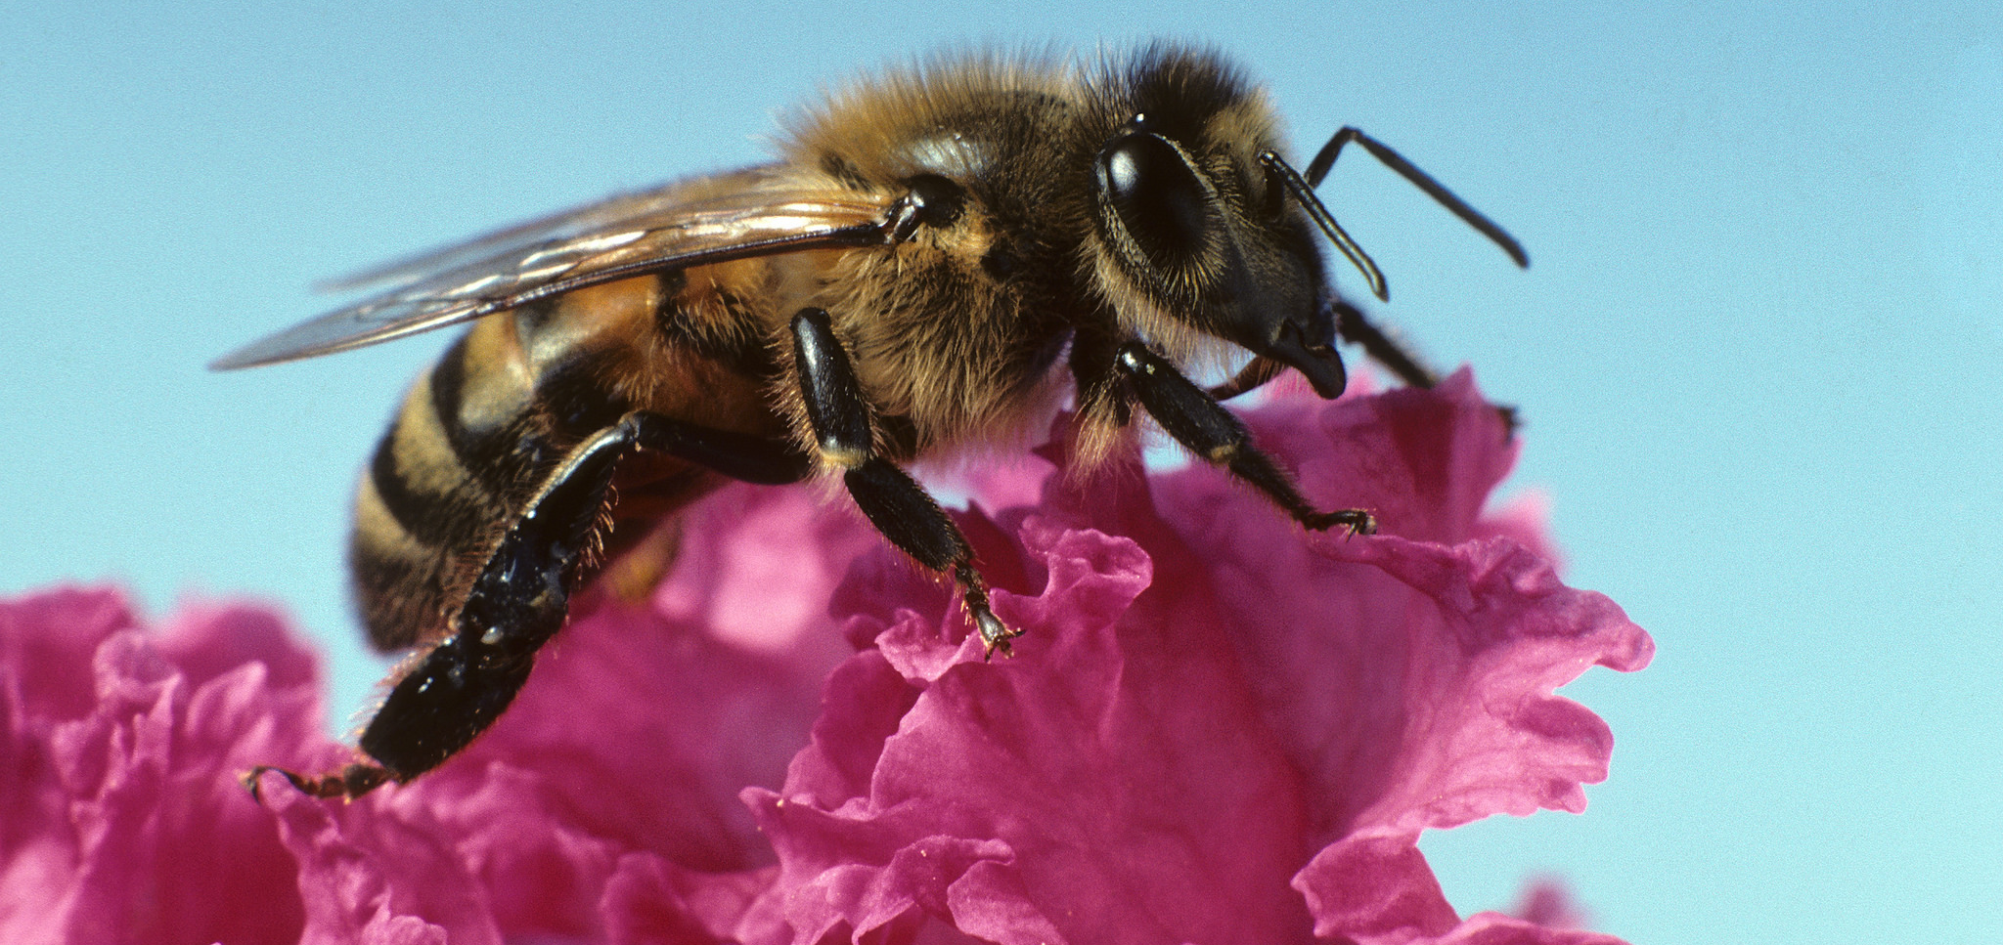
Pollinator Health Fund
A program founded in practice and partnership:
Program proposal based on feedback from researchers, stakeholders, and policy implementers.
Grounded in social, economic and policy realities
Addresses clear gaps in ongoing USDA and NSF-funded research.

Slide 21
$20,000,000 Funding Goal
Program Focus Areas
Understanding multiple stressors.
Habitat quality, establishment, maintenance.
Technology transfer to field-scale operations.
Outreach and education to underserved groups.

Slide 22
On The Horizon
Continued conversations and consultation with key stakeholders in the food and agriculture community.
Identify future programs that align with our mission.
Fundraise to support current and future programs.

Slide 23
How to reach out
Contact us directly.
Submit a concept through the FFAR website.

Slide 24
How to Reach Us
Dr. Tawny Mata, Scientific Program Director, tmata@foundationfar.org, 202.836.9957
Renée Bullion, Director of Development, rbullion@foundaitonfar.org, 202.836.9955

