Slide 1
Introducing
The Soil Health Institute
C. Wayne Honeycutt, Ph.D.
President and CEO

Slide 2
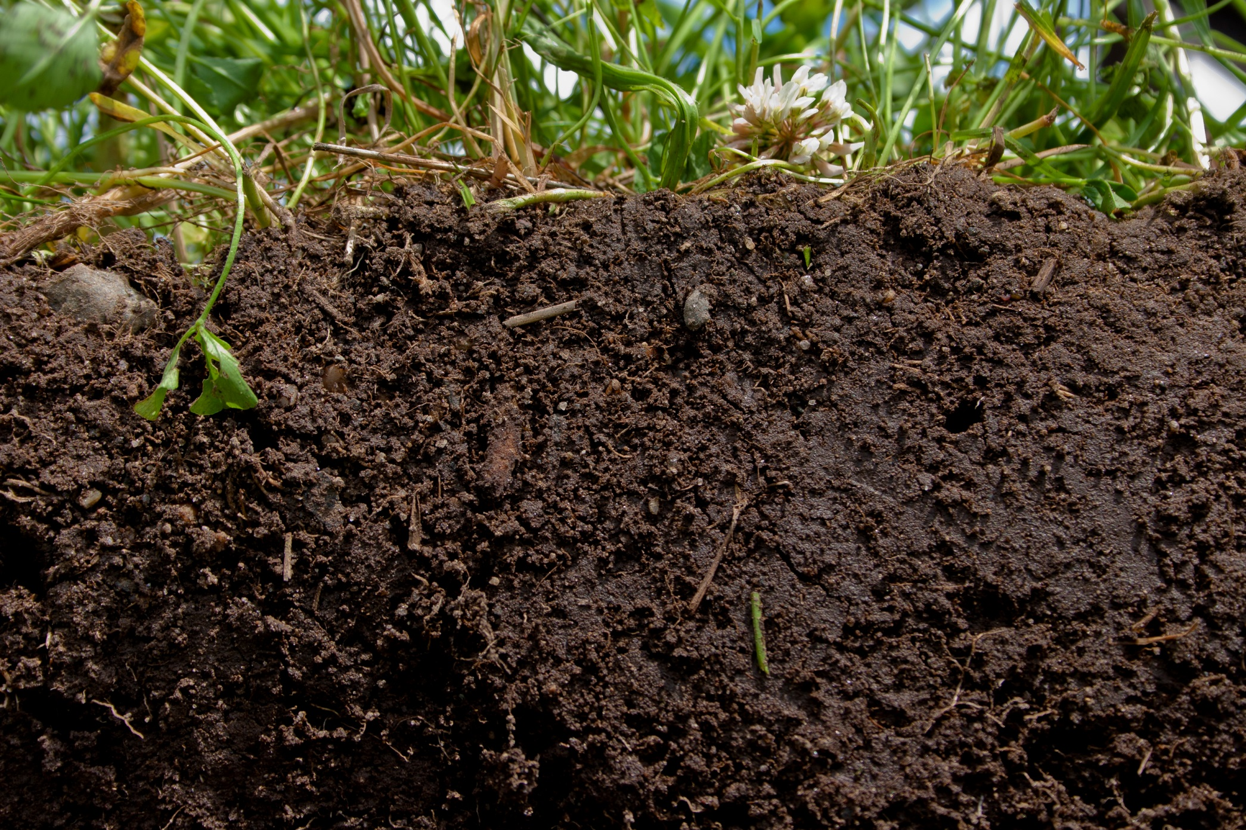
SOIL HEALTH:
The capacity of a soil to function as a vital, living ecosystem that sustains plants, animals, and humans.

Slide 3
The Imperatives

Slide 4
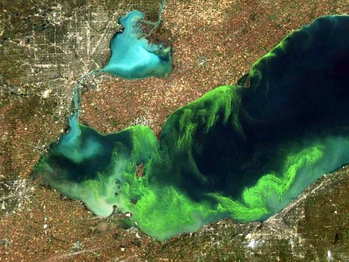
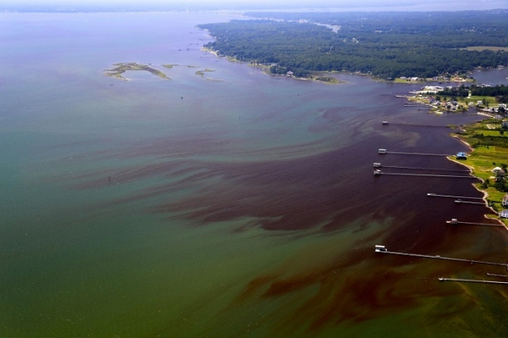
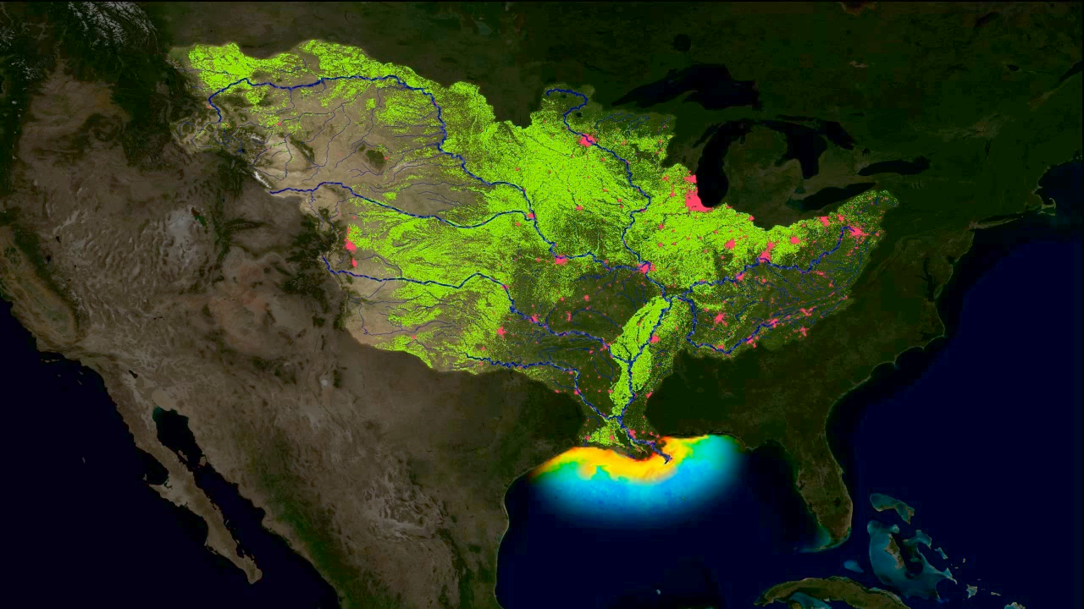

Slide 5
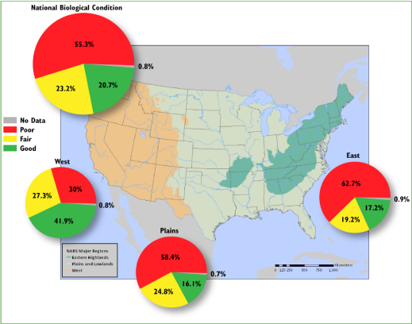
National Rivers & Streams Assessment
Biological condition:
Poor - 55.3%
Fair – 23.3%
Good – 20.7%
Unknown – 0.8%
Greatest stressors:
Phosphorous
Nitrogen
Riparian cover and
disturbance
Streambed sediment
Enterococci
Source: USEPA (2016)

Slide 6
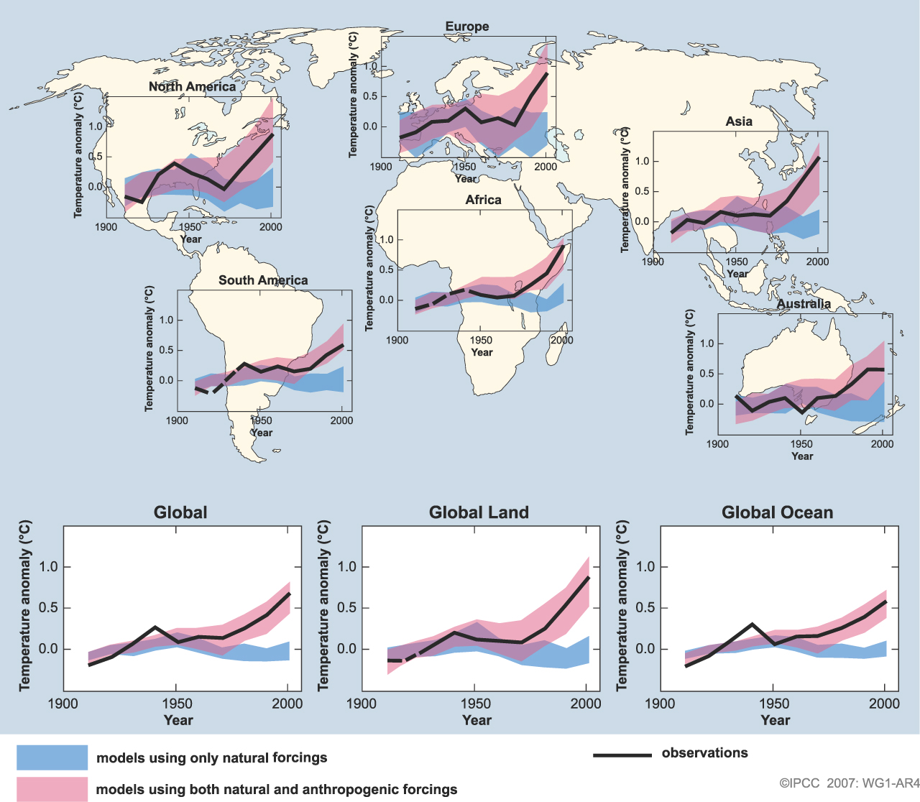
IPCC 2007 WG1-AR4
Notes:
----------
Image source:
Map of graphs showing model results by region is Fig. SPM.4 from page#11 of IPCC 2007 WG1-AR4 Summary for Policymakers.
http://www.ipcc.ch/pdf/assessment-report/ar4/wg1/ar4-wg1-spm.pdf
Caption:
Comparison of observed continental- and global-scale changes in surface temperature with results simulated by climate models using natural and anthropogenic forcings. Decadal averages of observations are shown for the period 1906 to 2005 (black line) plotted against the centre of the decade and relative to the corresponding average for 1901–1950. Lines are dashed where spatial coverage is less than 50%. Blue shaded bands show the 5–95% range for 19 simulations from five climate models using only the natural
forcings due to solar activity and volcanoes. Red shaded bands show the 5–95% range for 58 simulations from 14 climate models using both natural and anthropogenic forcings

Slide 7
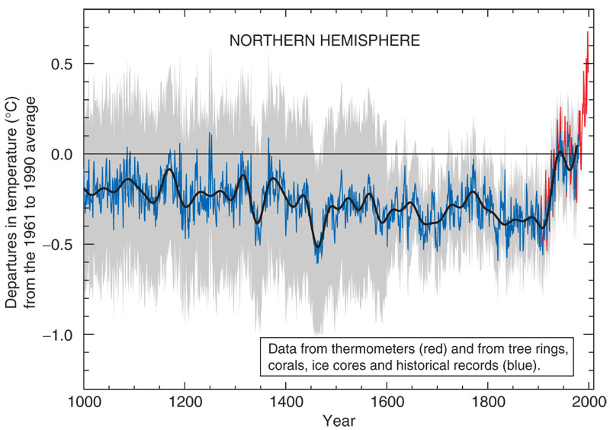
(10°F)
Increasing Temperature
(7°F)
(4°F)
Adapted from Hayhoe 2011

Slide 8
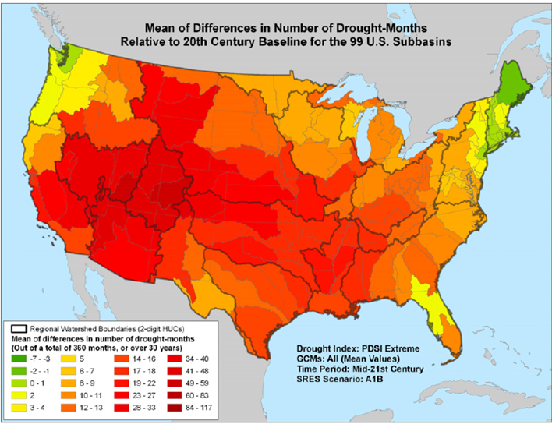
Strzepek et al., 2010

Slide 9
The Opportunities

Slide 10
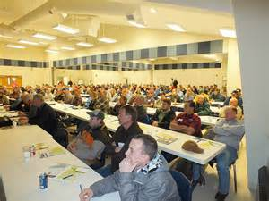
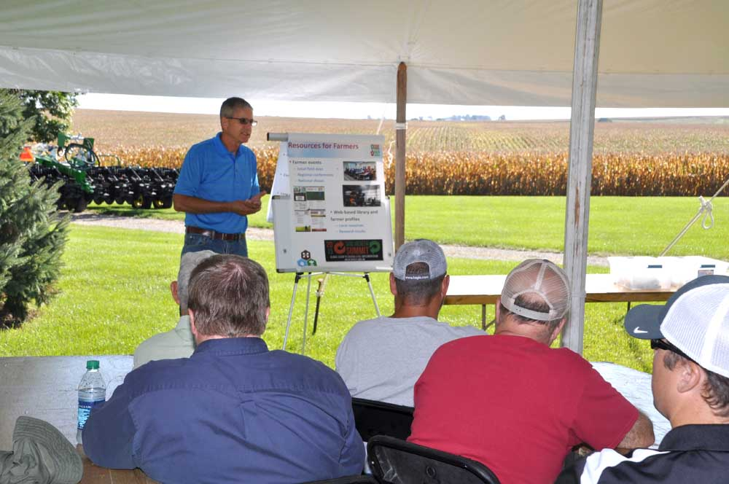
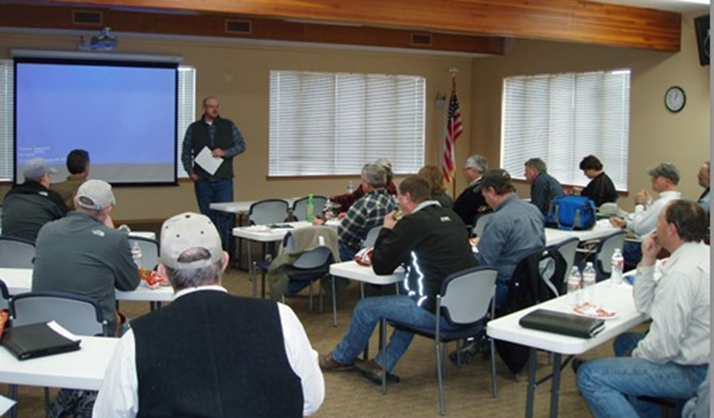
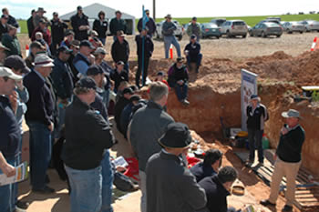

Slide 11
SAND
FC
Available Water Holding Capacity
WATER (% by Volume)
PWP
Adapted from Hudson (1994)
ORGANIC CARBON (% by Weight)

Slide 12
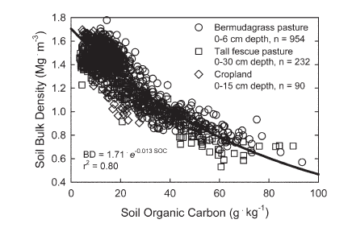
Georgia studies – Typic Kanhapludults.
Franzluebbers (2010) SSSAJ 74:347–357

Slide 13
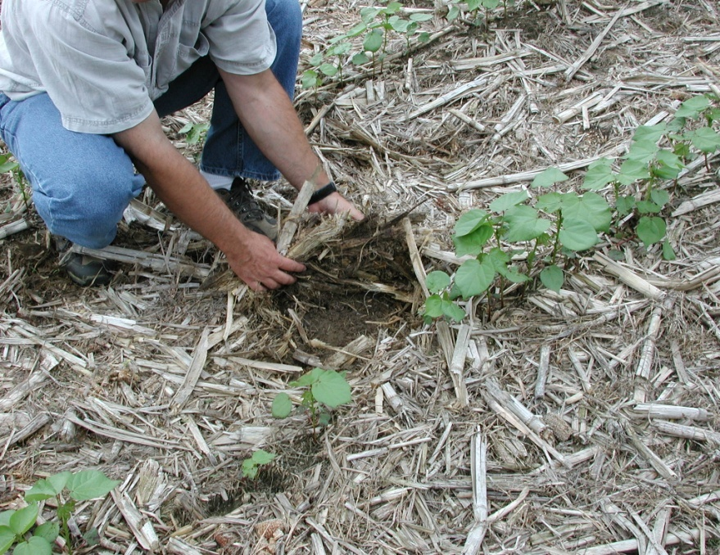
Key Soil Health Practice: No-Till

Slide 14
Soil Organic C (Mg/ha)
State | Years | Conventional Tillage | No Tillage
IA | 15 | 60.3 | 71.1
IL | 6 | 45.4 | 51.3
IN | 11 | 60.0 | 73.0
KY | 5 | 45.9 | 52.8

Slide 15
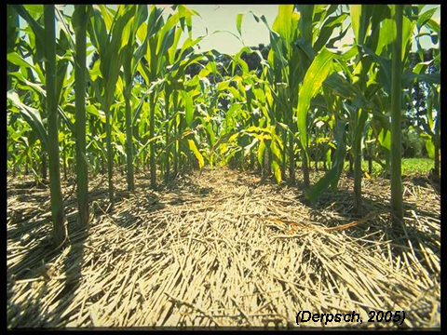
Key Soil Health Practice: Cover Crops

Slide 16
2012 Corn Yield Drought States
USDA-SARE, CTIC Survey
Notes:
They found that using cover crops increased yield by about 11% for corn (and 14% for soybean, data not shown).

Slide 17
Tillage & Cover Crop Impacts On Water Infiltration Rate
Location | Years | Tillage & Crop | Impact on Infiltration Rate | Reference
KS | 15 | NT Winter Wheat-Sorghum | 182% Increase with Cover Crop | Blanco-Canqui et al. (2011)
MD | 11 | NT Corn | 164-462% Increase with Cover Crop (different sites & years) | Steele et al. (2012)
KS | 11 | NT Wheat-Sorghum-Fallow | 132-194% Increase with No-Till | Stone and Schlegel (2010)
Malawi | 3 | NT Corn | 165% Increase in No-Till | TerAvest et al. (2015)

Slide 18
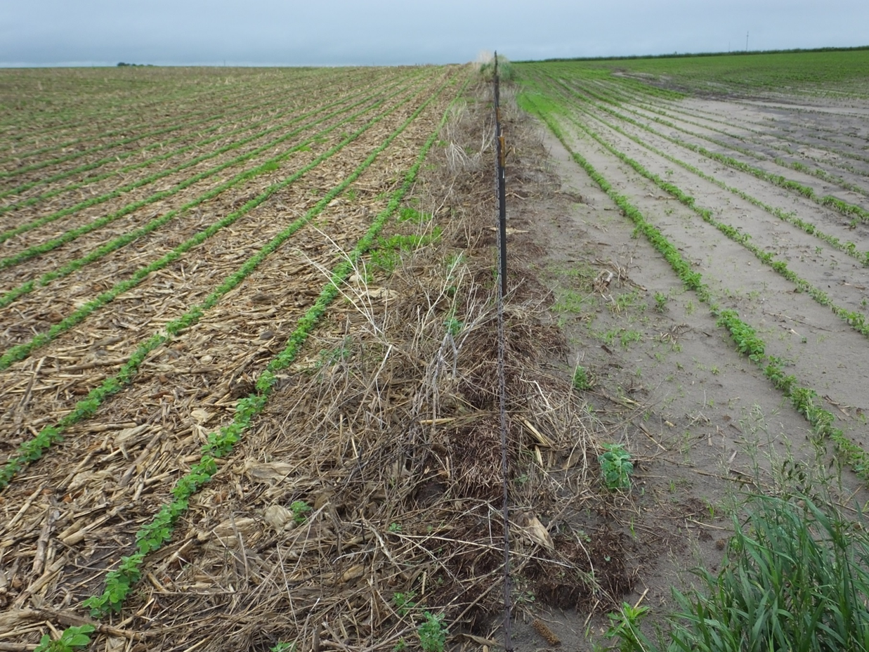
Infiltration – Brookings County, SD

Slide 19
Cover Crop Impacts on Nitrate Leaching
Location | Cover Crop | Reduction in Nitrate Leaching (%) | Reference
CA | Rye | 65-70 | Wyland et al. (1996)
DE | Rye | 30 | Ritter et al. (1998)
France | Ryegrass | 63 | Martinez and Guirard (1990)
IN | Winter Wheat (and reduced fertilizer) | 61 | Kladivko et al. (2004)
IA | Rye | 61 | Kaspar et al. (2007)
KY | Rye | 94 | McCracken et al. (1994)
KY | Hairy Vetch | 48 | McCracken et al. (1994)
MD | Rye | 77 | Staver and Brinsfield (1990)
MD | Rye | 80 | Staver and Brinsfield (1998)
MI | Rye | 28-68 | Rasse et al. (2000)
MN | Rye | 13 | Strock et al. (2004)

Slide 20
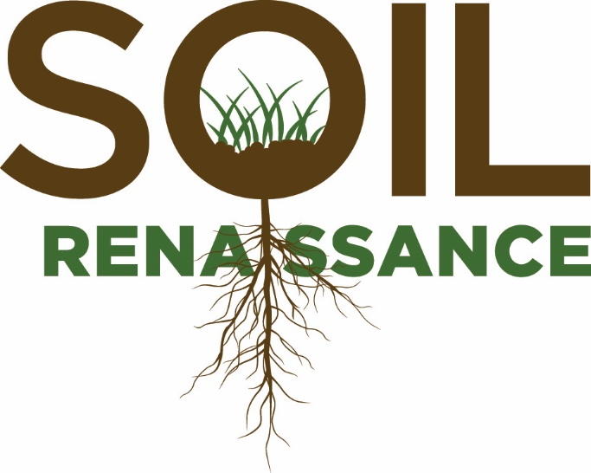
Initiated in 2013, Farm Foundation, NFP and the Noble Foundation initiated the Soil Renaissance to advance soil health and make soil health the cornerstone of land use management decisions.
$
RESEARCH
MEASUREMENT
ECONOMICS
EDUCATION
Convene the research community to advance soil health.
Incorporate soil health measures into standardized soil testing that is readily available, affordable, and commercially viable.
Quantify the effects of soil health on economic risks and returns.
Reawaken the public to the importance of soil health.

Slide 21
Mission
Safeguard and enhance the vitality and productivity of the soil through science-based research and advancement

Slide 22
Guiding Principles
Integrated Science Approach
Science-based
Partnership Driven
Inclusive and representative
Transparent and open sourced
Communications at all levels
Purposeful outcomes with measurable impacts
Continuing evaluation and improvement
Note: These guiding principles were developed by the Soil Renaissance strategic development committee and adopted by all working groups.

Slide 23
Governing Board
Board Chair
Soil Renaissance
(2)
Agricultural Producers
(8-10)
Professional Societies
(2)
Science and Technology
(5)
At Large
(4)
Noble
Foundation
Farm
Foundation
CLA
OFRF
ASTA
TFI
Policy
Independent Labs
NACD
Business/
Finance
President/CEO
Rodale
SWCS
Soil Science
19-21 voting members
1 non-voting, ex officio (President/CEO)
No compensation

Slide 24
Operational Structure
President/CEO
Admin
Chief Scientific Officer
Research
Communica-tions & Educ.
Economics
Policy
Development
Chief Operating Officer
Measure-ments & Standards
Location: RTP
Additional paid staff dependent on funding
Experts

Slide 25
Research
Identify gaps in soil health research
Priorities/solicitations determined by CSO (in consultation with the CEO) with External Science Advisors.
Construct research road maps
Current research is not consolidated nor in useful user form.
Soil health roadmap is a jigsaw puzzle of many pieces.
Rigorous protocol related to submission of proposals and assessment of outcomes
Research opportunities defined by continued Soil Renaissance convening hosted by the Soil Health Institute.

Slide 26
Soil Health Research Awards
Open Solicitations
Research and Educational Communities
Award Recipients
Awards and Funding
Progress Reports and Data
Research Opportunity
Announcements
Proposal Submission
Direct Solicitations
Awards and Funding
Scientific Review Panel(s)
Progress Reports and Data
External Science Advisors
Individuals from world-renowned organizations. Provide guidance and comment on progress and effectiveness of scientific programs.

Slide 27
Soil Health Institute Approach 1. Increase Adoption of SH Mgmt. Systems - Quantify impacts on profitability and economic risk. - Quantify SOC vs. AWHC relationships across soils, climates, cropping systems. Develop Decision Support System for producers. - Partner with boots on the ground organizations (NACD, LGU, NRCS, Agri- business, SH Partnership,…) for workshops, demonstration sites, field days, webinars,…

Slide 28
Soil Health Institute Approach 2. Target Adoption of SH Mgmt. Systems - Determine potential water quality improvements for given levels of SH mgmt. system adoption (modeling). - Ground-truth model predictions with Edge-of- Field monitoring (Discovery Farms, LTARs,…) - From above, identify priority sub-watersheds

Slide 29
Soil Health Institute Approach 3. Quantify Adoption and Impact - Assess current status of soil health in U.S. - Assess current status of soil health practice adoption in U.S. - Use above for establishing baseline for measuring future progress

Slide 30
Thank you
Notes:
Close by saying that I’m of the opinion that enhancing the health of our nation’s soils and indeed our world’s soils, is one of the most important endeavors of this and future generations. I believe it becomes increasingly important that we enhance soil health with each passing day that our world population grows, farmland is lost to development, GHG are emitted, water quality is degraded, soil is eroded, wildlife habitat is lost or fragmented, and farmers face more extreme weather challenges while trying to grow our food. At the SHI we are committed to obtaining and being a good steward of the resources needed to address these challenges.

Slide 31
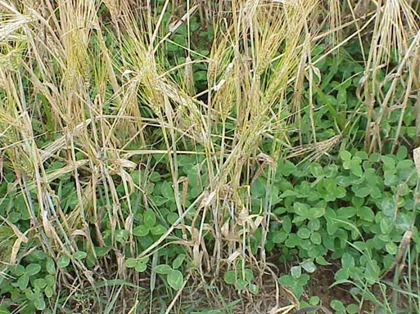

Slide 32
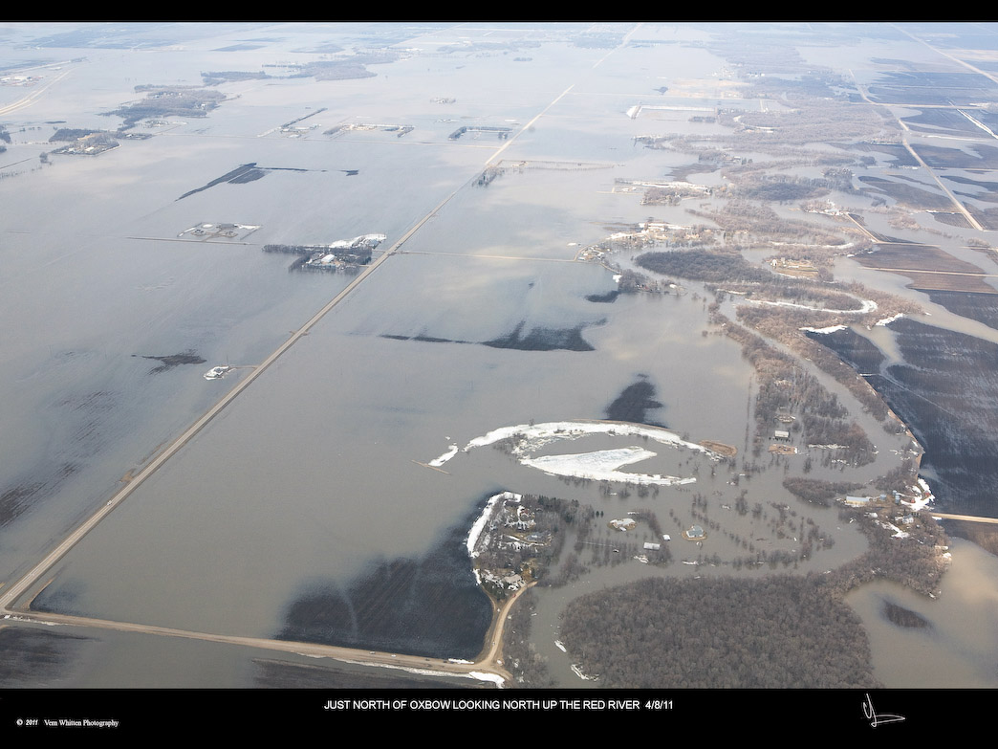

Slide 33
