Slide 1

  Module: GMO Presentation
  -Provides an update on current GMO messaging (consistent with GMOAnswers) and issues
  -Audiences: Members, industry allies and policy decision makers
  - Utility: Used in conjunction with core deck to address questions and explain ASTA’s position on the issues

Slide 2

ASTA supports GMOs and biotechnology as part of a wide array of potential tools at the disposal of plant breeders and farmers to address global challenges.
181M
90%
71
ACRES WORLDWIDE
ARE SMALL OR RESOURCE-LIMITED FARMERS
COUNTRIES GROW, IMPORT AND/OR USE BIOTECH
1.2B
18M
10
LBS OF REDUCED PESTICIDE APPLICATIONS
FARMERS IN 28 COUNTRIES
CROPS

Slide 3
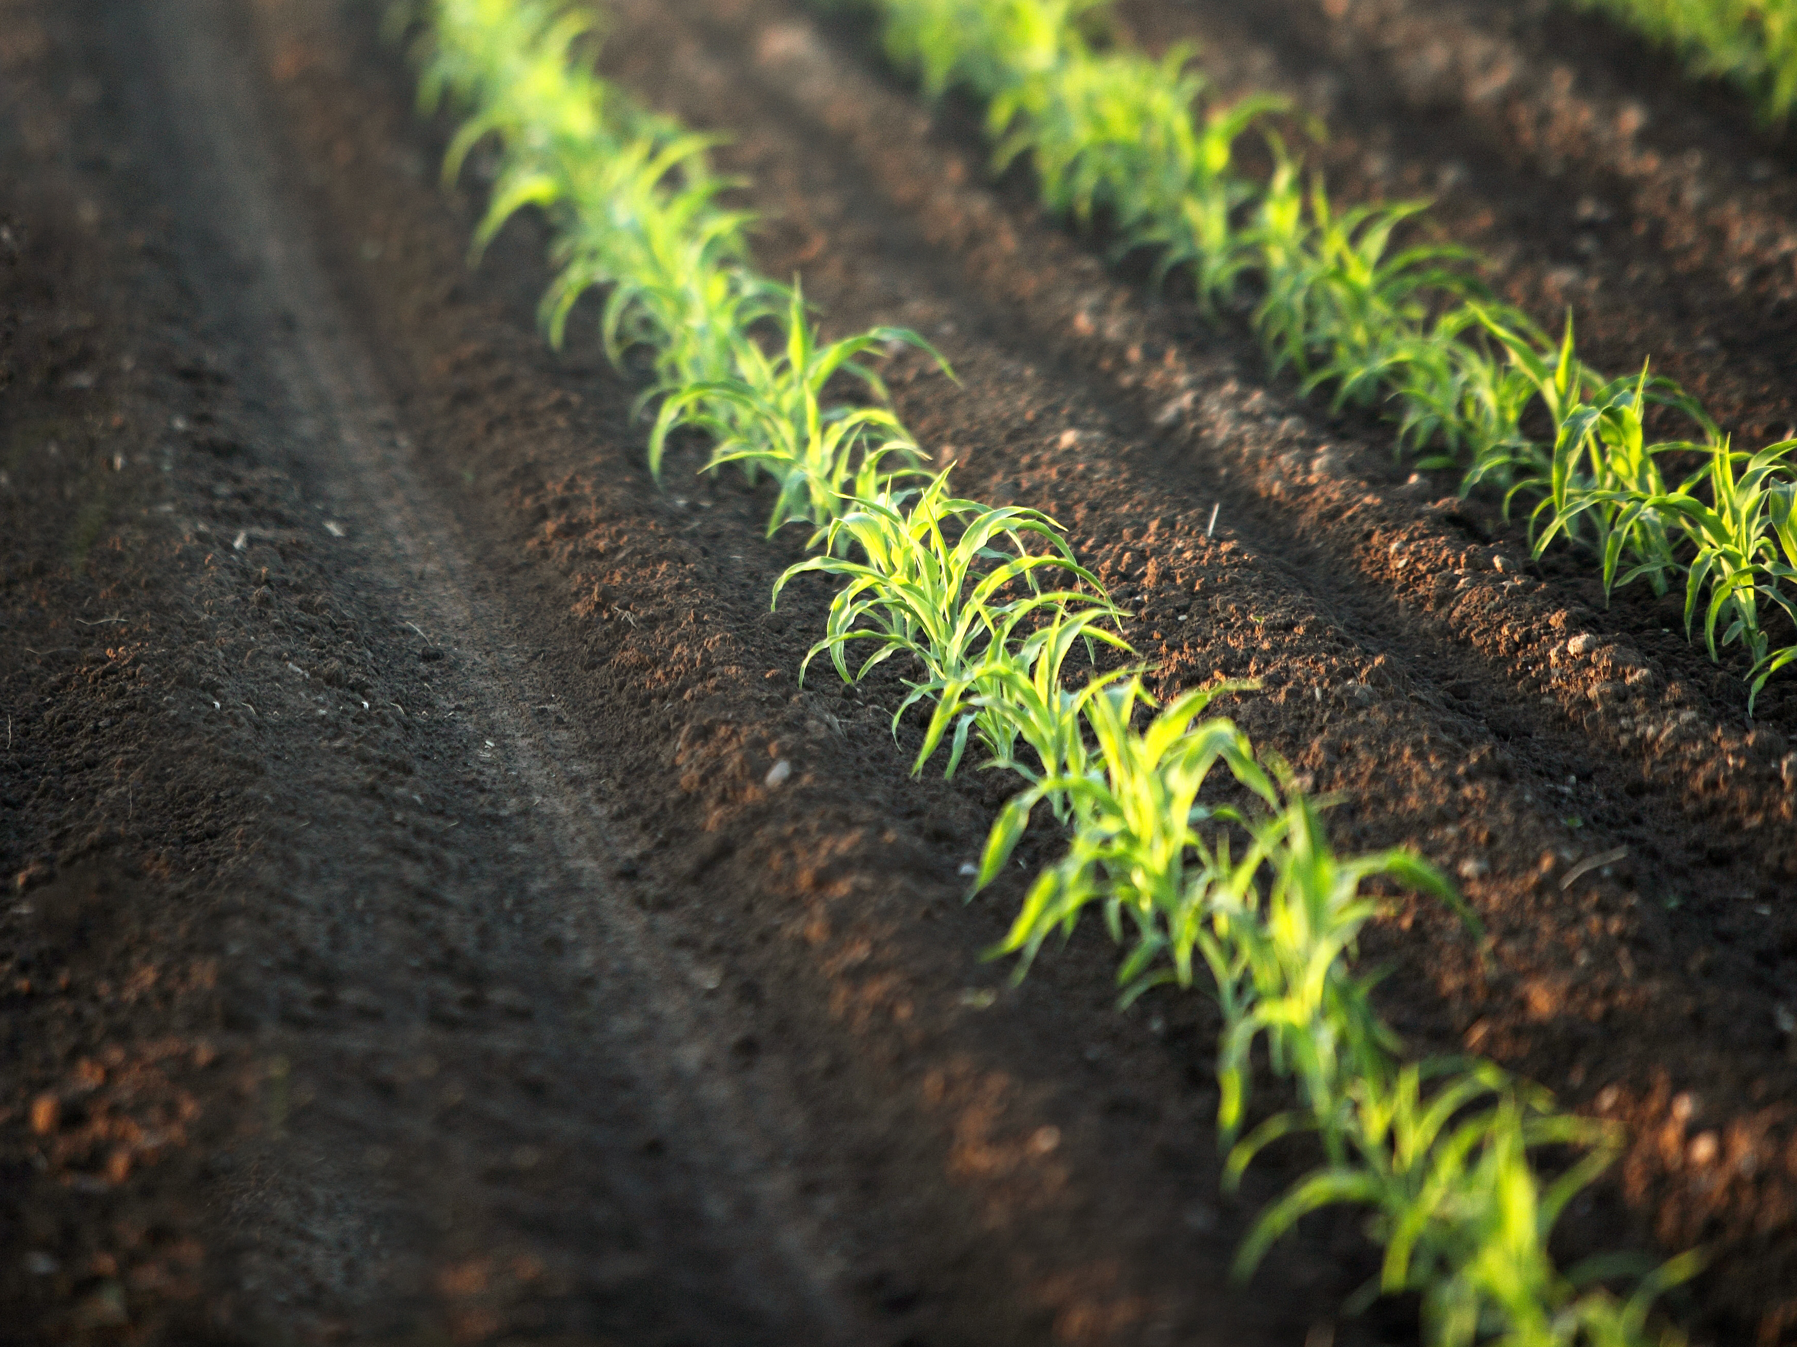
Farmers, consumers, the economy and our environment all positively benefit from GMOs
Producing More, With Less
Improved Farm Incomes
New Opportunities for Farmers in Developing Countries
Affordable Food
Fewer Chemical Applications
A Future of Healthier and More Nutritious Food
Improving Water Quality

Slide 4








ASTA joins many other organizations in confirming that biotech crops are safe for people, animals and the environment.

Slide 5
Specifically, ASTA supported national legislation to preempt a patchwork of costly state labeling regulations.
Uniform Rules
  ASTA recognizes that consumers want more information about their food.
  Supported the National Bioengineered Food Disclosure Standard which establishes a national system governing disclosure of biotech ingredients in food.
    Over the next two years USDA will develop rules on disclosure options for food companies that are truthful and not misleading
    Electronic link, on-pack symbol, on-pack words

Slide 6
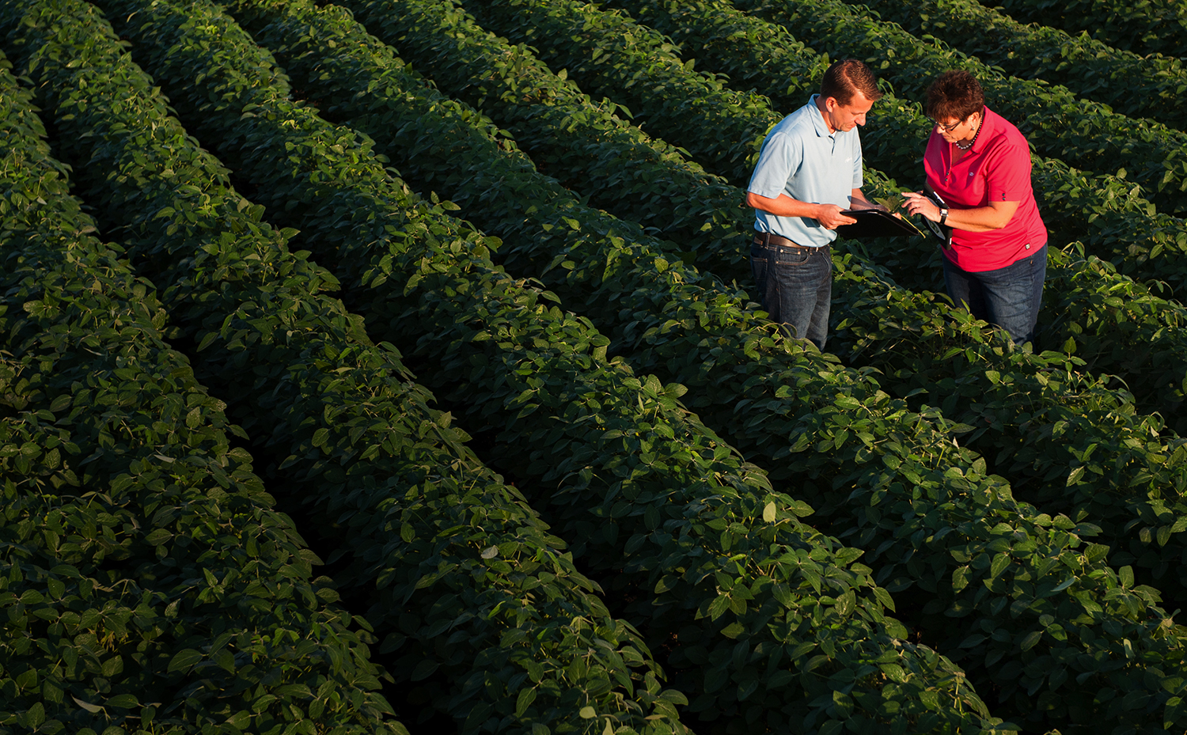
Learn More
www.geneticliteracyproject.org
www.gmoanswers.com
www.biofortified.org

