Slide 1
USDA-NRCS Plant Materials Program
Cover Crops for Soil Health Activities
Annie Young-Mathews, Plant Materials Center Manager
Corvallis, Oregon
American Seed Trade Association Convention
Portland, Oregon June 20, 2016

Slide 2
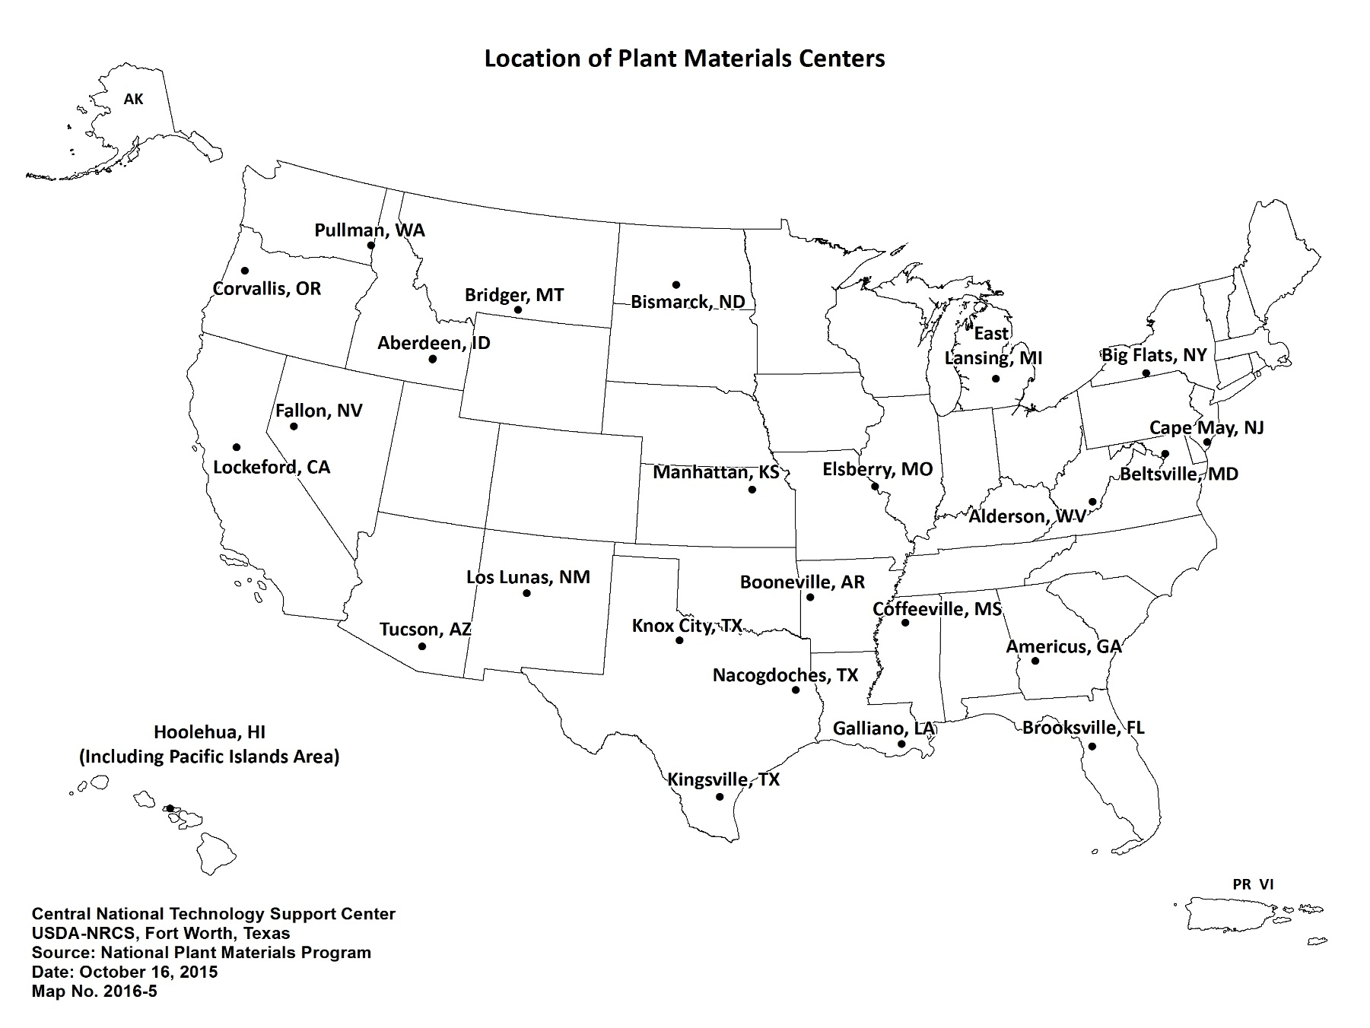
Locations of NRCS Plant Materials Centers

Slide 3
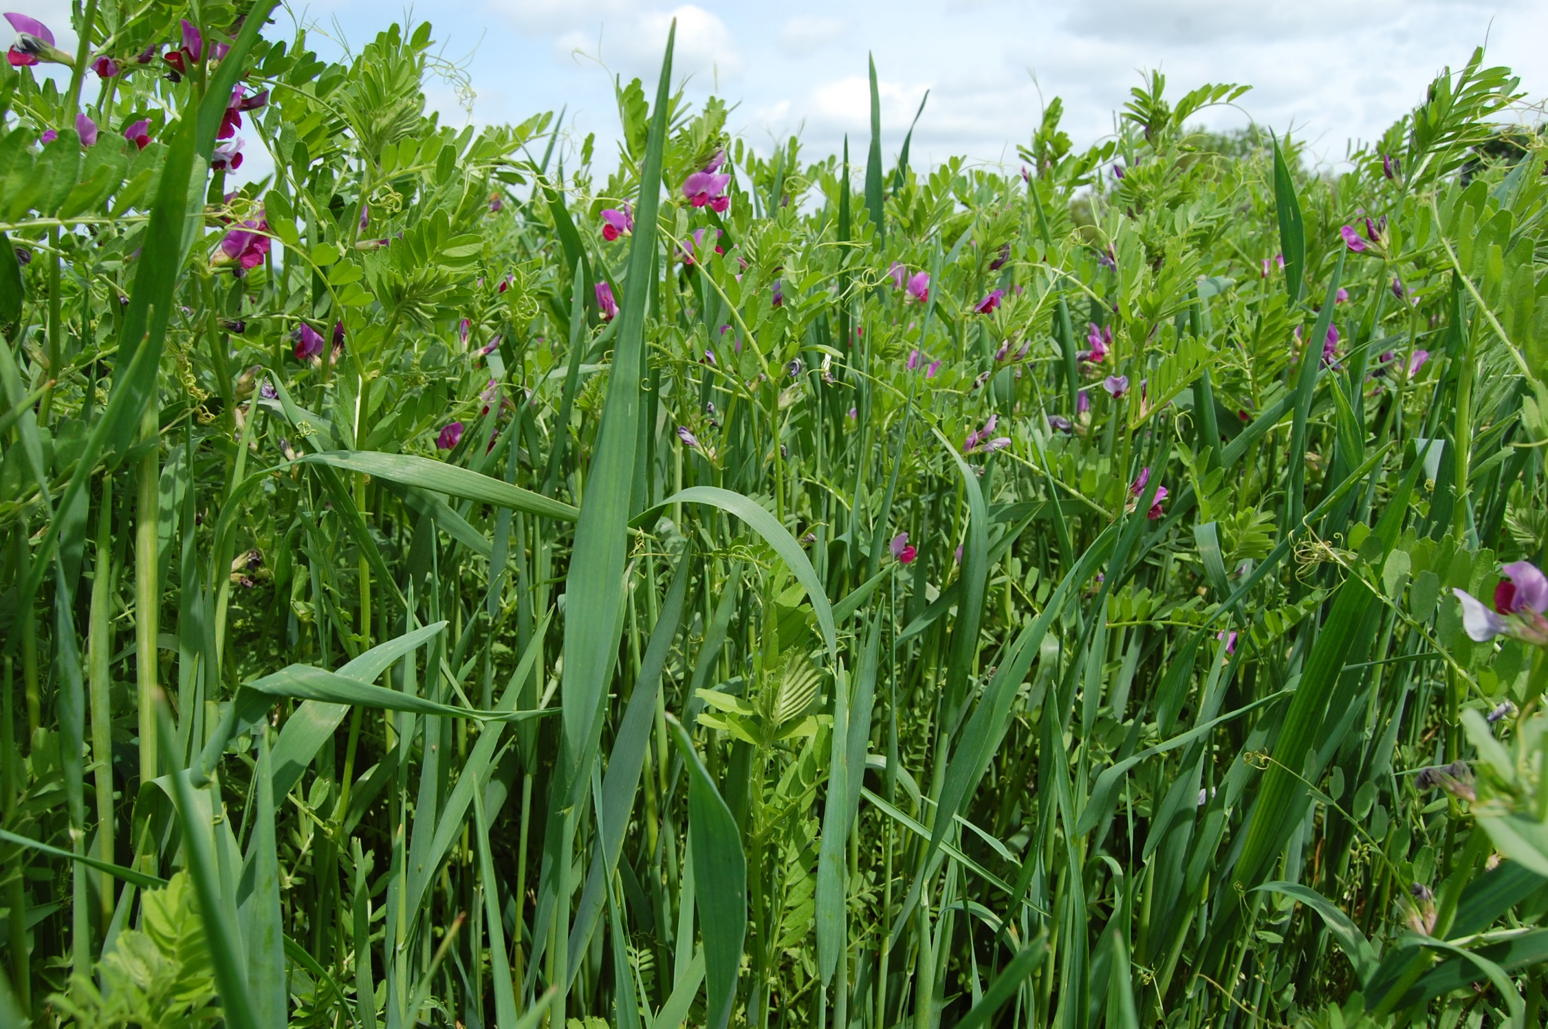
NRCS Soil Health Effort
Major outreach effort with farmers
Emphasis on cover crops
NRCS new Soil Health Division now staffed (16 specialists)
Plant Materials Center activities to support the effort

Slide 4
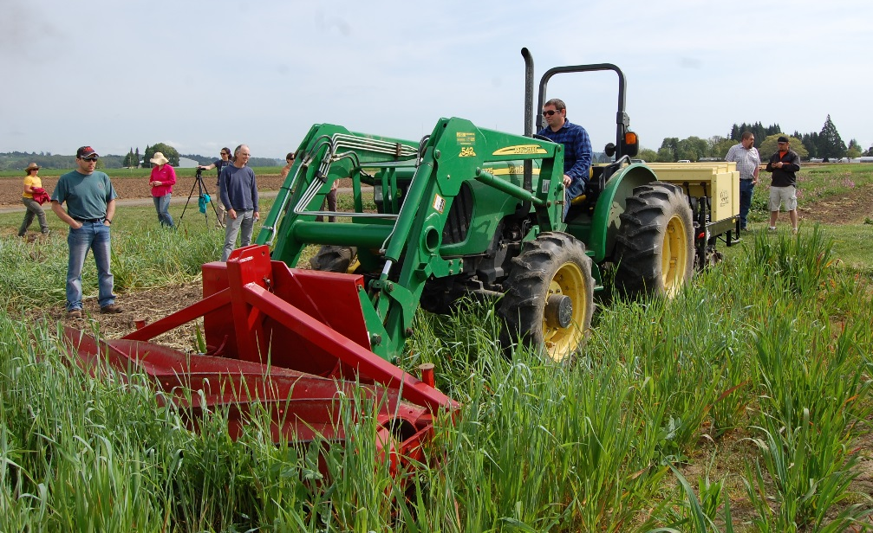
What is the plant materials program’s role in promoting cover crops?
Demonstration plantings (PMC and on-farm)
Technology development
Variety/cultivar adaptation trials
Training and workshops for NRCS and conservation districts
Technical notes, plant guides, standard and specifications, data to support conservation planning tools

Slide 5
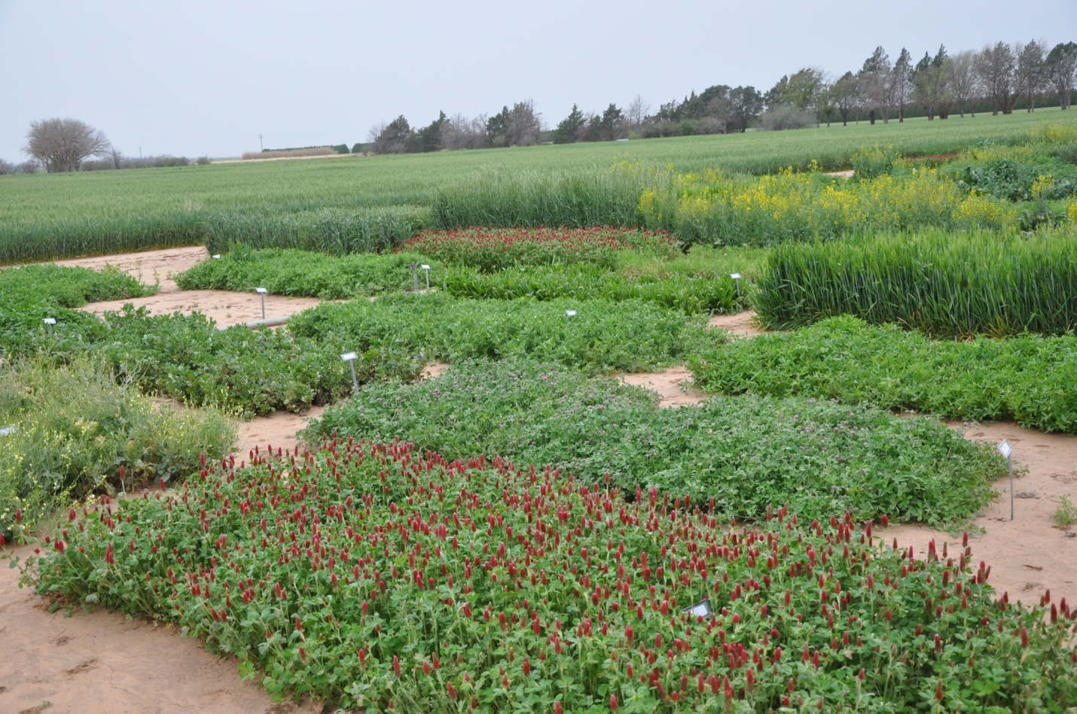
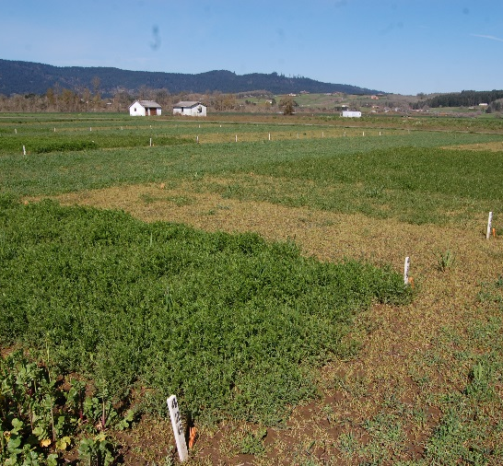
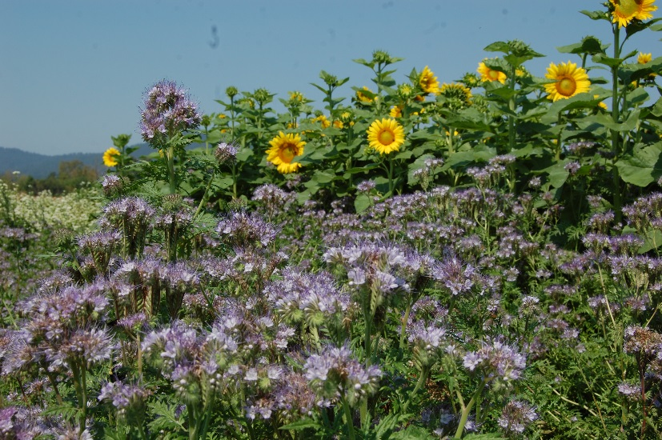
PMC Cover Crop Demonstrations
Multiple species/varieties (warm and cool season) - legumes, grasses, small grains, brassicas, other broadleafs
Observations and comparisons
Traditional and “new” species

Slide 6
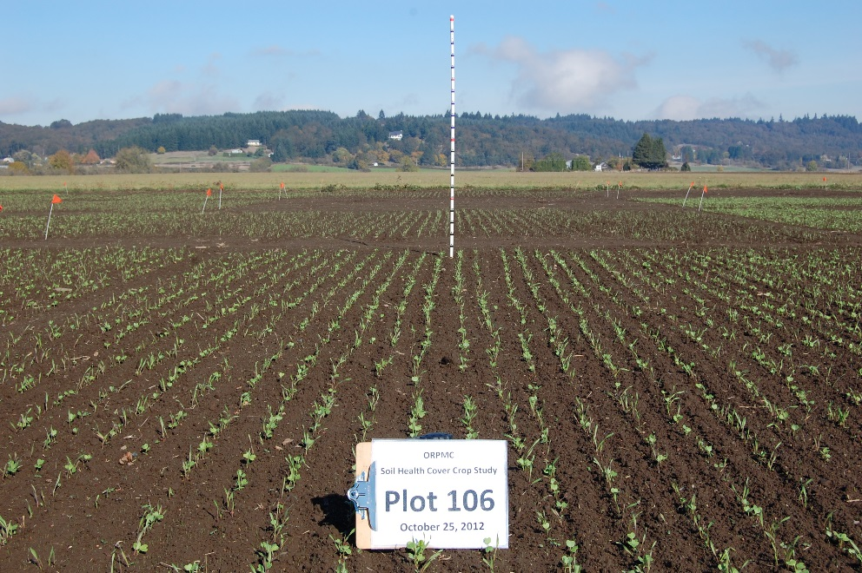
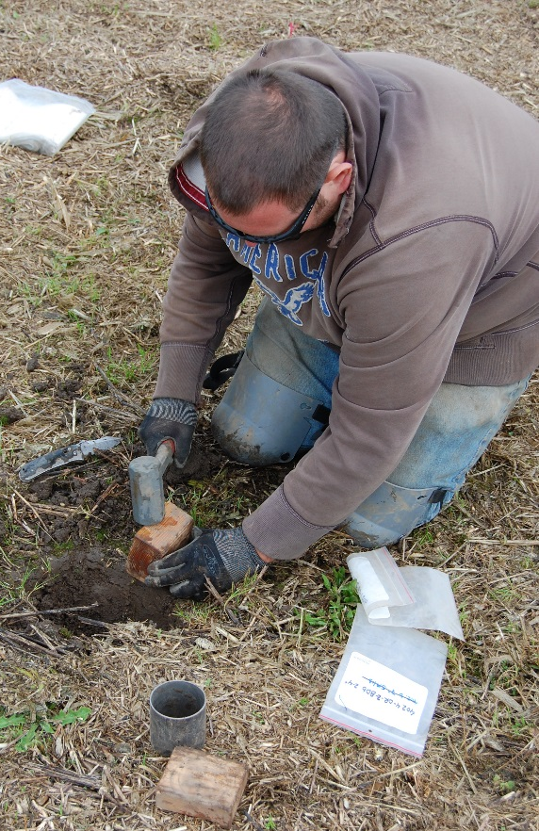
Cover Crop Technology Development Studies
Seeding rates
Seeding dates
Establishment methods
Cover crop mixes
Management
Termination methods
Termination dates
Effects on soil properties

Slide 7
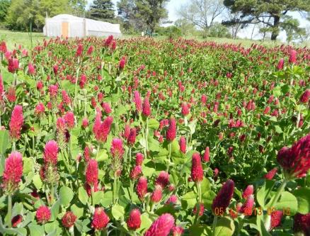
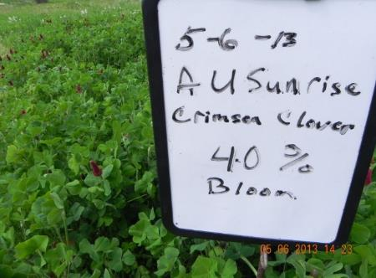
National Cover Crop Adaptation Trial – 24 PMCs
Core species identified by NRCS State Agronomists and Soil Health Specialists
54 variety/cultivars – Commercially available
2-year replicated trial; collaborating with ARS
Germination & Field Emergence
Canopy Cover
Winter Hardiness
Spring Green Up
Bloom Period
Plant Height
Aboveground Biomass
Nitrogen Content
Disease & Insect Resistance
Notes:
Dr. Steven Mirsky, ARS, leading a NIFA grant for breeding crimson clover, hairy vetch, and Austrian winter pea for improved cold hardiness, decreased hard seed, and increased biomass. Several ARS and University scientists are involved in this effort.

Slide 8
National Cover Crop Adaptation Trial
Crimson Clover (6)
AU Robin
AU Sunrise
AU Sunset
Cantea
Dixie
Kentucky Pride
Red Clover (8)
Cyclone II
Dynamite
Freedom!
Kenland
Cinnamon Plus
Starfire
Starfire II
Wildcat
Hairy Vetch (6)
Lana
Purple Bounty
Purple Prosperity
TNT
CSS – Groff
Vilana
Austrian Winter Pea (8)
Arvica 4010
Dunn
Frost Master
Lynx
Maxum
Survivor 15
Whistler
Windham

Slide 9
National Cover Crop Adaptation Trial
Cereal Rye (11)
Aroostook
Brasetto
Elbon
FL 401
Guardian
Hazlet
Maton
Maton II
Merced
Oklon
Prima
Wheeler
Wintergrazer 70
Wrens Abruzzi
Balansa Clover (2)
Fixation
Frontier
Black Oats (2)
Cosaque
Soil Saver
Daikon Radish (8)
Defender
Driller
Eco-till
Groundhog
Lunch
Nitro
Tillage
Sodbuster Blend

Slide 10
First Year Corvallis PMC Observations
Significant differences in bloom time (rye, balansa, crimson)
Some differences in seedling vigor and early cover (hairy vetch, peas)
Varietal differences in height & biomass (rye, others?)
Not many differences in disease & pest damage
Notes:
Rye = 7 week range in anthesis (4/5 – 5/24); Crimson = 2.5 week range of peak bloom; balansa = 3 week diff; peas total failure—need to repeat

Slide 11
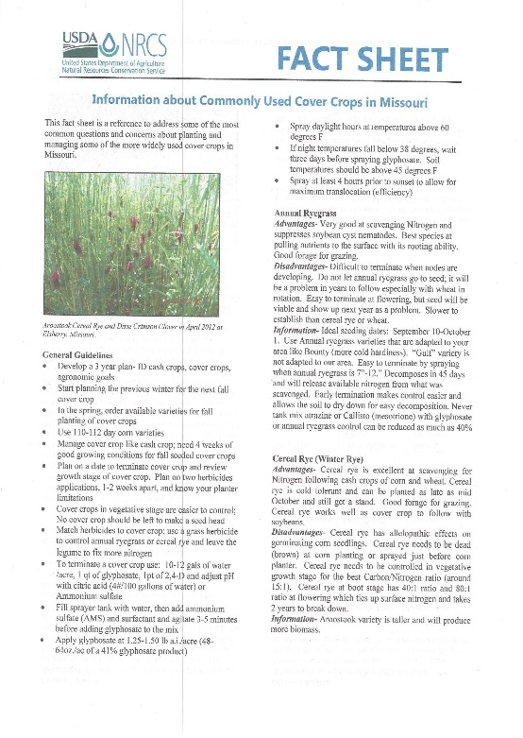
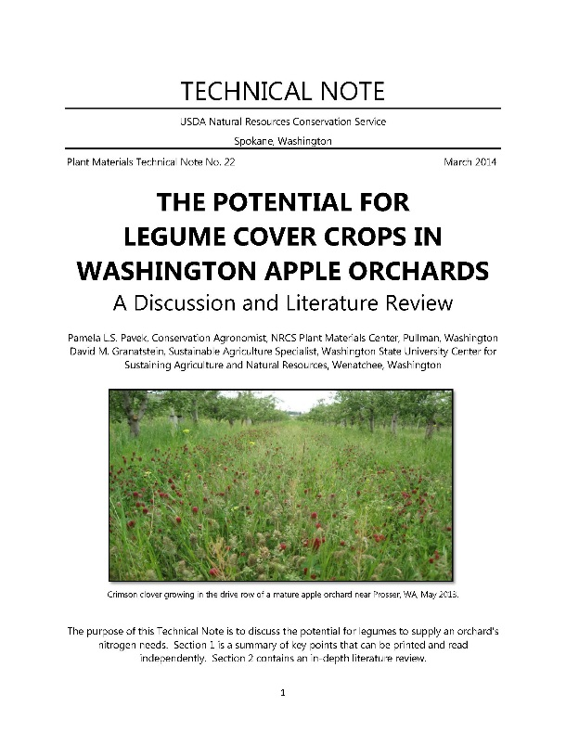
Technology Transfer
Field days
Training and workshops
Cover crop plant guides and fact sheet
Progress Reports
Species/variety recommendations in NRCS state/regional Seeding Guides

Slide 12
Questions?
Annie Young-Mathews
Corvallis PMC Manager
anna.young-mathews@or.usda.gov
(541) 801-2282
USDA is a equal opportunity employer and provider

