Slide 1
Neonicotinoid Treated Seed and Bee Health in Canada
Patty Townsend
CEO

Slide 2
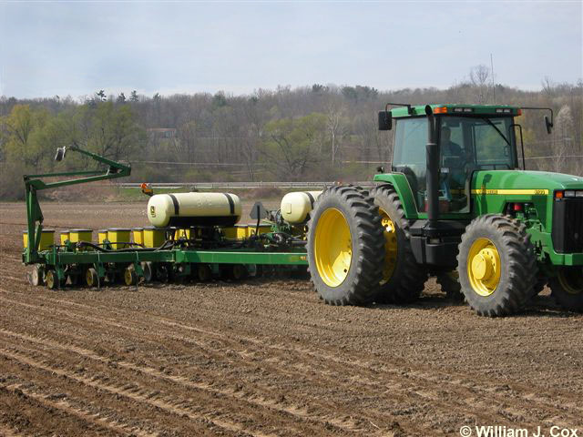
Neonicotinoids Treated Seed and Bee Health
in Canada
Contents
Neonic Use in Canada
Regulation
The Issue
CSTA’s Role
Where we are now

Slide 3
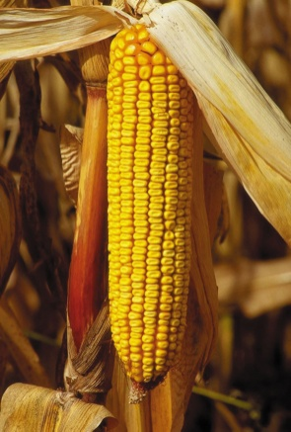
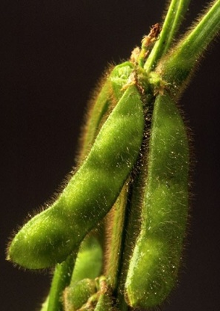
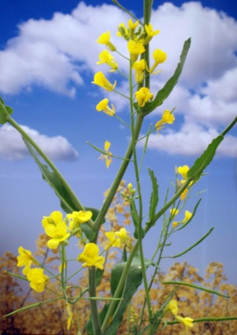
Neonicotinoid Treated Seed Use in Canada
Corn
3.1 million acres planted
95% of the acres are planted with neonicotinoid treated seed
Soybeans
5.5 million acres planted
60% of the acres are planted with neonicotinoid treated seed
Canola
19.9 million acres planted
99% of the acres are planted with neonicotinoid treated seed

Slide 4
Regulation in Canada
Pest Management Regulatory Agency of Health Canada has jurisdiction over pest control products in Canada – under Pest Control Products Act
Primary objective “prevent unacceptable risks to people and the environment from the use of pest control products”.
Pre-Market Review (science-based evaluation)
Post-registration oversight
Compliance, Incident Reporting and Sales Data Reporting
Re-evaluation (scientific re-assessment – 15 year cycle)

Slide 5
15 year re-evaluation launched in 2012
Re-evaluation includes:
Thiamethoxam, clothianidin and imidacloprid
All uses and application methods (e.g. soil, foliar, seed treatment)
Acute exposures (includes treated corn/soy seed)
Potential for sub-lethal / chronic effects from longer term exposure
Re-evaluation to be completed in 2017

Slide 6
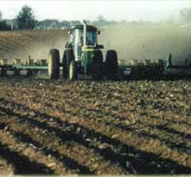
The Issue
2012 high number of bee deaths reported after spring planting
>5000 hives in corn growing areas of Ontario (some in Québec)
Attributed to dust generated during planting
2013 PMRA updated re-evaluation to focus on risks to pollinators and value of the product
Issued Notice of Intent establishing measures during re-evaluation
Preliminary Pollinator Risk Assessment to be completed in 2015

Slide 7
PMRA August 2013 Notice of Intent
Generated over 16,000 responses across Canada
Concluded: “Current agricultural practices related to the use of neonicotinoid treated corn and soybean seed are not sustainable”.
Mandated:
the use of safer dust-reducing seed flow lubricants;
adherence to safer seed planting practices;
new pesticide and seed package labels with enhanced warnings
updated value information be provided to support the continued need for neonicotinoid treatment

Slide 8
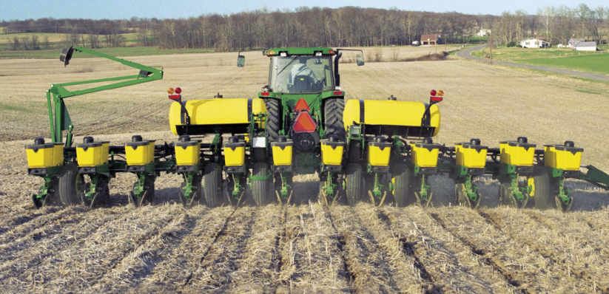
July, 2013 Seed Applied Insecticide and Pollinator Health Value Chain Coalition formed - Facilitated by CSTA
Grower groups from across Canada
Technology developers
Applicators
Seed Trade
5 key commitments
Development and promotion of Best Management Practises
Additional labelling
Improved technology for dust mitigation
Lifecycle stewardship of seed treatments and treated seed
Choice for farmers

Slide 9
Coalition
Communicated with federal and provincial Ministers of Agriculture and the Environment
Intense promotion, education, training on BMPs
CSTA became the liaison between the PMRA and the seed sector
Additional labelling
All seed companies sold Fluency Agent
Growers purchased enough Fluency Agent to cover all corn and soybean acres
More seed and treated seed options in a wider range of maturity zones
Neonic treated seed; fungicide only treated seed; bare seed

Slide 10
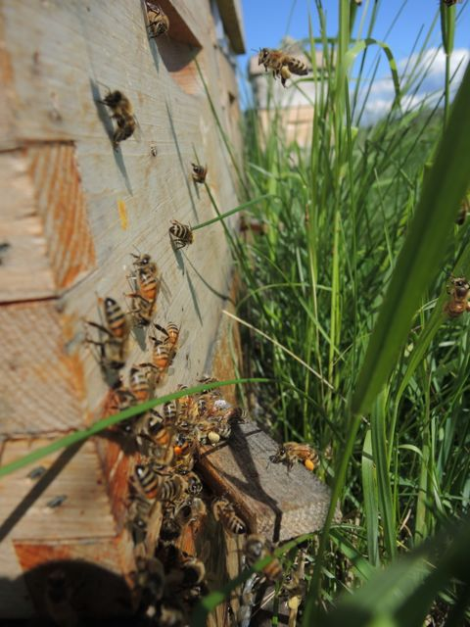
National Bee Health Roundtable
Established October, 2014
Chaired by AAFC and Canadian Honey Council
Membership
Farmer organizations from all crop kinds and horticulture
Apiculturists
CSTA
CropLife
Equipment Manufacturers
Provincial and Federal Governments
Academia

Slide 12
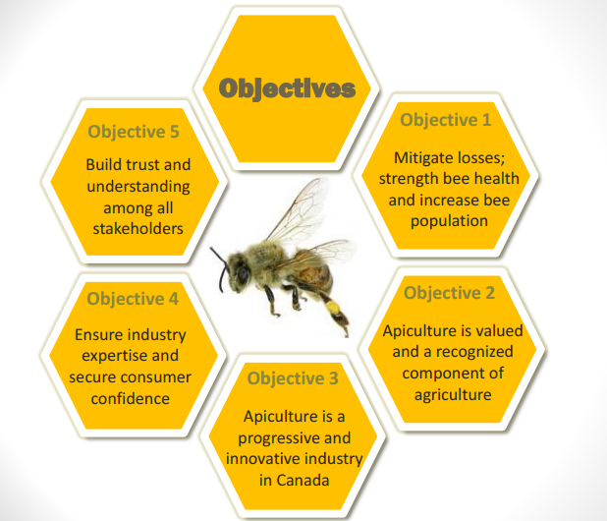

Slide 14
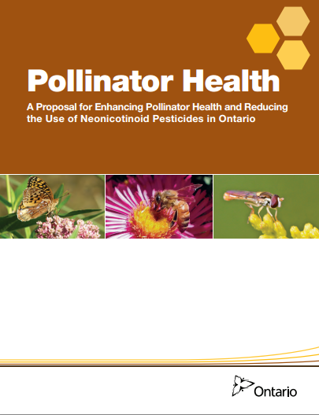
November 24 – Province of Ontario Issues “Aspirational Goals”
Reduce overwintering bee mortality to 15% by 2020
Reduce acres planted with neonic treated corn and soybeans by 80% by 2017

Slide 15
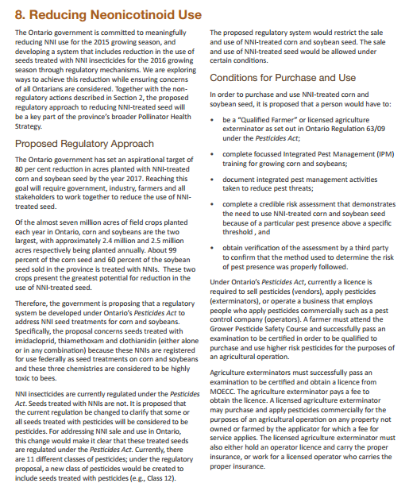
Proposed Regulations would class seed treated with Neonics as Pesticides and require:
farmers to be licensed to use NNI treated seed
a 3rd party assessment of need
vendors to be licensed to sell
only to qualified farmers with a “prescription” from a 3rd party
Vendors to report all sales of NNI treated seed
vendors to make untreated seed available

Slide 16
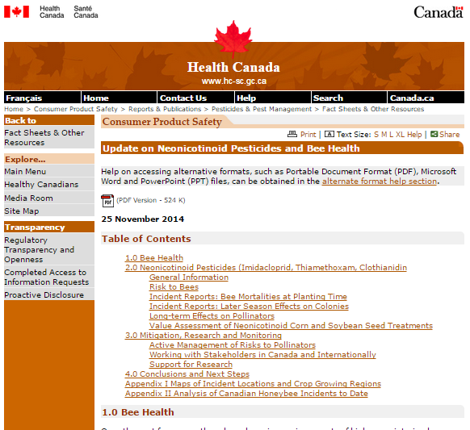
The same day, Health Canada’s PMRA concluded there is not sufficient evidence to draw conclusions regarding a link between these colony effects and potential neonicotinoid exposure

Slide 17
In 2014:
Bee death incidents during planting in Canada were down 70% from 2014
Bee death incidents during planting in Ontario were down 79% from 2014
72% of the post planting colony effects were reported by only 3 beekeepers in Ontario

Slide 18
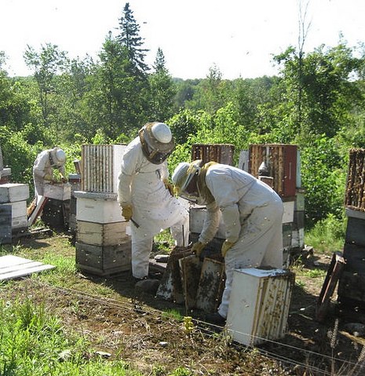
December 9, 2014 Statistics Canada Report on Bees in Canada:
Colony numbers in Canada in 2014 4% higher than in 2013
12% higher than 5 years ago
Beekeepers in Canada in 2014 3.4% higher than last year
18.5% higher than 5 years ago

Slide 19
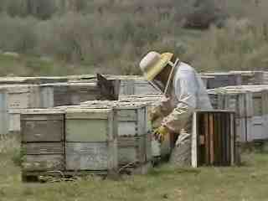
Statistics Canada Numbers for Ontario
Bee colonies in Ontario in 2014 15.7% higher than in 2013
35.7% higher than 5 years ago
Beekeepers in Ontario in 2014 3.39% higher than in 2013
25.7% higher than 5 years ago

Slide 20
Ontario farmer organization formed to fight back on government regulations that will “strangle” agriculture in Ontario
Considering its next steps
Insurance and banking communities expressing concerns about potential impact on their sectors
Non-farm media declaring that the government in Ontario has gone too far
Value Chain continues to communicate with other provinces
CSTA continues to focus on science and to insist that if the government of Ontario moves forward with these regulations, an independent 3rd party monitors
We need to work to keep federal regulators and other provinces focused on and supportive of science

Slide 21
Canadian Seed Trade Association
Suite 505 2039 Robertson Road
Ottawa, Ontario K2H 8R2
www.cdnseed.org

