Slide 1
Plant Breeding innovation Communications

Slide 2
Message Testing
Focus Groups:
Consumer Influencers
Looking at:
Plant breeding
Gene editing
“The jury is still out.”
Consumers want to know seeds are safe for them and safe for the environment.
Put it in the context of real-life benefits – for farmers, consumers and the environment.
Show safe history of use
Who do they trust?
-Scientists
-Farmers
What messages resonate?
-Efficient use of resources
-Sustainable impact
-Environmental benefits

Slide 3
Research & Messaging Guide
Summary of focus group findings
Messages that do (and don’t) resonate
How to talk about PBI
Addressing concerns
Personalizing the message

Slide 4
Industry Presentation Template
Evolution of Plant Breeding Story
What is PBI?
How does gene editing work?
What’s in it for farmers, consumers?
Industry commitment to quality, track-record of safe use
What could the future hold?
Policy overview: domestic and international

Slide 5
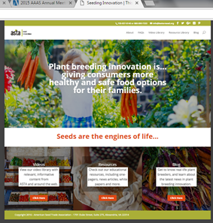
Microsite
Public Facing
Educational Resource:
FAQs
Breeder profiles
Blog
Videos
One-pagers
News articles
Ongoing promotion &
updating with new content

Slide 6
Walt Disney World: EPCOT Flower & Garden Festival

Slide 7
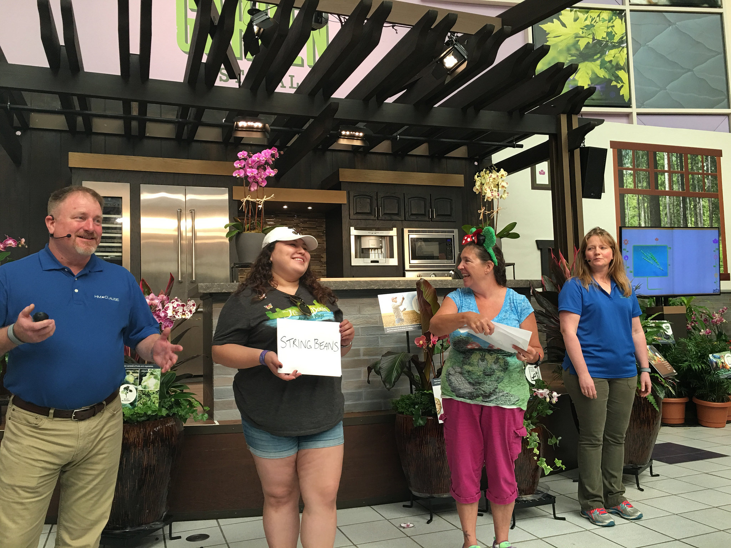
VIDEO

Slide 8
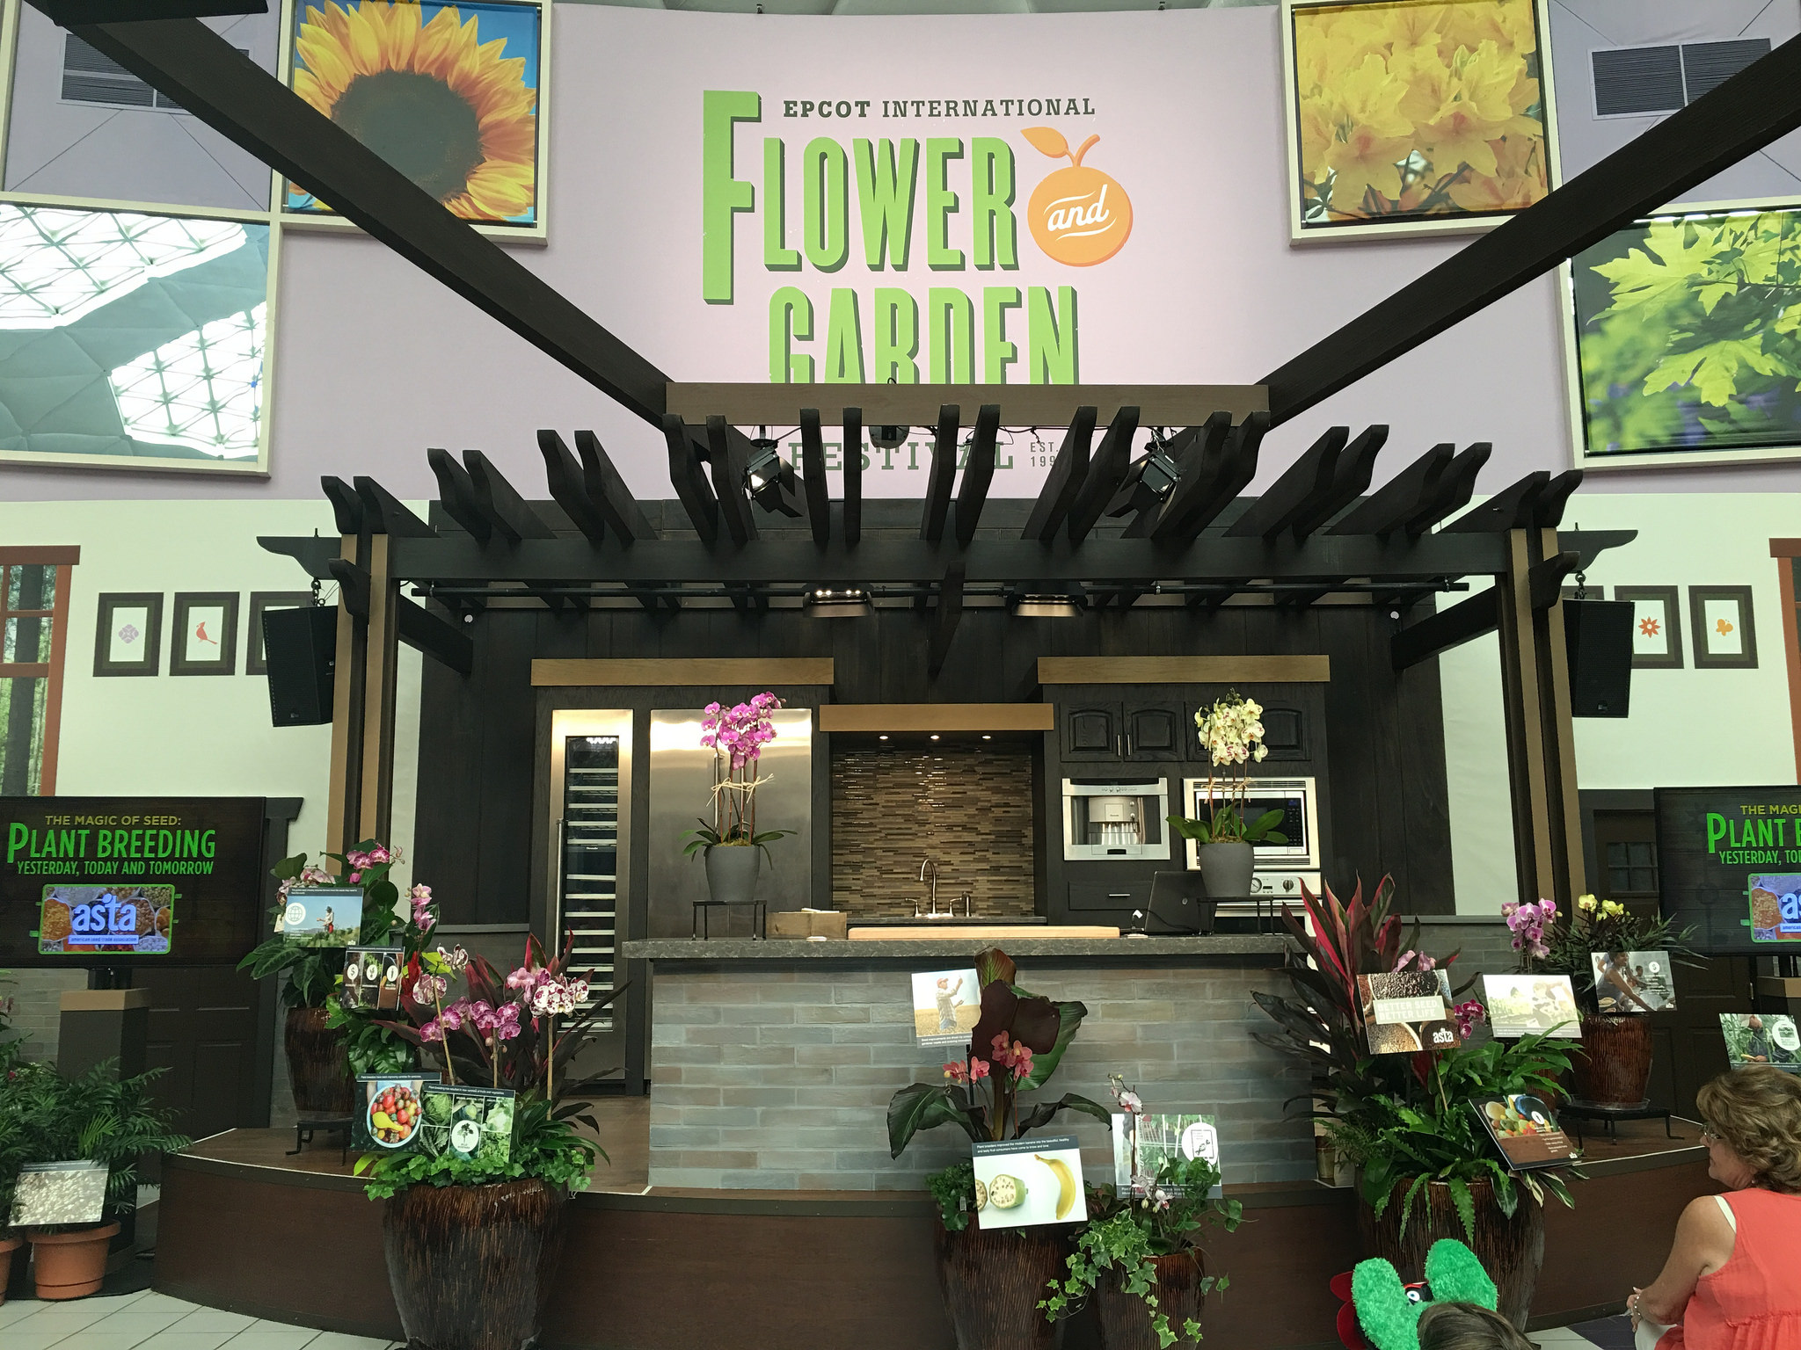
VIDEO

Slide 9
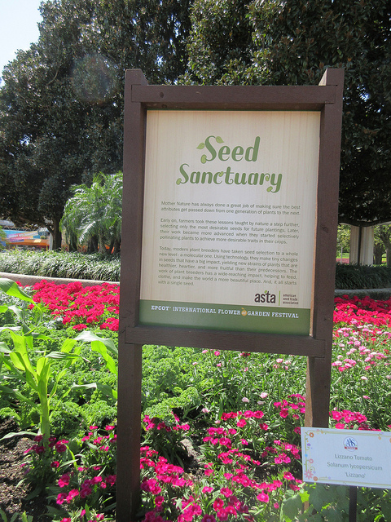
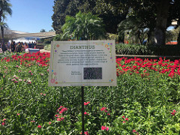
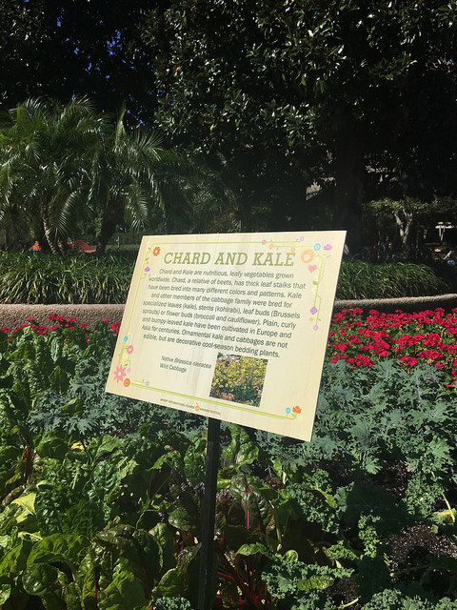
The ASTA Garden

Slide 10
Plant Breeding Media Tour / Video Series
First one planned for Aug. 17 & 18 in CA
Hosts: ASTA, NGB, CSA, UC Davis
Tour Stops:
HM.Clause – field day and briefing
Seminis – field day and briefing
UC Davis -- Seed Biotech Center, greenhouse, farm
Additional tours to be planned for Midwest, Northeast…partner with Universities

Slide 11
Cornerstone Animated Video
Story of plant breeding evolution and what’s on the horizon (including tools like gene editing)
Notes:
Partnership with CLI

Slide 12
What’s Next?
Third-Party Spokesperson Network
Farmers, nutritionists, scientists to help carry the message
Train on messages; identify engagement opportunities to reach outside the industry (online and speaking/events)
Continued collateral development
Infographics
Additional videos
Blog content
Continued collaboration
with value chain
Continued collaboration
at international level

Slide 13
Questions & Answers

