Slide 1
Plant Breeding Innovation
Notes:
Through advancements in agriculture and the development of new crop varieties, humans have historically strived to meet the needs of a growing population and to develop a safe, reliable and sustainable food supply. How will we continue to meet this challenge, while dealing with a changing climate and threats of new pests and diseases? Just like in other industries, continued innovation is paramount to the future of agriculture, and our quality of life.
ASTA recently conducted consumer focus groups to better understand the attitudes, feelings and perceptions of key stakeholder groups – Consumer Food Connectors (or “foodies”), Environmental Evangelists (people who take sustainability into account when making purchase decisions) and Millennials Moms – around issues related to seed improvement and plant breeding innovation. This research has been used to refine our messages and inform the underlying themes of our public-facing communications plan on plant breeding innovations. At the core of our findings is this --
Consumers want healthy and safe food for their families, their environment and their community – today and in the future. They want farmers to produce a variety of food choices, while wisely using natural resources, solving challenges locally, and reducing crop inputs. Plant breeding innovation, like gene editing, allows for this and more. Through evolving plant breeding methods that work within the genetic makeup of plants’ own families, plant scientists and breeders provide farmers with seeds that can thrive despite challenges, such as changing weather, plant diseases and pests, while reducing crop inputs.

Slide 2
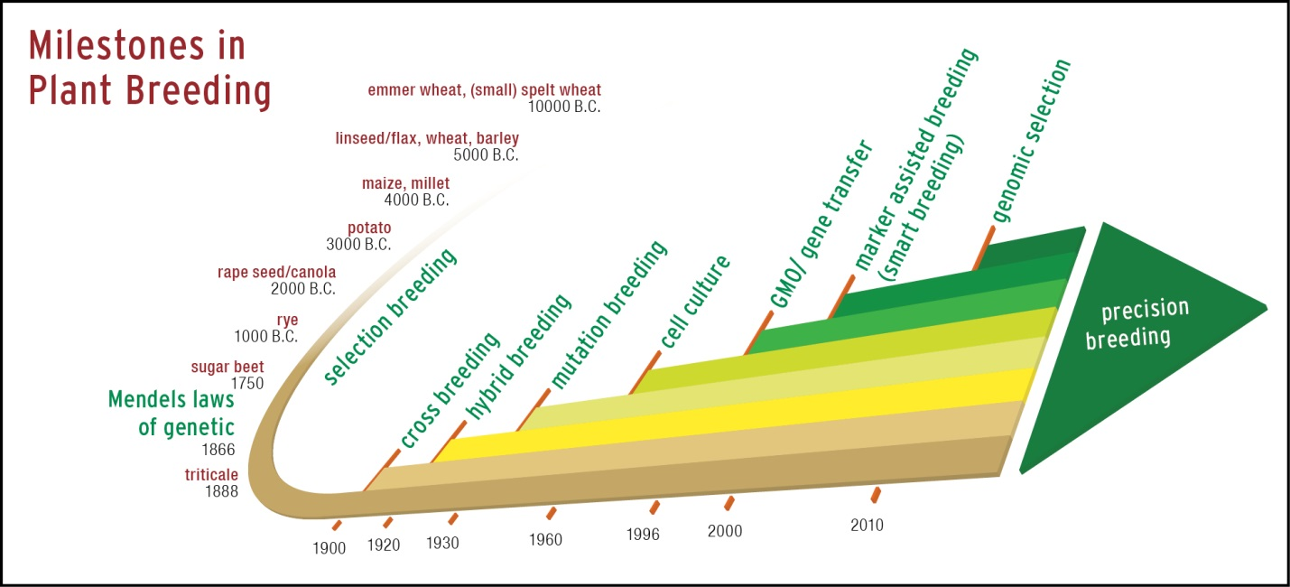
Evolution of Plant Breeding
Notes:
As we talk about plant breeding innovation, it’s important that we start with our history.
Over the last several thousand years, humans have taken a more active role in improving plant characteristics by specifically selecting seed from plants that looked, smelled or tasted particularly interesting.
The result was the domestication of plants, making it easier to grow and harvest them and become better, more reliable and nutritious sources of food. This same process continues today, though in a more formalized manner, using the science and art of plant breeding.
No matter the method used, the goal of today's plant breeders remains the same: producing better seed for a better quality of life.
In fact, you could say plant breeders are problem solvers. They are constantly innovating to find new ways to address farmers’ local challenges and meet the changing needs of consumers.
Evolving plant breeding methods -- like gene editing – can work within the plant family’s own genetic makeup.
These methods continue to build upon the knowledge and understanding of plant systems that plant scientists and breeders have been working with for years.
And allow us to reach the same endpoint as through traditional methods – but in a more precise way.

Slide 3
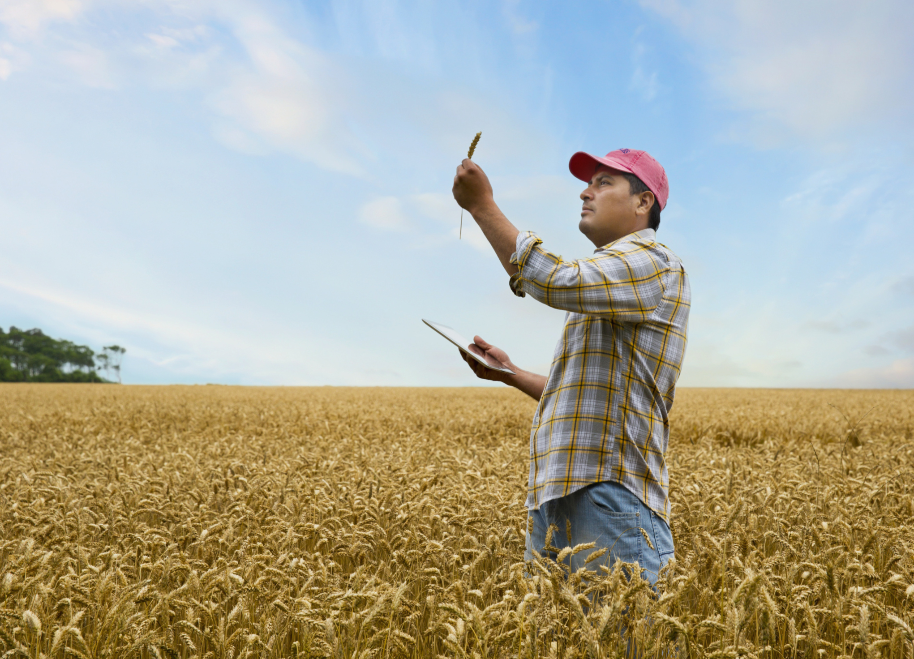
Relevance to Farmers
In order to grow more, using less, farmers need a variety of seed choices to:
Solve local needs
Manage changing weather
Fight plant disease and pests
Use fewer crop inputs and conserve natural resources
Notes:
In order to grow more using less, farmers need a variety of seed choices. Plant breeders help farmers find new and innovative solutions to meet their local needs and address challenges like --
Managing the impact of changing weather patterns
Fighting plant disease and pests
Use less crop inputs and conserve manage natural resources

Slide 4
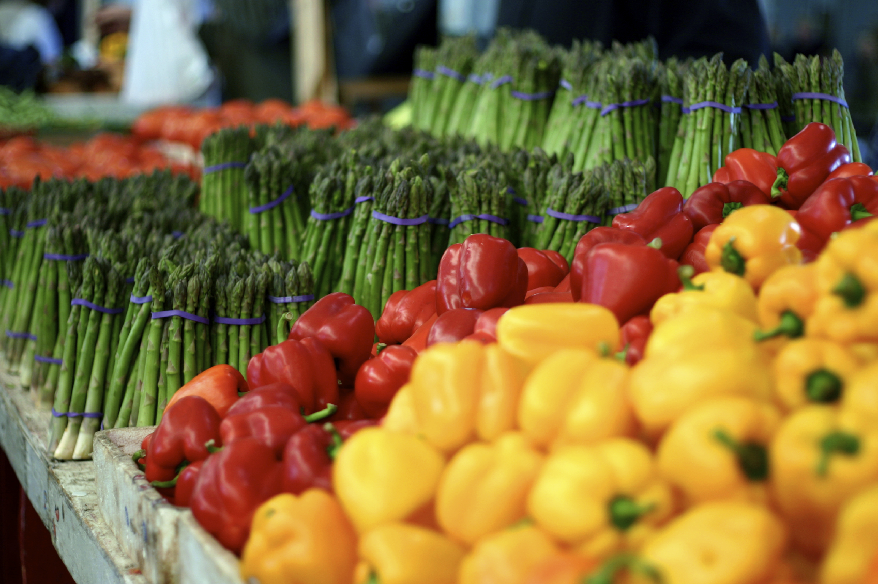
Relevance to Consumers
Consumers want healthy, safe food for their families, environment and community – today and in the future.
They want farmers to produce a variety of food choices, while conserving natural resources, and reducing crop inputs.
Notes:
While most of the general public doesn’t know a whole lot about plant breeding, recent consumer focus groups have shown that when making purchase decisions at the grocery store, people want food that is:
Healthy and safe for the their families
Safe for the environment
And they want a variety of option
When it comes to food production, they want farmers to produce a variety of food choices, while conserving natural wisely, and reducing crop inputs.

Slide 5
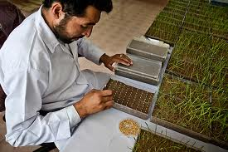
What is Gene Editing?
Like traditional breeding methods, using gene editing techniques we can develop new plant varieties without incorporating foreign DNA.
CRISPR–Cas is one example of a gene editing tool
Notes:
To help meet the changing needs and expectations of both farmers and consumers, plant breeders are constantly innovating based on the knowledge and understanding of plant physiology developed over many years. One example of a newer plant breeding method is gene editing.
Like traditional breeding methods, through gene editing we can develop new plant varieties without incorporating foreign DNA.
One example you’ve probably heard about is CRISPR–Cas.

Slide 6
Gene Editing Examples
Three Ways:
#1 Activate
e.g. drought tolerance
#2 Deactivate
e.g. disease sensitivity
#3 Make Small
Changes
e.g. mimic characteristic found in wild relatives
Notes:
So how does gene editing work? In simple terms, gene editing allows plant scientists and breeders to precisely make specific changes to a plant’s DNA using the plant’s own internal processes.
The result can be:
Activation of a beneficial characteristic – like drought tolerance or increased nutrition;
Deactivation of an unfavorable characteristic – like disease sensitivity; or
Small changes to the DNA that reproduce a characteristic found within the plant’s family – like disease resistant characteristic found in a wild relative.

Slide 7
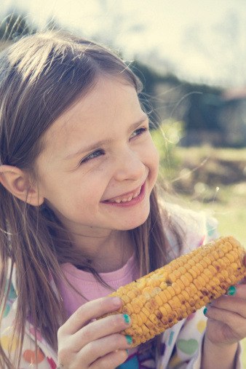
What could we do with gene editing?
More Sustainable Production
More efficient use of water and nutrients
Ability to grow on ‘poorer quality’ soils
Increased temperature tolerance
Improved photosynthetic capacity
Reduced use of inputs
Notes:
We could use this technology to address very real challenges like --
Resistance to disease & insects
Efficient use of water and nutrients – like fertilizer
Improved photosynthetic capacity (higher yields in less space)
Ability to grow on ‘poorer quality’ soil (resistance to salt or metals in soil)
Temperature tolerance (high or low temps)
Improve consumer appeal (appearance, flavor, nutrition etc.)

Slide 8
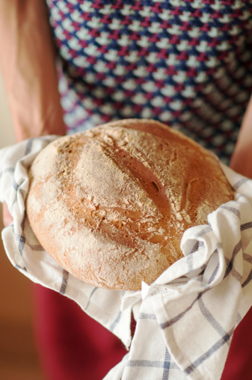
What could the future hold?
Tomato
-Disease
Resistance
Help Solve Farmers’ Challenges
Plant breeders are working on climate tolerant and disease resistant varieties of crops like corn and wheat that would be accessible to smallholder farmers.
Reducing Allergens
Research is being done on deleting gluten genes in wheat so people with gluten sensitivities can eat bread and baked goods made with wheat flour.
Spinach
-Disease
Resistance
Notes:
What could the future hold?
Plant breeding innovations can help solve challenges faced by farmers now and in the future:
For example, plant breeders are working on climate tolerant and disease resistant varieties of crops like corn and wheat that would be accessible to smallholder farmers.
How about allergen free wheat?
Thanks to innovative tools like gene editing, plant breeders could delete gluten genes in wheat – allowing people with gluten sensitivities to enjoy a wider variety of foods.

Slide 9
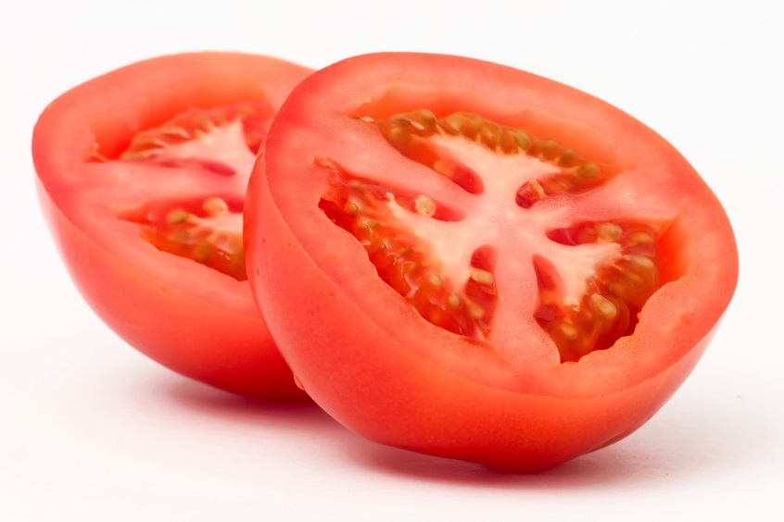
What could the future hold?
Producing Fruits & Vegetables with Better Taste, Appearance and Nutrition
Brighter colors and sweeter flavors
Higher levels of beneficial nutrients, like antioxidants, carotenoids and lycopene
Disease
Tomato
-Disease
Resistance
Increasing Resistance to Disease
Using naturally occurring characteristics within a plant’s own family, plant scientists can produce vegetables with the ability to fight diseases that could destroy them.
Examples: Downy mildew in spinach, fungal disease in tomato and citrus greening in oranges
Notes:
Other applications could benefit consumers:
Would like produce that looks better, tastes better and is more nutritious? Thanks to plant breeding innovation, we could see --
Brighter colors and sweeter flavors of popular vegetables
Produce with higher levels of beneficial nutrients, like antioxidants, carotenoids and lycopene
How about vegetables with built-in disease resistance?
Using naturally occurring characteristics within a plant’s own family, plant scientists can produce vegetables with the ability to fight diseases that could destroy them.
Examples: Downy mildew in spinach, fungal disease in tomato and citrus greening in oranges

Slide 10
ASTA Policy Position
Plant varieties developed through the latest breeding methods should not be differentially regulated if they are similar to or indistinguishable from varieties that could have been produced through earlier breeding methods.
Notes:
In order to realize these exciting possibilities, we need a policy climate that allows, and encourages, continued innovation.
Our overarching position is this: Plant varieties developed through the latest breeding methods should not be differentially regulated if they are similar to or indistinguishable from varieties that could have been produced through earlier breeding methods.
The seed industry has a phenomenal track record of safety. And it’s important to keep in mind that --
All foods derived from plants are regulated in the U.S. by the FDA and seeds are comprehensively regulated by USDA. Most new agricultural plant varieties are introduced without a specific pre-market safety review, given the long history of safe use of the underlying varieties used for breeding. A key feature of the plant breeding process is extensive testing and evaluation starting early in the breeding process and continuing until the final product is commercially available.
These tests are based on procedures breeders have used for many decades to create new plant varieties that are safe to grow and eat.

Slide 11
International: Consistent Criteria is Key
International Policy Impacts:
Global movement of ag products
Continued innovation & ag development
Research collaborations
Commercial seed trade
Introduction of crop innovations in smaller
or niche markets
It is key that governments and international organizations work together to avoid creating new trade barriers or disruptions due to inconsistent policies and practices.
Notes:
The seed industry and agriculture in general are global.
Inconsistent global policies can negatively impact trade in agricultural products.
Research collaborations cross country boundaries – inconsistent and overly burdensome policies will have a chilling affect on these collaborations (public/public and public/private)
Inconsistent and overly burdensome policies will have a disproportionately negative effect on crops with smaller or niche markets
Consistent and appropriate policies are needed for overall agriculture innovation and development

Slide 12
Domestic Policy
USDA: Proposed Rule to Revise Biotech Regulations
FDA: Request for Information
Both USDA & FDA acknowledged that some applications of gene editing result in plants that could be developed through more traditional breeding methods (in line with ASTA’s policy).
Notes:
*Current as February 2017 (please check with ASTA for latest information)
During the last few days of the outgoing Obama administration, USDA and FDA issued notices related to plant breeding innovation.
USDA released a proposed rule-making notice related to plant breeding innovation. ASTA has been actively engaged in discussions with the agency throughout the rule-making process, and is pleased that the proposal recognizes plant breeders’ long track record of safety and quality.
FDA issued a solicitation for comments on new plant varieties developed through gene editing techniques
Both agencies acknowledged that some applications of gene editing result in plants that could be developed through more traditional breeding methods (in line with ASTA’s policy)
Unclear what direction Trump administration will take. We will continue to engage with the new administration as the process continues.

Slide 13
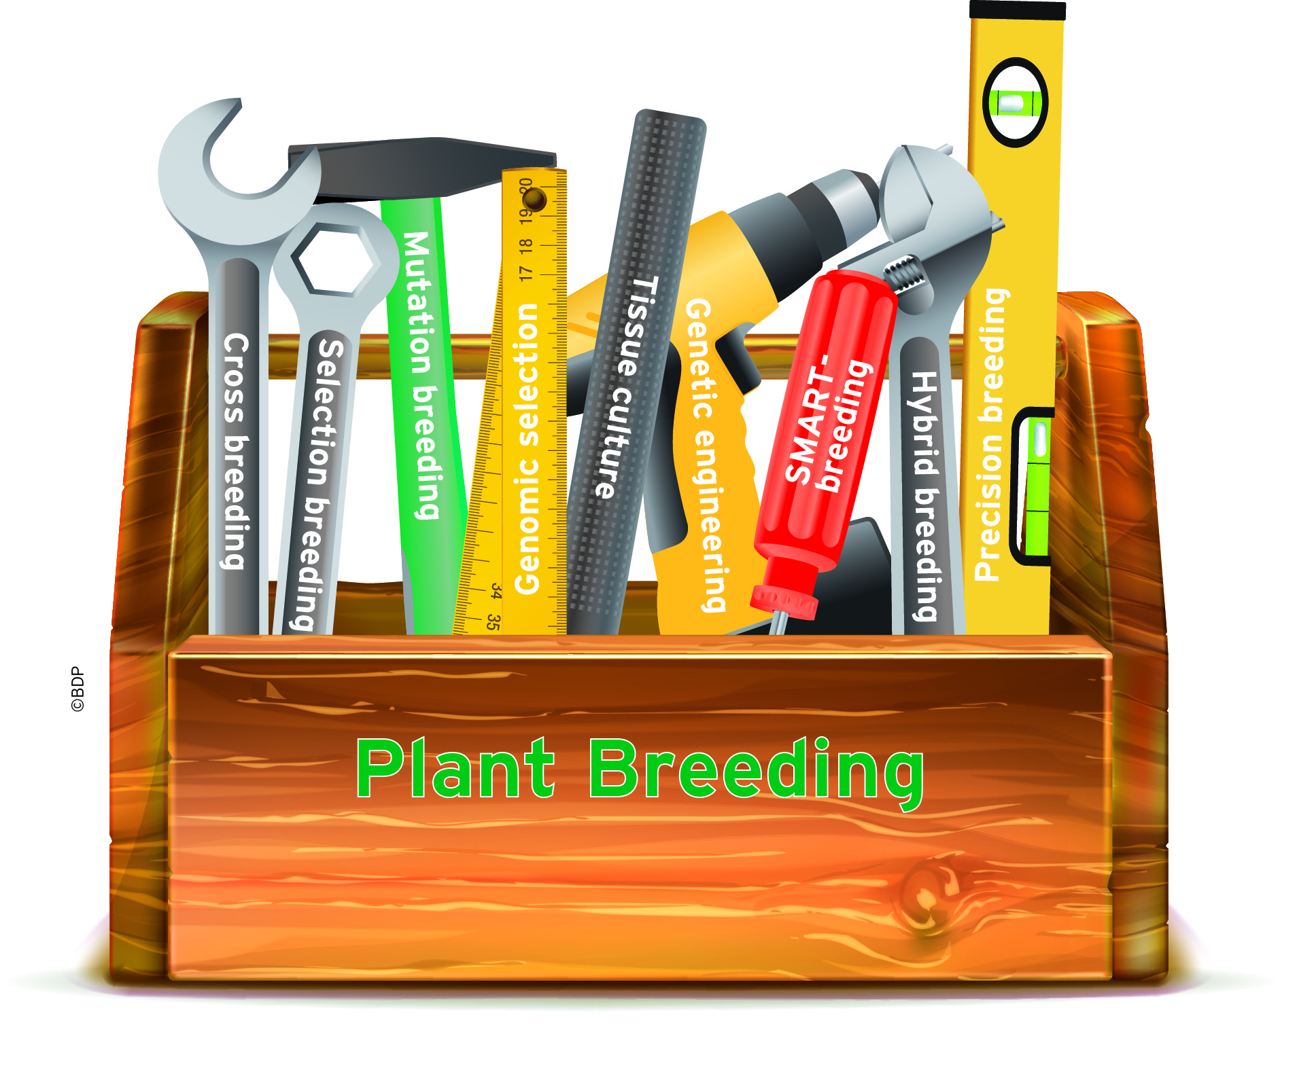
Goal: Access the Entire Toolbox
Notes:
Through advancements in agriculture and the development of new crop varieties, humans have historically strived to meet the needs of a growing population and develop a safe, reliable and sustainable food supply. How will we continue to meet this challenge, while dealing with a changing climate, threats of new pests and diseases, and ever-changing public demand? Farmers will need access to every tool available to do so in a safe, affordable and responsible manner. And it starts with the seed.

Slide 14
QUESTIONS?

