Slide 1
ASTA Phytosanitary Issues
Ric Dunkle, ASTA
ASTA V/ EIWG
June 20, 2017

Slide 2
ISPM 38
Adopted by IPPC at CPM 12 (April, 2017)
Next step: NPPOs have 12-18 months to prepare to implement
  Training sessions and workshops are being planned
ISF has developed a training manual and several ppts
Major benefits: specific guidance on PRA, recognition of seed production practices that reduce phytosanitary risk, paves way for accreditation approaches
Immediate impact: eliminate pests where seed is not a pathway

Slide 3
Main Features
Importance of determining the nature of the seed pathway
  Is the plant a host? Is the pathogen seed transmitted, seed borne or a contaminant on the seed?
ISPM 38 takes into account that different uses of seed pose different phytosanitary risks
Recognition that many seed production practices reduce phytosanitary risk
ISPM 38 references the ISF regulated pest listing database
Recognition that, to facilitate export and re-export, phytosanitary measures need to be harmonized

Slide 4
PRA Guidance in ISPM 38
Pest Risk Analysis ............................................................................................................................6
1.1 Seeds as pests ....................................................................................................................6
1.2 Seeds as pathways .............................................................................................................6
1.3 Purpose of import..............................................................................................................7
1.3.1 Seeds for laboratory testing or destructive analysis ..........................................................7
1.3.2 Seeds for planting under restricted conditions ..................................................................7
1.3.3 Seeds for field planting .....................................................................................................8
1.4 Mixing, blending and bulking of seeds .............................................................................8
1.5 Pest management in seed production ................................................................................8
1.5.1 Seed certification schemes ................................................................................................9
1.5.2 Resistant plant varieties.....................................................................................................9
1.5.3 Seed treatment.................................................................................................................10

Slide 5
ReFreSH
Ed Podleckis is the new APHIS Seed Health Coordinator
ReFreSH is still in progress: lots of work going on behind the scenes
NSHAPP may merge into ReFreSH (seed QM practices are being incorporated for CGMMV)

Slide 6
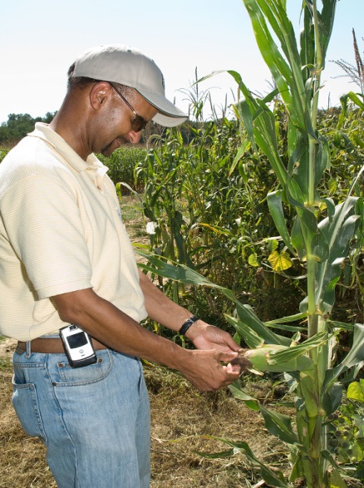
Risk Characterization: Needed for Key Pests/Crop Species
Pathway analysis
Pest risk assessment of high profile crops
Determine critical quarantine pests that follow the seed pathway
APHIS has started with spinach, tomato, Capsicum seed

Slide 7
Leading a Global Conversation
APHIS is working with other NPPOs to establish widely accepted global seed movement system that promotes a managed risk approach
APHIS has had initial conversations with QUADs countries (CA, AUS, NZ) and Netherlands
Initial discussions for an international NPPO meeting this year on seeds

Slide 8
Gottwald Research Project
Basic framework/model has been developed
Model is applicable to all seed types
Components and relationships among components have been identified/characterized
May form the foundation for ReFreSH

Slide 9
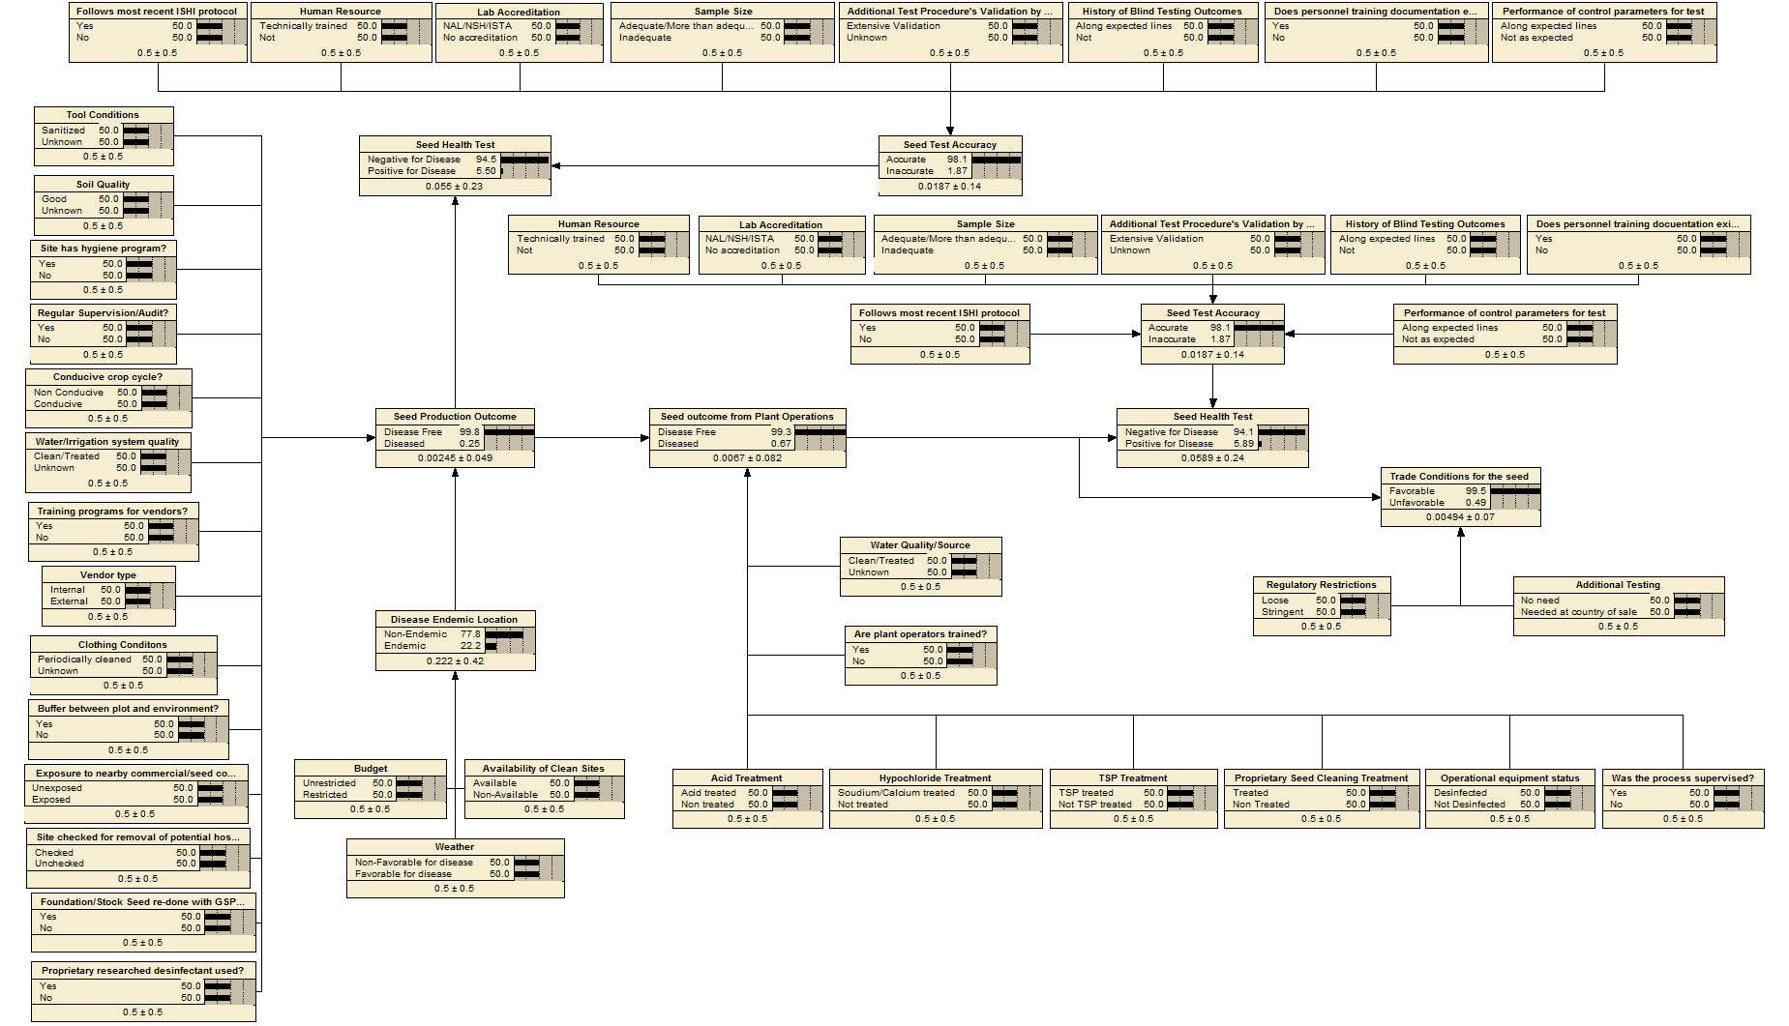
Overall Seed Production Model

Slide 10
Overall Seed Production Model
Field Production Variables - A
Lab Testing Variables - A
Seed Health Test
Seed Test Accuracy
Seed Production Outcome
Lab Testing Variables - B
ISHI Protocol
Seed Test Accuracy
Control Parameters
Plant Operations Outcome
Seed Health Test
Trade Conditions
Plant Operations Variables -A
Trade Operations Variables
Plant Operations Variables - B
Disease Endemic Location
Disease Endemnicity
Variables

Slide 11
Current Ongoing Activities
Researchers (Dr. Gottwald and Laboda) are populating the model with data/information/expert opinion for Cmm and tomato seed
This application will be demonstrated sometime this fall and at the next ASTA vegetable and flower convention (San Diego)
Next application: CGMMV and melon seed species
Project will be published in a peer refereed journal in 2018.

Slide 12
Spinach Downy Mildew
Seed borne oospores: based on recent research (Klosterman, Correll), there has been a push (by growers) to test spinach seed for organic production for DM oospores
Varieties with DM resistance claims often show sporulation in the field, raising concerns that a new deviating DM isolate has shown up
Testing for such potential deviating isolates has often proven to be a mixture of existing races and some of the supposed resistant varieties lack full resistance to one or more of these races.

Slide 13
Spinach Downey Mildew
Seed companies are against testing as long as there is no standard method.
The growers and some UC Davis researchers suspect the rapid development of new races are due to the fact that seed is infested with oospores and these oospores promote sexual reproduction.
More research on epidemiology and development of a standardized seed health test is needed (possible support through the V/F permanent research fund?).

Slide 14
Mexico
Recent politics are impacting our relations with Mexico: wall rhetoric, NAFTA renegotiation, etc.
Successful cross border workshop (Nogales, June 6-7)
  PMMoV, movement of untreated seed, pilot harmonization project, general seed testing issues, need for a workshop on risk management, sampling issues, seed treatment issues (heat treatment concerns)
Delegation to visit U.S. in August: first step toward a pilot project for Mexico to accept U.S. test results without retesting at the border

Slide 15
Korea
Korea’s policy of testing/re-testing at POEs has become a major technical trade barrier: shipment rejections for pathogens that were never identified as requirements on import permits or official website; information not in PExD
Ryegrass (Pseudomonas syringae atrofaciens), alfalfa (CMI), tomato (tomato streak virus), spinach (spinach latent virus), soil, etc…..)
Ambiguous, unvalidated testing methods
Korea has agreed to send a delegation to the U.S. this fall
Korea agreed to provide seed species-specific pest lists

Slide 16
Brazil
NI-16 now in force. Based on recent meetnigs and inputs, the U.S. annex XIV has been modified. ASTA provided additional analyses and inputs to APHIS and MAPA; MAPA still analyzing
NI 52 (small seed lots) also in force. Based on member feedback, the new process is still very cumbersome and takes many months before seed is released. Most of the delays are associated with import permit approvals.
Pilot project proposals are in preparation:
  Remove specific AD requirements (revert back to NI 1)
  Accredit Breeding programs
  Reduce requirements for low risk seed species

Slide 17
EU and Seeds for Sprouting
Currently U.S. origin seeds for sprouting are banned entry into the EU (due to changes in EU regulations in 2013)
Some seed companies produce seed specifically for the sprout industry
A certification program needs to be set up to comply with EU requirements
USDA – AMS and FDA are putting together a certification program for use in 2018. Industry input is critical!

Slide 18
Phomopsis
More (high value) shipment rejections in 2017
APHIS is conducting a PRA; nearing completion
Major issues: taxonomy in the genus Diaporthe is in disarray; no good seed health test
APS will have a session on Phomopsis at annual meeting (August 6-10, San Antonio, TX)

Slide 19
Priorities for Moving Forward
Training/workshops on ISPM 38 (including ASTA webinar for members, if interested)
Encouraging governments to remove pests from regulation for which seed is a pathway
Continue development of ReFreSH, NSHAPP, risk reduction model
Continue to promote harmonization of seed testing methods (bilaterally: Mexico, Korea, Brazil, Australia, NZ, etc.); multilaterally: ISHI-Veg, NSHS)
Support development of pest lists (ISF, ASTA)
Continue to serve as a technical resource for ASTA members

Slide 20
ASTA Seed Pest Database
http://www.phytodatabase.org/log.php
  user name: PDBGuest
  password: jEUtx4591A!

Slide 21
Phytosanitary Issues Management - Office of the Deputy Administrator
Andrea Simao, Director
Assistant Deputy Administrator
Michael Guidicipietro, Associate Director
Ingrid Watson
Deputy Director
Western Hemisphere
Christian Dellis
Deputy Director
Export Services
Jill Wallace
Deputy Director
Eastern Hemisphere
Tyrone Jones, Trade Director
Global Forestry Products
Lisa Kohl, Assistant Trade Director
Eric Longen, Trade Director
Mexico
Shelah Morita, Trade Director
Canada, Costa Rica, Panama,
Guatemala
Mohamed Sedegui, Trade Director
Peru Ecuador, Colombia, Venezuela, Guyana, Suriname, Belize, Nicaragua,
El Salvador, Honduras, Jamaica, Haiti, Dominican Republic
Barbara Spangler, Trade Director
Argentina, Brazil, Chile, Bolivia, Paraguay, Uruguay, French Guiana, and Caribbean (except Jamaica, Haiti, and Dominican Republic)
Julie Clapp, Export Specialist
PExD
Allen Dawson, Senior Export Specialist
Africa, Bahrain, Iran, Iraq, Israel, Jordan, Kuwait, Lebanon, Oman, Palestinian Territory, Qatar, Saudi Arabia, Syria, Turkey, UAE, and Yemen
Marcus McElvaine, Senior Export Specialist
Asia, Australia, New Zealand
Sarika Negi, Policy Manager
Accreditation/Certification
Michael Perry, Senior Export Specialist
PCIT, Export Program Manual (XPM), European Union
Margaret Smither, Senior Export Specialist Central/South America, Irradiation
Terrance Wells, Senior Export Specialist
Canada, Mexico, Caribbean, Mexico, U.S. Territory Wood Products, Budget
Hesham Abuelnaga, Trade Director
Middle East and Africa
Karen Ackerman, Trade Director
Australia, New Zealand,
Pacific Islands
Sheauchi Cheng, Assistant Trade Director
Prakash Hebbar, Trade Director
India, Japan, Korea, and ASEAN Countries
Wenbin Li, Trade Director
China, Mongolia, Taiwan, Pakistan,
Sri Lanka
Judy Macias, Assistant Trade Director
Horticultural Products
Matthew Messenger, Trade Director
Central Asia and Europe
George Galasso, Trade Director
Global Grain Commodities
Administrative Global Support
Vacant, Special Assistant
Chief of Staff
Patricia Somervell, Writer-Editor
Trade Correspondence Manager
Monica Montero, Trade Support Specialist
English/Spanish Translation
PIM Sharepoint/
Salesforce Database

Slide 22
Questions & Answers

