Slide 1
ReFresh
Ric Dunkle
V/F Emerging Issues Working Group
January 27, 2018

Slide 2
Regulating Seed Trade (U.S.)
Traditionally seed regarded by regulators as a relatively low risk pathway so seed moved in trade with minimal import requirements
Currently, most seed for planting imported into the United States requires only a phytosanitary certificate from the country of origin and port of entry inspection
Phytosanitary certification on consignment by consignment basis

Slide 3
Why The Recent Concern About Seeds?
2013: Detection of CGMMV in California
2014: National Seed Health Summit
Source: CDFA

Slide 4
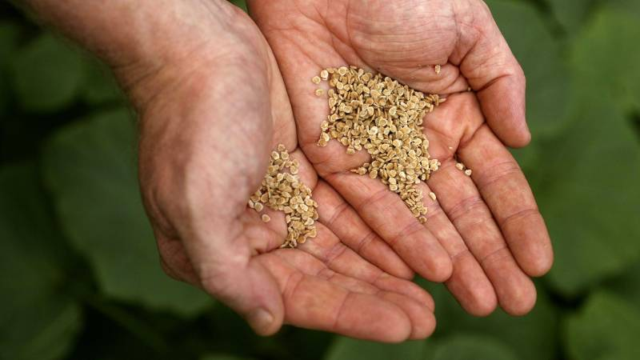
Challenges of Regulating Seed Trade
Increasingly global nature of seed industry
Trend to increasing demand for documents and declarations that specific pests are absent in imported seed
Providing those certifications on a consignment basis straining NPPO resources
Source: Good Fruits & Vegetables
Notes:
The increasingly global nature of the seed trade presents its own unique regulatory challenges. As new seed threats both confirmed and perceived emerge, importing countries require more assurances, in the form of certifications, tests and inspections, that imported seed is free of pests of concern. Providing those certifications on a consignment by consignment basis puts a real strain on the already stretched resources of both the importing and exporting countries’ national plant protection organizations.

Slide 5
NSHAPP
National Seed Health Accreditation Pilot Program
Implemented 2015
Program administered through Iowa State University
Voluntary program
Participating seed companies voluntarily test imported seed lots
Focus on testing cucumbers, melons and watermelon for CGMMV
10K lots tested; 22 positive lots detected

Slide 6
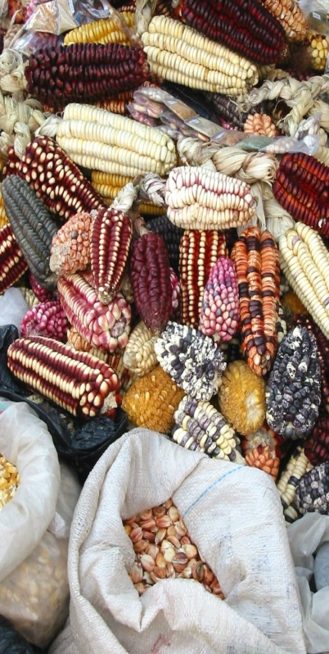
A New Approach- Regulatory Framework for Seed Health (ReFreSH)
Risk-, science-based systems approach
Aims to develop a more effective and efficient program for managing phytosanitary risk associated with international seed movements.
Leverage industry best practices
Promote global adoption of same system
Notes:
Shortly after CGMMV was reported in the U.S. in 2013, APHIS began looking for regulatory approaches to respond to the regulatory challenges of international seed trade. An initial response was the National Seed Health Accreditation Pilot Program or NSHAPP implemented in 2015. NSHAPP is a voluntary program where seed companies enter into an agreement to test imported cucurbit seed lots for CGMMV. To date over 10,000 lots have been tested and 22 positive lots have been detected and destroyed.
Recognizing that NSHAPP is limited to one pest- CGMMV- in a limited number of crops- cucurbits- and relies solely on seed testing, APHIS and industry began looking for a broader approach. In 2016-2017, a new approach, the Regulatory Framework for Seed Health or ReFreSH was conceived as a risk-based systems approach that leverages existing industry management practices for seed pests. The overall vision is for a globally accepted system that satisfies phytosanitary certification requirements.

Slide 7
A New Approach- Regulatory Framework for Seed Health (ReFreSH)
Goals:
Shift the current focus of consignment by consignment inspection and testing to a system where accreditation of producers and production processes forms the basis for phytosanitary certification
Accommodate all seed sectors (vegetable, cereal, row crop, farm and lawn, flower) and all sizes of companies
Notes:
Shortly after CGMMV was reported in the U.S. in 2013, APHIS began looking for regulatory approaches to respond to the regulatory challenges of international seed trade. An initial response was the National Seed Health Accreditation Pilot Program or NSHAPP implemented in 2015. NSHAPP is a voluntary program where seed companies enter into an agreement to test imported cucurbit seed lots for CGMMV. To date over 10,000 lots have been tested and 22 positive lots have been detected and destroyed.
Recognizing that NSHAPP is limited to one pest- CGMMV- in a limited number of crops- cucurbits- and relies solely on seed testing, APHIS and industry began looking for a broader approach. In 2016-2017, a new approach, the Regulatory Framework for Seed Health or ReFreSH was conceived as a risk-based systems approach that leverages existing industry management practices for seed pests. The overall vision is for a globally accepted system that satisfies phytosanitary certification requirements.

Slide 8
ReFreSH- How it could work
Companies producing and exporting seed become accredited by their NPPO
NPPOs of importing countries accept accreditations as equivalent to phytosanitary certification of individual seed consignments
Accreditation is basis for issuing phytosanitary certificates
Compliance assured by quality management systems/audits
Notes:
This is how the system could work:
A company producing seed and exporting it from country A is accredited by that country’s NPPO using criteria established by ReFreSH
The seed is imported by Country B whose NPPO accepts the ReFreSH certification as equivalent to the current system of consignment by consignment certification via inspection/testing.
So, in effect, accreditation forms the basis for a phytosanitary certificate.
Of course, there will have to be a quality management systems component including internal and external audits to ensure that required measures are applied and all required procedures are followed.

Slide 9
ISF Systems Approach WG VISION
One globally accepted Systems Approach that serves as an alternative to existing pest risk management options to secure phytosanitary certification for the international movement of seed
Global acceptance via IPPC

Slide 10
How do we get there?
Inventory current systems
Identify BMPs
Conduct commodity PRAs
Identify mitigation measures
Establish accreditation criteria
Validate via pilot(s)
ReFreSH
Notes:
ReFreSH is based on the idea of a phytosanitary HACCP (Hazard Analysis and Critical Control Points) approach using testing and phytosanitary measures applied at critical points in the production process to verify seed safety, mitigate risks and prevent pest movement.
This is not a new concept, the ASTA Guide to Seed Quality Management is this type of approach.
The design of the ReFreSH model moves through a series of steps:
Inventory current regulatory systems- There is no need to reinvent the wheel: we can learn valuable lessons from existing systems for seeds and other commodities (GSPP, Systems Approach for Nursery Certification – SANC, the U.S./Canada Greenhouse Certification Program, etc.).
Identify existing industry best management practices- just as we can leverage existing regulatory systems, we can do the same with current industry best management practices.
Conduct commodity PRAs- conducting pest risk assessments for a variety of seed commodities helps identify the range of pests that the systems approach will need to mitigate.
Identify potential mitigation measures- Determine whether there are mitigation measures to reduce the risk of pest introduction into the seed production process and where in the process they can be applied.
Establish performance criteria that must be met to be accredited
Validate via pilot programs- begin with small scale pilots for limited commodities/trading partners.

Slide 11
Where are we now?
ReFreSH Working Group
APHIS, Industry, Academia, NPB
Draft ReFreSH Concept paper
Leveraging existing systems/practices
Seed production site visits to Iowa and California
QMS/BMP comparison document
PRAs
Spinach, Melon
Notes:
ReFreSH working group has been assembled with members from several APHIS staffs; selected industry representatives, academia and the National Plant Board. The group has met by phone and in person and a core group is scheduled to meet for two days next week at APHIS in Maryland to put what we hope are finishing touches on a draft ReFreSH concept paper.
Leveraging existing systems/practices: a group from APHIS and the NPB visited seed production sites and diagnostic laboratories in Iowa (row crops) and California (vegetables) to gather background information. A UC Davis plant pathology graduate student working with the ReFreSH has compiled a summary of selected QMS and BMPs that will be used by the working group in designing ReFreSH.
PRAS: To inform the development of the ReFreSH model and target specific mitigation measures, APHIS risk analysis staff are conducting multiple PRAs; a PRA for spinach seed has been completed and is undergoing review; the PRA for melon has been started.
Mitigation measures: The QMS/BMPs compilation document catalogs many available measures while a gap analysis that compares those measures with the pests identified in the PRAs to determine additional measures will be conducted.

Slide 12
Where are we now
Inventory current systems
Identify BMPs
Conduct commodity PRAs
Identify mitigation measures
Establish accreditation criteria
Validate via pilot(s)
ReFreSH
Notes:
ReFreSH is based on the idea of a phytosanitary HACCP (Hazard Analysis and Critical Control Points) approach using testing and phytosanitary measures applied at critical points in the production process to verify seed safety, mitigate risks and prevent pest movement.
This is not a new concept, the ASTA Guide to Seed Quality Management is this type of approach.
The design of the ReFreSH model moves through a series of steps:
Inventory current regulatory systems- There is no need to reinvent the wheel: we can learn valuable lessons from existing systems for seeds and other commodities (GSPP, Systems Approach for Nursery Certification – SANC, the U.S./Canada Greenhouse Certification Program, etc.).
Identify existing industry best management practices- just as we can leverage existing regulatory systems, we can do the same with current industry best management practices.
Conduct commodity PRAs- conducting pest risk assessments for a variety of seed commodities helps identify the range of pests that the systems approach will need to mitigate.
Identify potential mitigation measures- Determine whether there are mitigation measures to reduce the risk of pest introduction into the seed production process and where in the process they can be applied.
Establish performance criteria that must be met to be accredited
Validate via pilot programs- begin with small scale pilots for limited commodities/trading partners.

Slide 13
Buckets (aka Critical Control Points)
Pre-planting: Site Selection & Preparation
Pre-planting: Plant & Seed Inputs
Production: Pre-harvest
Production: Seed Harvest
Postharvest: Seed Quality Testing
Postharvest: Handling & Storage
Postharvest: Conditioning & Treatment
Distribution & Transport

Slide 14
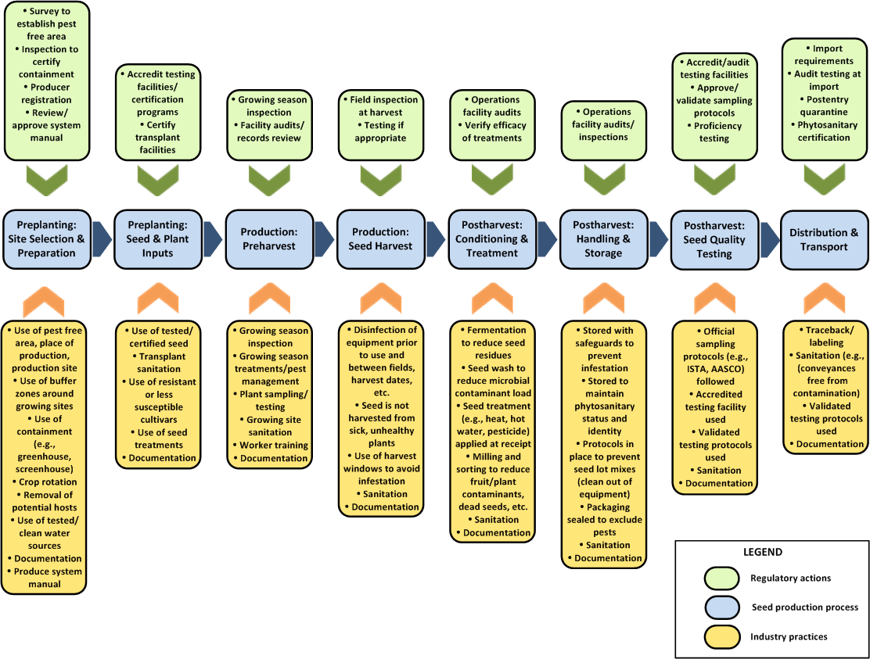

Slide 15
A Closer Look
Accredit testing facilities/ certification programs
Certify transplant facilities
Pre-planting: Plant & Seed Inputs
Use tested/ certified seed
Transplant sanitation
Use resistant or less susceptible cultivars
Seed treatments
Documentation

Slide 16
Sources
Review of existing QMS and industry BMPs
Guidance from international standards
ISPM 11: Pest risk analysis
ISPM 14: Systems approaches
ISPM 36: Integrated measures for plants for planting
ISPM 38: International movement of seed
RSPM 40: Risk management
Notes:
The International Plant Protection Convention, IPPC, officially adopted the International Standard for Phytosanitary Measures (ISPM) 38 for the International movement of seeds in March of 2017. ISPM 38 incorporates guidance for the use of integrated measures in a systems approach for pest risk management by recognizing that the use of various measures during seed production, pre-harvest and post-harvest practices can significantly reduce and manage phytosanitary risk. The measures may be applied at any point in the during seed production and delivery cycle as long as the NPPO of the exporting country has the ability to oversee the action to ensure compliance.

Slide 17
Overall Seed Production Model
Field Production Variables - A
Lab Testing Variables - A
Seed Health Test
Seed Test Accuracy
Seed Production Outcome
Lab Testing Variables - B
ISHI Protocol
Seed Test Accuracy
Control Parameters
Plant Operations Outcome
Seed Health Test
Trade Conditions
Plant Operations Variables -A
Trade Operations Variables
Plant Operations Variables - B
Disease Endemic Location
Disease Endemnicity
Variables
Notes:
This is the 50,000 ft level characterization of the Gottwald model. At each stage of seed production there is a production component that must factor in pest and disease management variables, followed by harvest and post harvest components that have their own management variables. Seed testng and inspection serve as indicators of effectiveness.

Slide 18
Next Steps
Complete identifying mitigations and corresponding regulatory oversight activities
Develop accreditation criteria for ReFreSH
Complete description of ReFReSH by September 30, 2018
April 12-13: meeting with 6 countries (Chatham House rules) in Rome, Italy to discuss/promote se of systems approach internationally (USA, AUS, FR, NL, RSA, Chile)
Bring NSHAPP under umbrella of ReFreSH
Explore creation of pilot projects
ReFreSH is still a work in progress!

Slide 19
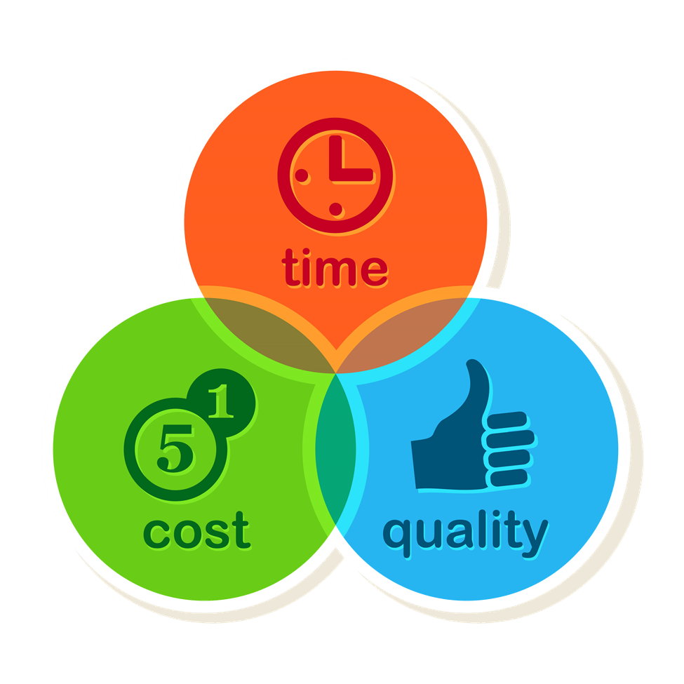
What’s in it for me?
To justify the ReFreSH effort there must be a demonstrated benefit to industry and regulators
For industry:
Faster release of product at import
Reduced operational cost
Harmonized import requirements
For regulators:
Greater phytosanitary security
Greater efficiency and transparency

Slide 20
Questions & Answers

