Slide 1
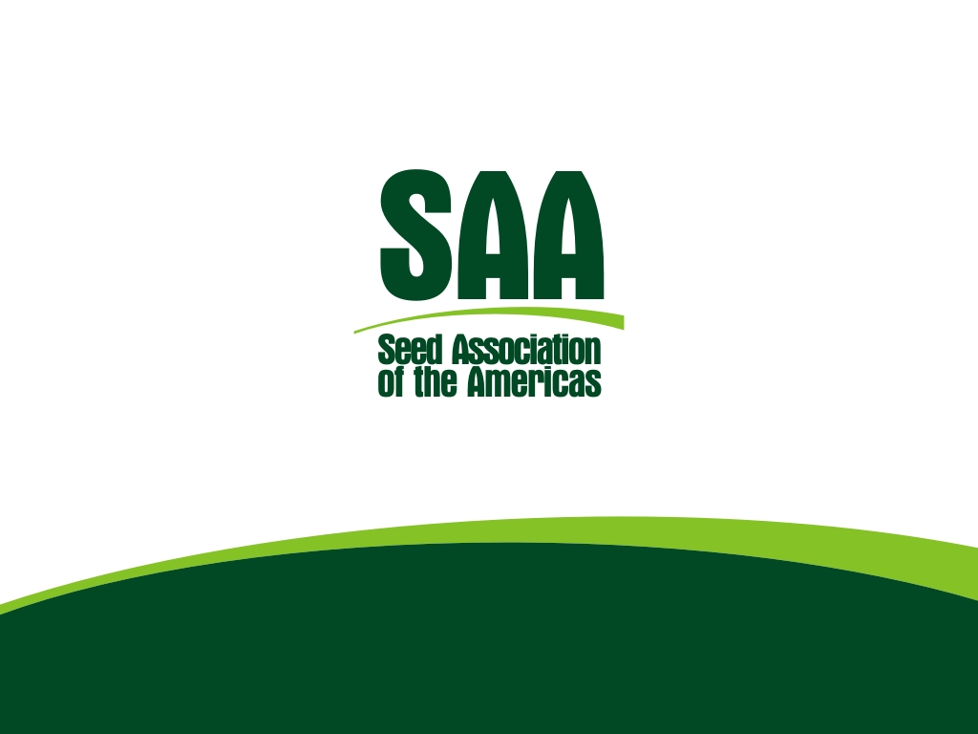
Chair: Antonio Tejada
Vice Chair: Paula Bey
Carlos Salvador
Seed Treatment Working Group
December, 2016

Slide 2
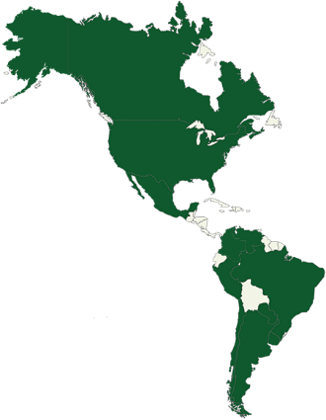
SAA Vision
“The Seed Association of the Americas is the globally recognized leading authority, representing with a unified voice, all common interests for the seed industry in the Americas"

Slide 3
Seed Treatment Working Group
Main Purposes of STWG
Facilitate Treated Seed Trade across the Americas
Promote safe use of Seed Applied Technology
Notes:
Promote the use of certified seed and profesisonal seed treatment application

Slide 4
Seed applied technologies
Identification of all Regulatory Agencies in SAA countries in the Continent, along with information of main contact within each agency: Database
Official agencies to fill out a questionnaire pertaining to:
Main Crops Seed being imported and exported
Label requirements for seed being imported and exported
Regulations on Biological products being applied to the seed
Looking for a way to harmonize labeling across crops, countries and regions
Education and Training Materials
Translation of some Seed Treatment User Guides and On Line Application Training courses: with the support from ISF and ASTA, on their already produced and published materials.
Next step is to take these courses down to other Seed Treatment Working Groups that are being formed in different SAA Members Countries.
Outcomes of the survey
(www)

Slide 5
Regulatory Activities
Identification and Contact Info of the Regulatory Agencies from each Country in the Americas – Database completed
Questionnaire regarding Seed Trade, Regulatory & Labeling Information
Mapping of key stakeholders: List of Seed Applied Technology Providers + regulatory agencies in each Country
Scale up to ISF → coordinate efforts

Slide 6
Questionnaire Preliminary Outcomes
Main crops being moved across countries :
Corn and Sorghum
Most Vegetables
Soy & Canola
Grass and Legume Forage Seed
Labeling of Seed Applied Technologies, overall is not a requirement in most reporting Countries of South America
The majority of requirements are for phytosanitary documentation

Slide 7
2016 Activities update
Face to Face Meeting in Santiago :: Chile; August :: topics
Participants from: Canada, USA, Mexico, Colombia, Ecuador, Brazil, Paraguay, Peru, Uruguay, Argentina and Chile
Sharing of local challenges being faced by Industry, as far as Seed Applied technologies go
Sharing of Best Practices and joint activities locally, in order to avoid suspensions of Seed treatments being applied
Important to maintain communication with the Phytosanitary Working Group, as Seed Applied Technologies are part of their discussions
Continued inflow of information from local Associations to build the Regulatory information to be uploaded into the Data Base

Slide 8
Challenges being faced by local Associations
Chile:
New regulations coming into effect, where a seed applied product must be on the seed to prevent disease spread for incoming seed
How can the STWG can help developing a guideline that can be shared with companies working in Chile
Canada:
Ontario is regulating the use of Neonics on Corn and Soy, with their goal to eleminate its use by 2017
Goverment looking to cancel registration on products (Neonics´) used on vegetables and other garden seed, affecting its flow into the country

Slide 9
Challenges being faced by local Associations
Mexico:
No Seed treatment Working group within AMSAC yet
Double treatments being required by authotities, quemical and physical: Is this really necesary?
Brazil:
Need a process to get rid of empty seed bags, as there is nothing in place currently, which creates a big environmental hazzard (although is a requisit defined by law) – how to do so? At what cost?
Treated seed that was not planted… which is the proper way to discard them? Not yet defined in BR
100% of Corn sedes are treated (compulsory by law)
Uruguay:
Treated sedes on grain exports a current problem

Slide 10
Challenges being faced by local Associations
USA:
A lawsuit was filed in US Federal Circuit Court to require US EPA to regulate seeds treated with pesticide products as pesticides through the planting process. Currently, EPA’s regulatory authority covers the application of the pesticide on the seed. After that application USDA and the Federal Seed Law regulates seed. If the plaintiffs (environmental groups, NGOs and bee keepers) had won, EPA would regulate seed through planting and would likely require a permit to plant seed. The plaintiffs lost this case and the seed industry/grower groups won the case

Slide 11
Mitigation plans and STWG efforts
Create and strengthen communication channels with regulatory authorities
Involve CropLife in discussions with authorities to reduce future risks & more regulations on Seed Applied Technologies across the Americas
Keep taking advantage of all Stewardship and Training documents available in different languages, created by ASTA and ISF (eg: AR & BR)
Take advantage of available resources in different countries where proper handling, application and use of seed treatments and treated seed can be shared with industry, distributors and producers
SAA to gather all this information and through the ST WG scale down to its members

Slide 12
Mitigation plans and STWG efforts
Strengthen communication with the Phytosanitary groups, not only within SAA, but also, within local associations
Consistent messaging on the benefits of Seed applied technologies across all Seed Associations, Local, Regional and Global

Slide 13
Activities going forward
Have communication fórums across the Americas with industry, authorities and general public
Create a list of products being used most commonly on seed moving across countries
Work more in conjunction with CropLife and Authorities across the Americas
Include new technologies within the working group, such as Biologicals/Natural products, as well as, seed treatment application technologies
Promote the use of documents and information gathered and uploaded to the SAA website for its Members

Slide 14
Thank you for your attention!
and Join SAA!
www.saaseed.org

