Slide 1
Introduction to the Soil Health Partnership
Nicholas J. Goeser, National Corn Growers Association

Slide 2
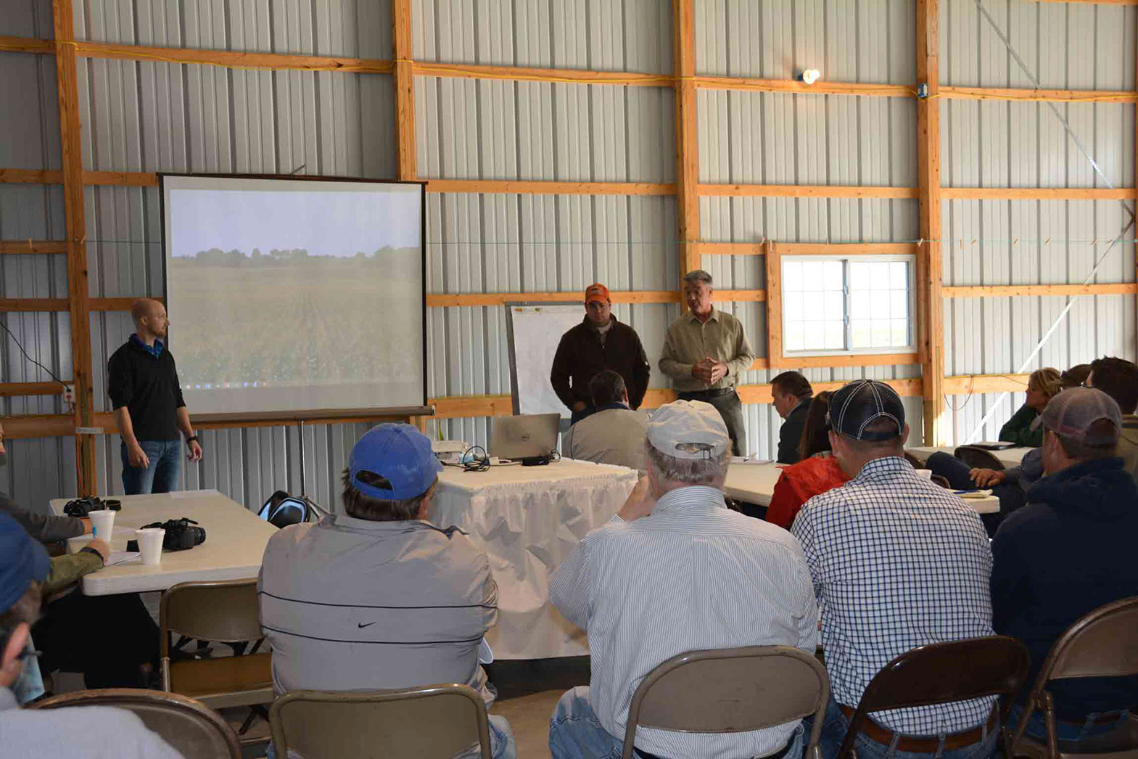
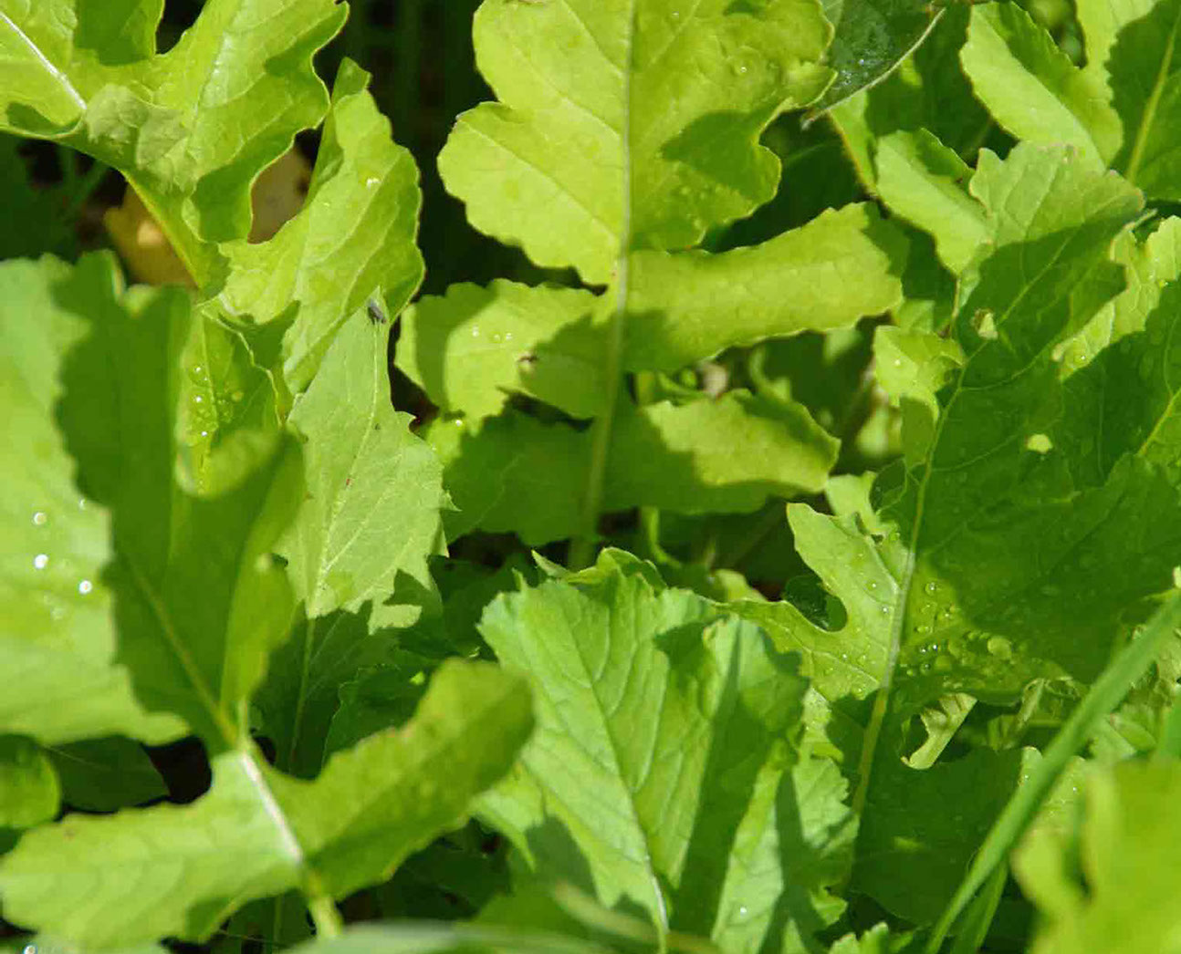
Overview
Objectives and organizational structure
Demonstration farm network
Outreach and communications structure
Research approach
Future Steps

Slide 3
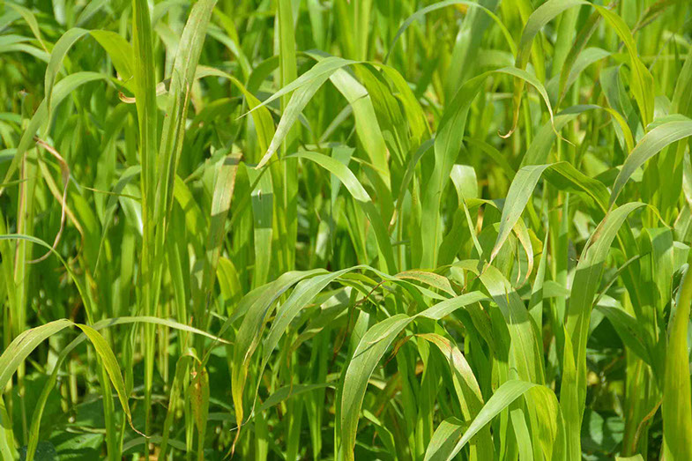
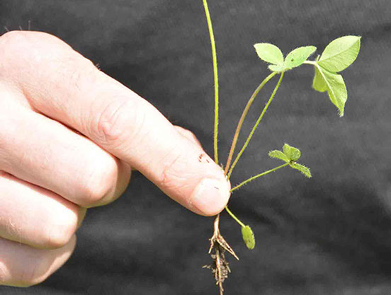
Goals of the Partnership
Build a network of demonstration farms
Establish research protocols
Publish findings and recommendations
Support networking and technical assistance

Slide 4
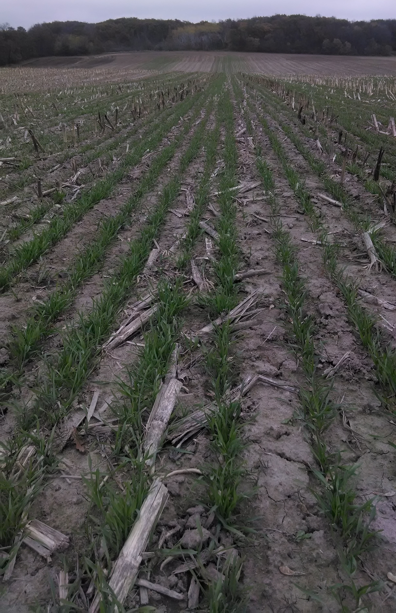
Partners and Organizational Structure
NCGA – administrator
Funding
Primary: Monsanto and Walton Family Foundation
NRCS CIG Grant ($1M) – awarded
Actively seeking additional funding partners
Steering committee: NCGA, MON, TNC
Technical advice: TNC
Scientific Advice: Science Advisory Council

Slide 5
Demonstration Farm Network
Network of 20+ sites annually across focusing on Iowa, Illinois and Indiana
Host location for field days and local resources
Develop farmer peer to peer mentoring networks
Measure soil health across various management practices
Farmer led discussion on improving soil health
e.g. Cover Crops, Precision Ag, Tillage, Advanced Nutrient Mgt
Use Field to Market Fieldprint calculator to measure and report outcomes

Slide 6
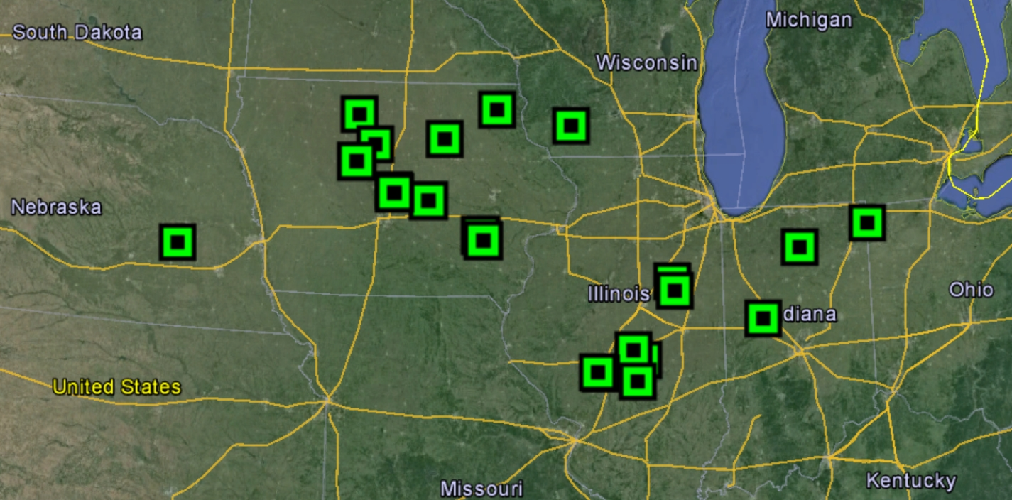
Current SHP Sites

Slide 7
Outreach and Communications for Farmers
Local field days
Web-based library of resources and farmer profiles
Tell the story of the SHP farmers
Resources for cover crops, conservation tillage, etc
Convene annual “Soil Health Summit”
Recognition program for leading farmers

Slide 8
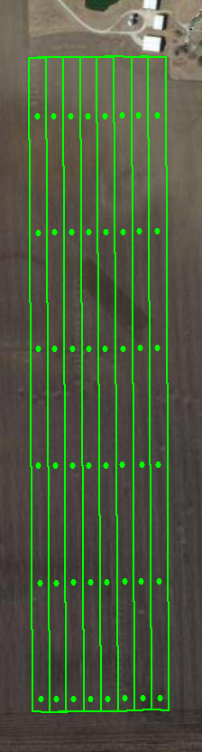
Research Approach –Systems comparisons
Standardized methodology across demonstration farm sites
Systems approach
Farmer control compared to adaptive management
Cover crops
Conservation tillage
Advanced nutrient management
Commitment to publish
Long term trends

Slide 9
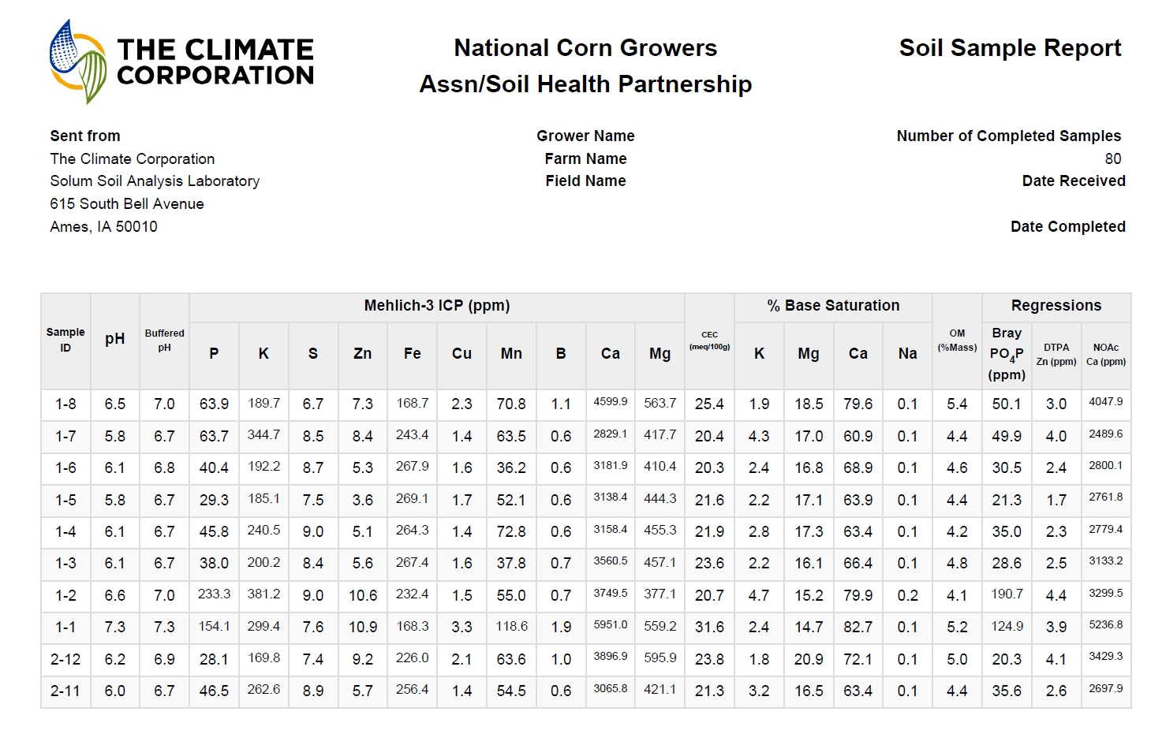
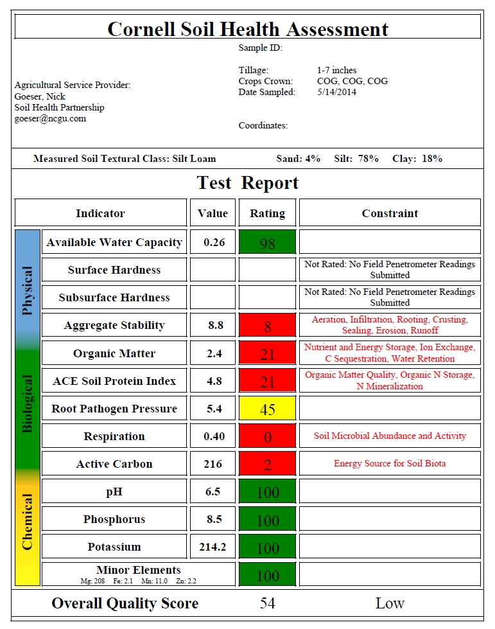
Metrics – Soil Health

Slide 10
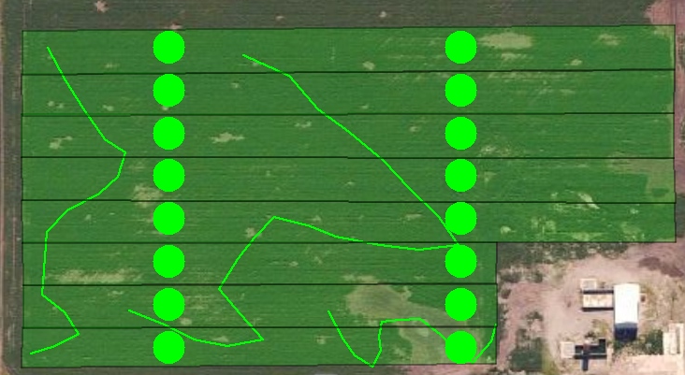
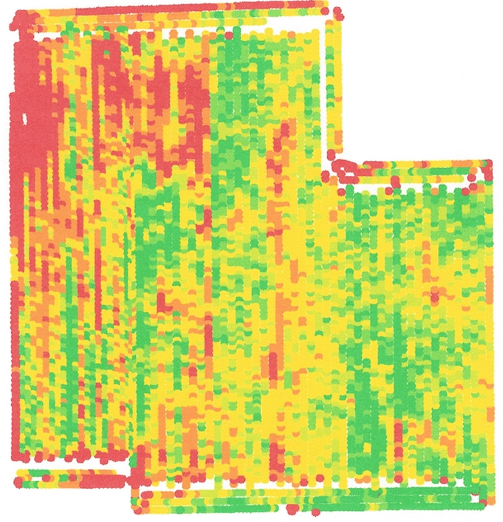
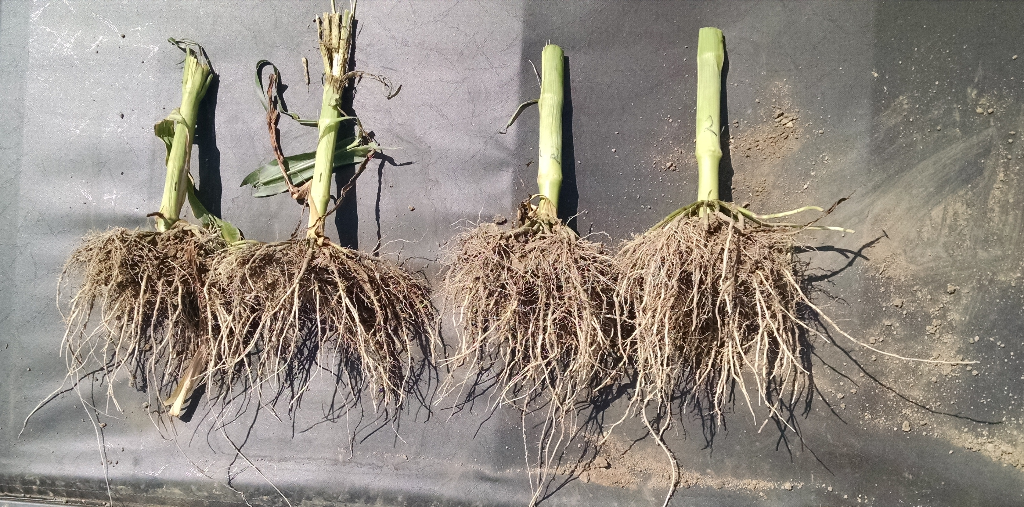
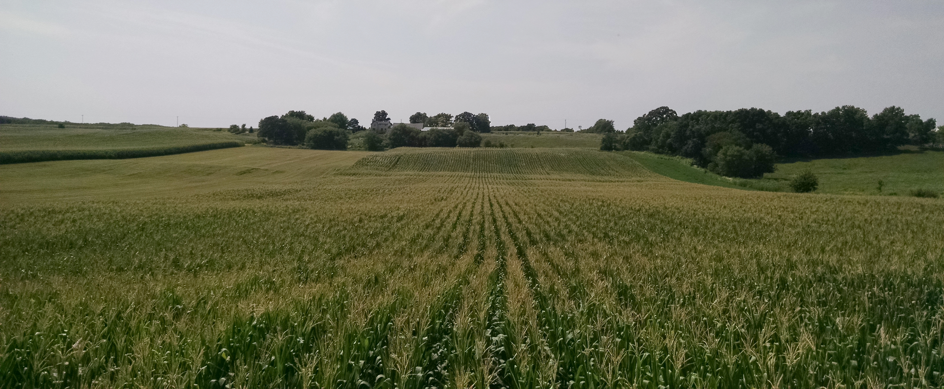
Metrics – Yield and Plant Health
http://www.niacc.edu/academics/departments/agriculture/field-yield-results/

Slide 11
Metrics – Economics
Yields
+/-
Cover crops
Seeding cost, termination,
Tillage
# passes, fuel usage, etc
Nutrient management
Nutrient applications, fertilizer costs, cover crop interactions
IPM
Pesticide costs – herbicide, insecticide, fungicide
Management
Labor, management time changes

Slide 12
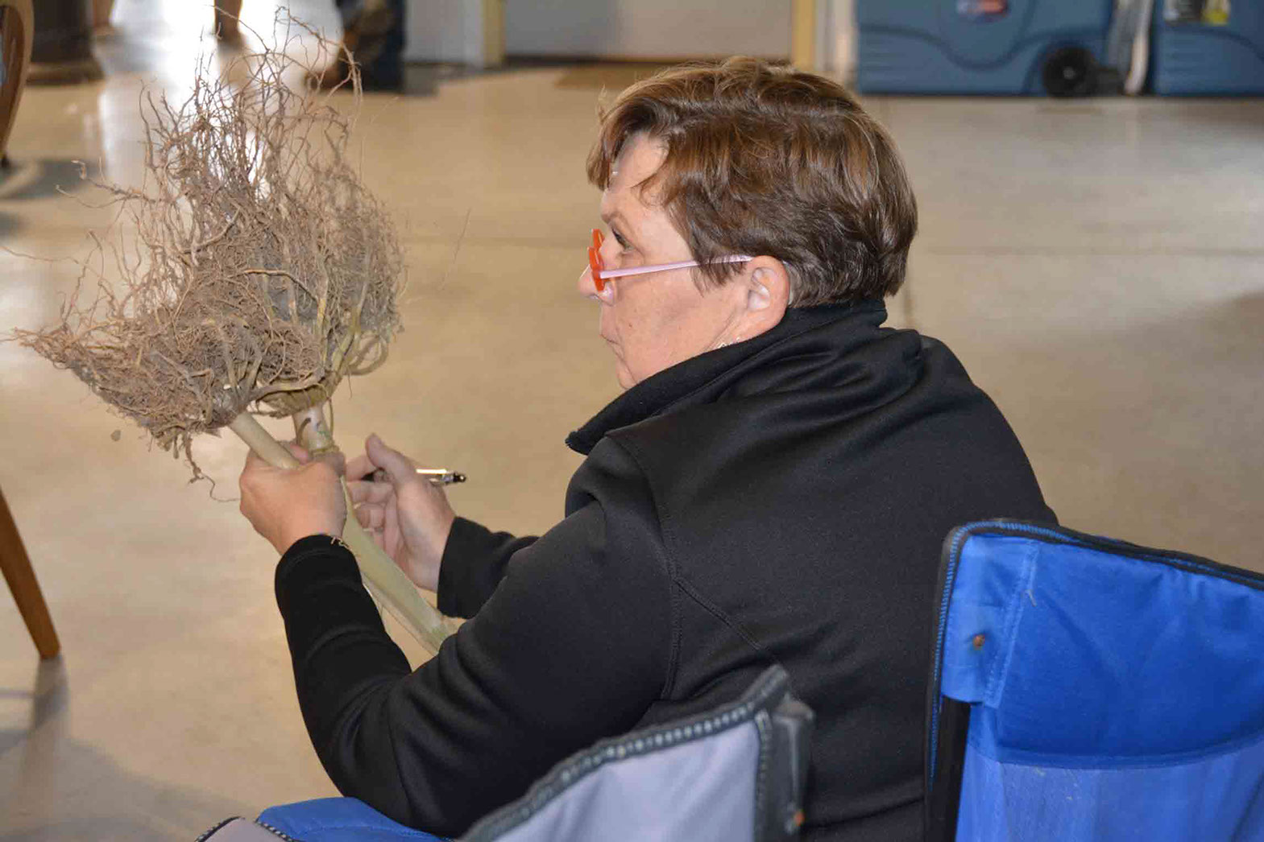
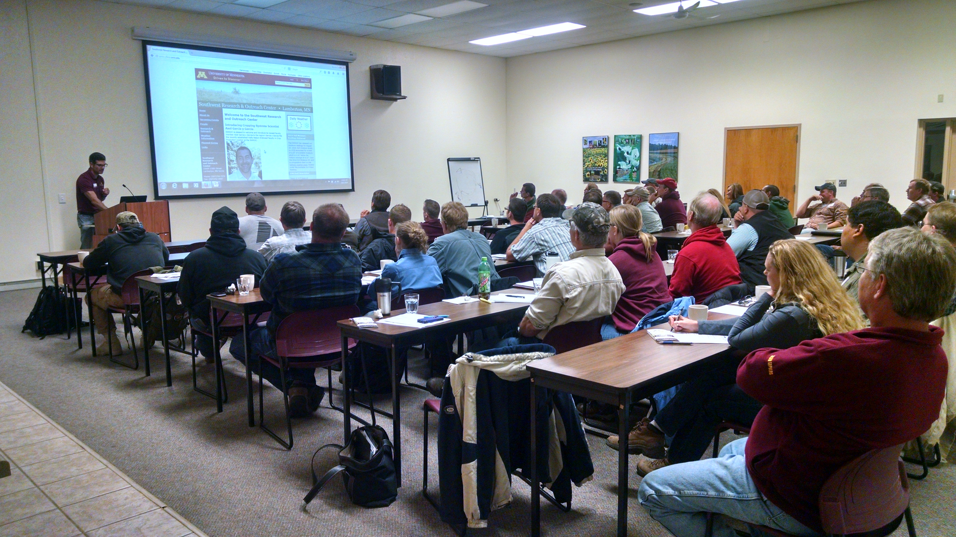
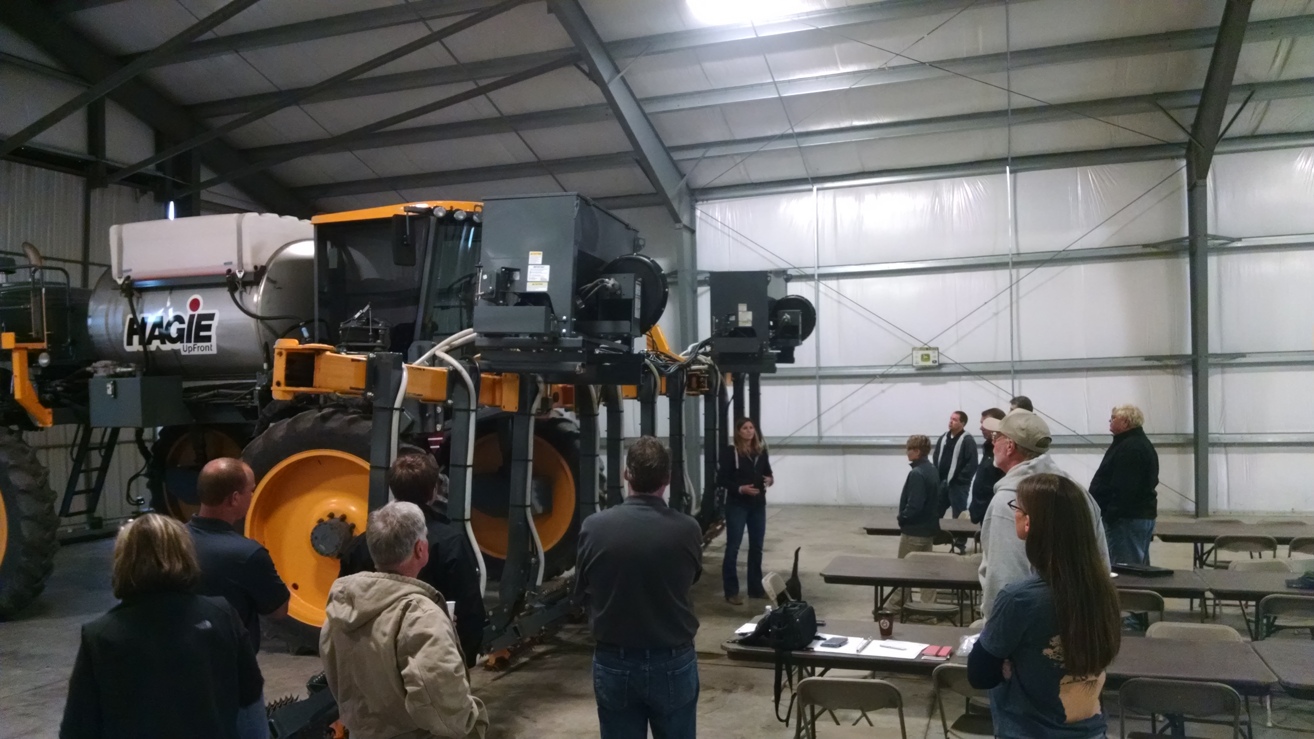
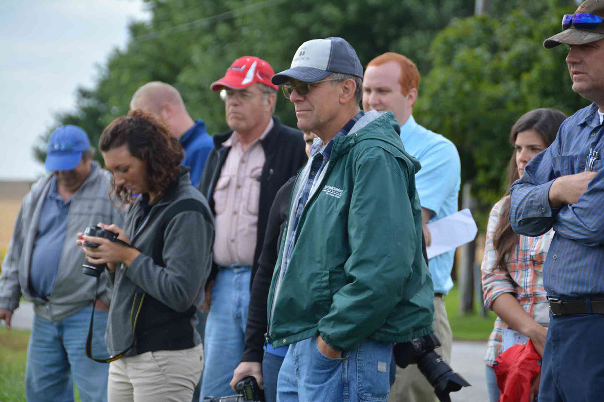
Focus on Cover Crops
What are farmers asking?
What are the recommendations to farmers?

Slide 13
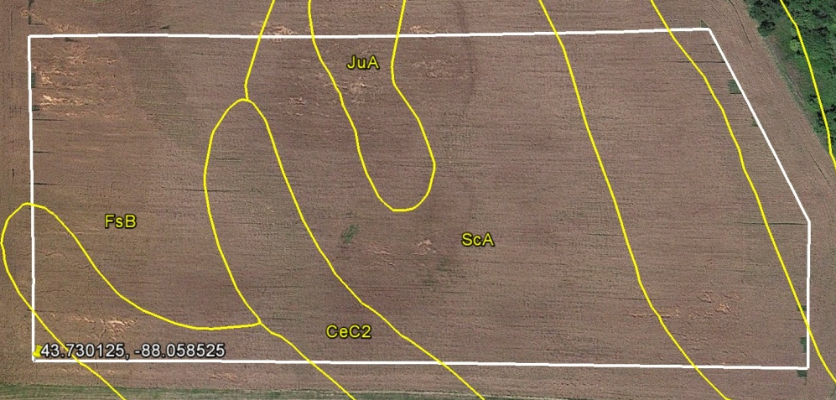
Focus on Cover Crops
Planning
12-18 month program across crop rotation
What are the goals for the cover crop species or mix?
Address specific areas
Low organic matter, great erosion potential, compaction, weed management

Slide 14
Plan A – Cover crop selection
Select cover crop species or mix to address specific areas of concern
Midwest Cover Crop Council Cover Crop Decision Tool Input information
Location information, cash crop, planting date, cover crop attributes

Slide 15
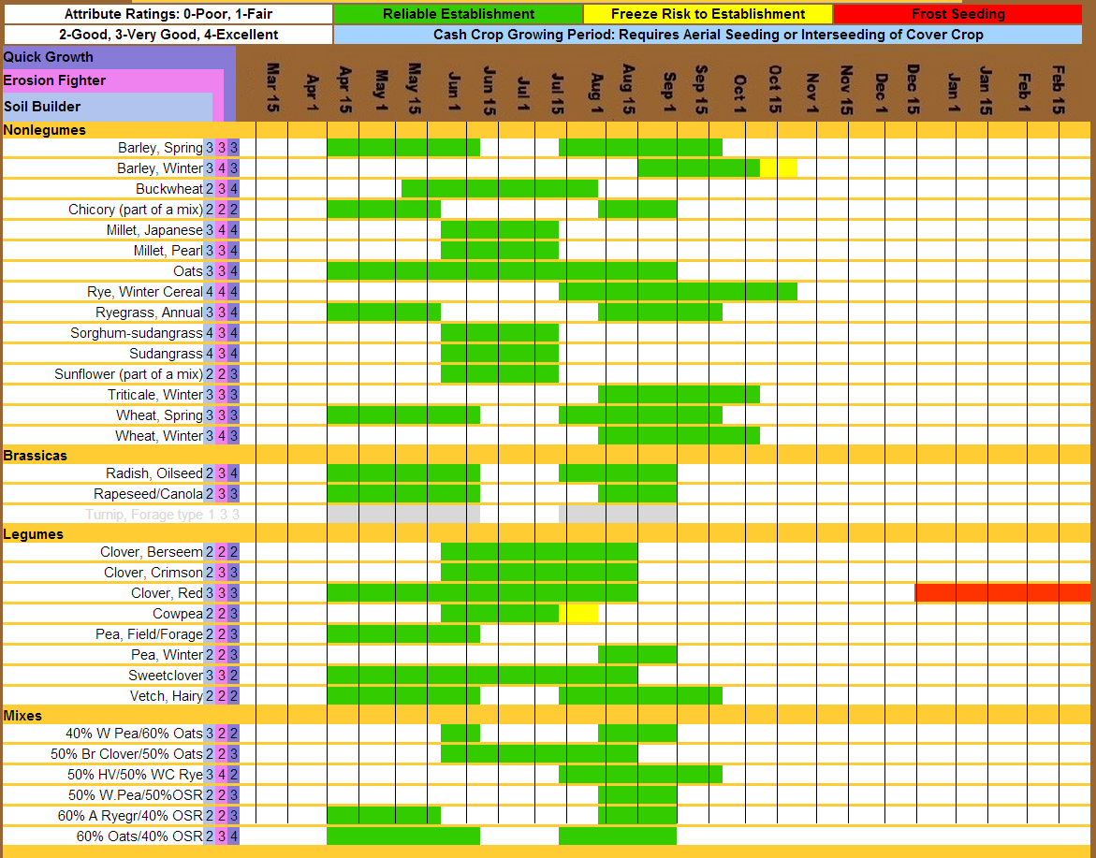

Slide 16
Plan A – System management
Grid sampling for documentation - tracking field changes
Hybrid and variety maturity
Cover crop supplier
Seed quality
Volume
Delivery adjustments
Herbicide adjustments to avoid carryover effects on cover crop establishment
Labor requirements
Termination of cover crop
Environmental conditions and herbicide efficacy
Heavy precipitation and low temperatures

Slide 17
Plan B – Adjustments due to harvest weather delays
Cover crop species adjustments
Potential switch to a more cold hardy species
Cover crop seed availability for species switch
Consider alternative cover crop seeding methods
Aerial seeding
Converted ground sprayer

Slide 18
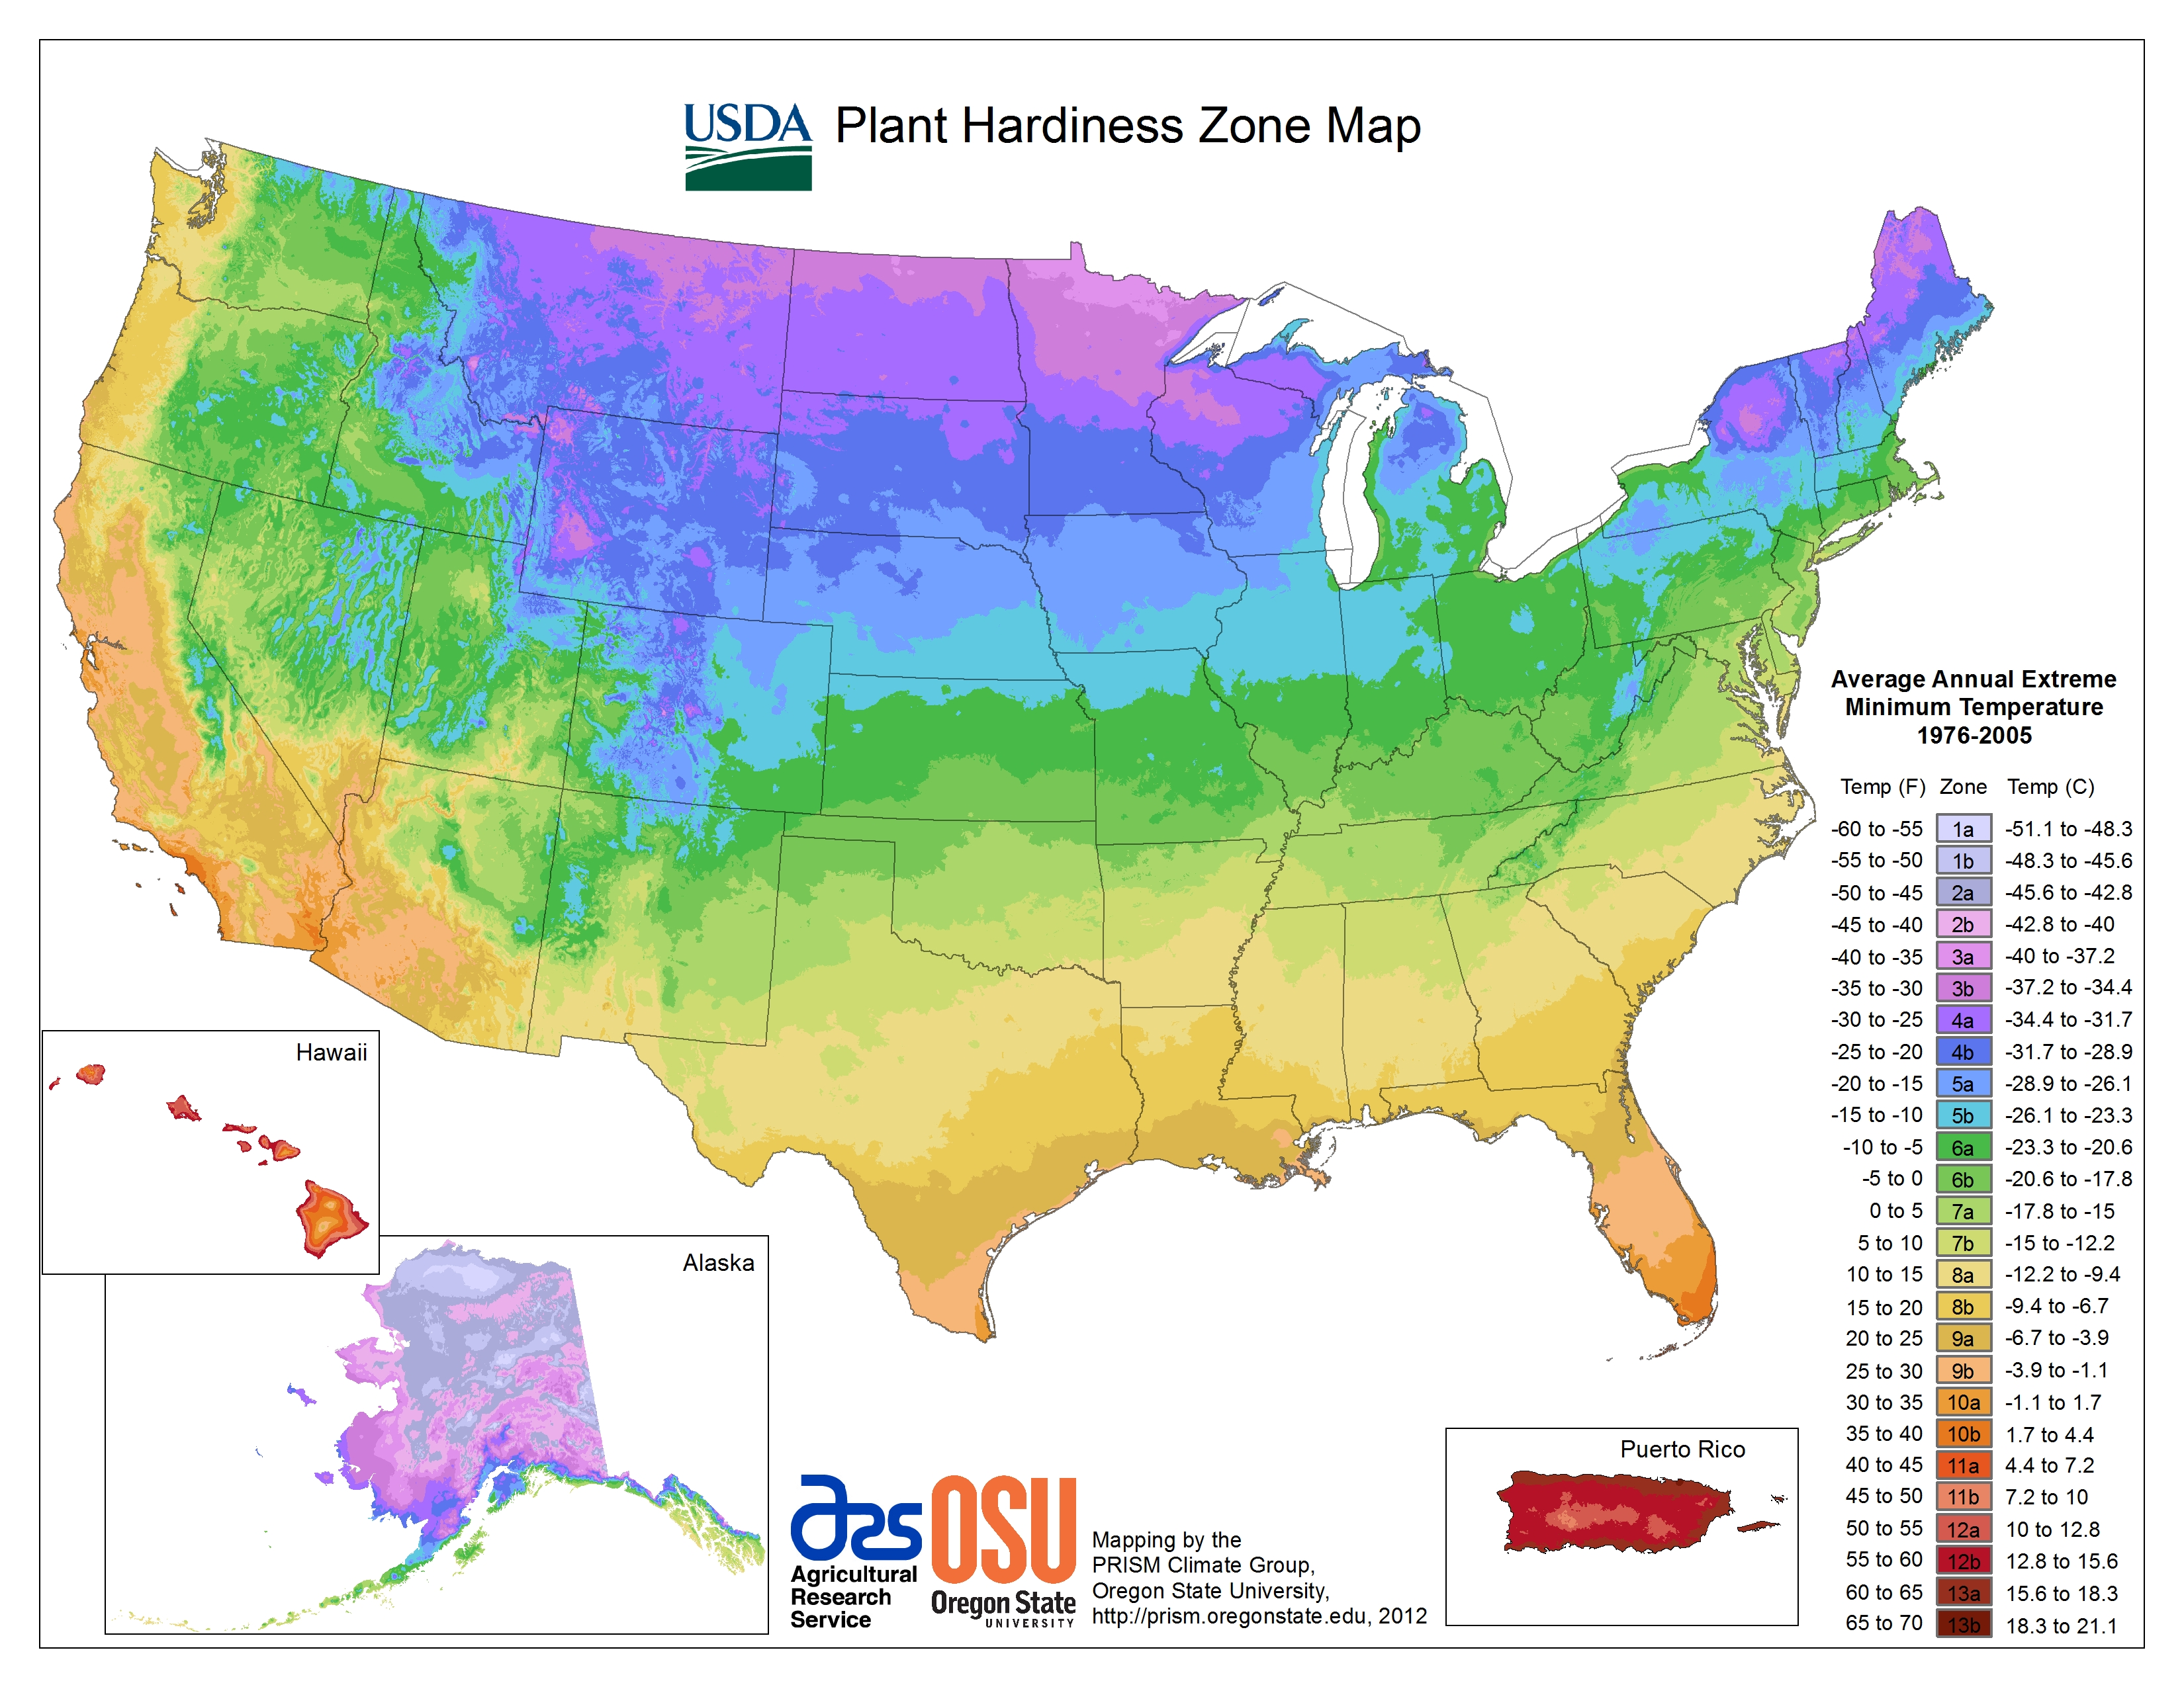
Future cover crops research
Species/mix interactions with
Nutrient management
Herbicides
Hybrids
No till/minimum till
Varietal characterization
Location trials
Soil types
Climatic gradients

Slide 19
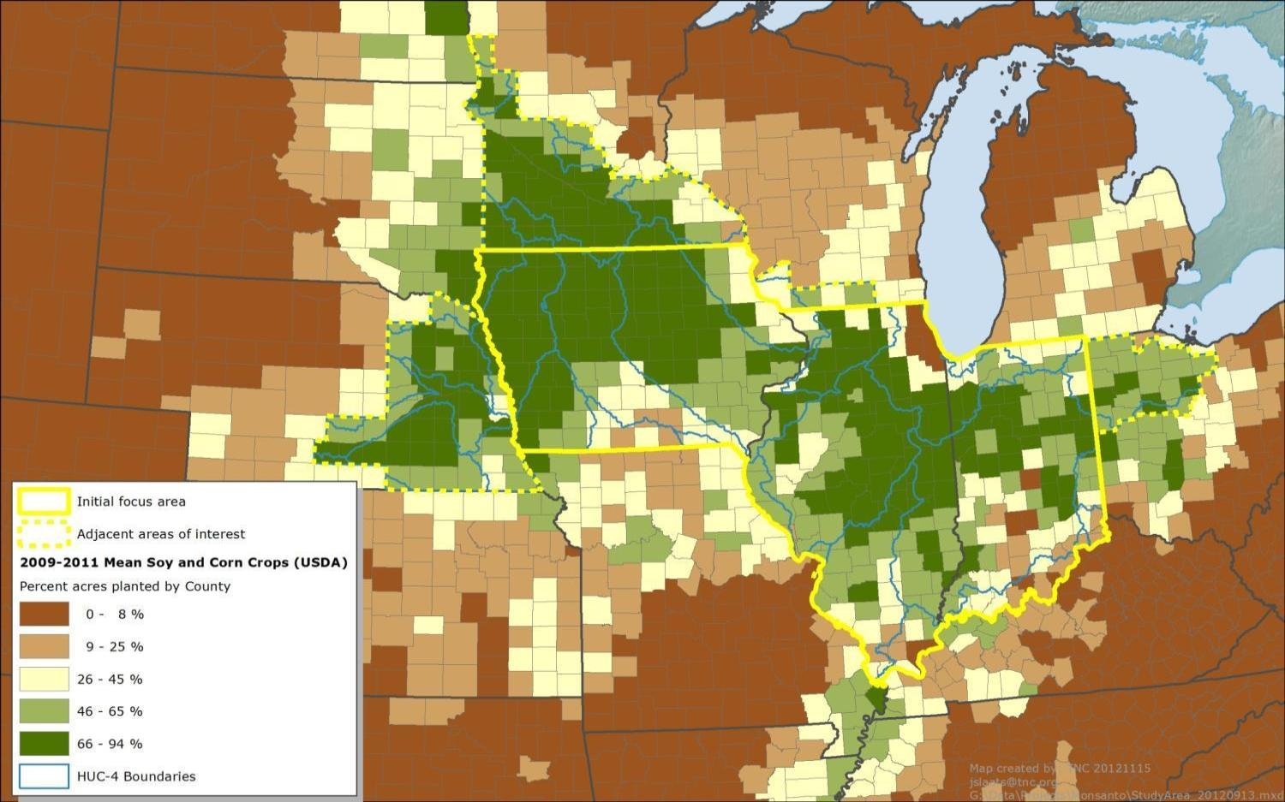
Next Steps
Network expansion
20+ farmers/year
Fostering peer-to-peer mentoring skills
Refinement of localized BMPs for farmers across the geography
Continue to foster collaboration
Data collection
Cover crops, soil health, sustainability, water quality, agronomic performance
Outreach and communications
Funding support

Slide 20
How to get involved
If you are interested in collaborative opportunities please email soilhealth@ncga.com
Website: Soilhealthpartnership.org
THANK YOU!

