Slide 1
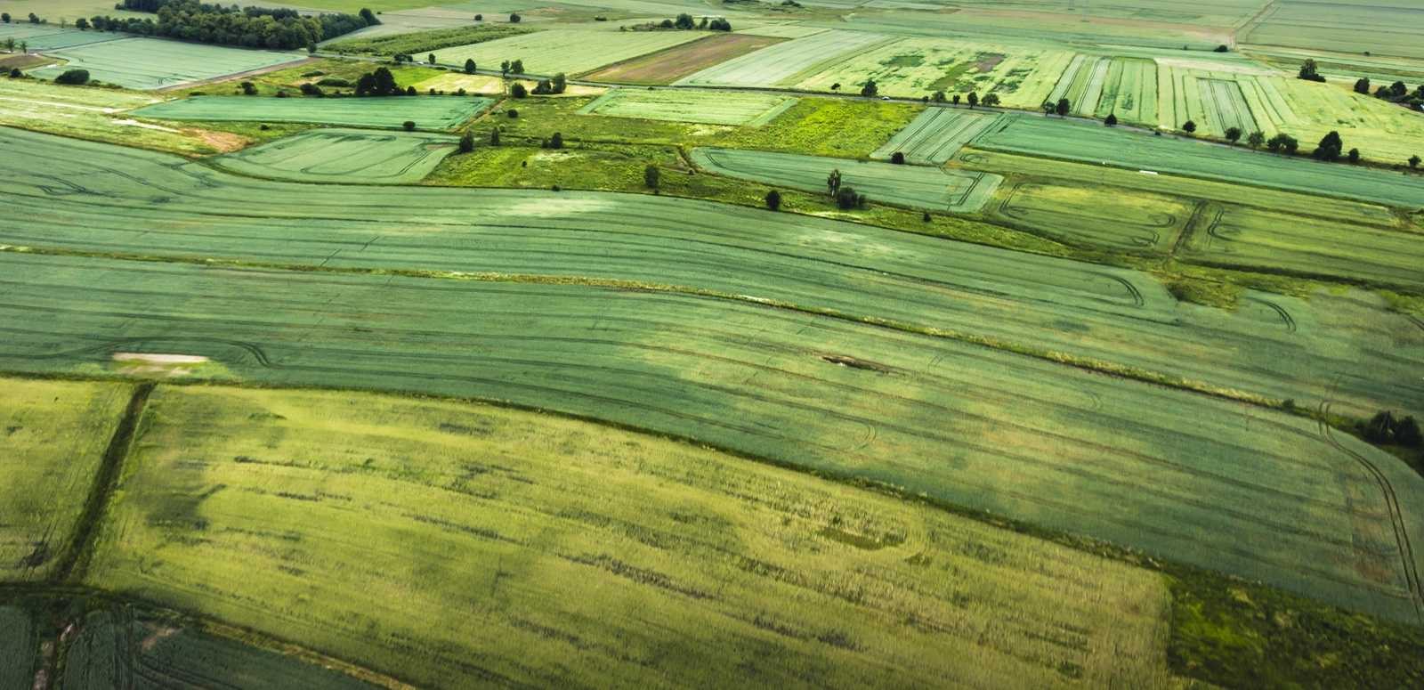

January 27, 2018
Advancements in Agriculture through Partnerships

Slide 2
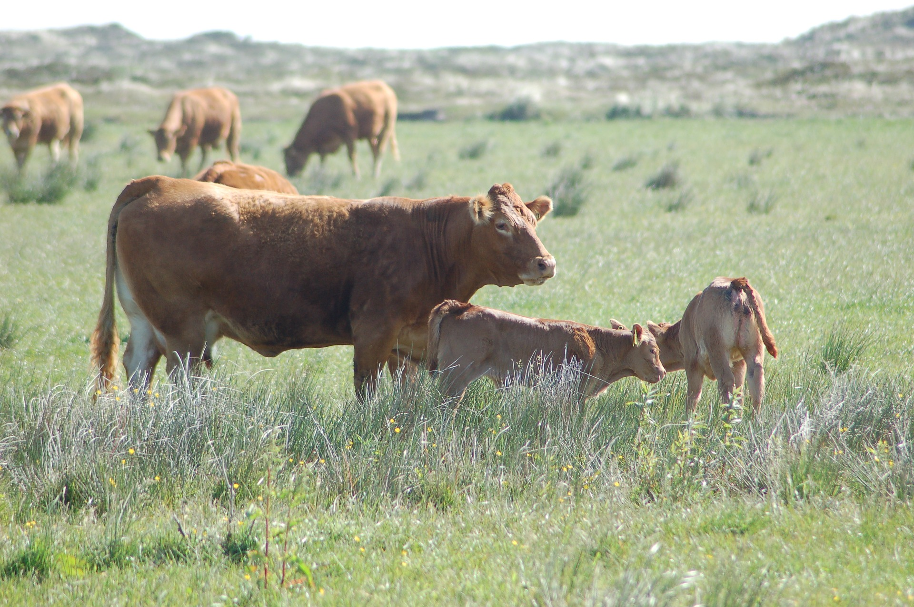

OUR VISION
We envision a world in which ever-innovating and collaborative science provides every person access to affordable, nutritious food grown on thriving farms.

Slide 3
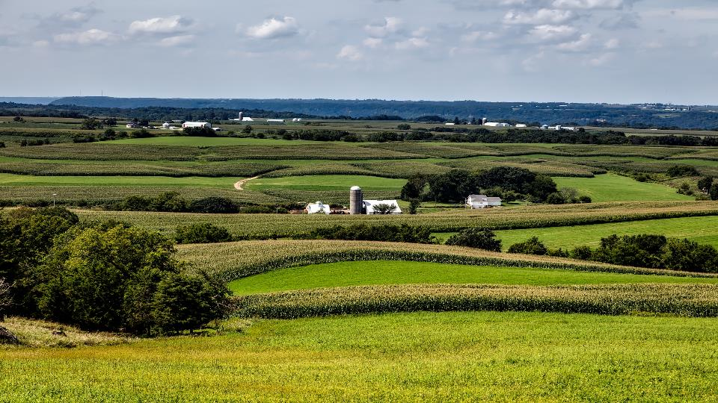

How We Work
$200M
+
$200M
FFAR
Investment
Non-U.S. Federal Match
Private-Public
Partnerships
We build unique partnerships to support innovative science addressing today’s food and agriculture challenges.
Flexible and nimble
Filling gaps in knowledge

Slide 4

CHALLENGES
POLLUTION
SUSTAINABILITY
COMPETITION FOR RESOURCES
SHIFTING DEMOGRAPHICS
competition for land and water resources
NUTRITION AND HEALTH
CLIMATE

Slide 5



PARTNERSHIPS
ADVANCING SOLUTIONS TO COMPLEX PROBLEMS--TOGETHER
COLLABORATION
TRANSFORMATIONAL CHANGE TO BENEFIT HUMANITY
COMPLEX
PROBLEMS
    POOLED RESOURCES
    POOLED KNOWLEDGE
    SHARED RISK

Slide 6
Pre-competitive Investments to Spur Innovation

Slide 7
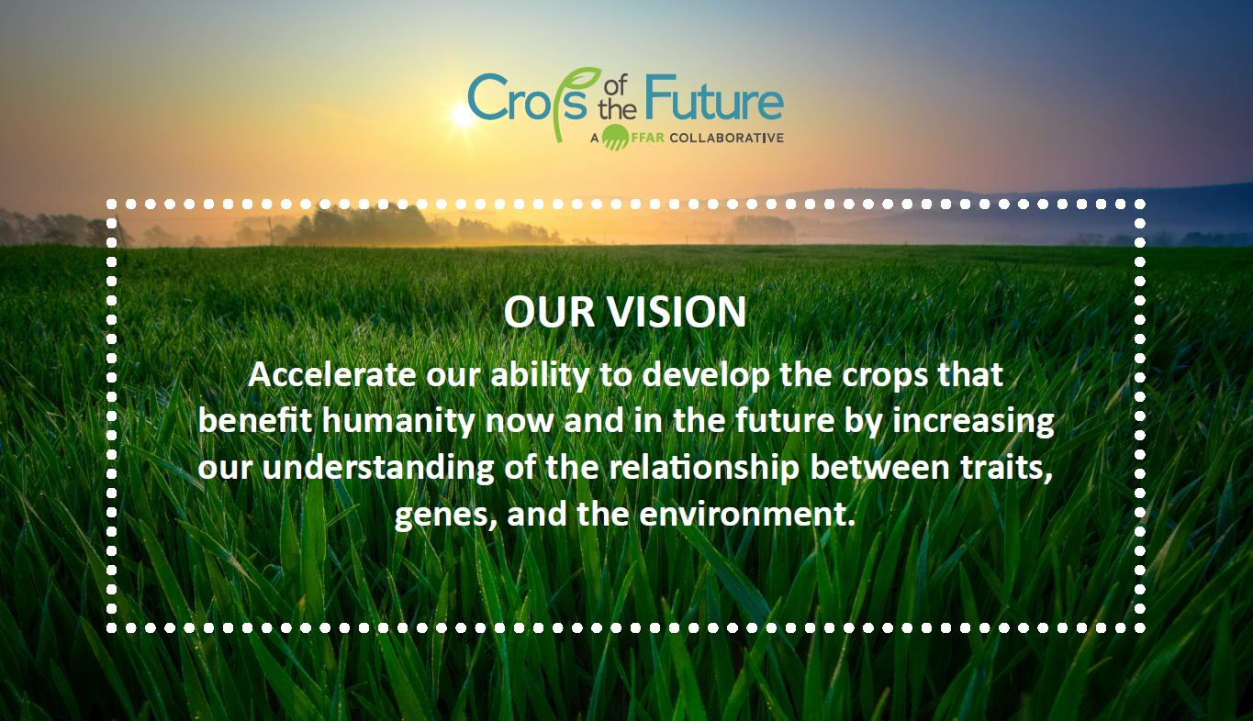

Slide 8




Initial Focus
Wheat
Maize
Leafy
greens
Cross-crop
technologies

Slide 9

COMPLEX CHARACTERISTICS
Understanding the physiological, biochemical, and molecular processes that influence the traits that give rise to complex characteristics.

Slide 10
COMPLEX CHARACTERISTIC
Trait 1
+
Trait 2
+
Trait 3
+
Trait 4
Molecular/
Biochemical/
Physiological
Molecular/
Biochemical/
Physiological
Molecular/
Biochemical/
Physiological
Molecular/
Biochemical/
Physiological
GENES
GENES
GENES
GENES

Slide 11
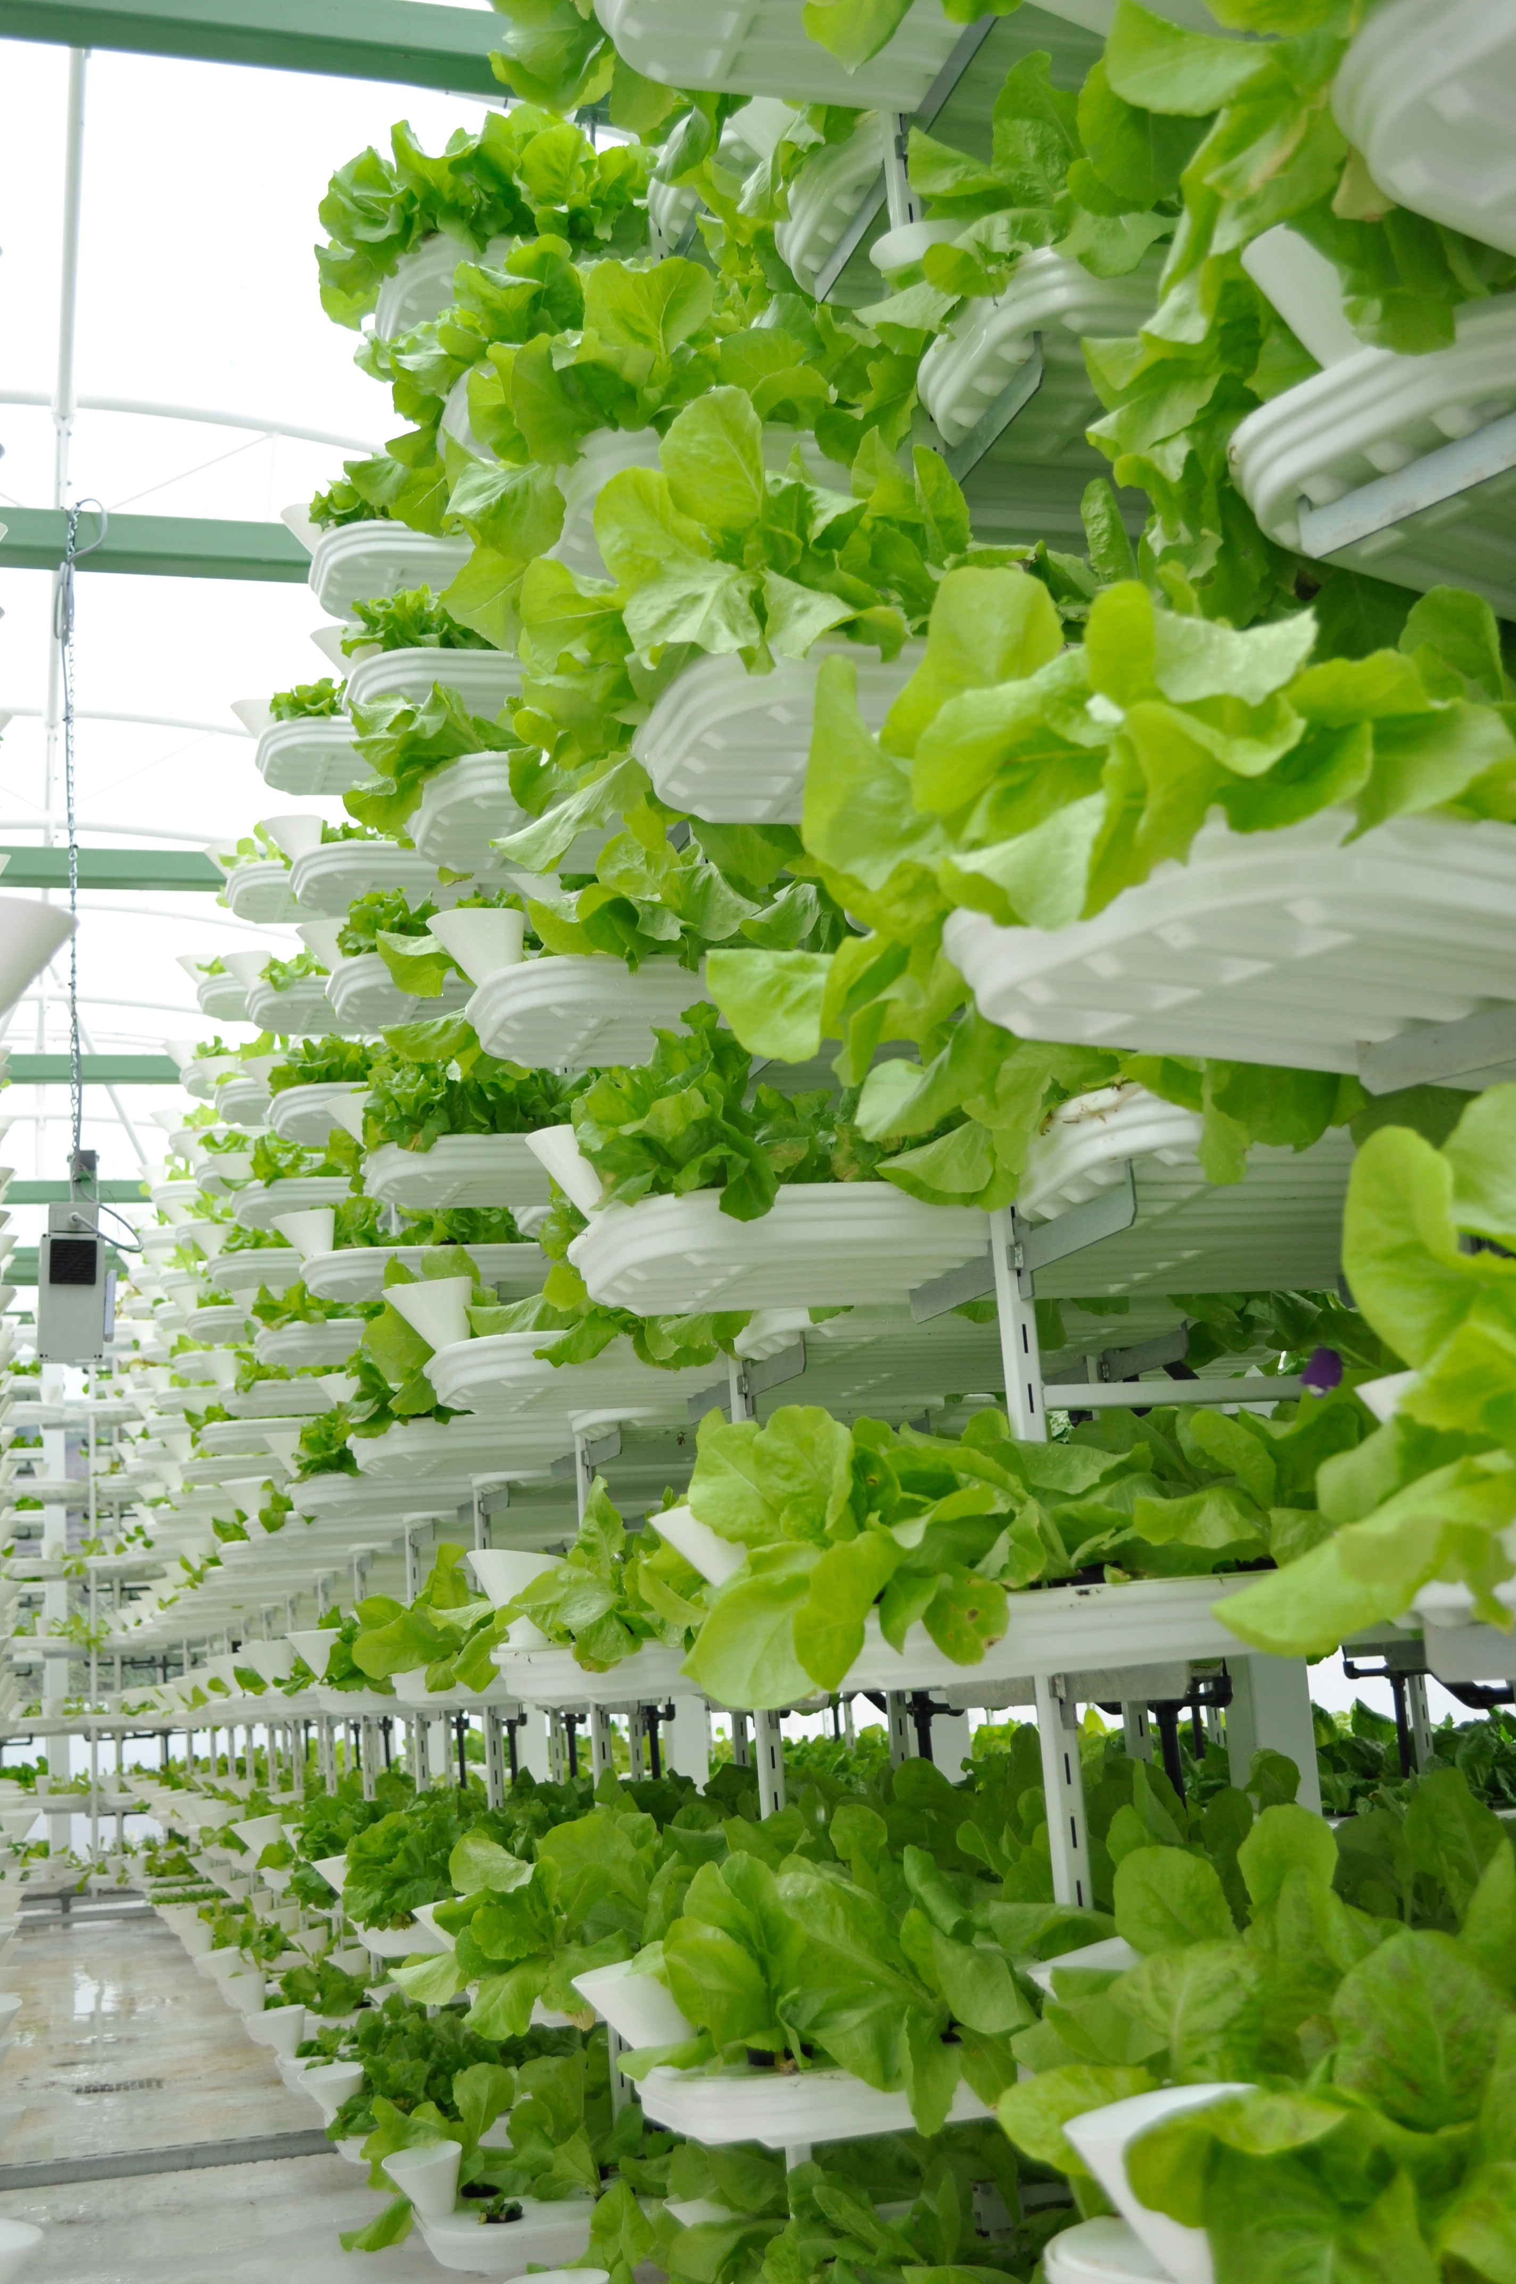
CONTROLLED ENVIRONMENTS
Addressing Challenges and Creating New Opportunities
Reduced water use, space, and other inputs
Increased Nutrition
Increased Flavor
Manipulate chemical composition
Manipulate organoleptic properties
Photo courtesy of Valcenteau and WikiCommons

Slide 12
CONTROLLED ENVIRONMENTS
Environmental Control Leads to Phenotypic Control
Same genotype and age, different lighting regimens

Slide 13



VERTICAL FARMING
Farming Beyond Lettuce
PRODUCT 365
LOCAL ECONOMIC GROWTH
Farming Beyond Lettuce
NICHE MARKETS
ACCESS

Slide 14
NICHE MARKETS FOR HIGH-VALUE CROPS
Food
Nutraceuticals
Medicinal
NICHE MARKETS
Industrial Precursors
High-Value Crops = High-Value Seeds

Slide 15


PARTNERSHIPS NEEDED FOR PROGRESS
ECONOMIC
OPPORTUNITIES
FOOD
SECURITY
WHAT CAN
WE GROW?
INFASTRUCTURE
MARKETS

Slide 16
CHALLENGE—GROWING CROPS INDOORS
Domestication And Adaptation
Current Focus
Lighting
Production Systems
Lettuce and herbs
Largely Neglected
Crops
Research in crop adaptation/domestication is high-risk, but it comes with high rewards

Slide 17
FFAR CROPS IN INDOOR ENVIRONMENTS COLLABORATIVE
Indoor Systems Require Different Traits
FFAR is developing a pre-competitive collaborative to advance efforts to grow specific, high-value crops indoors: a combination of environmental control (inputs) and plant genetics
Production-based Traits
Crop architecture
Production time
Yield
Photoperiod
Consumer-driven Traits
Nutrition
Organoleptic properties
Pre-cursors for industry
Medicinal
More of a focus on high-value traits, RATHER THAN disease resistance, drought tolerance, heat stress tolerance, ……

Slide 18
ONE LAST THING

Slide 19

FFAR Project: Decoding Science Behind New Plant and Animal Breeding Technologies (1)
Goal
To leverage knowledge on communicating science and stimulate social science research that results in a “clarity campaign” for NBTs, and their effects on food, health and the environment.
  A multi-disciplinary, multi-method, iterative process that emphasizes empirical testing of potential messaging effects.
  Partnerships with farmer/producers, industry, public health professionals or other stakeholders (e.g., consumer groups).

Slide 20

FFAR Project: Decoding Science Behind New Plant and Animal Breeding Technologies (2)
Objectives:
  To develop a comprehensive “toolbox” for building frames and metaphors that:
    “humanize” science,
    help understand technologies, and
    build trust between the public and scientists.
  To build on published evidence-based approaches to science messaging.

Slide 21
Looking Ahead
HELP SHAPE THE VERTICAL FARMING INDUSTRY AND THE FUTURE OF AGRICULTURE BY WORKING WITH FFAR
Engage with FFAR
  Submit a research concept online
  Join a convening event to participate in developing future programs
  Start with a conversation: Contact us directly

Slide 22
How to Reach FFAR
John Reich
jreich@foundationfar.org

