Slide 1

  Module: Seed Intellectual Property
  -Explains why Seed IP is a necessary protection for plant breeders to enable them to develop improved seed to help solve many of our global challenges
  -Audiences: Members, potential spokespeople, industry allies and policy decision makers

Slide 2
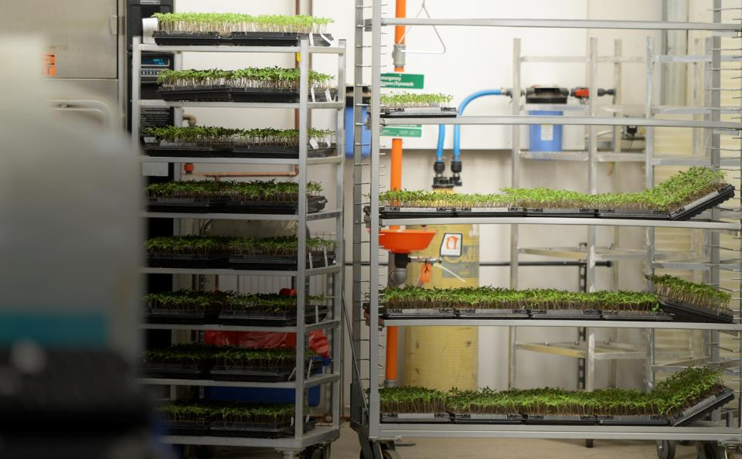
The success we have been discussing is enabled by the seed breeders and seed companies that invest significant resources into R&D.
10-15 years
Millions of $ in investment
Skilled scientific expertise
Land and special equipment

Slide 3




The new varieties developed are unique to the breeders activities and are thus afforded intellectual property protection
Same protection afforded to technologies and discoveries in other industries.

Slide 4



The seed industry uses a variety of tools to protect their IP to both the benefit of the breeder and consumer.
  Plant Variety Protection
  Utility Patent
  Plant Patent
  Contracts
  Trade Secrets

Slide 5
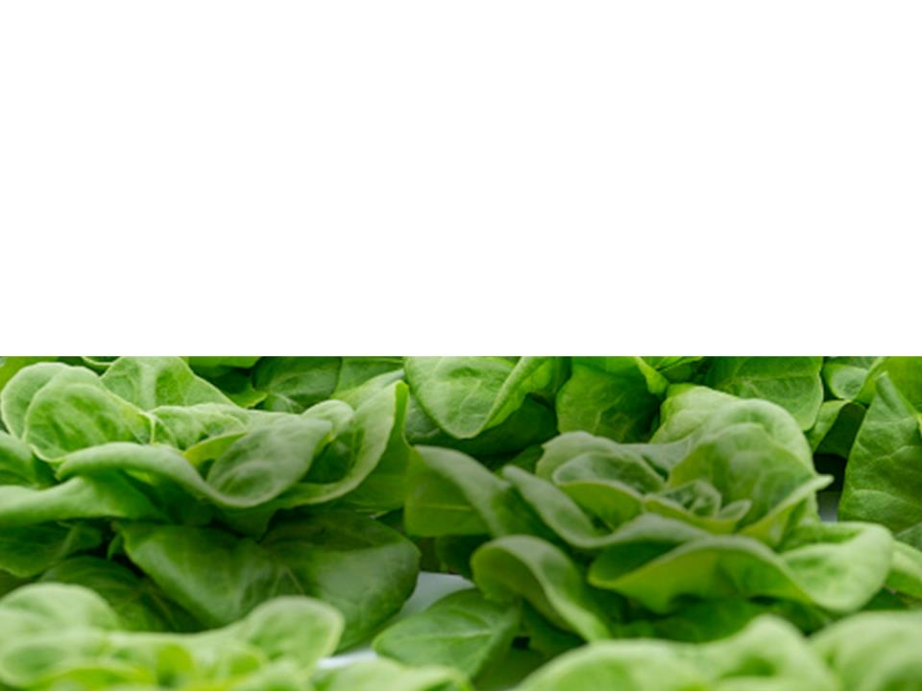
As seed improvements advanced, farmers came to value and expect the arrival of improved seed each year.
Seed improvement expectations each year
Higher germination
Higher seed purity
Latest innovations in disease resistance, pest resistance, flavor, etc.
Continuous seed improvement has led to a strong, decades long, farmer and consumer expectation of better seed and better produce each year

Slide 6
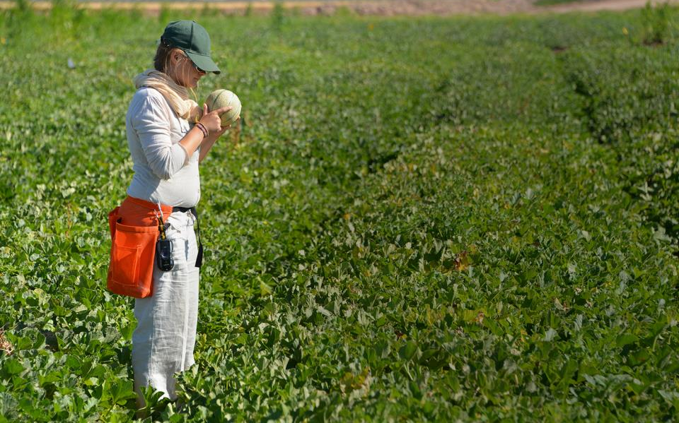
Farmers are still allowed to save seed for use on their own land, as long as it only has PVP protection or the seed IP has expired.
Farmers that want to use seed without restrictions can obtain public varieties through:
USDA’s National Plant Germplasm System
Land grant universities

Slide 7
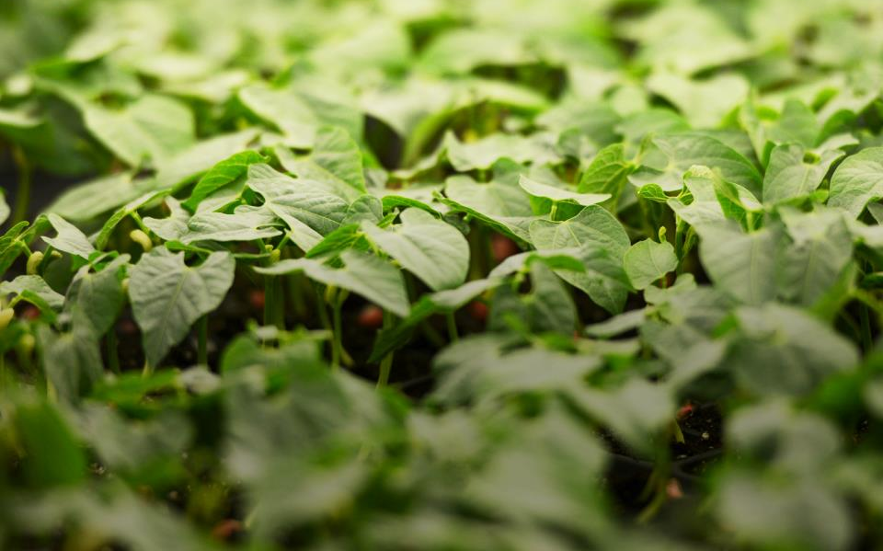

Many leading international government bodies recognize the importance of Seed IP rights.
International Governmental Organizations
International Union for the Protection of New Varieties of Plants (UPOV)
World Trade Organization (WTO) and Trade Related Aspects of Intellectual Property (TRIPS)
World Intellectual Property Organization (WIPO)

Slide 8
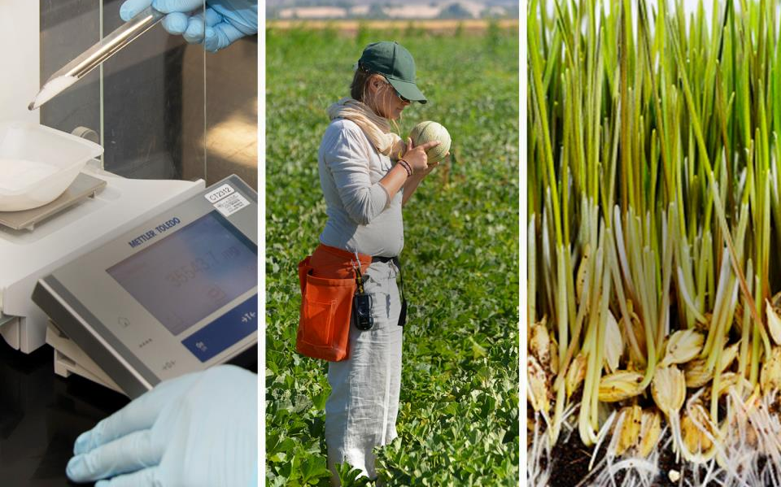
ASTA is committed to maintaining vital IP protection for researchers, breeders and seed companies to continue to improve our seed.
RESEARCHERS
BREEDERS
SEED COMPANIES

