Slide 1


Slide 2
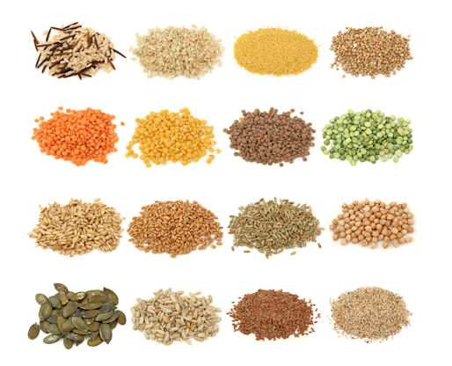
Novel technologies for treating seedborne pathogens
Ron Walcott
http://paoniafarmandhome.com/tag/botanical-interests-organic-seeds/

Slide 3
Ideal characteristics of seed treatments
Broad spectrum activity
Effectively inactivate/kill pathogens
Penetrate deep into seed tissues
Low toxicity to humans/animals & plants
No toxic residues
Easy to apply
Applicable to large seedlots

Slide 4
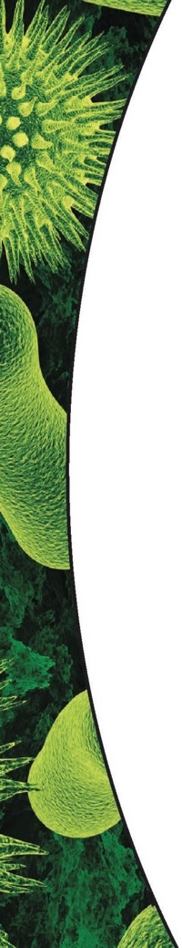


Aerosolized H₂O₂
How Does It Work?
Destroys proteins, carbohydrates and lipids on contact (via oxidation) which results in killing bacteria, bacterial and fungal spores and inactivation of viruses.
Reacts with chemical agents by breaking their double bond and neutralizing them via oxidation. The same is true with weaponized biological agents as they are neutralized via oxidation.
The by-products of the activated hydrogen peroxide are oxygen and water and by-products are safer to handle than those left by conventional methods.
(1) <8% Hydrogen Peroxide Solution
(5) Plasma Arc
(6) Activated Ionized Hydrogen Peroxide (AIHP) Fog
Reactive Oxygen Species
(2) Nozzle
(3) Hydrogen Peroxide Fog
(4) Electrodes

Slide 5
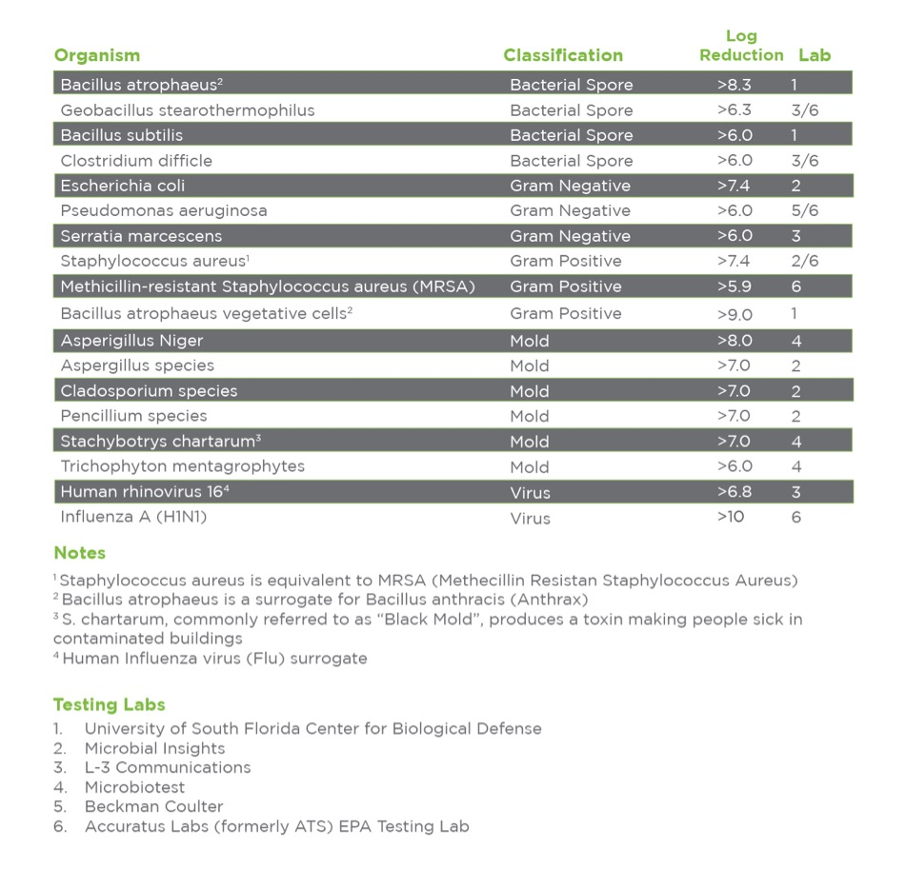




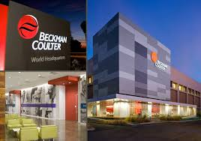

Efficacy Against Microbial Pathogens
1.
2.
3.
4.
5.
6.

Slide 6
Potential of Steramist as a seed treatment
Pros
Broad spectrum activity
Low moisture
Limited residual toxicity expected
Short treatment time
Cons:
Ability to penetrate into seeds
General applicability & efficacy as a seed treatment
Current status:
Customizable applications
Not evaluated as a seed treatment

Slide 7
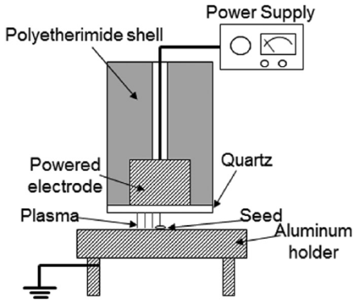
Non-thermal “cold” plasma
Plasma:
generated by subjecting gas to high electric fields
composed of excited atoms & molecules, free radicals and electrons
kill microbes on contact by degrading DNA & cellular components
remains at ambient temp (25-50C) when generated with low voltage & pressure
Jo, et al, Crop Sci. 2014

Slide 8
Non-thermal plasma treatment for seedborne pathogens
Gibberella fujikori on rice seed
Jo et al, Crop Sci. 2014

Slide 9
Non-thermal plasma treatment for seedborne pathogens
Xanthomonas campestris pv. campestris on Brassica seeds
Nishioka et al., Biocontrol Sci., 2016

Slide 10
Potential of non-thermal plasma as a seed treatment
Pros
Potential for broad spectrum activity
Low moisture
Limited residual toxicity expected
Short treatment time
Cons:
Ability to penetrate into seeds
Current status:
Research needed to evaluate efficacy on naturally infested seeds

Slide 11
SOLUTIONS FOR
YOUR CHALLENGE
Immobilized biocidal enzymes
USING IMMOBILIZED BIOCIDAL ENZYMES TO ADDRESS 3 KEY PROBLEMS IN AGRICULTURE
Problem | Zymtronix’s solution | Added-value
Seeds carry pathogens and fail increasingly stringent sanitary inspections | Cleansing formula to kill seedborne pathogens | Quickly sanitize batch of seeds
Germinating seedlings are exposed to seedborne and soilborne pathogens | Antibacterial and antifungal coating for seed protection | Activation during early germination
Spread of diseases through crops | Broad spectrum foliar spray | Quick control at the first sign of symptoms
All have potential for organic certification.
NON-CONFIDENTIAL

Slide 12
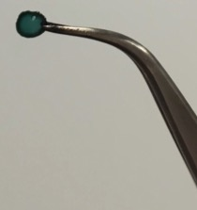
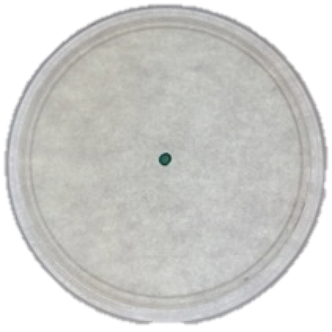
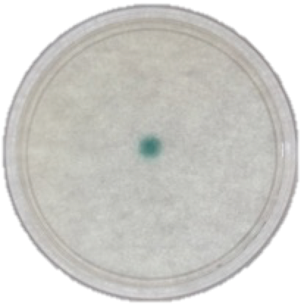


ZYMTRONIX DELIVERS STABLE BIOCIDAL ENZYME FORMULATIONS
Solid-film, Dissolvable, Stabilized enzyme formulation:
Controlled release
Tunable activity duration
Stable storage
Dry: inactive formulation
Hydrated: Active formulation
NON-CONFIDENTIAL

Slide 13
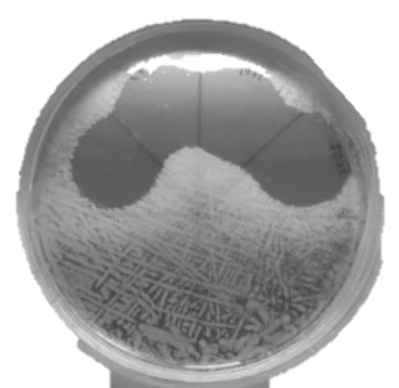
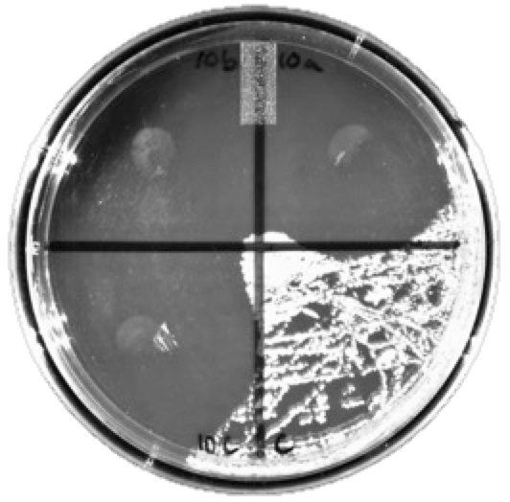
PROTECTING AGAINST
BACTERIAL PATHOGENS
Controlled release of potent antibacterial free-radicals
Broad spectrum at low concentrations of enzymes.
Diffusible free-radicals effective against broad spectrum of gram-negative and gram-positive bacteria.
Formula has been re-optimized for increased potency (220%) against a broad range of plant bacterial pathogens in solution or solid from (6 logs CFU reduction) - also efficient on E. Coli
Zones of bacterial inhibition
surrounding enzyme disks
2015
2016
NON-CONFIDENTIAL

Slide 14
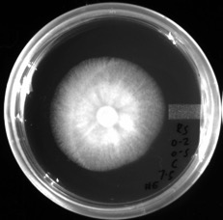
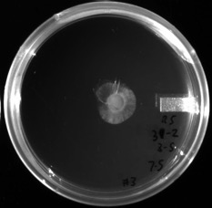
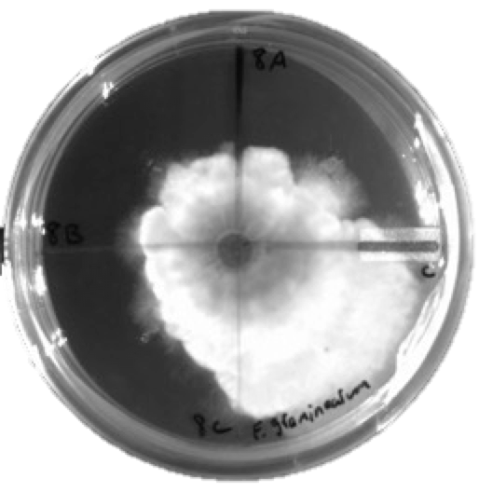
FUNGICIDAL AND FUNGISTATIC ACTIVITY
Up to complete inhibition of growth against damping-off pathogens.
  Complete inhibition of Pathogen 3 and 72% reduction in Pathogen 4 growth.
Control Formulation
Control Formulation
Pathogen 3
Pathogen 4
Treatments
Effective chemorepulsion of fungal growth
Control quadrant
NON-CONFIDENTIAL

Slide 15
Potential of immobilized biocidal enzymes as seed treatments
Pros:
Broad spectrum activity
Amenable as a seed coat
Cons:
Ability to penetrate into seeds
Current status:
Research needed to evaluate efficacy against naturally infested seeds

Slide 16
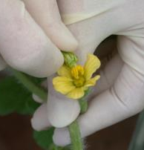
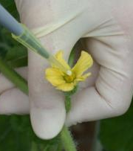
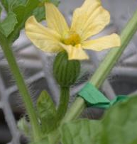
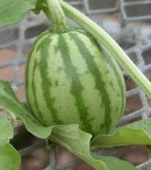
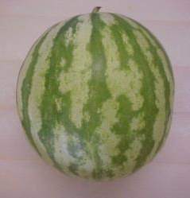
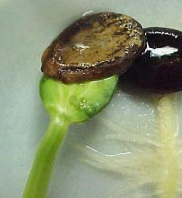
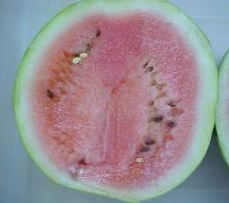
Seed treatment with BCAs

Slide 17
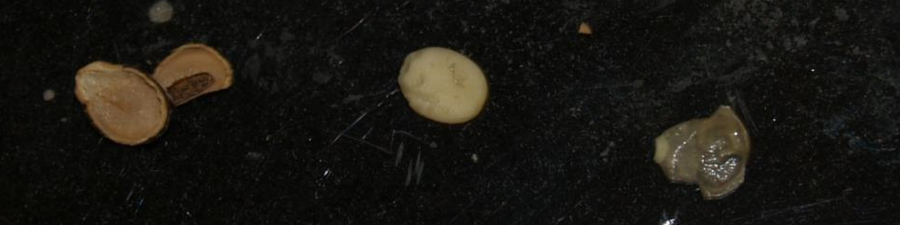
Localization of A. citrulli in watermelon seed tissues
Testa
Endosperm/Embryo
PE layer
A. citrulli cells accumulate in embryos of stigma-inoculated seeds
A. citrulli cells accumulate on the PE layer in pericarp-inoculated seeds
Seed sections | Stigma-inoculation (%) | Pericarp-inoculation (%)
Testae | 7.5 c | 2.5 c
PE layers | 77.5 b | 95.0 a
Embryos/ endosperms | 90 ab | 6.5 c
Dutta et al., 2012, Phytopathology

Slide 18
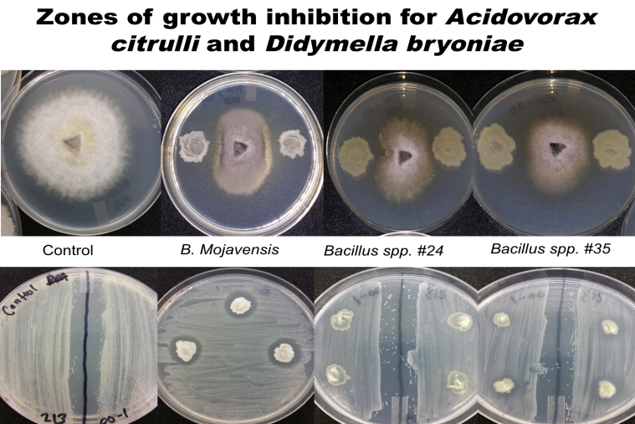
Flower inoculation to deposit BCA inside seeds
Strategy:
Identify naturally occurring watermelon seed microflora with antagonistic activity against A. citrulli
Control
B. mojavensis RRC101
Bacillus spp. #24
Bacillus spp. #35
Evaluate flower inoculation for internal seed treatment with
  biocontrol candidates

Slide 19
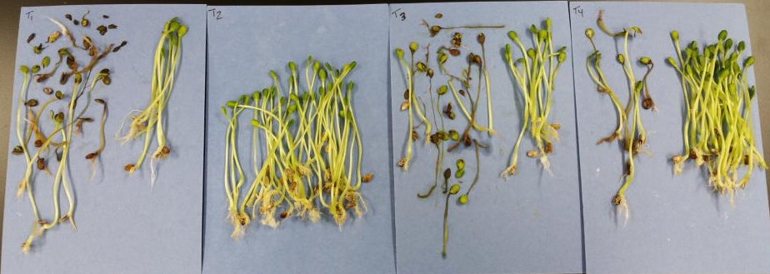
BFB transmission for seeds inoculated with biocontrol agents via flower treatment, then challenged with A. citrulli (10⁷ CFU/ml)
Bacillus sp.
#24
Bacillus sp.
#35
Bacillus mojavensis
RRC101
PBS
A
Biocontrol agents significantly reduced BFB incidence when applied to watermelon flowers
Level of reduction is unacceptable by commercial standards!
Optimization needed
AB
B
B

Slide 20
Potential flower inoculation with BCAs as seed treatments
Pros:
Broad spectrum activity (fungi/bacteria)
Can penetrate into seeds
Cons:
Consistency of application
Research needs:
Optimization of flower inoculation technique
Field evaluations
Investigate compatibility with commercial seed production practices

Slide 21
Summary
It is critical to explore new technology to find effective seed treatments to address phytosanitary concerns
A more detailed understanding of the seed-to-seedling transmission process may reveal more targets for seed treatments

Slide 22
Acknowedgements
Stephane Corgie & Zach Hansen,
Zymtronix Catalytic Systems Inc.
The McGovern Business Incubator
414A-1 Weill Hall,
Cornell University
Ithaca, NY. 14853,
USA
TOMI™ Environmental Solutions, Inc.
Elizabeth P. Battaglia
Executive Vice President
1-301-250-5316
www.tomimist.com | ebattaglia@tomimist.com

Slide 24
Introduction to the
Canadian Horticultural Council
David Jones
Manager, Potato Industry Coordination

Slide 25
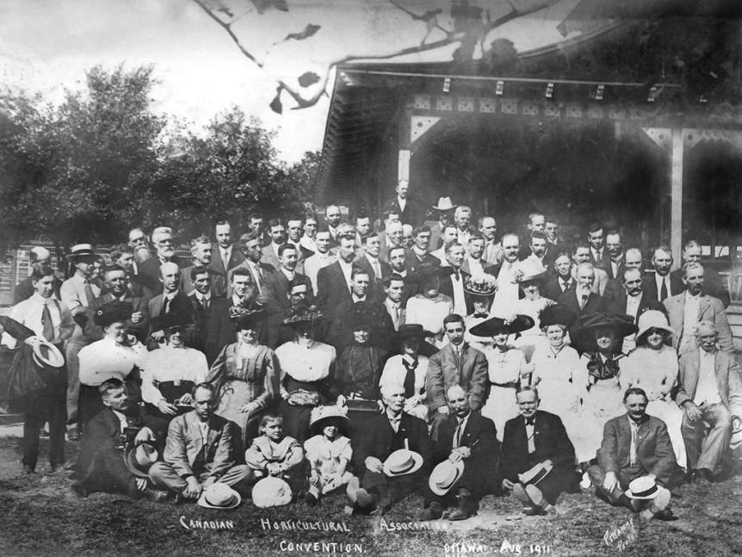
Notes:
CHC has been actively promoting the interests of its members since 1922.

Slide 26
Canadian Horticultural Council
Overview of CHC
Vegetable Industry in Canada
Pesticide Re-evaluations

Slide 27
Identify Industry Priorities -
Potato Sector
New Uses of Potatoes
Breeding of Improved Varieties
Food Value of Potatoes
advertising claims made on behalf of other competing foods and widely promoted diets that are reducing the consumption of potatoes

Slide 28
December 1934
Conference on Potatoes (Ottawa)

Slide 29
Who we are
National non-profit advocacy group
Based in Ottawa Ontario
Governed by a Board of Directors (regional)
7 full-time staff; 3 part-time staff
The voice of Canadian fruit and vegetable growers

Slide 30
Who we represent
Over 130 member organizations representing 20,000 growers
Over 120 different commodities
  Field Vegetables
  Greenhouse Vegetables
  Tree Fruit
  Berries
  Potatoes
Members are in Canada and beyond

Slide 31
What we do
Advocate for members on key issues
  Labour
  Crop Protection
  Trade & Market Access
Respond to government consultations
  Next Agricultural Policy Framework (April 2018 to March 2023)
  Pesticide Re-evaluations
  Cost Recovery (CFIA)
  Animal & Plant Health Strategy (CFIA)
Coordinate research projects and funding
Coordinate market access/development projects and funding

Slide 32
Field Vegetables Canada (2015)
$1.04 billion FGV
Planted area by province (%)

Slide 33
Field Vegetables 2011-2015 (ac)
Corn, sweet 51,748
Peas, green 32,020
Beans, green or wax 21,018
Carrots 20,188
Tomatoes 15,209
Cabbage 13,817
Dry onions 12,611
Lettuce 10,187
Broccoli 10,174
Pumpkins 7,043
Squash/Zucchinis 6,547
Cucumbers 5,176
Peppers 4,805
Asparagus 4,523
Rutabagas/turnips 4,227
All 245,673 (Potatoes 357,068)

Slide 34
Greenhouse Vegetables (2015)
$1.29 billion FGV
Planted Area by Province

Slide 35
Greenhouse Vegetables 2011-2015 (m²)

Slide 36
Pesticide Re-evaluations in Canada
Under authority of the Pest Management Regulatory Agency (PMRA) – Health Canada
Two Re-evaluation Streams:
Old Active Ingredient Backlog
  Originally 400+ actives
  e.g. captan, chlorothalonil, thiram
Cyclical 15-year Review After First Registration
  e.g. neonicotinoids

Slide 37
Pesticide Re-evaluations in Canada
Process:
Initiation of Re-evaluation
Publication of Proposed Re-evaluation Decision (PRVD)*
Public Consultation (90-days)
Re-evaluation Decision Document (RDD)
Label amendments or phase-out of uses
*no consideration of economic value/benefit

Slide 38
Proposed Re-evaluation Decisions (pending Final Decisions)
Active Ingredient | linuron Group 7 | mancozeb Group-M | metiram Group-M | ferbam Group-M | ziram Group-M | thiram Group-M | chlorothalonil Group-M | Iprodione Group -2 | captan Group-M | cypermethrin Group-3 | Imidacloprid Group-4
Trade Name | LOROX Herbicide | DITHANE Fungicide | POLYRAM Fungicide | FERBAM Fungicide | ZIRAM Fungicide | THIRAM Fungicide | BRAVO Fungicide | ROVRAL Fungicide | CAPTAN Fungicide | RIPCORD Insecticide | ADMIRE Insecticide
Consultation Status | Sept 24, 2012 Response Submitted Pending Final Decision Dec 2016* | Sept 27, 2013 Response Submitted Pending Final Decision Mar 2017 | Sept 18, 2014 Response Submitted Pending Final Decision Mar 2017 | May 27, 2016 Response Submitted Pending Final Decision Jun 2018 | May 27, 2016 Response Submitted Pending Final Decision Jun 2018 | May 27, 2016 Response Submitted Pending Final Decision Jun 2018 | June 10, 2016 Response Submitted Pending Final Decision Mar 2018 | July 15, 2016 Response Submitted Pending Final Decision Mar 2018 | July 30, 2016 Response Submitted Pending Final Decision Mar 2018 | Aug 30, 2016 Response Submitted Final Decision Sep 2018 | Nov 23, 2016 Response due Feb 21, 2016 Final Decision Dec 2017
Proposed Decision (*final decision) | Cancel all uses | Cancel all Uses | Cancel all Uses | Cancel all Uses | Cancel all Uses | Cancel all Uses | Cancel certain uses and limitations on remaining uses | Cancel all Uses | Cancel certain uses and limitations on remaining uses | Decrease no. of applications for some uses and large buffer zones | Cancel all Agricultural Uses
Horticultural Food Uses Proposed to be Cancelled (*final decision) | Asparagus Carrots Caraway Celery Coriander Dill Parsnip Potato Apple Peach Pear Plum Cherry Saskatoon Sweet Corn | Potato (foliar and seed) Tomato Onion Celery Carrot Cabbage Cauliflower Pumpkin Squash Melon Watermelon Cucumber Apple Pear Grape | Potato Tomato Asparagus Carrot Celery Apple Grape | GH Cucumber, GH Tomato, GH Lettuce, Apple, Pear, Apricot, Cherry, Peach, Plum, Blackberry, Boysenberry, Dewberry, Raspberry, Blueberry, Cranberry, Currant, Grape | Tomato Cucumber, Melon Squash Pumpkin, Apple (BC only) Peach (BC only) Apricot (BC only) | Celery Sweet Potato Apple Peach Plum Strawberry Seed Treatment - (beets, broccoli, Brussels sprouts, cabbage, carrot, cauliflower, celery, lettuce, pepper, radish, spinach, turnip, eggplant, tomato, onion, snap bean, peas, squash, pumpkin, watermelon, cucumber, cantaloupe, onion) | Broccoli Brussels Sprouts Cabbage Cauliflower Corn (sweet) Celery Onion (dry and green) Cherry (sweet and sour) Peach Nectarine Blueberry (high and low) Cranberry | Cabbage (stored) Cauliflower, Garlic (preplant dip) Lettuce Onion Snap Bean Leek Potato (seed piece trt) GH Cucumber GH Lettuce GH Tomato Apricot Cherry Peach Plum Raspberry Strawberry Grape Ginseng Seed Treatment (carrot) | GH uses (except soil) Apple Pear Cherry Plum Peach Nectarine Apricot Grape Pumpkin Squash Tomato Strawberry Loganberry Blueberry Blackberry Raspberry On-Farm Bean Seed Treatment |  | Potatoes Root Veg (1-B) Tuberous and Corm Veg (1-D) Sweet Potato Leaves of Root and Tuber Veg (2) Leafy Greens (4-A) Leafy Petioles (4-B) Brassica Leafy Veg (5) Legume Veg (6) Fruiting Veg (except cucurbits 8) Cucurbit Veg (9) Pome Fruit (11) Stone Fruit (12) Berry –Small Fruit (13-A,B,F,G) Cranberry Herbs (19-A) Globe Artichoke Seed Treatments In-Furrow GH (drench and irrigation) Tomato, Cucumber, Pepper, Eggplant, Lettuce, Brassica 5A

Slide 39
Thiram Re-evaluation
Proposed Decision
  Cancel all uses
  Risks identified for workers during mixing/loading, application, planting & re-entry
  Risks to birds, mammals (ingestion of seed)
  Risks from foliar applications (apples, celery, peaches, plums, strawberries)

Slide 40
Thiram Re-evaluation
Seed Treatment Assessment
  Based on cereals, oilseeds, pulses
  40,000 – 216,000 kg seed treated per 8-hr day
  Treatment over 60 days per year
On-Farm Seed Treatment
  54 – 5400 kg seed per day
Planting Assessment
  1350 – 5400 kg seed planted per day
  10 days planting per year

Slide 41
Thiram Re-evaluation
Quantify use of thiram in vegetable production
ASTA working group very helpful in providing extent of use information for each vegetable
  Direct seeding rates, transplant seeding rates
  Percentage of planted acres treated with thiram ST
  Seed number/weight, seeds per acre
    Calculate thiram applied for each vegetable crop for direct seeding and/or transplant
    Total thiram use as seed treatment in vegetables

Slide 42
Thiram Re-evaluation
Quantify use of thiram in vegetable production
Conclusion:
2,400 kg thiram active ingredient applied as seed treatment in vegetable production in Canada

Slide 43
Thiram Re-evaluation
Address PMRA assumptions
Risk assessments based on 21 million ha crops vs. field vegetables 100,000 ha
Virtually all seed imported and already treated
Low use rates and low exposure to environment
Use of transplants for some crops
Precision planting and value of seed
Other seed treatments/coatings

Slide 44
Thiram Re-evaluation
Next steps
PMRA Re-evaluation Decision Document
  June 2018
  Phase-out begins (3-years) or amendment of uses/label

Slide 45
Neonicotinoids
Pollinator focused re-evaluation
  Imidacloprid, clothianidin, thiamethoxam
  Proposed Decision December 2017
Cyclical (15-yr) Re-evaluations (health & environment)
  imidacloprid (Proposed Decision November 2016)
  clothianidin, thiamethoxam (Proposed Decision December 2018)
Special Reviews (aquatic invertebrates)
  clothianidin, thiamethoxam (December 2017?)
Pollinator Incident Report Evaluations (ongoing)
  80% reduction in planting incidents since mitigation

Slide 46
Imidacloprid Re-evaluation
Proposed Decision
  Cancel all uses
  No risks identified for human health
  Risks identified for aquatic invertebrates based on water monitoring data
  Monitoring data from Ontario and Quebec (some limited Saskatchewan)
  Modelled association of greenhouses (Ontario), field vegetables (Ontario, Quebec) and potatoes (Quebec)

Slide 47
Imidacloprid Re-evaluation
Consultation Response
(90-days; February 21, 2017)
Industry:
  Requested extension of deadline
  AAFC Multi-stakeholder Forum (Dec 21 and Feb 14)
  3 Working Groups formed
    Alternatives
    Risk Mitigation
    Environmental Monitoring

Slide 48
Imidacloprid Re-evaluation
Consultation Response
Canadian Horticultural Council:
  grower surveys – impact risk assessment
    use (extent, frequency, method, rates, importance)
    use of seed treatment (imidacloprid + clothianidin)
    well received by PMRA (captan, chlorothalonil, mancozeb)
  processor field data (potatoes)
  mitigation (developments since water sampling)
    Vegetative buffer strips
    Nutrient management in greenhouses & water treatment
    Municipal sewers

Slide 49
Pesticide Re-evaluations
Impact on Sector
Ability to compete
  Grower loss of production tools (carrots, apples)
  Potential loss of production acres
Revocation of Maximum Residue Limits
  Imports exceeding the General MRL of 0.1 ppm
  Requirement for Import MRL if residues present (problematic)
  Impact on trade and foreign growers
  CFIA Pesticide Surveillance Reports by crop/country/pesticide

Slide 50






Thank you
djones@hortcouncil.ca
www.hortcouncil.ca
CHC AGM
March 14-16
Winnipeg
@CHC_CCH
Notes:
Seasonal Agricultural Worker Program
Dispute Resolution Corporation (DRC)
AAFC Pest Management Centre (PMC)
CanadaGAP and GFSI Recognition
Destination Inspection Service (DIS)
Single Licensing through the Safe Food for Canadians Act with the DRC named as the service provider
Regulatory Cooperation Council Action Items (Crop protection, Financial risk mitigation, Plant health, Food safety)
Canadian Agri-Science Cluster for Horticulture (1 and 2)

Slide 51
Captan Re-evaluation
Proposed Decision
  Cancel use in greenhouse, tree fruit, grapes, berries, field tomato, on-farm seed treatment
  Cancel use of WP as dry hopper box treatment
  Limit to 1 foliar application cucumbers, potatoes, squash, pumpkin
  Risks identified for human health (post-application workers)

Slide 52
Captan Re-evaluation
Consultation Response
Grower survey reported :
  number of applications 2 (peaches) to 5 (apples) per season
  application rates used 63% to 89% of maximum
  monitoring/scouting most common activity (10 per season)
  other post-application activities limited
Final Decision March 2018

Slide 54









Re-Evaluation Schedule for Insecticides
on Sept 9th 2016 a letter from ADAMA announced to their customers the arbitrary withdrawal of Pyristar for Vegetable Uses !...
Deadlines for re-evaluation | 30/04/2017 | 31/01/2018 | 31/04/2018 | 31/07/2018 | 31/07/2019 | 31/12/2021
Active Ingredient (AI) | thiaclopride | chlorpyrifos-ethyl | thiametoxame | fipronil | imidaclopride | tefluthrine
AI Profile | Medium Spectrum Niche market in veg crops High cost AI | Narrow spectrum High Cost AI | Narrow spectrum High Cost AI | Narrow spectrum High Cost AI | Narrow spectrum High Cost AI | Medium/Narrow Spectrum Niche market in veg crops High cost AI
Is Active Ingredient on the Substitution List ? | YES | No | No, but suspended as neonicotinoid | YES | No, but suspended as neonicotinoid | No
Member state in charge of re-evaluation
Commercial Formulations
DEAD
Revised :
30/09/2017
Revised :
?/?/ 2024
UK
SPAIN
FRANCE
FRANCE
GERMANY
GERMANY
stopped

Slide 55




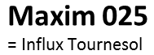
Re-Evaluation Schedule for Fungicides
Deadlines for re-evaluation | 31/12/2015 | 30/04/2017 | 31/10/2017 | 31/10/2017 | 31/04/2018 | 31/10/2018
Active Ingredient (AI) | mefenoxam | thiram | iprodione | thiofanate-methyl | triticonazol | fludioxonil
AI Profile | Medium spectrum Normal Cost AI | Broad spectrum Mass market Low Cost AI | Medium spectrum Mass Market Normal Cost AI | Medium spectrum Normal Cost AI | Narrow spectrum Mass Market Normal Cost AI | Medium spectrum Medium cost AI
Is Active Ingredient on the Substitution List ? | No | No | YES | No but close to carbendazim, banned in EU | No | YES
Member state in charge of re-evaluation | Closed
Commercial Formulations
Revised :
30/06/2017
Revised :
30/04/2018
Revised :
date still ?
FRANCE
FRANCE
SWEDEN
AUSTRIA
FRANCE

Slide 56




Authorization Process
Plant Protection Products (PPP) Regulation
EC 1107/2009
Active Ingredient
Commercial Product
Registration at EU Level through reporting member state (RMS)
Registration at Member State level with extension to EU sub-area (3 zones)
Validity 20 years
Validity 10 years
10
Reapplication after 20 years
Reapplication after 10 years (if active ingredient still authorized)
10

Slide 59
U.S. Update
Jane DeMarchi, VP Government and Regulatory Affairs

Slide 60
EPA Update
Anderson vs. EPA Lawsuit on Treated Seed
EPA Policy to Mitigate the Acute Risk to Bees from Pesticide Products
Neonic Review: Bee Risk Assessment
  Imidacloprid, Clothianidin and Thiamethoxam
Chlorpyrifos proposed revocation of tolerance – comments submitted
Pyrethroid risk assessment – comments due March 31
Notes:
As part of its normal review EPA has completed its preliminary risk assessment on all pyrethroids as a class. Assessment was published in the Federal Register on November 30, 2016
Because EPA conducted a screening level assessment (simplistic /worst-case), all uses of pyrethroids exceed EPA level of concern due to exaggerated calculation of ecological risk
EPA is pushing for mitigation that could result in loss of uses and additional restrictions
PWG’s request for an extension was granted; you have until March 31 to file comments. The PWG has provided EPA with ample supporting data for refined assessments that we want them to consider in their risk management decision, which will come by the end of the year.
EPA Policy - Unclear how to actually label because there aren’t crop specific labels.

Slide 61
U.S. Fish and Wildlife Service
Listing of Rusty Patched Bumblebee as Endangered
  Pushed through final listing in 7 weeks
  No industry comments were taken into account
  Provides a hook for activists to file lawsuits on any new chemistry.
Monarch Conference Report
  Establishes priority for conservation of monarch habitat
Notes:
Rusty Patch Bumble Bee – Pushed through to final listing in 7 weeks. FWS dismissed all industry comments. Took a hard line on use of management tools.
Next step will be recovery plan and consultation plan which will take a while. However, provides a hook for activist groups to file lawsuits. In any state where there is Rusty Patch activists could file a lawsuit for any new chemistry. This listing seems like a gift to the activists by FWS. Will impact more than ag, gas and oil, electric etc.
Endangered not threatened. No idea what conservation even looks like.

Slide 62
Guide to Seed Treatment Stewardship
Updating website
Developing new farmer outreach tools – focus is corn farmers
Planter Demonstration Day – April 26

Slide 63
Questions & Answers

