Slide 1
Storm the Hill

Slide 2
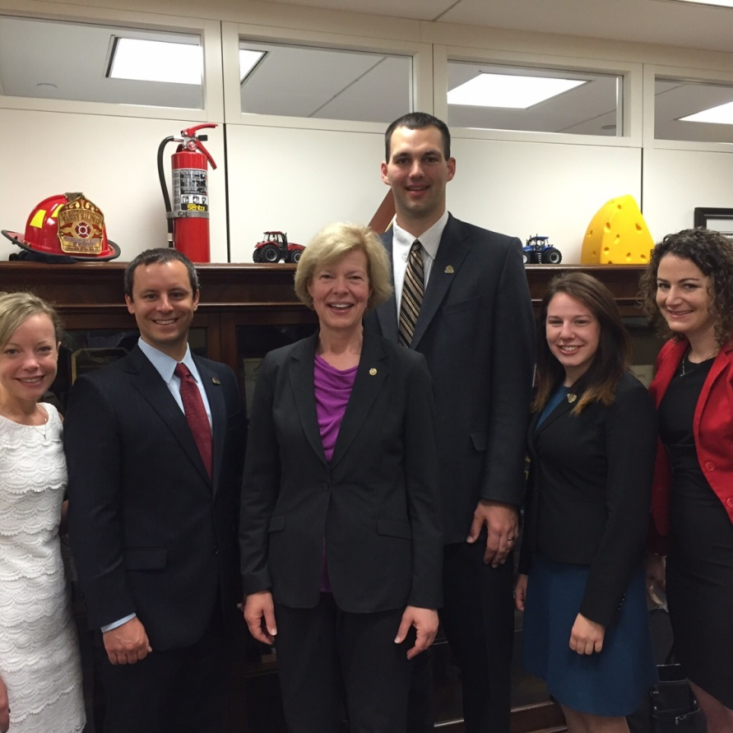
Storm the Hill 2017
SCHEDULE
Tuesday, April 4
Arrive in Washington D.C. by 5:00 p.m.
5:30 p.m. – Informal gathering of lobbying participants (Location TBD)
Wednesday, April 5
7:30 a.m. – Breakfast and issues briefing (Hogan Lovells)
9:30 a.m. to 4:30 p.m. – Capitol Hill visits
5:00 p.m. – Depart D.C.*
*If at all possible, we would ask that you do not make plans to leave D.C. before 5:00 p.m. on Wednesday evening.
Notes:
Storm the Hill 2017 will be held in conjunction with ASTA’s spring IEC and Exec Committee meetings in Washington, D.C.
Since you will already be in D.C. for the Exec Comm meeting,

