Slide 1
U.S. Agricultural Trade Outlook
Tanner Ehmke, Manager
Knowledge Exchange Division, CoBank
Disclaimer: The information provided in this presentation is not intended to be investment, tax, or legal advice and should not be relied upon by recipients for such purposes. The information contained in this presentation has been compiled from what CoBank regards as reliable sources. However, CoBank does not make any representation or warranty regarding the content, and disclaims any responsibility for the information, materials, third party opinions, and data included in this report. In no event will CoBank be liable for any decision made or actions taken by any person or persons relying on the information contained in this presentation.

Slide 2
Today’s presentation
Trade War
Agricultural Exports
Economic Outlook and Trade Implications

Slide 3
Exports are Important for U.S. Agriculture

Slide 4
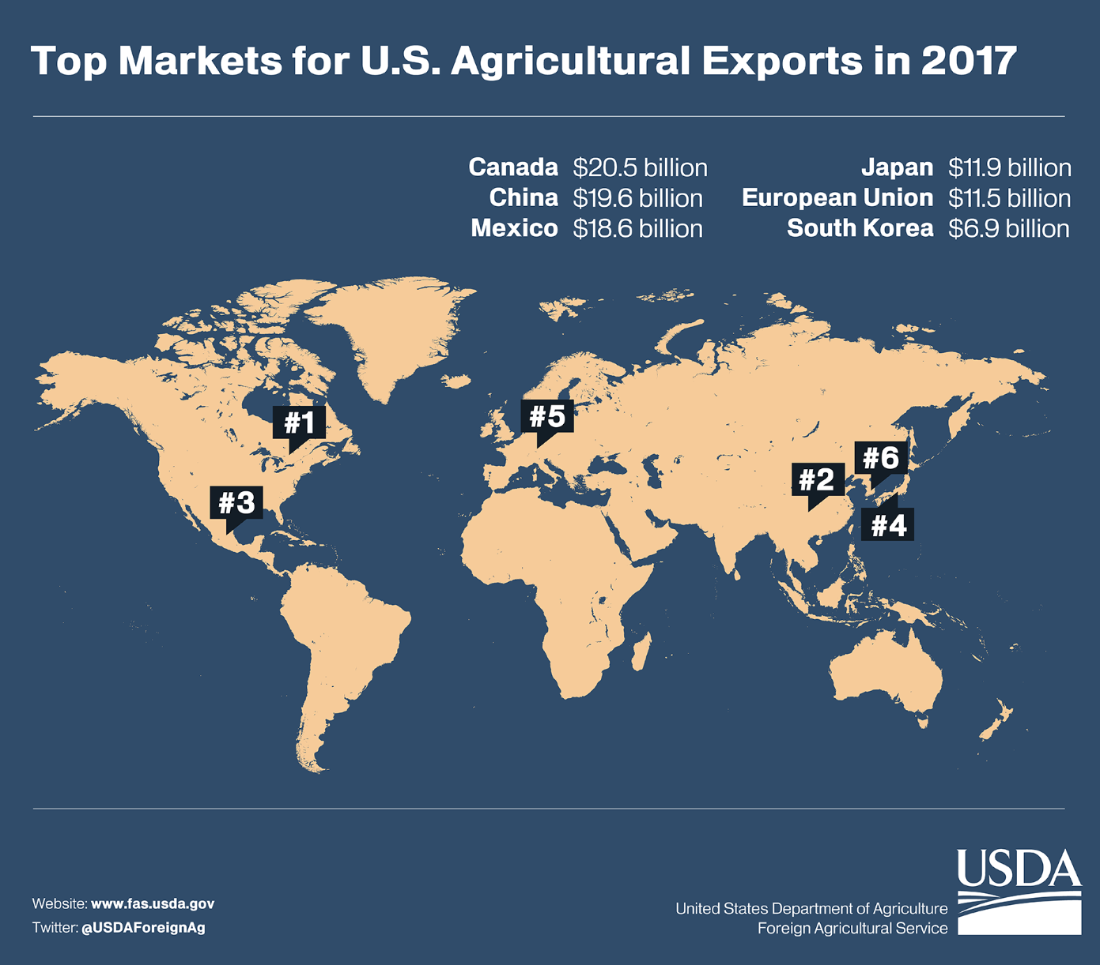
The US is engaged in 5 major trade disputes. These trading partners are also our 5 largest ag export markets

Slide 5
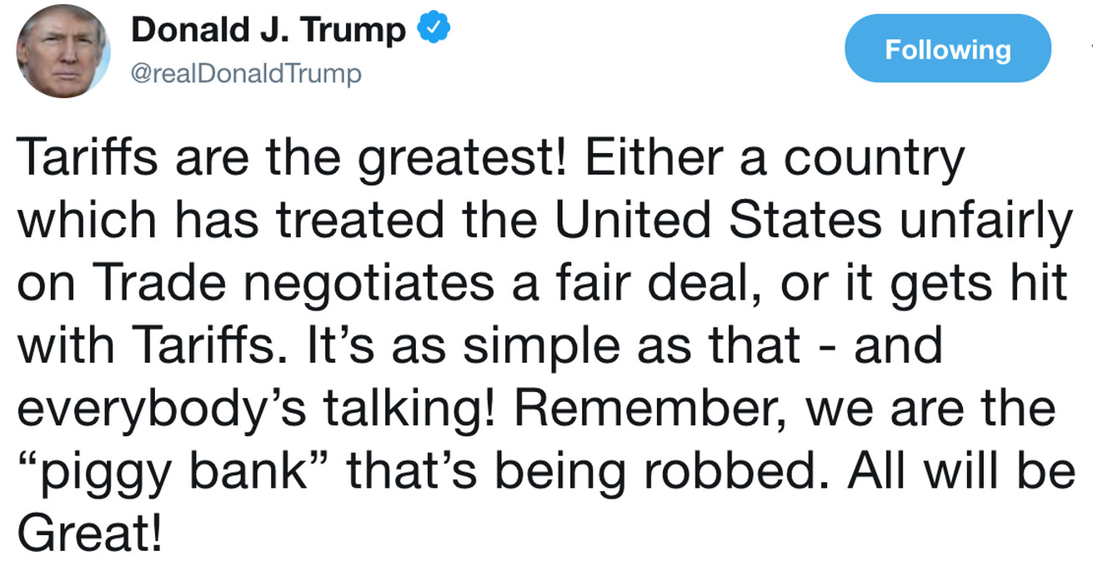
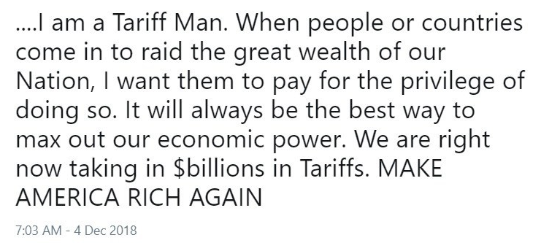
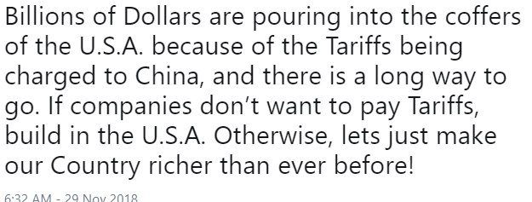
Tariffs: Negotiating Strategy, or Trade Protectionism?

Slide 6
Current Trade Negotiations
China
Talks with China were in the “end game,” but are now uncertain. Enforcement will be key.
Major exports : Soy, cotton, coarse grains, pork, dairy, wheat, tree nuts, fresh fruit, tobacco
USMCA
The new NAFTA – USMCA – has been signed by the U.S., Canada, and Mexico. However, it must still be approved by each respective legislative body.
Major exports to Mexico: Corn, soybeans, pork, dairy, beef, poultry, wheat, forest products, fresh fruit
Major exports to Canada: Forest products, prepared food, fresh fruit and vegetables, fish products, pork
Japan
Bilateral U.S.-Japan negotiations are ongoing. CPTPP is already hurting U.S. market share.
Major exports: Corn, beef, pork, soybeans, wheat, forest products, processed vegetables
European Union
Talks with the EU have resumed. Europeans are reluctant to discuss agricultural products, a politically explosive topic in countries like France. Auto tariffs looming?
Major exports to EU: Tree nuts, soy, forest products, fish products, wine & beer, processed fruit

Slide 7
Retaliatory Tariffs
China
Tariffs on 90% of US ag exports.
25% tariff on soybeans, grain, animal protein, tree nuts, produce, etc.
Mexico (tariffs lifted)
10-20% on pork and pork products
10-25% on cheese, whey, and other dairy products
20% on apples, cranberries, and potatoes
Canada (tariffs lifted)
25% tariff on yogurt, bovine, maple syrup, OJ, pizza
EU
20% tariff on rice, cranberries, peanut butter, kidney beans

Slide 8
U.S.-China Trade War
Source: Peterson Institute for International Economics

Slide 9
Loss of Ag Trade with China has Been Severe
Source: USDA-GATS

Slide 10
U.S./China Trade Negotiations: What’s on the Table?
China
Enhance protection of intellectual property (IP) rights
Forced technology transfers
Online piracy
Counterfeit manufacturing
Trade-secret protection
Enforcement?
Open its domestic market wider to foreign investment
Boost imports for foreign products
Refrain from devaluing its currency.
U.S.
Lift tariffs? How and when?
Current state of negotiations
Trade negotiating teams have not met since talks ended in stalemate on May 10.
Trump has threatened to impose 25% tariffs on an additional $300 billion of Chinese imports if China’s President Xi does not meet with him at the G20 meeting in Osaka on June 28-29.
If the U.S. does impose additional tariffs, China would almost certainly retaliate. However, it is unknown what measures China would enact and which sectors of the U.S. economy would be hardest hit.
Source: ProFarmer

Slide 11
USMCA
May 17, 2019
U.S. agreed to lift steel and aluminum tariffs on Canada and Mexico
Increased the chance of the Canadian, U.S., and Mexican legislative bodies to each pass the signed U.S.-Canada-Mexico Agreement (USMCA)
Canada and Mexico will remove their retaliatory tariffs on US goods, which include agricultural and consumer products.
May 27, 2019
Canada and Mexico began process for USMCA ratification.
USMCA still waiting to pass respective legislative bodies
U.S.: Faces resistance from Democrats in Congress; Pelosi has signaled a floor vote will happen soon. Labor and environment are the usual Democratic sticking points, but there could be additional challenges.
Canada: Trump to meet with Trudeau this week (Thursday, June 20). Ratification will move forward with Canadian Parliament “in tandem” with U.S. ratification. Parliament goes on recess in August.
Mexico: Needs simple majority vote in Senate for ratification. Vote is pending.

Slide 12
Trade Climate with Mexico Still Uncertain
On the same day the Trump administration submitted a letter to Congress to initiate the US-Mexico-Canada Agreement (USMCA) approval process, Pres. Trump announced 5% tariffs on all US imports from Mexico to “address the emergency at the Southern Border.”
Trump suspends the scheduled tariffs against Mexico after reaching a “signed agreement” with the country to reduce or eliminate illegal immigration.
Details of the agreement remain vague with conflicting accounts of what the terms of the deal are.
Does not include some form of promise for Mexico to import more U.S. ag commodities

Slide 13
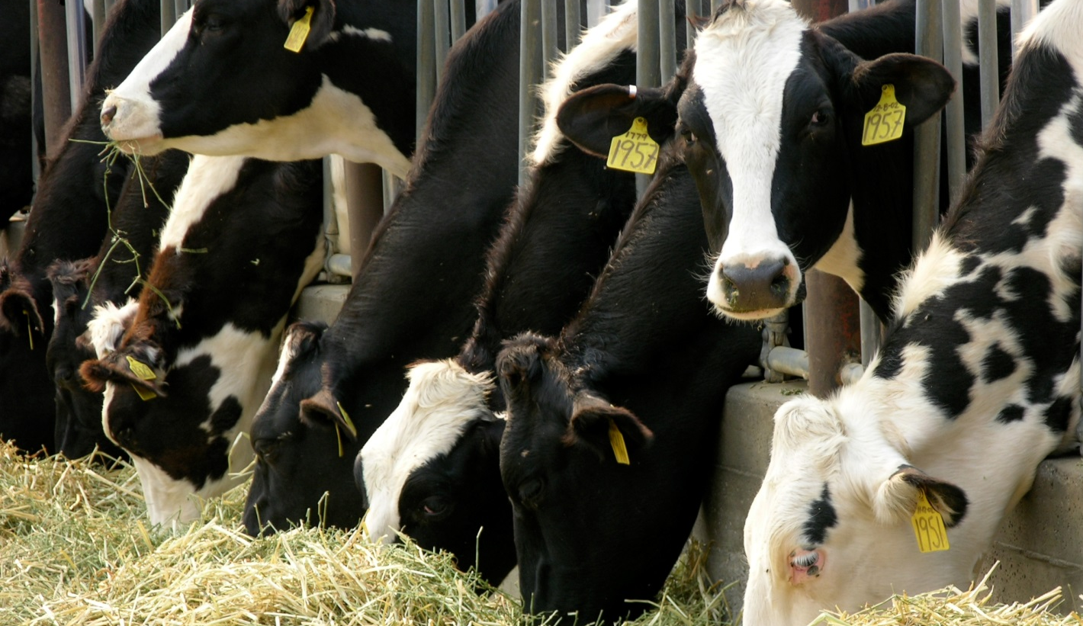
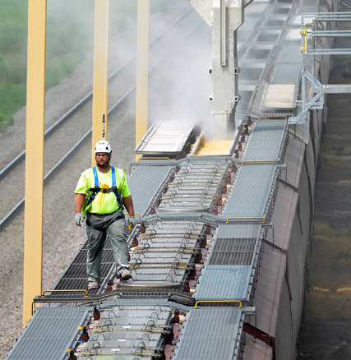
Agricultural Exports
Sources: UC Davis, NY Times, CoBank

Slide 14
Grain Exports
Corn 2%
Sorghum 76%
MMT
MMT
Wheat 8%
Rice 5%
MMT
Source: USDA-FAS Export Sales, June 6, 2019

Slide 15
Soybean and Cotton Exports
Soybeans 20%
Upland Cotton 14%
MMT
Million Bales
Source: USDA-FAS Export Sales, April 25, 2019

Slide 16
Corn, Soybeans, Wheat and Cotton Prices
Trade War Begins
Source: CME Group, MGEX, NYMEX

Slide 17
Fruit and Vegetable Exports
Fresh Fruit 3%
Fresh Vegetables 0.1%
MMT
Processed Fruit 14%
Processed Vegetables 5%
1k MT
1k MT
Source: USDA-FAS, Jan-Dec 2017 and 2018

Slide 18
Seed Exports up 2% in 2018, down 10% in 2019 (J-A)
Field Crop 19%
Vegetable (Leguminous) 30%
MT
Forage 10%
Vegetable (Other) 1%
Source: USDA-FAS

Slide 19
Seed Imports up 2% in 2018, down 16% in 2019 (J-A)
Field Crops 30%
Vegetable (Leguminous) 32%
MT
MT
Forage 11%
Vegetable (Other) 38%
MT
Source: USDA-FAS

Slide 20
U.S. Dollar and Trade Implications
Sources: UC Davis, NY Times, CoBank

Slide 21
Strong U.S. Dollar is Headwind for Ag Commodities
Source: Federal Reserve Bank of St. Louis

Slide 22
US$ Pushed Higher by “Flight to Safety” in Trade War
Source: Bloomberg

Slide 23
Weaker Crude Oil Signaling Slower Global Economy
Source: Nymex

Slide 24
BDI Has Trended Lower Since Start of Trade War, Indicating a Slowdown in Global Commerce
Source: Bloomberg

Slide 25
IMF Forecasts 2019 Global Growth at 3.3%, Down from 3.6% in 2018 on Trade War Concerns
Rising
Middle
Class
2004-08
Avg.=4.5%
Economic
Turmoil
2010-13
Avg.=3.9%
Policy
Realignment
2014-19
???
Average growth rate
1980-2017 = 3.5%
Notes:
March 2019

Slide 26
U.S. GDP Growth Has Been Strong
Source: Federal Reserve Bank of Richmond

Slide 27
Unemployment is at 50-year low
Source: Federal Reserve Bank of Richmond

Slide 28
Labor Market Remains Tight
Source: Federal Reserve Bank of St. Louis

Slide 29
Growth in Average Hourly Earnings Has Slowed. A Sign of a Slowing Economy?
Source: Federal Reserve Bank of Richmond

Slide 30
“Core Inflation” Remains Below Fed’s 2% Target. Persistently Low Inflation Can Damage Growth.
Inflation remains stubbornly weak and is of growing concern for The Fed.
Source: Federal Reserve Bank of St. Louis

Slide 31
3-Month vs 10-year Yield Curve has Inverted. Another Sign of a Slowing Economy and/or Recession?
Source: Federal Reserve Bank of St. Louis

Slide 32
Fed Has Held Rates Steady in 2019, but Rate Cut(s) Is Becoming Increasingly Likely Amid Trade War
Federal Reserve “Dot Plot”
5.0
4.5
4.0
3.5
3.0
2.5
2.0
1.5
1.0
0.5
0.0
2019
2020
2021
Longer run

Slide 33
Issues to Watch on U.S. Dollar
World & U.S. Economies
China: China’s economy is slowing from the trade war with potential impacts on global economy.
EU: A “no-deal” Brexit on Oct. 31 could significantly impact the British and EU economies.
U.S.: Weak jobs growth and stagnant wage growth are raising concerns of a slowing U.S. economy and recession.
Political Gridlock: U.S. government debt ceiling must be lifted on Sept. 30. A government default could reverberate through the economy.
The Fed
Uncertainty: Increased uncertainty on trade and fiscal policy is a cloud on the business climate.
Economy: Concern is growing of a slow-down in the U.S. economy and of greater recession risk because of trade uncertainty and policy risk.
Rates: The Fed has signaled that it is open to lowering rates to extend the current economic expansion.
U.S. Dollar Outlook
Strength in 2019: “Flight to safety” from trade war and a slowing global economy are supporting the value of the dollar, creating a headwind for U.S. exports.
The Economy and The Fed: A U.S. recession and a rate cut from The Fed could weaken the U.S. dollar and support exports.

Slide 34
Questions
Tanner Ehmke, Manager
Knowledge Exchange Division, CoBank, ACB
(303) 740-4182
tehmke@cobank.com

