Slide 1
American Seed Trade Association
IPR Committee
UPOV PRISMA- PBR Application Tool (Electronic Application Form (EAF))
Ben Rivoire
Technical/ Regional Officer, UPOV
Chicago_December 6, 2017

Slide 2
UPOV: INDEPENDENT INTERGOVERNMENTAL ORGANIZATION
The International Convention for the Protection of New Varieties of Plants
established in 1961
The International Union for the Protection of New Varieties of Plants
Union internationale pour la protection des obtentions végétales

Slide 3
MISSION STATEMENT
“To provide and promote an effective system of plant variety protection, with the aim of encouraging the development of new varieties of plants, for the benefit of society”

Slide 4
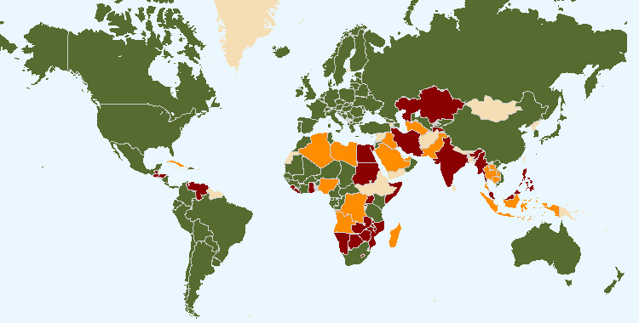
UPOV STATUS on October 10, 2017
The boundaries shown on this map do not imply the expression of any opinion whatsoever on the part of UPOV concerning the legal status of any country or territory
Members of UPOV (75 - covering 94 States)
Initiating States (16) and Organization (1)
States (24) and Organization (1) in contact with the UPOV Office

Slide 5
Overview
Introduction to the UPOV PRISMA PBR Application Tool
How UPOV PRISMA works today
Next version for UPOV PRISMA
Communication around UPOV PRISMA

Slide 6
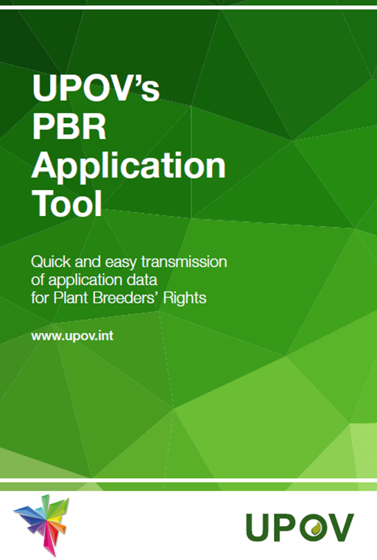

Slide 7
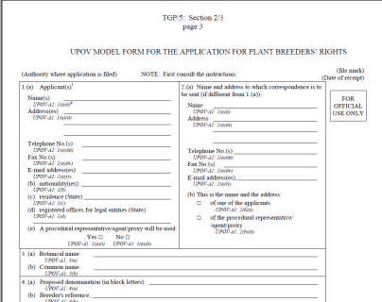
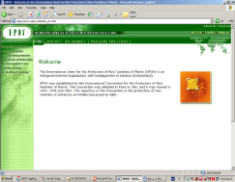
PBR Application- how it works today
MANUAL Form
?
Authority A
ELECTRONIC Form
?
Authority B
7
Notes:
7

Slide 9
UPOV PRISMA- PBR Application Tool (Electronic Application Form (EAF))
Easy way to transfer and re-use your PBR application data, using an efficient multi-lingual e-system available online for all participating countries worldwide

Slide 10
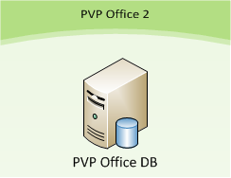

Slide 11
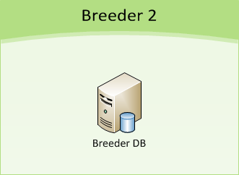

Slide 12
Overview
Introduction to the UPOV PRISMA PBR Application Tool
How UPOV PRISMA works today
Next version for UPOV PRISMA
Communication around UPOV PRISMA

Slide 13
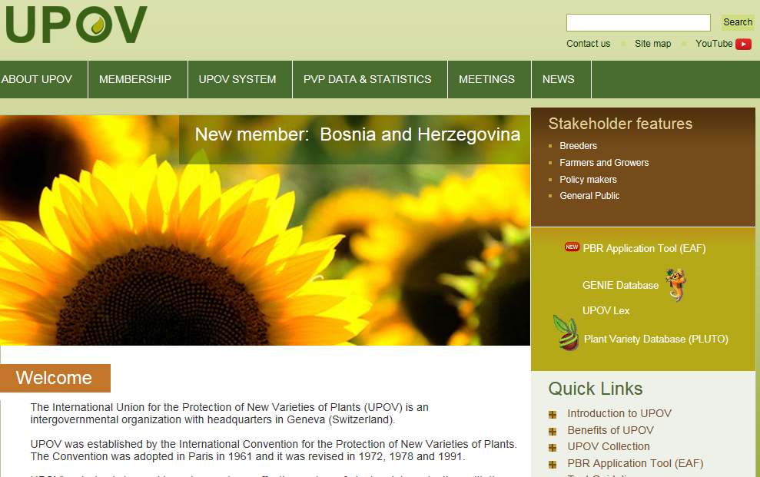
Where to find it…
UPOV PRISMA tool
Information

Slide 14
Start a new application
5 crops
16 authorities
Reuse of data stored locally
Available options will be displayed for selection (several languages supported)

Slide 15
UPOV members (16) and crops (5) currently covered by PBR Application Tool (EAF)
AUTHORITY | APPLE FRUIT VARIETIES | LETTUCE | POTATO | ROSE | SOYABEAN
Argentina | √ |  | √ | √ | √
Australia | √ | √ | √ | √ | √
Chile | √ | √ | √ | √ | √
China |  | √ |  | √
Colombia |  |  |  | √
France | √ | √ | √ | √ | √
Kenya | √ | √ | √ | √ | √
Netherlands | √ | √ | √ | √ | √
New Zealand | √ | √ | √ | √
Norway | √ | √ | √ | √ | √
Republic of Moldova | √ | √ | √ | √ | √
Switzerland | √ | √ | √ | √ | √
Tunisia | √ | √ | √ | √ | √
Turkey | √ | √ | √ | √ | √
United States of America |  | √ | √ |  | √
Uruguay | √ |  | √ |  | √

Slide 16
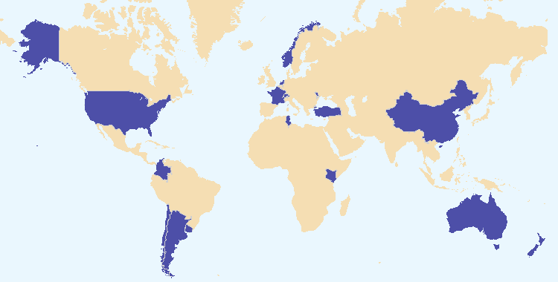
Coverage of the UPOV PRISMA PBR Application Tool: July 2017

Slide 17
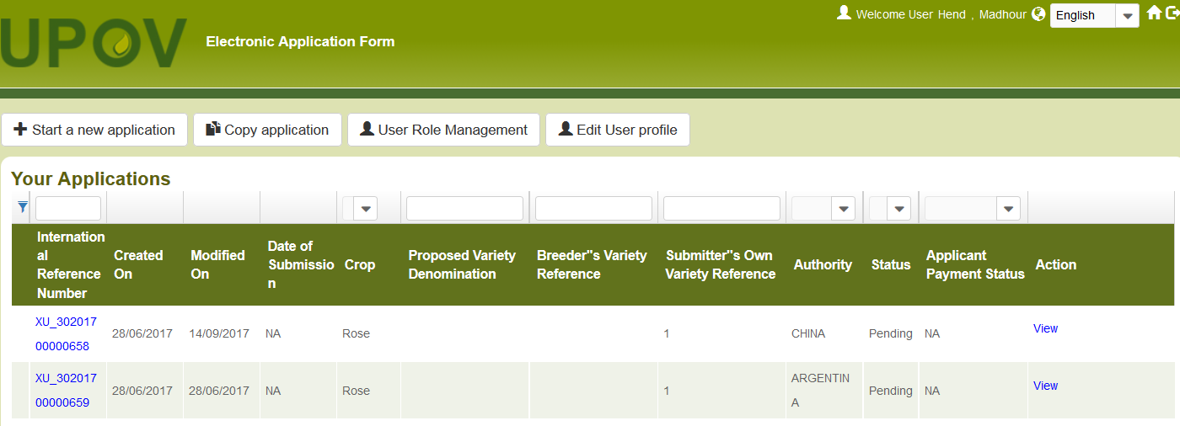
Navigation languages

Slide 18
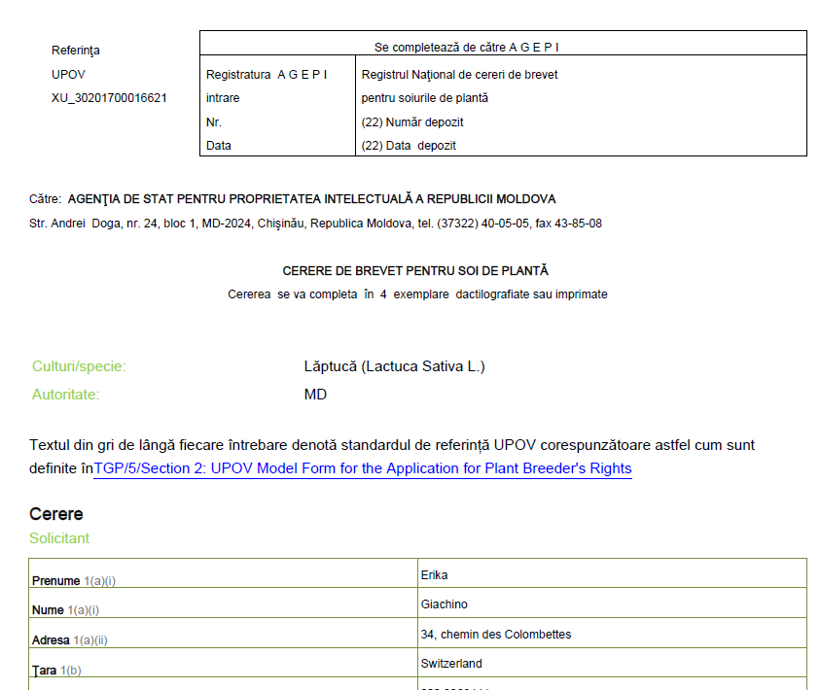
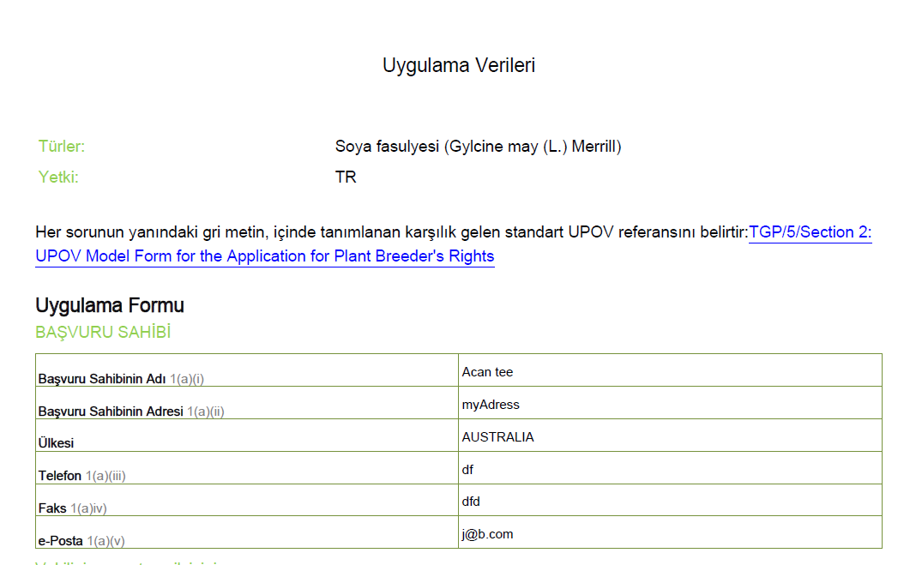
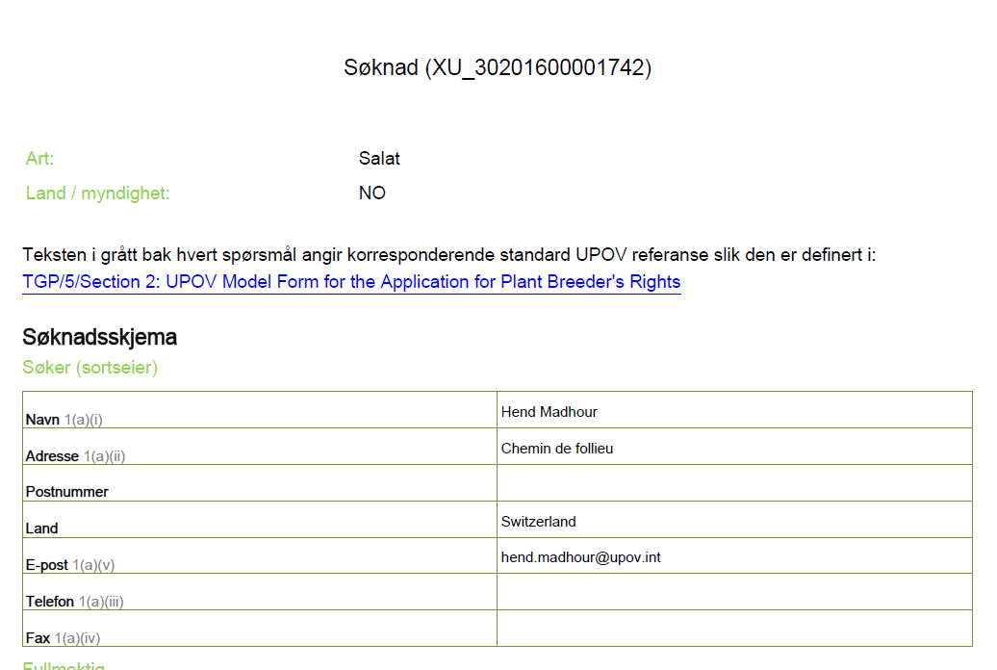
Output form languages
Romanian
Turkish
Norwegian

Slide 19
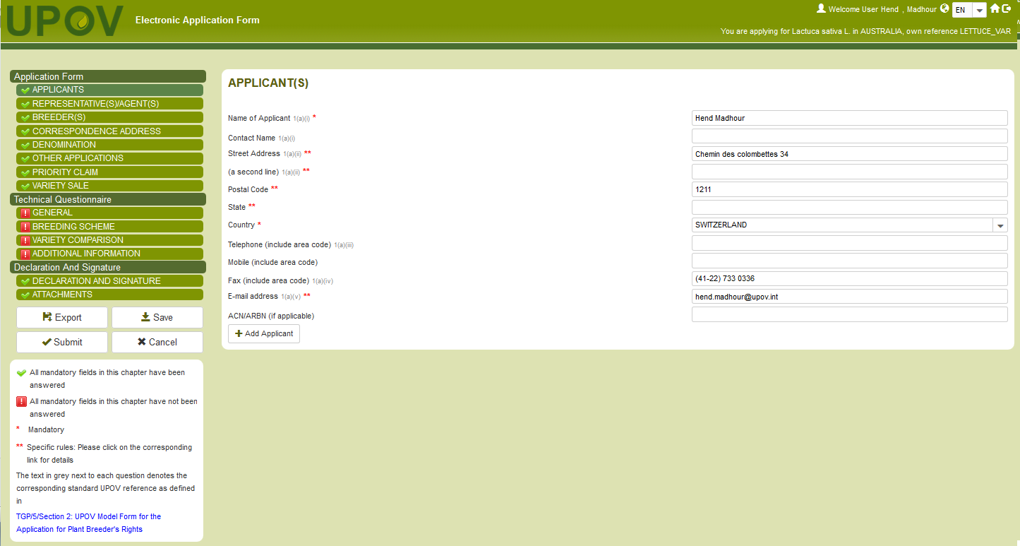
Start a new application
supported languages

Slide 20
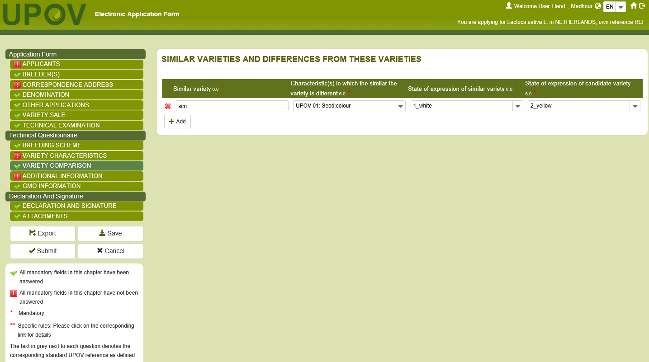
Apply to another authority
Complete missing information

Slide 21
Key benefits
Online PBR application tool to provide application data to participating PVP Offices in required format (hard copy, e-mail notification, system-to-system)
Application forms can be displayed in range of languages (answers must be provided in acceptable language for PVP Office - some information in TQ will be automatically translated in navigation and output form languages)
Variety data can be re-used in subsequent applications
Different user roles can be specified (e.g. drafter, signatory, translator, agent, procedural representative)
Controlled access, secure and confidential
Easy access to PVP application forms [and next steps in procedure from mid-2018]
Track your applications…

Slide 22
Overview
Introduction to the UPOV PRISMA PBR Application Tool
How UPOV PRISMA works today
Next version for UPOV PRISMA
Communication around UPOV PRISMA

Slide 23
Anticipated expansion from January 2018 (Version 2.0)
Bolivia (Plurinational State of)
Canada
European Union
Georgia
Mexico
Paraguay

Slide 24
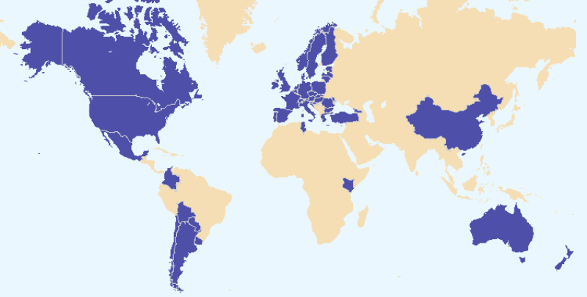
Anticipated coverage of the
UPOV PRISMA PBR Application Tool January 2018

Slide 26
New languages
Navigation language
Japanese
Output form language
Georgian

Slide 27
Navigation languages
日本語

Slide 28
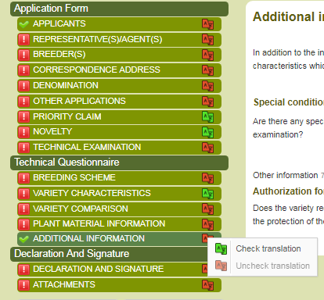
Translation alert
Highlight sections requiring translation
Check/uncheck translation by chapter

Slide 29
UPOV PRISMA V2.1 (mid-2018)
New authorities which could be included in EAF Version 2.1 (information already provided):
Brazil
(Ecuador)
(Japan)
Republic of Korea
Viet Nam
OAPI
South Africa

Slide 30
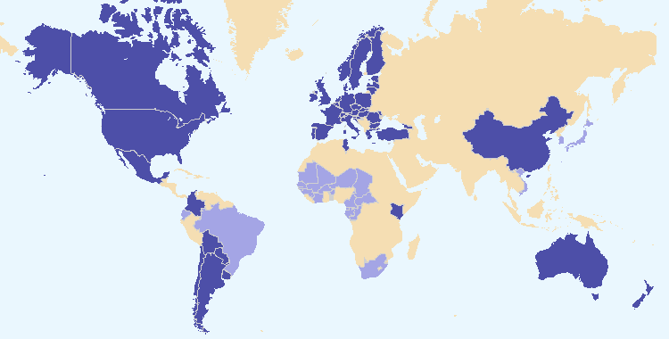
New authorities which could be included in
UPOV PRISMA PBR Application Tool Version 2.1

Slide 31
Overview
Introduction to the UPOV PRISMA PBR Application Tool
How UPOV PRISMA works today
Next version for UPOV PRISMA
Communication around UPOV PRISMA

Slide 32
COMMUNICATION
WEBSITE &
SOCIAL MEDIA
PROMOTIONAL MATERIALS
PROMOTIONAL ACTIVITIES
TRAINING

Slide 33
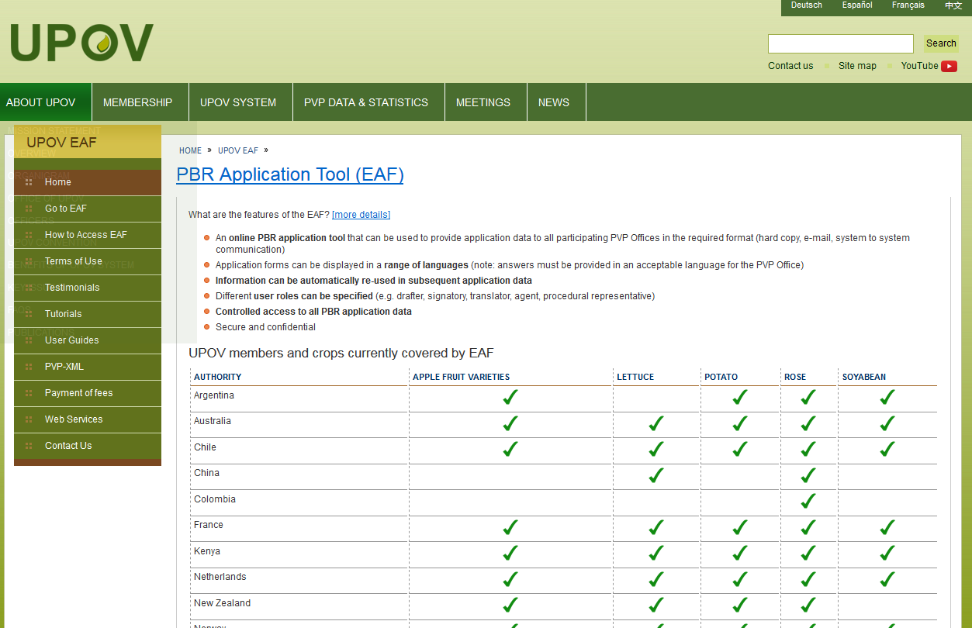

Slide 34
Breeder Testimony

Slide 35
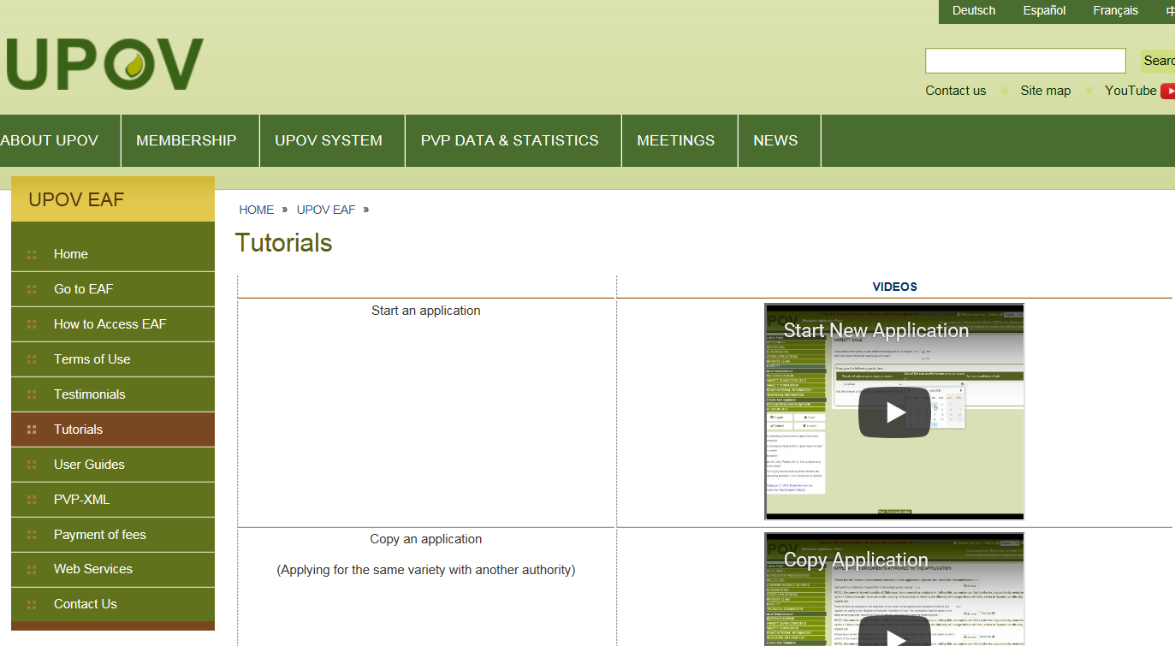
Tutorials

Slide 36
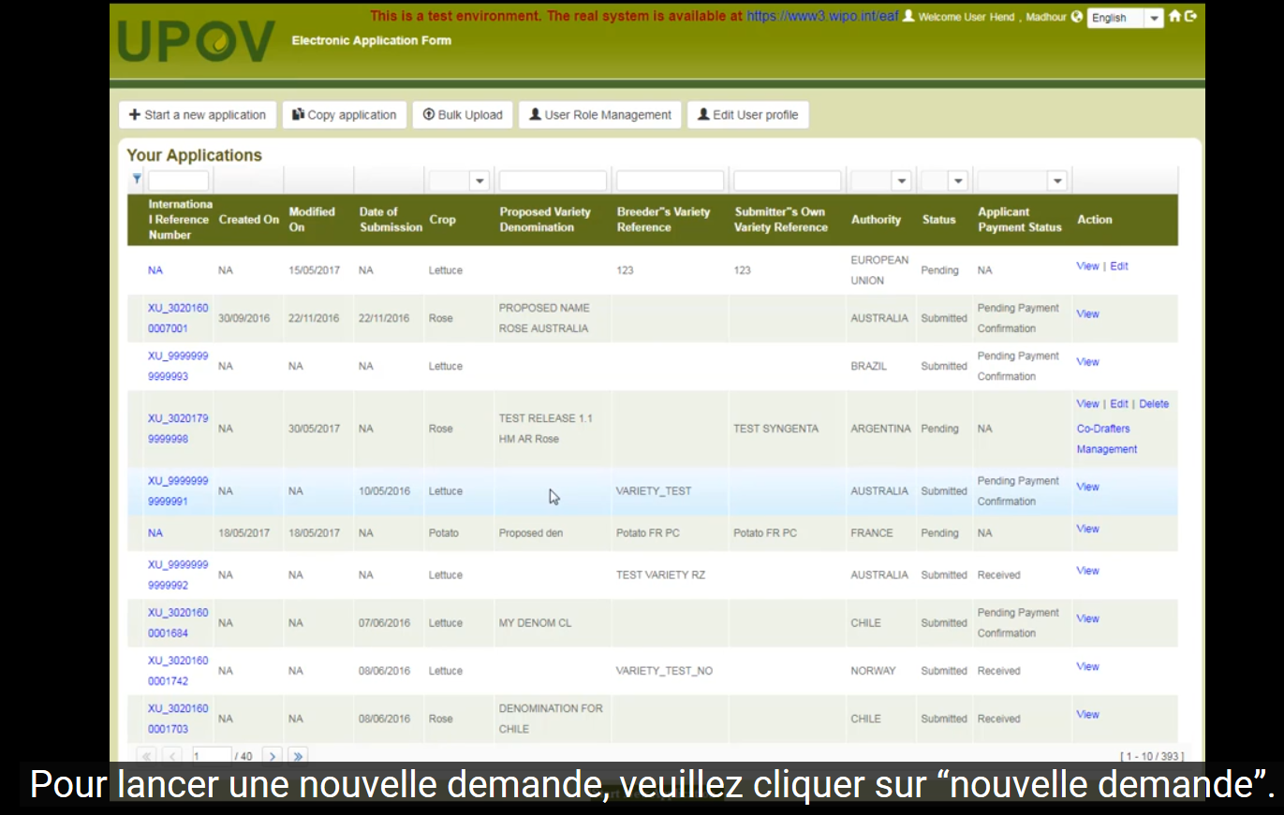
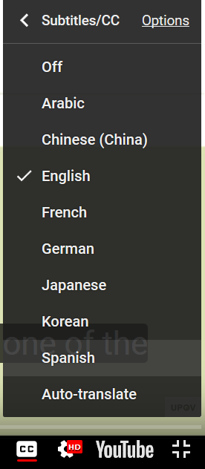
Tutorials

Slide 37
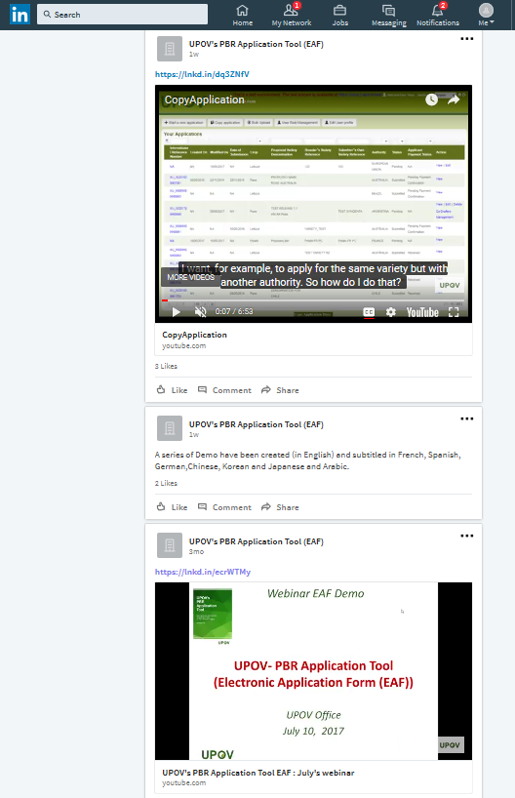
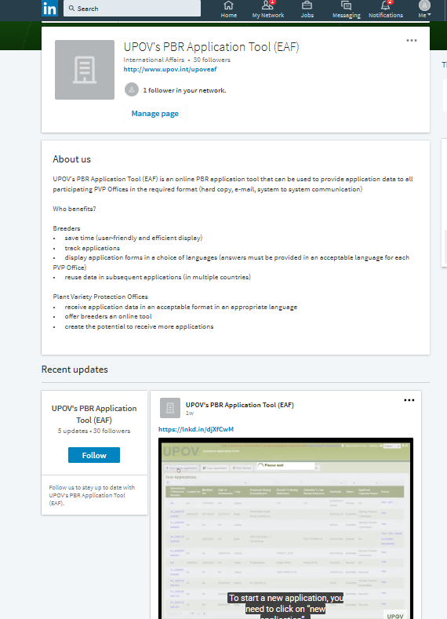
EAF showcase page –

Slide 38
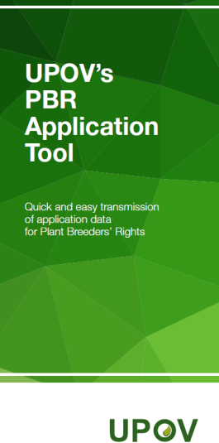
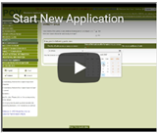
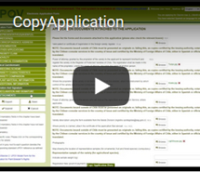
Posters / roll-up banners
Flyers
Press releases
Website & social media

Slide 39
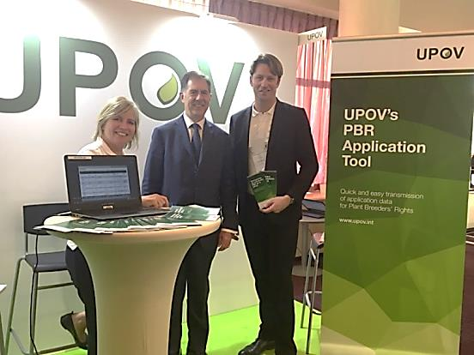
On-site Promotion
ISF Congress
CIOPORA AGM
AOHE
ESA
SAA
AFSTA
ASTA
On-site Promotion On-site and On-line Sessions
On-site training sessions (Geneva)
On-line training sessions
via webex/webinars for breeders/applicants

Slide 40
…to help us promote UPOV PRISMA
Breeders
Inform your colleagues or members about PRISMA
Follow us and share updates on your social media networks

Slide 41
UPOV PRISMA
Get started now* and
use UPOV PRISMA for FREE
until June 2018!
*Offer starts with the release of New Version 2.0 of UPOV PRISMA in January 2018

Slide 42
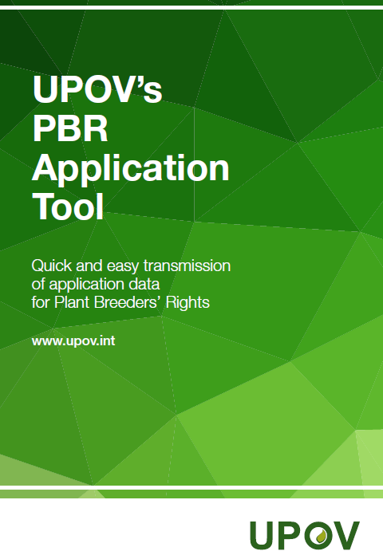
prisma@upov.int

