Slide 1
Update on the American Seed Trade Association & U.S. Plant Variety Protection Board Molecular Marker Working Group
ASTA 2017 & Seed Expo
Chicago, IL
December 3-7, 2017
Paul Nelson, US MMWG Co-Chair

Slide 2
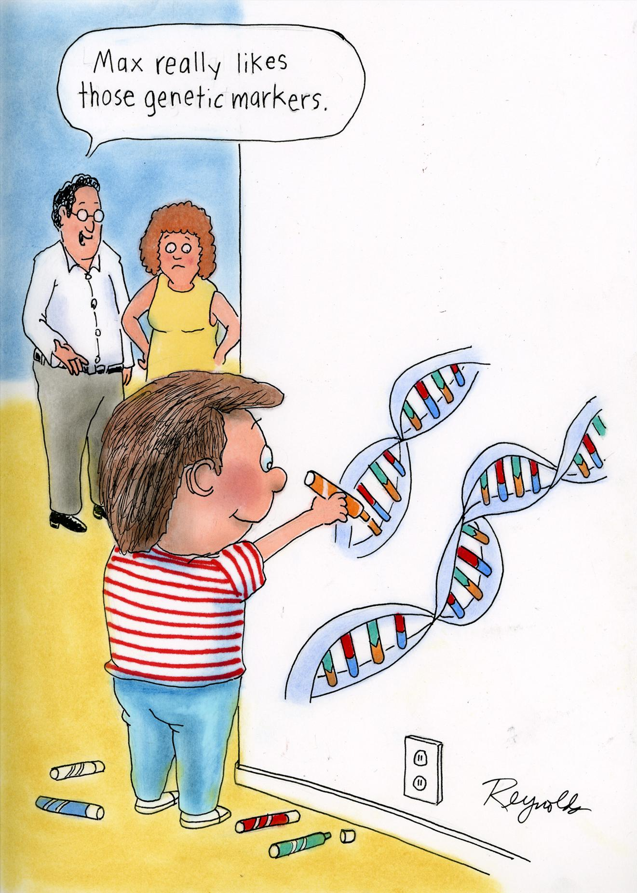

Slide 3
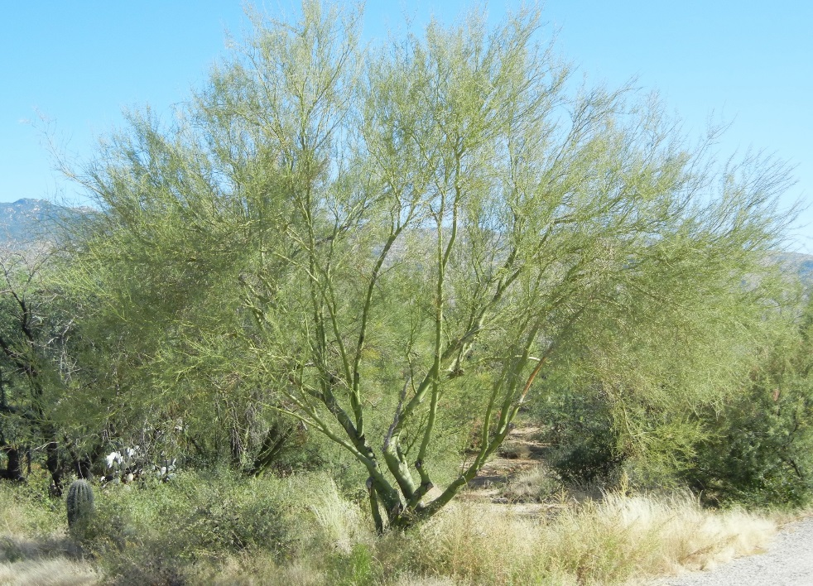
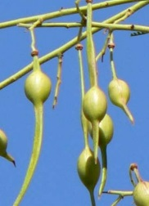
DNA Markers in Plant Science
Genomic Prediction
Marker-Trait Association
Germplasm Characterization
Seed Purity
Criminal Cases
IP Enforcement

Slide 4
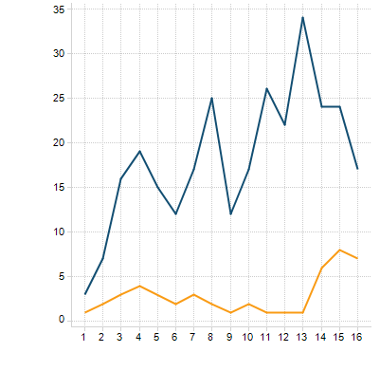



DNA Markers in DUS – Gaining Momentum
# Abstracts
USA
MMWG
IMODDUS
SAA
Marker WG
CPVO
GEVES
Reference Management
Isozymes to Complement Morphology
CPVO
NL, KR,
CN
DNA pre-screens
UPOV BMT Session

Slide 5
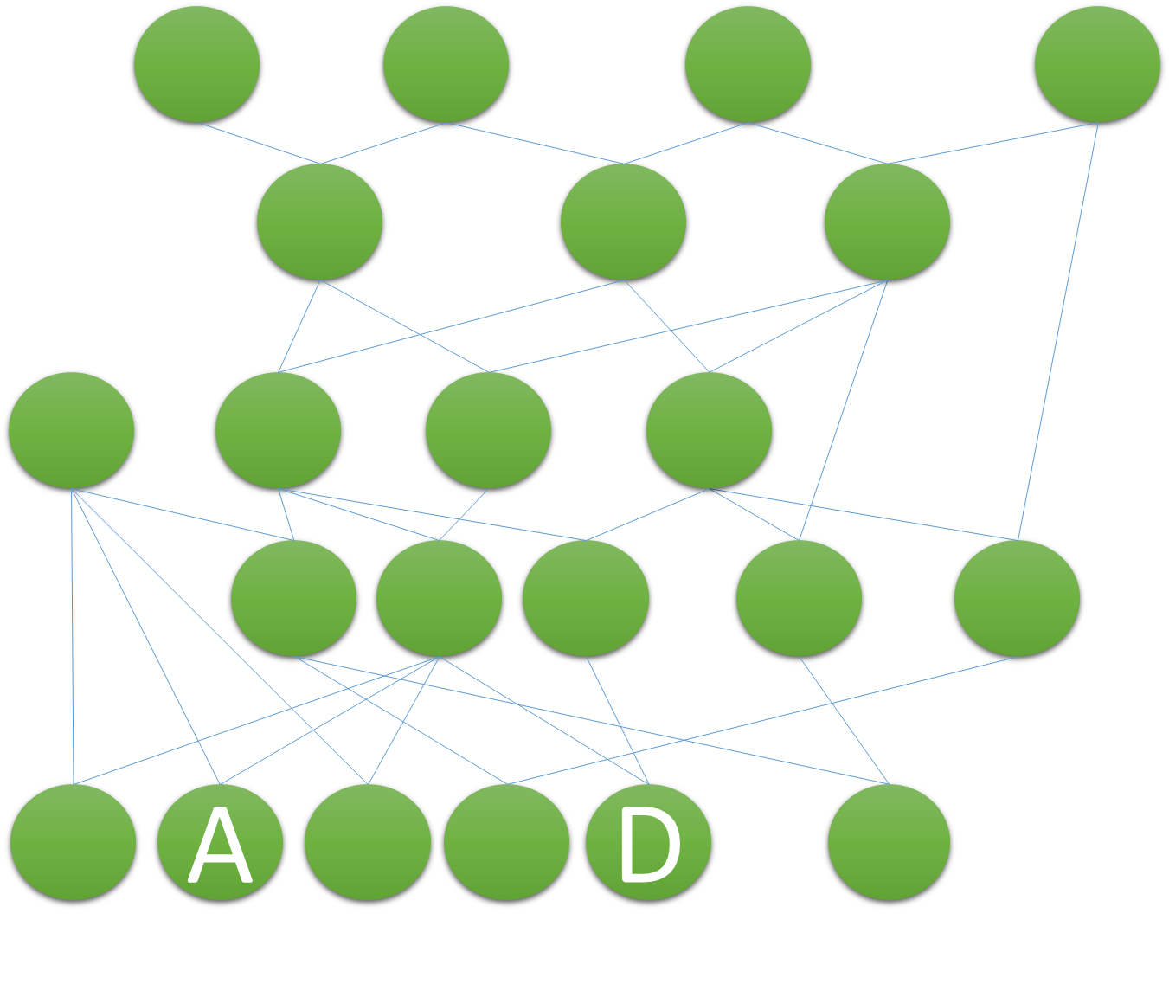
Modern Breeding Necessitates New Methods in DUS
Breeding Methods: DNA markers, established heterotic pools, faster cycle time
Breeding Selection Criteria: Performance (yield, agronomics, disease)
DUS Criteria: Morphology (non-performance visual observation)
Standard morphological descriptors often fail to establish distinctness.
  PVP Office asks for additional evidence.
  Breeder returns to field -> time, $$.
  DNA markers can be used to establish distinctness.

Slide 6
Molecular Marker Working Group (MMWG)
Purpose: Explore methods for using DNA markers in DUS
27 Scientists
18 Institutions
(Public and Private)
Quarterly Meetings
Technical Focus
US PVP Board
ASTA
MMWG
United States Plant Variety Protection Board
American Seed Trade Association
Joint Molecular Marker Working Group

Slide 7
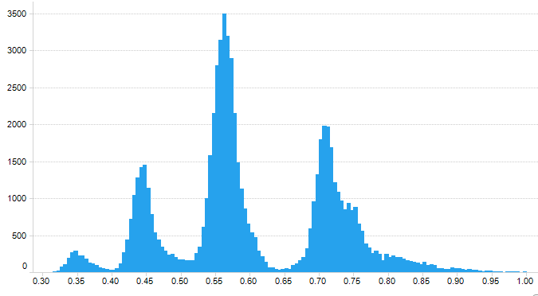
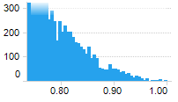
MMWG Focus - Direct Varietal Comparisons
Marker similarity as supplemental evidence when standard morphological descriptor comparison is inconclusive for two varieties.
Establish method and determine proper threshold for application of marker similarity.
Scientifically vetted methods (peer review)
Grounded in morphology
Soybean first (greatest need)

Slide 8
UPOV BMT/16
Four MMWG talks
The use of Reference Variety Similarities in Varietal Distinctness II: Reference Variety Selection
Assessment of reproducibility of 6K SNP genotyping in soybean across laboratories
Determining the parameters to characterize Soybean varieties using single nucleotide polymorphisms
Update on the American Seed Trade Association and United States PVP Office Molecular Marker Working Group
Minimal negativity toward US approach
Anti-DNA marker sentiment is fading
Netherlands: French Bean – encouraging test-case

Slide 9
Next Steps
Prepare final recommendation for the PVP Office/Board
Global engagement:
  CPVO IMODDUS (EU marker working group)
  SAA marker working group – soy harmonization
  BMT/17 September 2017
Additional Crops/Models
Thank You

