Slide 1
PhytosanitARY report
Vegetable/Flower Emerging Issues Working Group
January 28, 2017

Slide 2
Topics/Issues to Cover
USDA APHIS Initiatives: NSHAPP, ReFreSH
Seed ISPM: Expectations for 2017, ISF proposed activities
Country issues: Chile, Brazil

Slide 3
ReFreSH
ReFreSH = Regulatory Framework for Seed Health
New APHIS initiative that will focus on regulating seed via recognition of seed quality management practices that reduce/manage phytosanitary risk rather than regulating each consignment/shipment
Foundation of program will be accreditation of seed companies based on their seed QM practices and their overall capacity to manage phytosanitary risk
The new seed ISPM, once adopted, will provide an overall framework for this approach

Slide 4
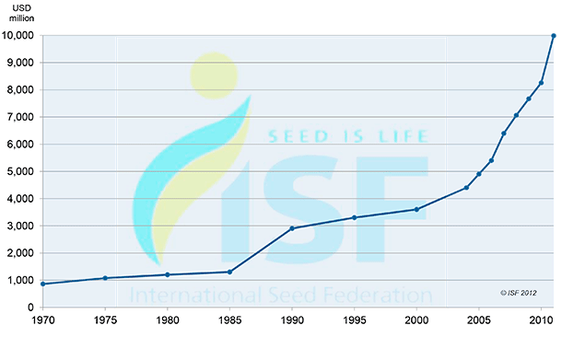
Forty Years of Seed Trade
4

Slide 5
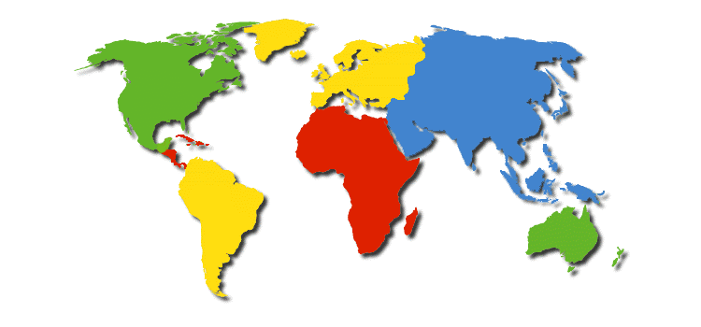
A Complicated Trade Model
3
1
5
6
2
4
7
1.Breeding parental lines: Europe State 1
2.Production of basic seeds: Europe State 2
3. Treatment and manufacture of basic seeds: Europe state 1
4. Production of hybrid seeds: China
5. Treatment and manufacture of commercial seeds: Europe state 1
6. Commercial packaging: USA
7. Final market: Mexico
*Adapted from a presentation by Ric Dunkle, PPQ Seed Summit, 2014
Notes:
Most trade is based on a simple model. One country wants to move their product to a second country. Seed does not adhere to this trade model and the complexity of seed trade presents challenges for regulators who are concerned about maintaining seed free of pests. It is not uncommon for seed to pass through 5 or more countries before it ends up with the final consumer. Seed companies are truly global in nature with research and development, breeder line development, stock seed production, grow out, and post-harvest processing spread around the globe. The trade model represents varying quantities of seeds from a few hundred seeds for a breeder line being developed and tested to container loads full. The diversity of shipment sizes posses problems for seed testing and risk characterization.

Slide 6
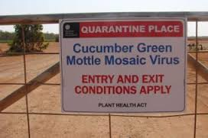
Export Trends
More concern about seed as a pathway
More testing before shipment and upon arrival
Mother plant testing replacing field walks
Interest in developing accreditation systems
6

Slide 7
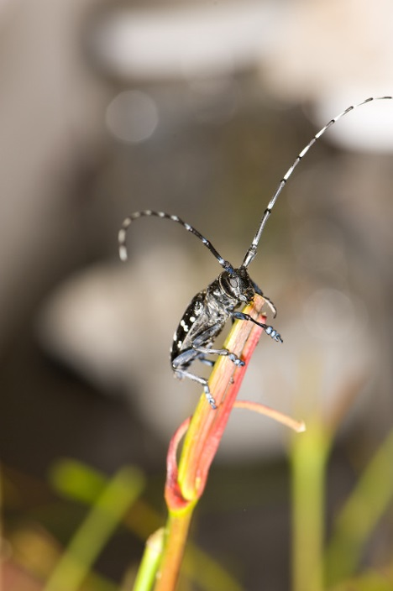
Challenges of Seed Trade
Seed potential pathway for pathogens
Visual inspection not effective at finding pathogens
Seed moves in complex global patterns
NPPOs are all coming up with disparate solutions to the “seed problem”

Slide 8
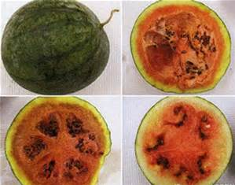
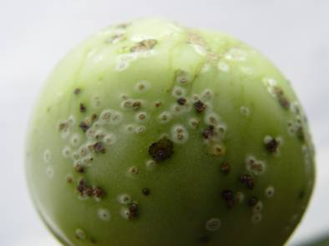
How do we mitigate the seed pathway?
Notes:
The U.S. had a couple cases of CGMMV pop up in fields in California. This raised the profile of seed transmitted diseases within APHIS and caused us to consider a different approach to seed imports.

Slide 9
Potential Models Considered
NAPPRA and NSHAPP
Citrus Nursery Stock Protocol
EC Nursery Passport
Seed Industry Best Management Practices
ISPM 15
SANC
USGCP/USNCP

Slide 10
Commonalities of Systems Considered
Start clean and stay clean
Document systems to maintain integrity of crop
Using testing to verify system integrity
Complicated movement patterns

Slide 11
International Interest in Seeds
Recent increase in number of requirements and regulations from other countries
Ongoing work to develop an international seed movement standard
Seed treatment project in NAPPO
Opportunity for PPQ and Seed Industry
Notes:
Like many other countries who are facing similar challenges, we are grappling with how best to facilitate the safe, uninterrupted movement of seed while protecting US agriculture from seed-borne disease risks.
Today, we’re seeing the emergence of numerous regulations and requirements from different countries, including Brazil, Chile, the European Union, Russia, and Australia.
It seems that everyone is trying to come up with something new to regulate seed trade and help mitigate the risk of seed-borne disease.
In addition, the IPPC is also working on a draft standard for seed movement.
In my opinion, the time is ripe for someone to step forward and lead a global dialog on seed trade and seed transmitted diseases.
I believe that PPQ is well-positioned, working with you, the seed industry, to lead that conversation.

Slide 12
A New Approach
Regulatory Framework for Seed Health (ReFreSH)
Risk-, science-based systems approach
Work within current seed trade model
Leverage industry best practices
Promote global adoption of seed trade framework

Slide 13
ReFreSH-Clean Seed “Passport”
Participating company will be issued a clean seed document
Production process will be certified/accredited at each stage
Industry required to report pests
Goal: Facilitate safer global movement of clean seed

Slide 14
Certification/Accreditation Process
Molecular Tests
Field Walks
Inspection
Application
Supporting Documentation
Phytosanitary Certificate Issued

Slide 15
ReFreSH
Clean Source Material
Test to verify and/or inspect mother plants
Identify priority commodity/pest combinations
Breeder
Lines
Safeguard and inspect/test progeny
Focus on safeguarding because testing not practical
Grow Out
Use clean production practices
Develop system that can be used in various locations

Slide 16
ReFreSH
Increase Seed
Field inspection, test
Best management practices
Harvest Seed
Maintain identity
Safeguard against pest incursions
Post-harvest
Maintain identity
Safeguard against pest incursions

Slide 17
Information Needs
Seed production practices
Global production areas and typical movement patterns
Pests of high concern
Differences between small and large producers
17

Slide 18
Information Sharing Between APHIS and Industry
How can industry be comfortable sharing information?
Confidentiality agreements?
One on one meetings?
18

Slide 19
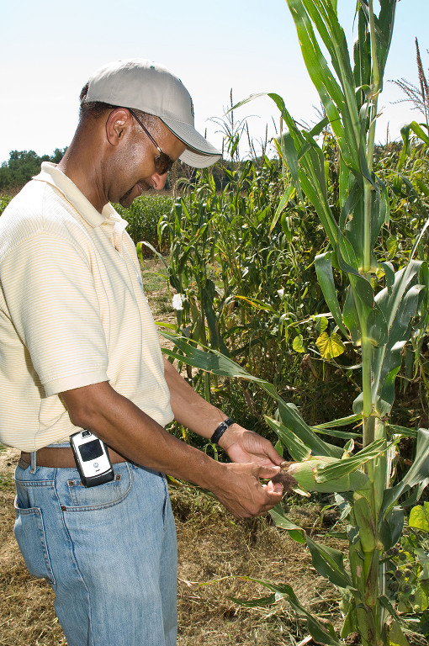
Risk Characterization
Pathway analysis
Pest risk assessment of high profile crops
Determine critical quarantine pests that follow the pathway

Slide 20
Technical Needs
Develop validated testing methods for pathogens of concern
Resolve sampling question
What do we do with small lots of seeds?
20

Slide 21
Accreditation Standards
Document and evaluate production practices
Evaluate current best management practices
What can we build on?
Identify key risk management points in production and post-harvest processing
Develop standards for production and post-harvest processing and storage
21

Slide 22
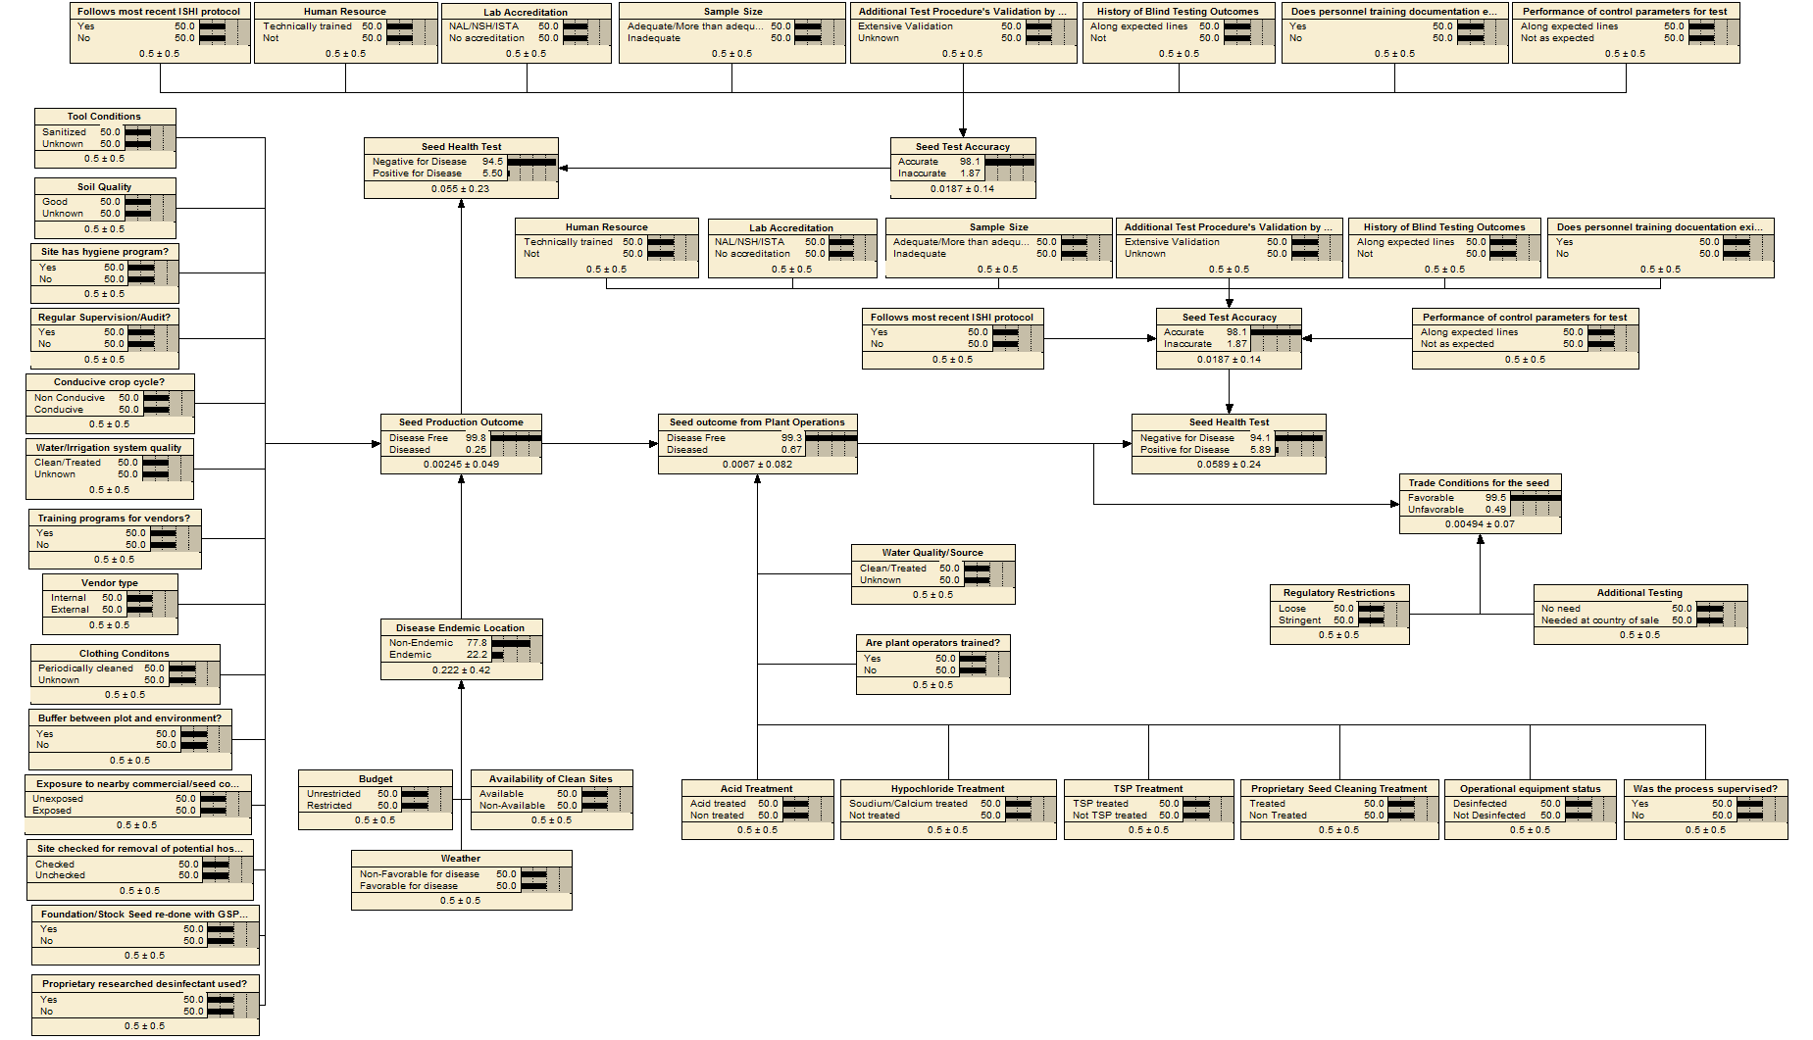
Gottwald Model Structure

Slide 23
Leading a Global Conversation
APHIS is working with other NPPOs to establish widely accepted global seed movement system that promotes a managed risk approach
APHIS has had initial conversations with QUADs countries and Netherlands
Initial discussions for an international NPPO meeting this year on seeds

Slide 24
Encouraging Industry Participation
High industry participation key to success
What can we do to encourage industry to participate?
24

Slide 25
Many Pieces of the Puzzle Globally…….
Seed industry (ASTA, NSAs, SAA, ISF)
Other seed accreditation/certification systems and organizations (GSPP, NAKT, NSHS, ISHI-Veg, etc.)
Other governments/NPPOs
NAPPO, EPPO, IPPC

Slide 26
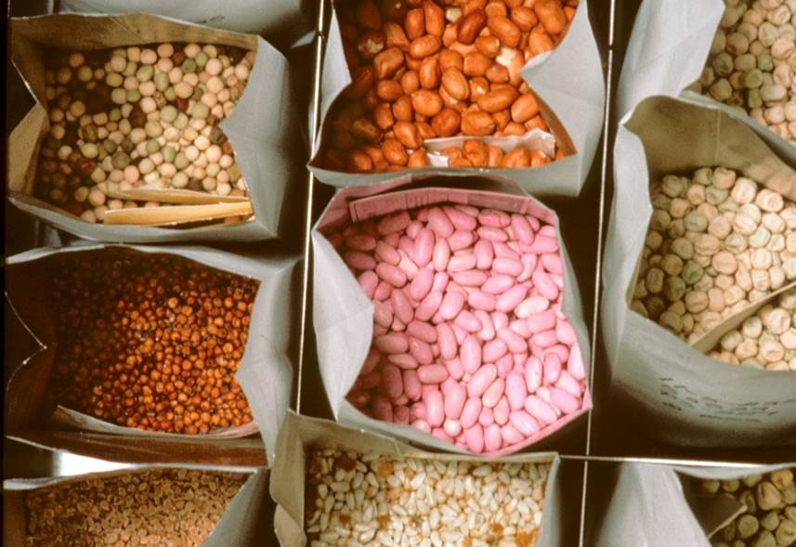
Benefits of a Seed Health Framework
More predictable, technically justified requirements
Faster and easier movement of seeds
Lower risk of seed transmitted disease
Notes:
If successfully implemented, ReFreSH would increase the safety of global seed trade and reduce the risk of seed transmitted diseases.
It would also establish predictable, technically justified requirements that would allow for faster, easier movement of seeds.

Slide 27
Next Steps
A joint APHIS-ASTA committee is being established to develop the concept and program:
ASTA/Industry:
Scott Heuchelin, Laurel Carter, Samantha Thomas, Ric Dunkle/Kelly Crist, Eric Nelson, Brad Peters, Claudia Nari, Tom Moore, Tom Day, Marel Langrens, Lisa Baker, Wayne Wiebe, Tracy Bruns, Nikki Phillips
APHIS:
Angela McMellen-Brannigan, Bob Bishop, Christina Devorsak, Matt Messenger, Sarika Negi, Don Seaver, Indira Singh,, Shalaja Rabindran

Slide 28
Next Steps
Develop concept document
Seek wider support within seed industry (ASTA, SAA, ISF)
Validate Gottwald risk characterization model
Develop international pilot program (APHIS)

Slide 29
Seed ISPM
Status: went out for round 2 of country consultation last July1-Sept 30; Steward (Nikko Horn, Netherlands PPO) revised the standard; Standards Committee met last November and decided to move the revised standard forward to the next CPM (12) for adoption
CPM 12 meets in Incheon, Republic of Korea April 4-11, 2017
Countries will have a 1 year period to prepare to implement
Next steps: develop instructional materials, organize international training sessions

Slide 30
Seed ISPM
ISF plans:
Develop a manual based on the seed ISPM
Organize a “thematic day” to be held in Budapest May 25, right after the ISF congress
Tom Moore (U.S. member of the ISF Phytosanitary Committee) will be involved!
Dennis Johnson is now the steward of the ISF Phytosanitary Committee (replaced Radha)
ASTA plans:
Support ISF activities
Technical sessions: SAA, NAPPO, COSAVE

Slide 31
Country Issues
Chile: SAG accepted all our proposals except one: CGMMV
SAG will still require certification based on inspection and sampling of asymptomatic plants OR a seed test
SAG indicated that it will accept a technical justification to discontinue sampling/testing of asymptomatic plants if one can be found
Brazil: New Normative 16 to enter into force Feb 27; MAPA received additional analyses provided by ASTA and still analyzing/considering this info
Just published a new norm for regulation of seed for research purposes (NI 52); we are analyzing and intend to provide APHIS and MAPA comments
Still trying to organize a meeting with MAPA before NI 16 enters into force

Slide 32
Questions & Answers

