Slide 1
NOSB Readout
National Organic Standards Board
ASTA Organic Committee
4-Feb-2019

Slide 2
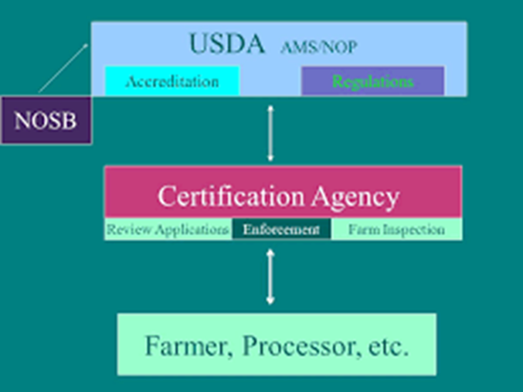
Role of USDA NOP, NOSB, ACAs and Farmer, Processor
USDA National Organic Program (NOP):
Creates and modifies regulation
Accredits certification bodies
National Organic Standards Board (NOSB):
Advisory Board
Accredited Certification Agents (ACAs):
Interpret regulation and certify growers and handlers
Organic Farmers / Processors

Slide 3
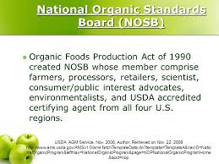
NOSB

Slide 4
Who Serves on the NOSB?
Organic Producer
Ashley Swaffar Jesse Buie Emily Oakley Steve Ela
Environmentalists / Resource Conservationists
Harriet Behar Asa Bradman James R. "Rick" Greenwood
Consumer / Public Interest Advocates
Dan Seitz A-dae Romero-Briones Sue Baird
Handlers / Processors
Tom Chapman Eric Schwartz
Retailer
Lisa de Lima
Scientist (Toxicology, Ecology, or Biochemistry)
Dave Mortensen
USDA Accredited Certifying Agent
Scott Rice

Slide 5
NOSB Meeting Recap

Slide 6
NOSB By the Numbers
“Over the course of three days, NOSB voted on 14 proposals, considered 7 discussion documents, completed reviews of over 40 sunset materials, and passed 2 resolutions. NOSB received over 590 written comments prior to the meeting, and listened to nearly 14 hours of oral testimony received from approximately 47 commenters during two webinars and 92 commenters during the in-person meeting. The public comment period was open for only 22 days.”
Source: Organic Trade Assn.

Slide 7
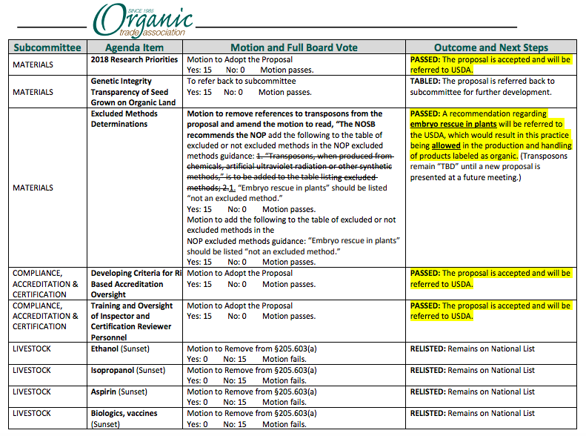

Slide 8
NOSB Priorities
Strong Organic Control Systems
Farm-to-Market Traceability
Robust Enforcement
Support the Standards

Slide 9
Organic Seed Usage
The NOSB passed a recommendation to revise the organic regulations to require continuous improvement of organic seed usage by organic farmers.
This is the first proposed regulatory change to the organic seed requirements since the implementation of the organic standards.
The organic seed usage guidance was re-opened for public comment.

Slide 10
Organic Seed Usage
1. To amend the National Organic Regulations §205.204 Organic seed and planting stock practice standard as follows:
(a) The producer must use organically grown seeds, annual seedlings, and planting stock: Except, That,
(1) Nonorganically produced, untreated seeds and planting stock may be used to produce an organic crop when an equivalent organically produced variety is not commercially available: Except, That, organically produced seed must be used for the production of edible sprouts;
Improvement in sourcing and use of organic seed/planting stock must be demonstrated every year until full compliance with (a) is achieved.
Guidance:
Increase 3 sources to 5 sources
All sources must be organic seed suppliers
Trials including organic seed varieties compared to standards

Slide 11
Genetic Integrity
National Organic Standards Board/Materials Subcommittee Proposal
Genetic Integrity Transparency of Seed Grown on Organic Land
August 14, 2018
VI. PROPOSAL (17 Points)
1. A system of sampling, testing and transparency of findings of GE contamination on all field corn seed planted on organic land is required. Once this has been implemented for one or two years, other at-risk crops could be added.
3. All field corn seed lots planted on organic land, both organic and nonorganic seed, and whether sold or used to feed on-farm livestock, shall be tracked in the farm Organic System
4. Seed suppliers or farmers have the option of five levels of purity, determined through approved sampling and testing protocols.
The detectable levels of purity from GE contamination for organic field corn seed are:
a. 0.1% or less
b. 0.25% or less
c. 0.9% or less
d. 5% or less
e. Over 5%

Slide 12
Genetic Integrity Transparency of Seed Grown on Organic Land
“A significant amount of public comments…identified challenges with the proposal as presented in the meeting materials.
NOSB unanimously voted to send the proposal back to subcommittee for additional work.”

Slide 13
Excluded Methods
National Organic Standards Board
Materials/GMO Subcommittee Proposal
Additional Excluded Methods to be listed in the
National Organic Program Excluded Methods Guidance Document
“The proposal on excluded methods terminology addresses two specific excluded methods: transposons and embryo rescue in plants. Public comments were supportive of the NOSB proposal that embryo rescue in plants is not considered an excluded method under NOP definitions. Public commenters said transposons are not an excluded method in themselves, but rather they are a result of a production method that may or may not be excluded. Thus, NOSB decided to send the issue of transposons back to subcommittee to further discuss the specific methods that may result in a transposon, and develop a proposal specific to those methods.”

Slide 14
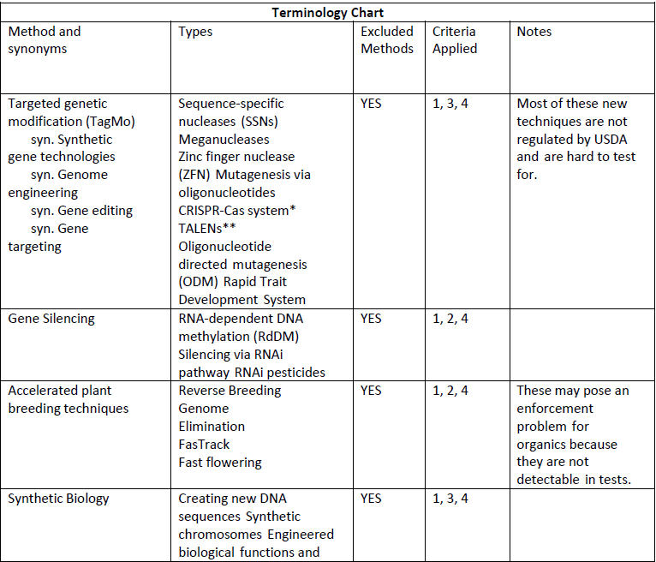

Slide 15
Paper Pots
“Paper pots for transplanting are not explicitly listed on the National List of Allowed Inputs and therefore their usage as a production aid in organic farming can be confusing because paper mulch is allowed and may be incorporated into the soil…The public comment periods during both the webinars and the in-person meeting were saturated with commenters voicing support of paper transplant pots...NOSB unanimously passed a resolution that NOP allow the continued use of paper pots while the review and potential rulemaking proceed.

Slide 16
Next N.O.S.B. Meeting
April 24-26, 2019
Seattle, WA
Oral public comments via webinars: April 16 and April 18
The deadline to submit written comments and/or sign up for oral comment at either the webinar or in-person meeting is 11:59 p.m. ET, April 4, 2019.
The spring NOSB docket were open, with the two seed focused documents present on the docket for continued comment. ASTA submitted comment in conjunction with the Organic Seed Alliance (OSA) on JANUARY 2, 2019.

Slide 17
FARM BILL
Title VII: Research
National Strategic Germplasm and Cultivar Collection Assessment and Utilization Plan
Calls on USDA to develop a plan of needs for NPGS
Foundation for Food and Agriculture Research - $185 million total
Specialty Crop Research Initiative - $80 million per year
AGARDA - Competitive Research Program for mechanization research
Notes:
The Foundation is funded at $185 million, but FFAR must first provide Congress a detailed plan that includes a plan for soliciting additional resources. (The 2014 Farm Bill established the foundation with $200 million)
SCRI’s enhanced funding allows $80 million to be available for all specialty crops to apply for. There is also an additional $25 million set aside in a Citrus Trust Fund that will be dedicated to funding research in Citrus Greening.
The Farm Bill takes note that labor is one of the most pressing challenges to the specialty crop sector. There is language that requires that the Secretary conduct a review of programs at the Department of Agriculture that affect the production or processing of specialty crops, and develop and implement a strategy to accelerate the development and use of automation and mechanization in the production or processing of specialty crops

Slide 18
FARM BILL
Title VII: Research (Continued)
Organic Agriculture Research and Extension Initiative
Establishes permanent, mandatory funding
$20 million for 2019 and 2020, $25 million for 2021, $30 million for 2022 and $50 million for 2023.
Urban and Indoor Agriculture
$10 million in mandatory funding for research grants to enhance urban, indoor, or other emerging agricultural production methods. It requires USDA to conduct a census of urban, indoor, and other emerging agricultural production

Slide 19
FARM BILL: SPECIALTY CROPS
Title X: Horticulture
Organic
Certification Cost Share Program
Data collection fund
Plant Variety Protection Amendment
Amends the PVPA to incorporate asexually propagated plants
Plant Biostimulants
The bill authorizes a report on plant biostimulants and allows USDA to conduct a study on the definition of a plant biostimulant, and the legislative and regulatory barriers to market entry for these products.
Notes:
The Farm Bill provides USDA with $5 million to collect data on the organic sector, in an effort to crack down on the importation of fraudulent organic products. The bill also contains language making minor modifications to the National Organic Standards Board such as allowing an employee of an organic farming operation to represent the owner or operator on the NOSB.

Slide 20
STORM THE HILL 2019
Mark your calendars!
Wednesday, April 3
Full timeline:
April 2: Welcome Happy Hour
April 3: Capitol Hill Visits
April 3 (late afternoon):
SeedFirstPAC Reception
Registration opens after V&F
California members visit with Rep. Jimmy Panetta (CA-20)

Slide 21
National Bioengineered Food Disclosure Standard (NBFDS)
The implementation date of the Standard is January 1, 2020. Compliance with the standard is voluntary until December 31, 2021.
The rule establishes specific requirements for disclosing whether a product is a bioengineered food.

Slide 22
Definition of Bioengineered Food
“Food must contain genetic material that has been modified through in vitro recombinant deoxyribonucleic acid (DNA) techniques for which the modification could not otherwise be obtained through conventional breeding or found in nature to be subject to the BE disclosure requirement”.
(Voluntary labeling is allowed for certain foods that do not meet the definition of “bioengineered food” but are derived from bioengineered crops or food.)

Slide 23
Bioengineered Foods
A List of Bioengineered Foods is established to help companies determine if they may need to make a BE disclosure.
Alfalfa, Apple (ArcticTM varieties), Canola, Corn, Cotton, Eggplant (BARI Bt Begun varieties), Papaya (ringspot virus-resistant varieties), Pineapple (pink flesh), Potato, Salmon (AquAdvantage®), Soybean, Squash (summer) and Sugarbeet.

Slide 24
Organic
Foods certified under the National Organic Program, i.e., those bearing certified labels including “100% Organic,” “Organic,” and “Made with Organic,” are exempt from the BE disclosure requirement.
Such foods are also permitted under the Act and the rule to be labeled as “non-bioengineered”, “Non-GMO,” or a similar claim. Food products with less than 70 percent organically produced ingredients are not exempt and remain subject to disclosure.

Slide 25
Thresholds
A threshold is established for the inadvertent or technically unavoidable presence of bioengineered substances of up to five percent (5%) for each ingredient.
Any intentional BE presence would trigger disclosure.

