Slide 1

Dedicated to Promoting Seed Innovation

Slide 2


Basics of Our Mission
Understanding the value of innovation
Understanding the need to protect
innovation
Establishing best practices for our Members
Facilitating and promoting compliance of
innovation
Promoting seed innovations while reducing
enforcement issues

Slide 3
Why is this Program Important
US agriculture industry is approximately a $200 billion dollar a year industry
A recent survey showed:
  Costs per IP compliance issue ranged from $300,000 to $500,000 in lost revenue for a single violation; this number can reach into the millions depending on the seed technology
  The lost revenue could be reinvested in research and development or for programs and projects for the benefit of farmers and consumers.
  By 2050 it is estimated that agriculture will need to feed and additional 2 billion people.

Slide 4
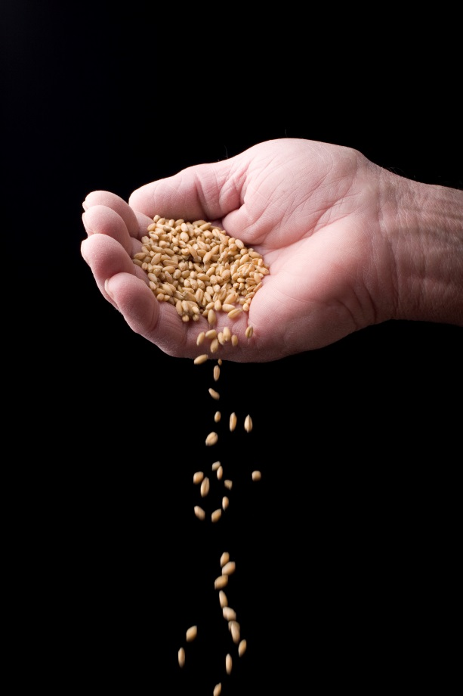
Division Structure
  Vegetable and flower division
  Field crop division
    Soybeans
    Cotton
    Wheat
  Other potential divisions
    Grass

Slide 5
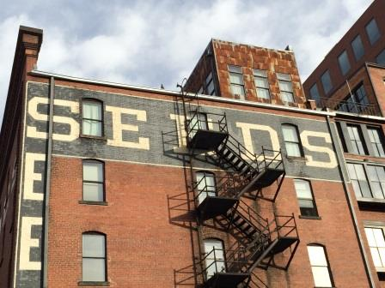
Who Do We Want to Reach?
Our members
  Seed industry executives
  Sales and marketing
  Research and development
Integrated seed companies
Growers and Producers
Cleaners
Brokers
Service Providers
Consumers

Slide 6









Who We Are
SIPA welcomes membership from across the seed industry:
  seed companies
  growers
  producers
  authorized dealers
  brokers
  suppliers
  service providers
  universities
  state and federal agencies
Anti-Infringement
Bureau

Slide 7


Program Officers
  Chairperson:
    Ton van der Velden, Enza Zaden
  Vice Chairperson:
    Mimi Ricketts, Monsanto
  Secretary/Treasurer:
    Eloy Corona, Bayer Crop Science

Slide 8
Member level | Company Type | Rights | Cost
Full Member | Integrated Seed Companies | Full voting rights at both Program and Division levels Right to participate in the Divisions | Program $10,000 Member level/ $7,500 per division
Associate Member | Integrated Seed Companies Production Companies Brokers Authorized Dealers Seed Cleaners | Right to participate in the Divisions | Program $5,000 Member level/ $3,750 per division
Supporting Member | Integrated Seed Companies Production Companies Brokers Authorized Dealers Seed Cleaners Service providers Attorneys, Auditors, Labs, Investigators | May be asked to participate in a specific Division | Program $1,000 Member level/ $500 per division
University Member | University and State agencies |  | Free

Slide 9
Education
Identify and develop educational materials
Best practices related to the identification, promotion, and protection of seed innovation
Serve as both a clearinghouse and repository of educational materials
Provide educational workshops directed to:
  Integrated Seed companies
  Growers and Producers
  Brokers and Dealers
  Cleaners
  Service Providers

Slide 10

Promoting Compliance
Facilitate and promote compliance of intellectual property rights
Limited to education and investigative services where SIPA serves as an information repository
    Working with Seed Treating Companies
    Working with Auditors
    Working with Investigators
    Working with law enforcement
      Criminal issues
    Providing a mechanism for anonymous reporting of compliance issues

Slide 11
Thank you

Slide 12
Contact Information
Executive Director: James Weatherly
  Email:
    jamesw@seedipalliance.com
  Phone:
    970-492-1100
  Address:
    1860 Blake Street, Suite 620
    Denver, Colorado 80202

