Slide 1
Why the FAO International Treaty is IMPORTANT AND should be RATIFIED NOW
ASTA Legislative and Legal Concerns Committee
Tuesday Dec 9th 2014
Stephen Smith

Slide 2
Ask yourself:
Can I predict all the genetic diversity my breeding program will need over the next several decades?
Am I 100% confident I have ready access and assured freedom to use and commercialise all the genetic diversity that I will need to use in my research and development program over the next several decades?

Slide 3
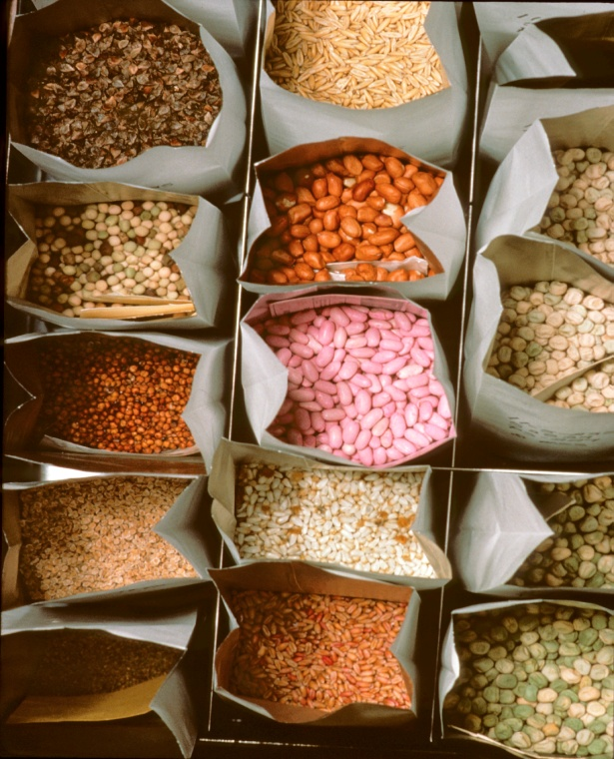
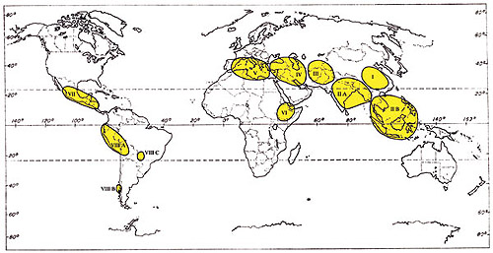
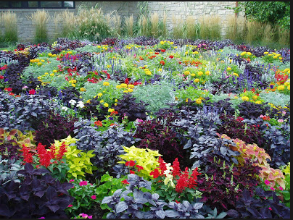
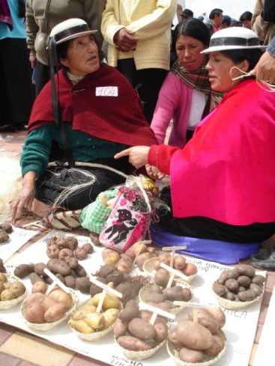
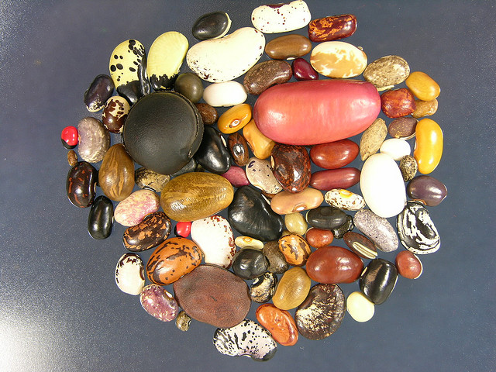
Global Crop Genetic Resource Diversity “There is no reason that the Corn Belt Dents, just one of 280 races of corn , should have all the best alleles.” W.L.Brown

Slide 4
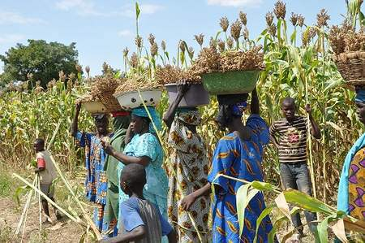
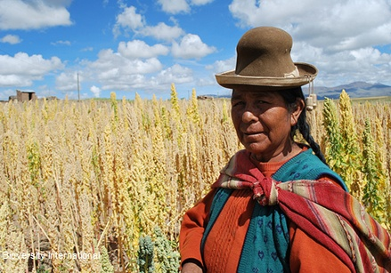
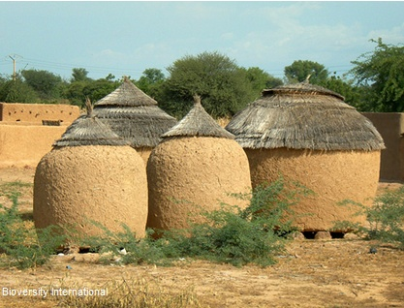
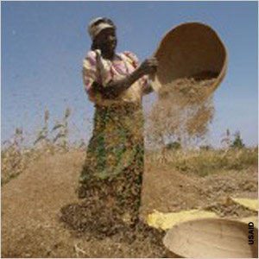
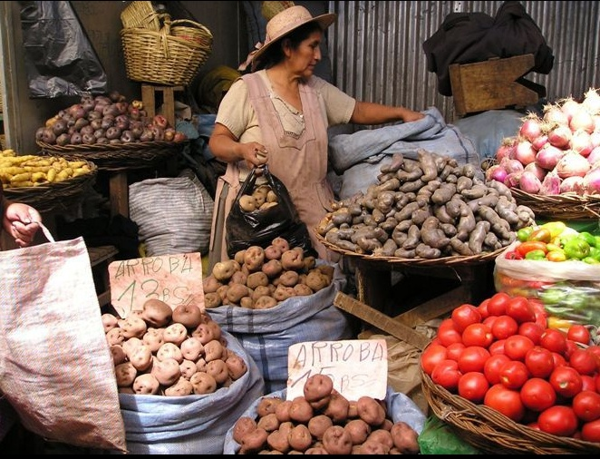
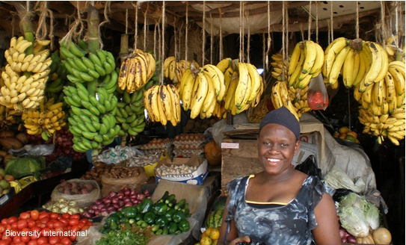
Accessing genetic resources is NOT removing genetic resources; Treaties and laws are in place to provide benefit sharing

Slide 5
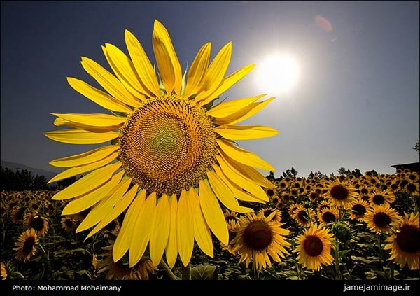
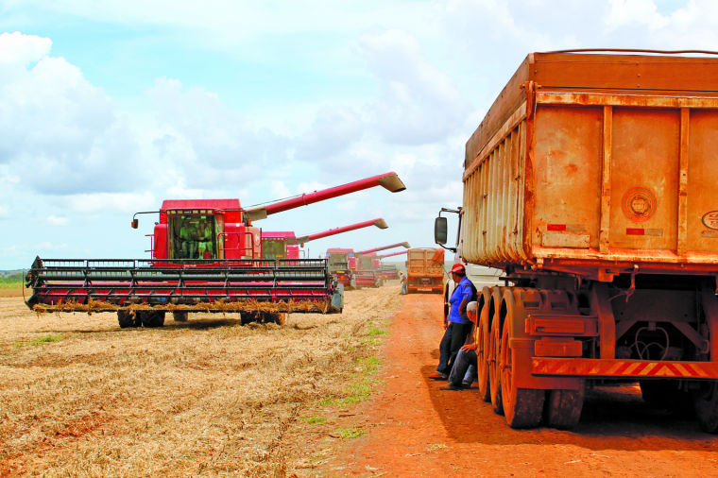
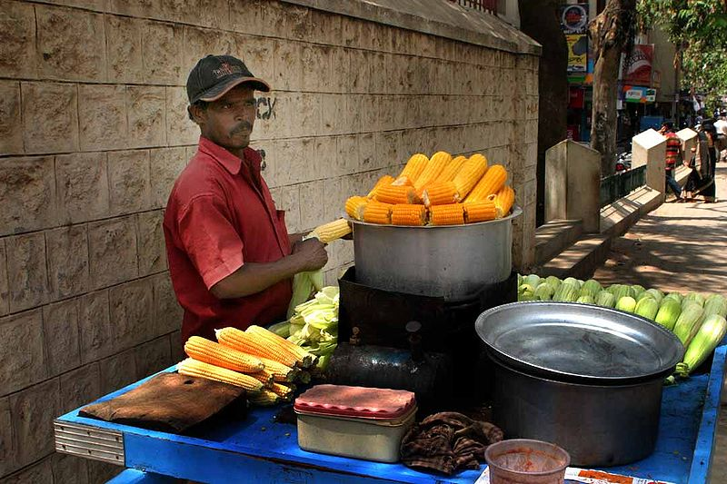
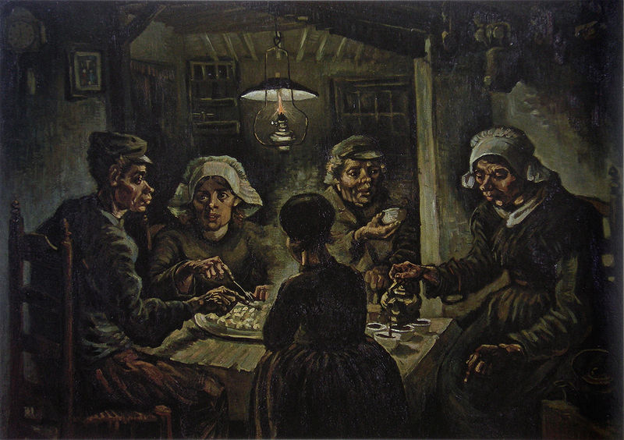
No region is self-sufficient for crop genetics: Access to genetic resources is a primary benefit to all
Notes:
Sunflower—from US to Iran
Maize from Mexico to India
Soybean harvest from China to Brazil
Potato eaters Van Gogh-from Peru to Europe

Slide 6
What would be your preferable means to access new genetic diversity?
Bi-lateral approach
Multi-lateral approach
Negotiate with a focal point in every country from where germplasm has originated?
Many focal points will greatly over-value their germplasm and not comprehend value for use in agriculture
Most countries have not established focal points
Legitimacy of each focal point to provide FTO might later be called into question
Are you certain you know the point of origin of the PGRFA you need?
Do you want to have to prove legitimate access for past several generations of germplasm used in products
Do you want to have to track every item of germplasm through progeny –essentially until the end of time even past any useful contribution from sourced germplasm?
Do you have enough lawyers and licensing agents?
Do you want to hire more lawyers and licensing agents instead of plant breeders?
One stop shopping with a buffet of use terms to select from
Known points of access established
One standard Material Transfer Agreement
Some use terms may still be over-valued but at least clear known options
Improvements in sMTA
International agreement provides maximum FTO legitimacy
Country of origin issue is irrelevant and so removes potential FTO question
Exempt agricultural use from detailed tracking
Pushback on CBD-Nagoya expansion
Leaves bilateral options open if breeders chose to undertake for specific reasons

Slide 7
The FAO IT route to multilateral access of germplasm is preferred
The bilateral approach is hugely resource demanding, not yet functional in most countries, and uncertain
Further:
The FAO IT approach provides context and means to:
Put to rest N-S arguments over ownership of germplasm, allegations of biopiracy, inequitable access-benefit sharing for use of genetic resources in agriculture
Codify acceptance-embrace of IP in encouraging greater use and thereby resultant benefits to farmers and consumers including support re-invested into the conservation and use of PGFRA
Demonstrate important, complimentary and synergistic roles for both public and private sectors research and plant breeding

Slide 8
Why US ratification of the FAO IT?
US has a seat and can exercise its voice in developing global ABS environment for PGRFA globally rather than sidelined as an observer
Revise sMTA so it is business sensible
Pushback to encroachment of CBD-Nagoya complexities, bureaucracies, uncertainties onto simpler, better understood, PVP ABS regimes around the globe
Strengthen global resolve for all countries to abide by their obligations under the FAO IT—move one-way germplasm flows (IN)→ multilateral germplasm flows (IN-OUT) (e.g. China, India)

Slide 9
Why NOW?
Without ratification, the U.S. is missing opportunities to protect our national interests.
The Treaty is Already Impacting U.S. Public and Private Breeding Programs.
Our future access to other important genebanks is in jeopardy.
The Treaty is Preferable to the Convention on Biological Diversity’s Nagoya Protocol.
Broad agreement and no new laws needed

Slide 10
“The seed industry has long supported ratification of the International Treaty on Plant Genetic Resources for Food and Agriculture (Treaty). We plan to ramp up our efforts to push for ratification in the next Congress. This will entail many steps over the two year cycle including a hearing in the Senate Foreign Relations Committee and a vote of the full Senate.” Jane DeMarchi ASTA

Slide 11
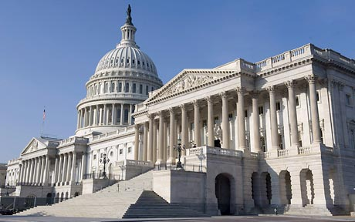
Come Lobby!

